Slide 1
PeptideShaker Overview
What makes PeptideShaker special?
Free, open-source and platform independent!
Focus on user-friendliness and visualization!
Completes the proteomics analysis cycle!
Vaudel et al.: Nature Biotechnol. 2015 Jan;33(1):22–24.
- proteomics: shaken, not stirred!

Slide 2

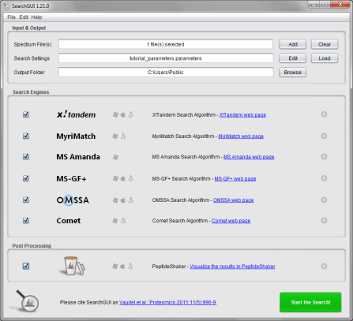
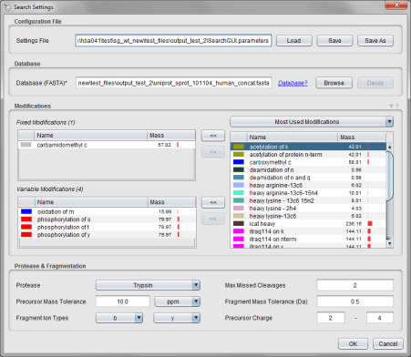
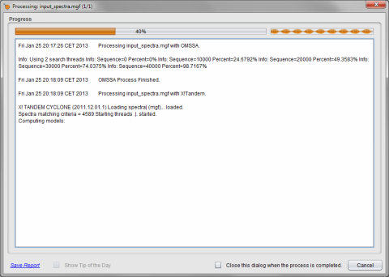
PeptideShaker Overview
Use SearchGUI to identify your spectra!
Apply six proteomics search engines …
… with the same settings …
… in a simple graphical user interface.
Click here to download SearchGUI

Slide 3
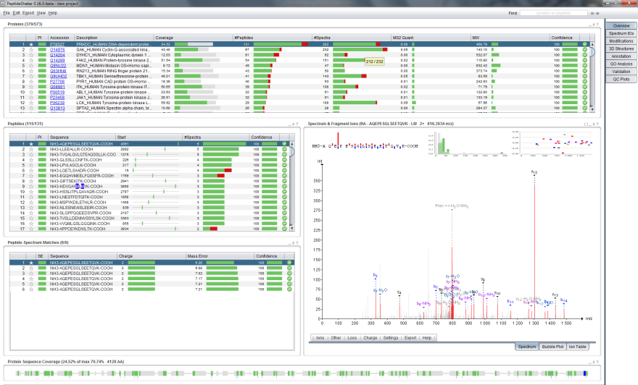
PeptideShaker Overview
Get an overview of all proteins, peptides and spectra!
Proteins
Peptides
Spectrum
PSMs*
Coverage
* Peptide-Spectrum Match

Slide 4
PeptideShaker Overview
All tables, plots and graphics are linked!
Selecting a protein …
1
… displays the peptides …
… which opens the spectrum …
2
4
… and then the PSMs …
3
… and updates the sequence coverage.
5

Slide 5
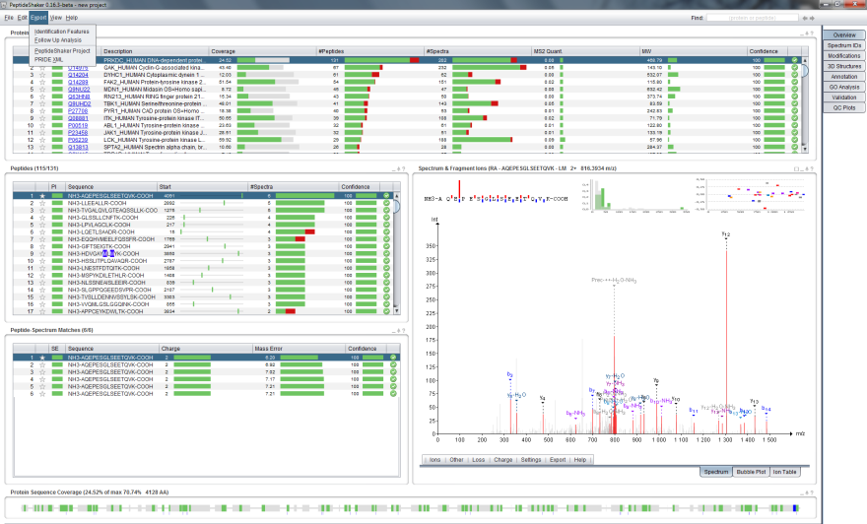
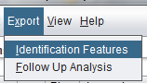
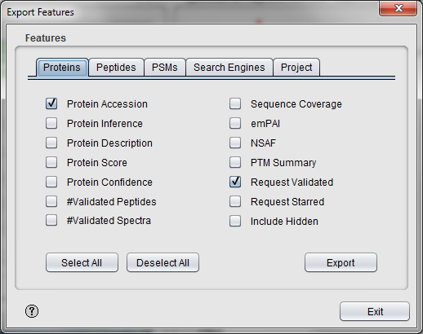
PeptideShaker Overview
Easily export specific features to other tools!
Export features

Slide 6
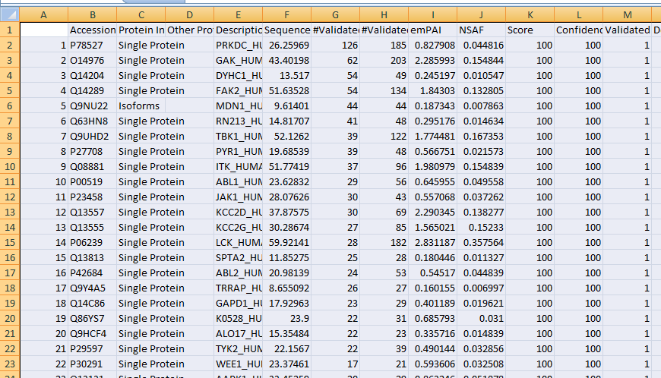

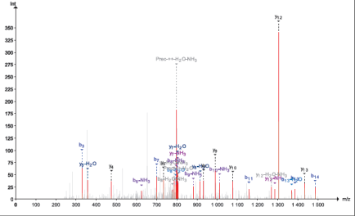
PeptideShaker Overview
Or export directly from the table or plot!
Export to Excel
Export to PDF

Slide 7
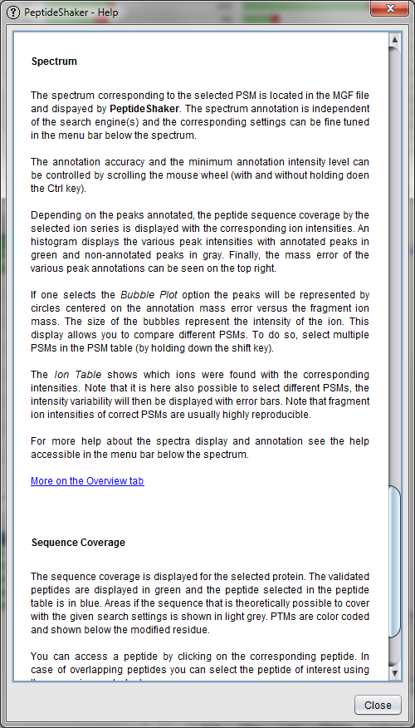
PeptideShaker Overview
Get help for each table, plot and feature!
Help

Slide 8
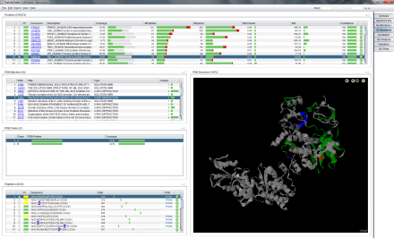
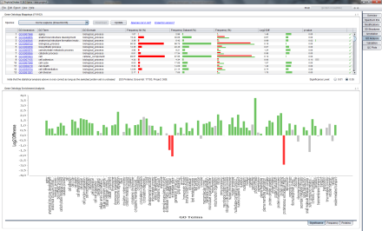
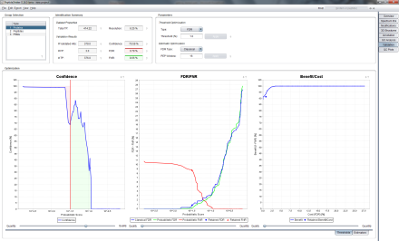
PeptideShaker Overview
Specific tabs for specific tasks!
Peptide to Protein Structure Mapping
Gene Ontology Analysis
Custom Peptide and Protein Validation
Plus: Spectrum ID analysis, PTM analysis, Protein Annotation, QC Plots …

Slide 9
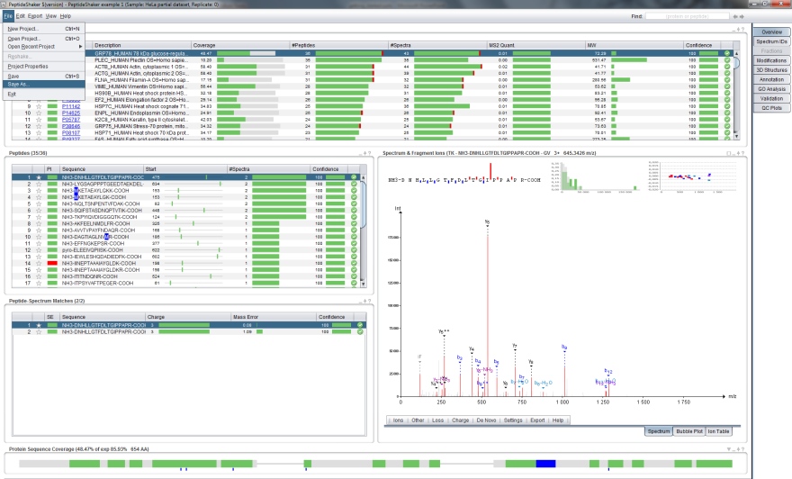
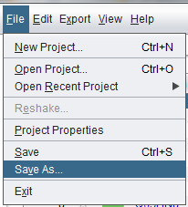
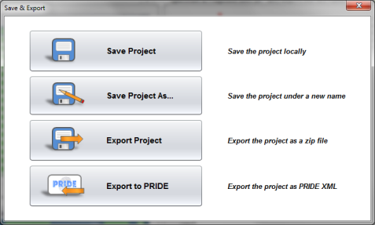
PeptideShaker Overview
Easy sharing of projects with collaborators!
Export
project

Slide 10

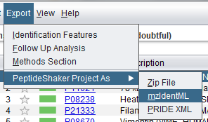
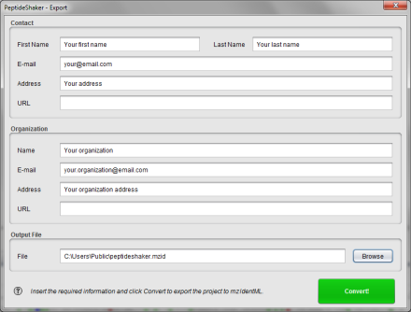
PeptideShaker Overview
Straightforward export to PRIDE!
mzIdentML
export

Slide 11
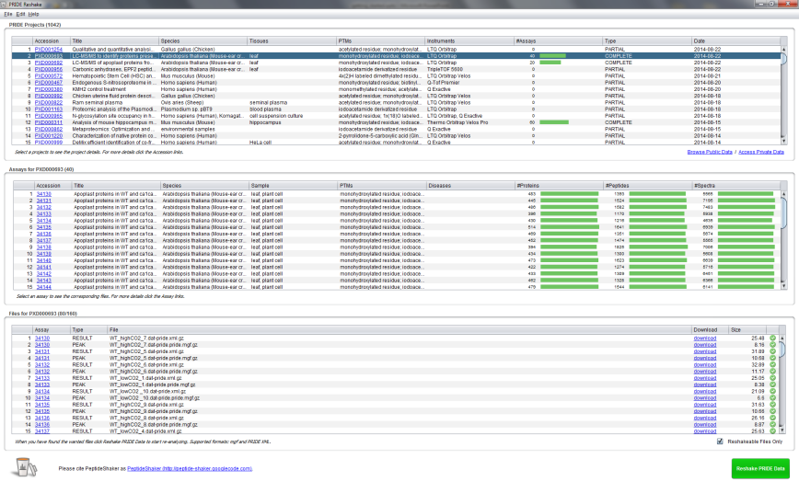
PeptideShaker Overview
Easy reanalysis of public PRIDE data!
Find the desired project …
… inspect the project details ….
… and start re-analyzing the data!

Slide 12
PeptideShaker Overview
Now open a PeptideShaker example dataset!
Click to open an example dataset*
*Data kindly provided by the Leibniz-Institut für Analytische Wissenschaften - ISAS - e.V., Dortmund, Germany.

Slide 13
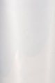

Back
Next
Back
Next

