Slide 1
PeptideShaker Overview
What makes PeptideShaker special?
Free, open-source and platform independent!
Focus on user-friendliness and visualization!
From spectra to identifications and beyond!
- proteomics: shaken, not stirred!

Slide 2
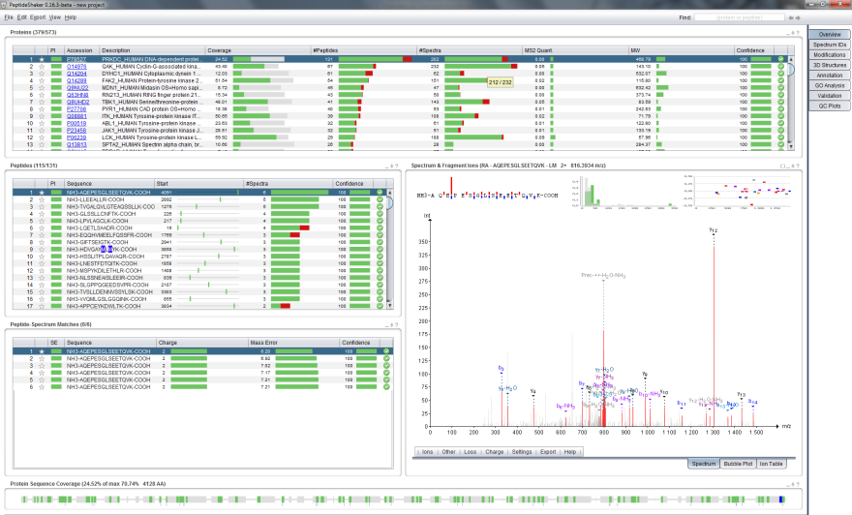
PeptideShaker Overview
Get an overview of all proteins, peptides and spectra!
Proteins
Peptides
Spectrum
PSMs*
Coverage
* Peptide-Spectrum Match

Slide 3
PeptideShaker Overview
All tables, plots and graphics are linked!
Selecting a protein …
1
… displays the peptides …
… which opens the spectrum …
2
4
… and then the PSMs …
3
… and updates the sequence coverage.
5

Slide 4
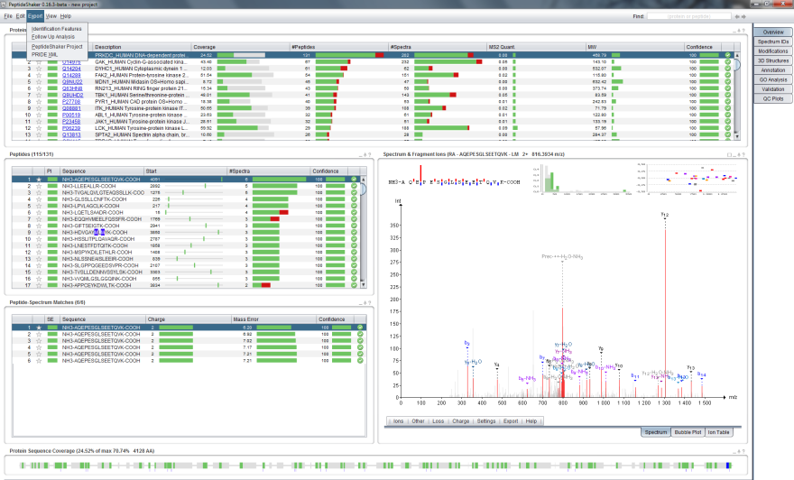
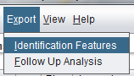
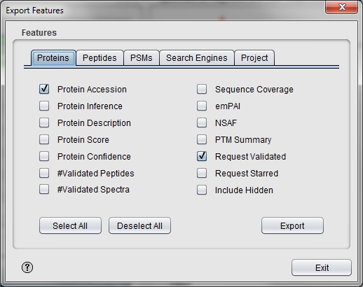
PeptideShaker Overview
Easily export specific features to other tools!
Export features

Slide 5
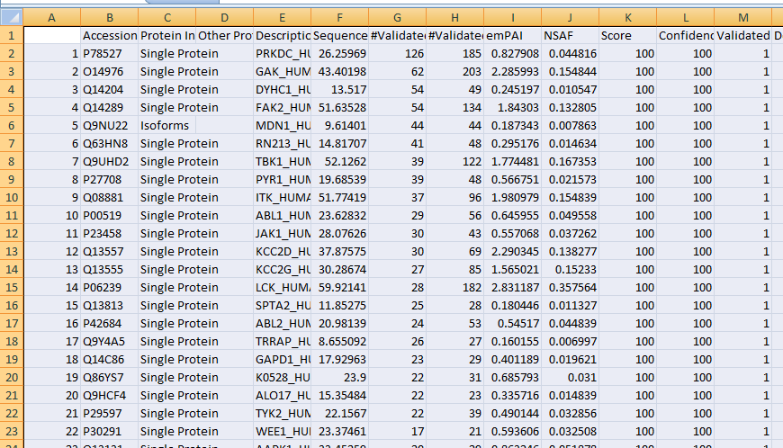

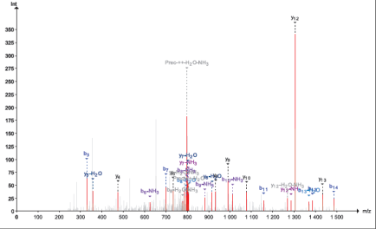
PeptideShaker Overview
Or export directly from the table or plot!
Export to Excel
Export to PDF

Slide 6
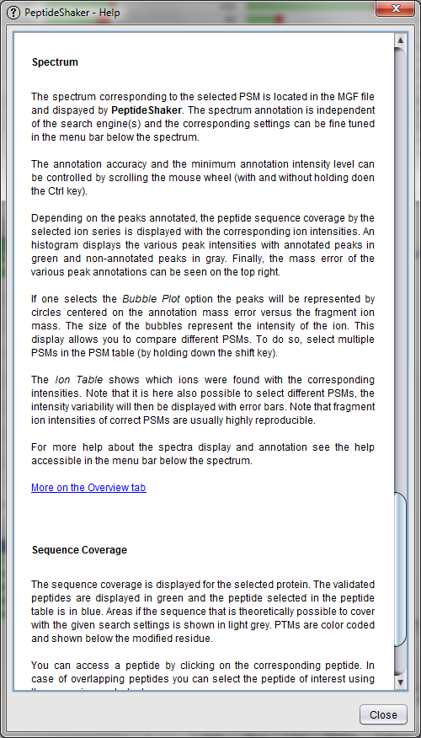
PeptideShaker Overview
Get help for each table, plot and feature!
Help

Slide 7
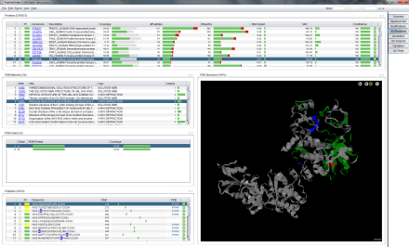
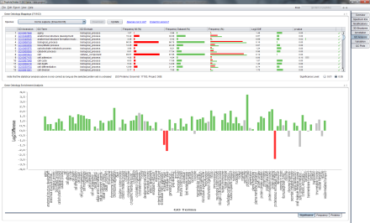
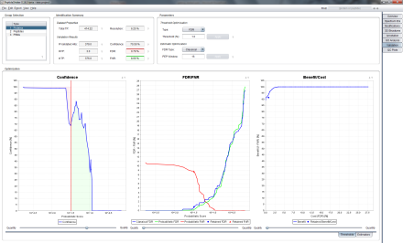
PeptideShaker Overview
Specific tabs for specific tasks!
Peptide to Protein Structure Mapping
Gene Ontology Analysis
Custom Peptide and Protein Validation
Plus: Spectrum ID analysis, PTM analysis, Protein Annotation, QC Plots …

Slide 8
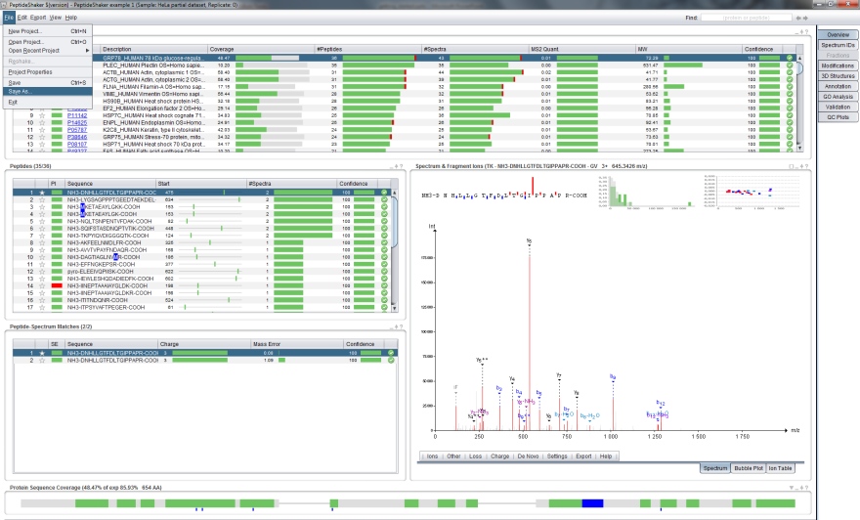
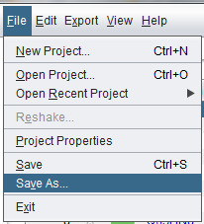
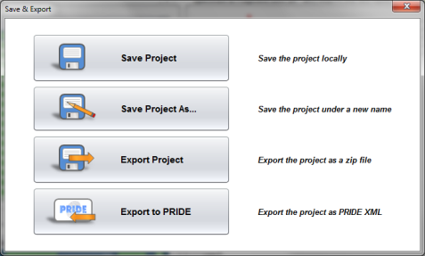
PeptideShaker Overview
Easy sharing of projects with collaborators!
Export
project

Slide 9

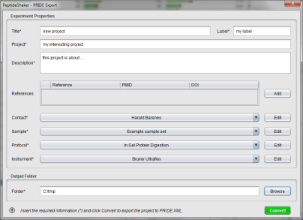
PeptideShaker Overview
Straightforward export to PRIDE!
PRIDE Export

Slide 10

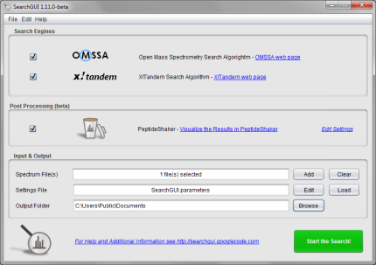
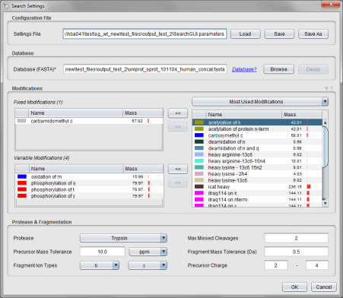
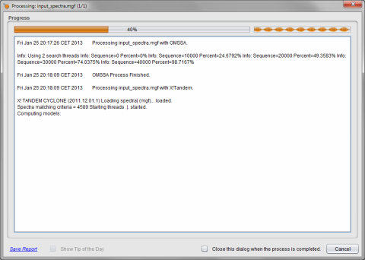
PeptideShaker Overview
Try using SearchGUI to identify your spectra!
Search OMSSA and X!Tandem …
… with the same settings …
… in a simple graphical user interface.
Click here to download SearchGUI

Slide 11
PeptideShaker Overview
Now open a PeptideShaker example dataset!
Click to open an example dataset*
*Data kindly provided by the Leibniz-Institut für Analytische Wissenschaften - ISAS - e.V., Dortmund, Germany.

Slide 12


Back
Next
Back
Next

