Slide 1
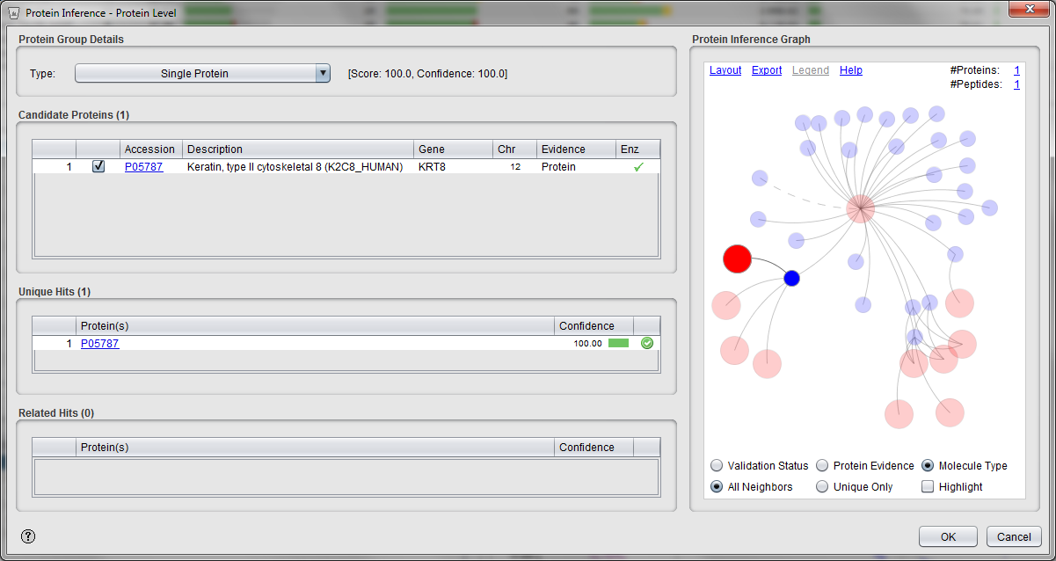
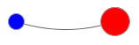

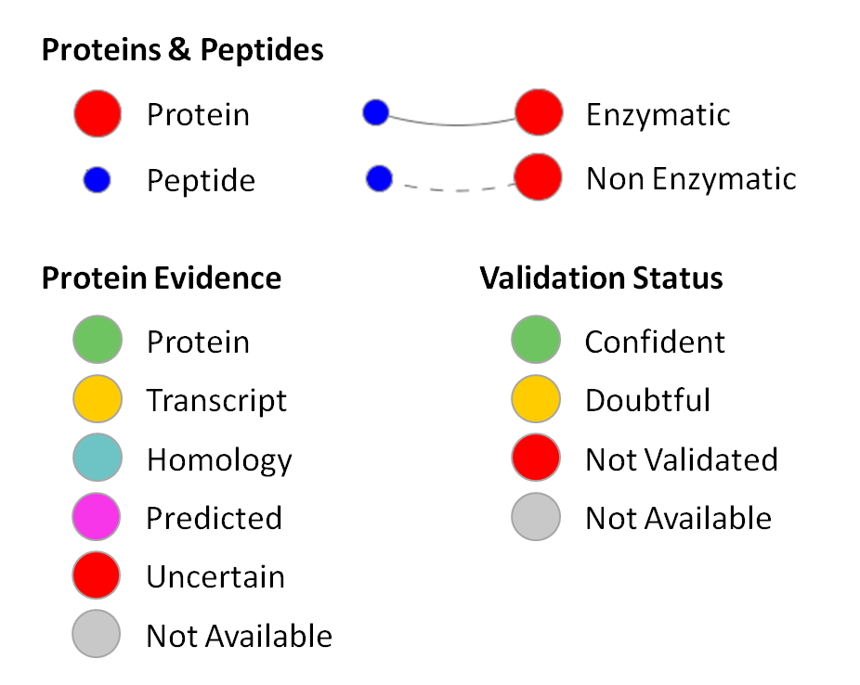
Proteins & Peptides
Protein
Enzymatic
Peptide
Non Enzymatic
Protein Evidence
Validation Status
Protein
Confident
Transcript
Doubtful
Homology
Not Validated
Predicted
Not Available
Uncertain
Not Available

