Slide 1
ROOMS TYPES

Slide 2
SIGNIFICANCE OF ROOM
The sale of hotel rooms contributes 50% or more to the hotels revenue.
A room sale occurs when room is leased for occupation for 24 hours, at a predetermined cost.

Slide 3
TYPES
Single Room
Twin room
Double Room
Triple Room
Quad Room
Hollywood Twin Room
Double Double Room
Interconnecting Room
Adjoining Room
Palor Room
Studio Room

Slide 4
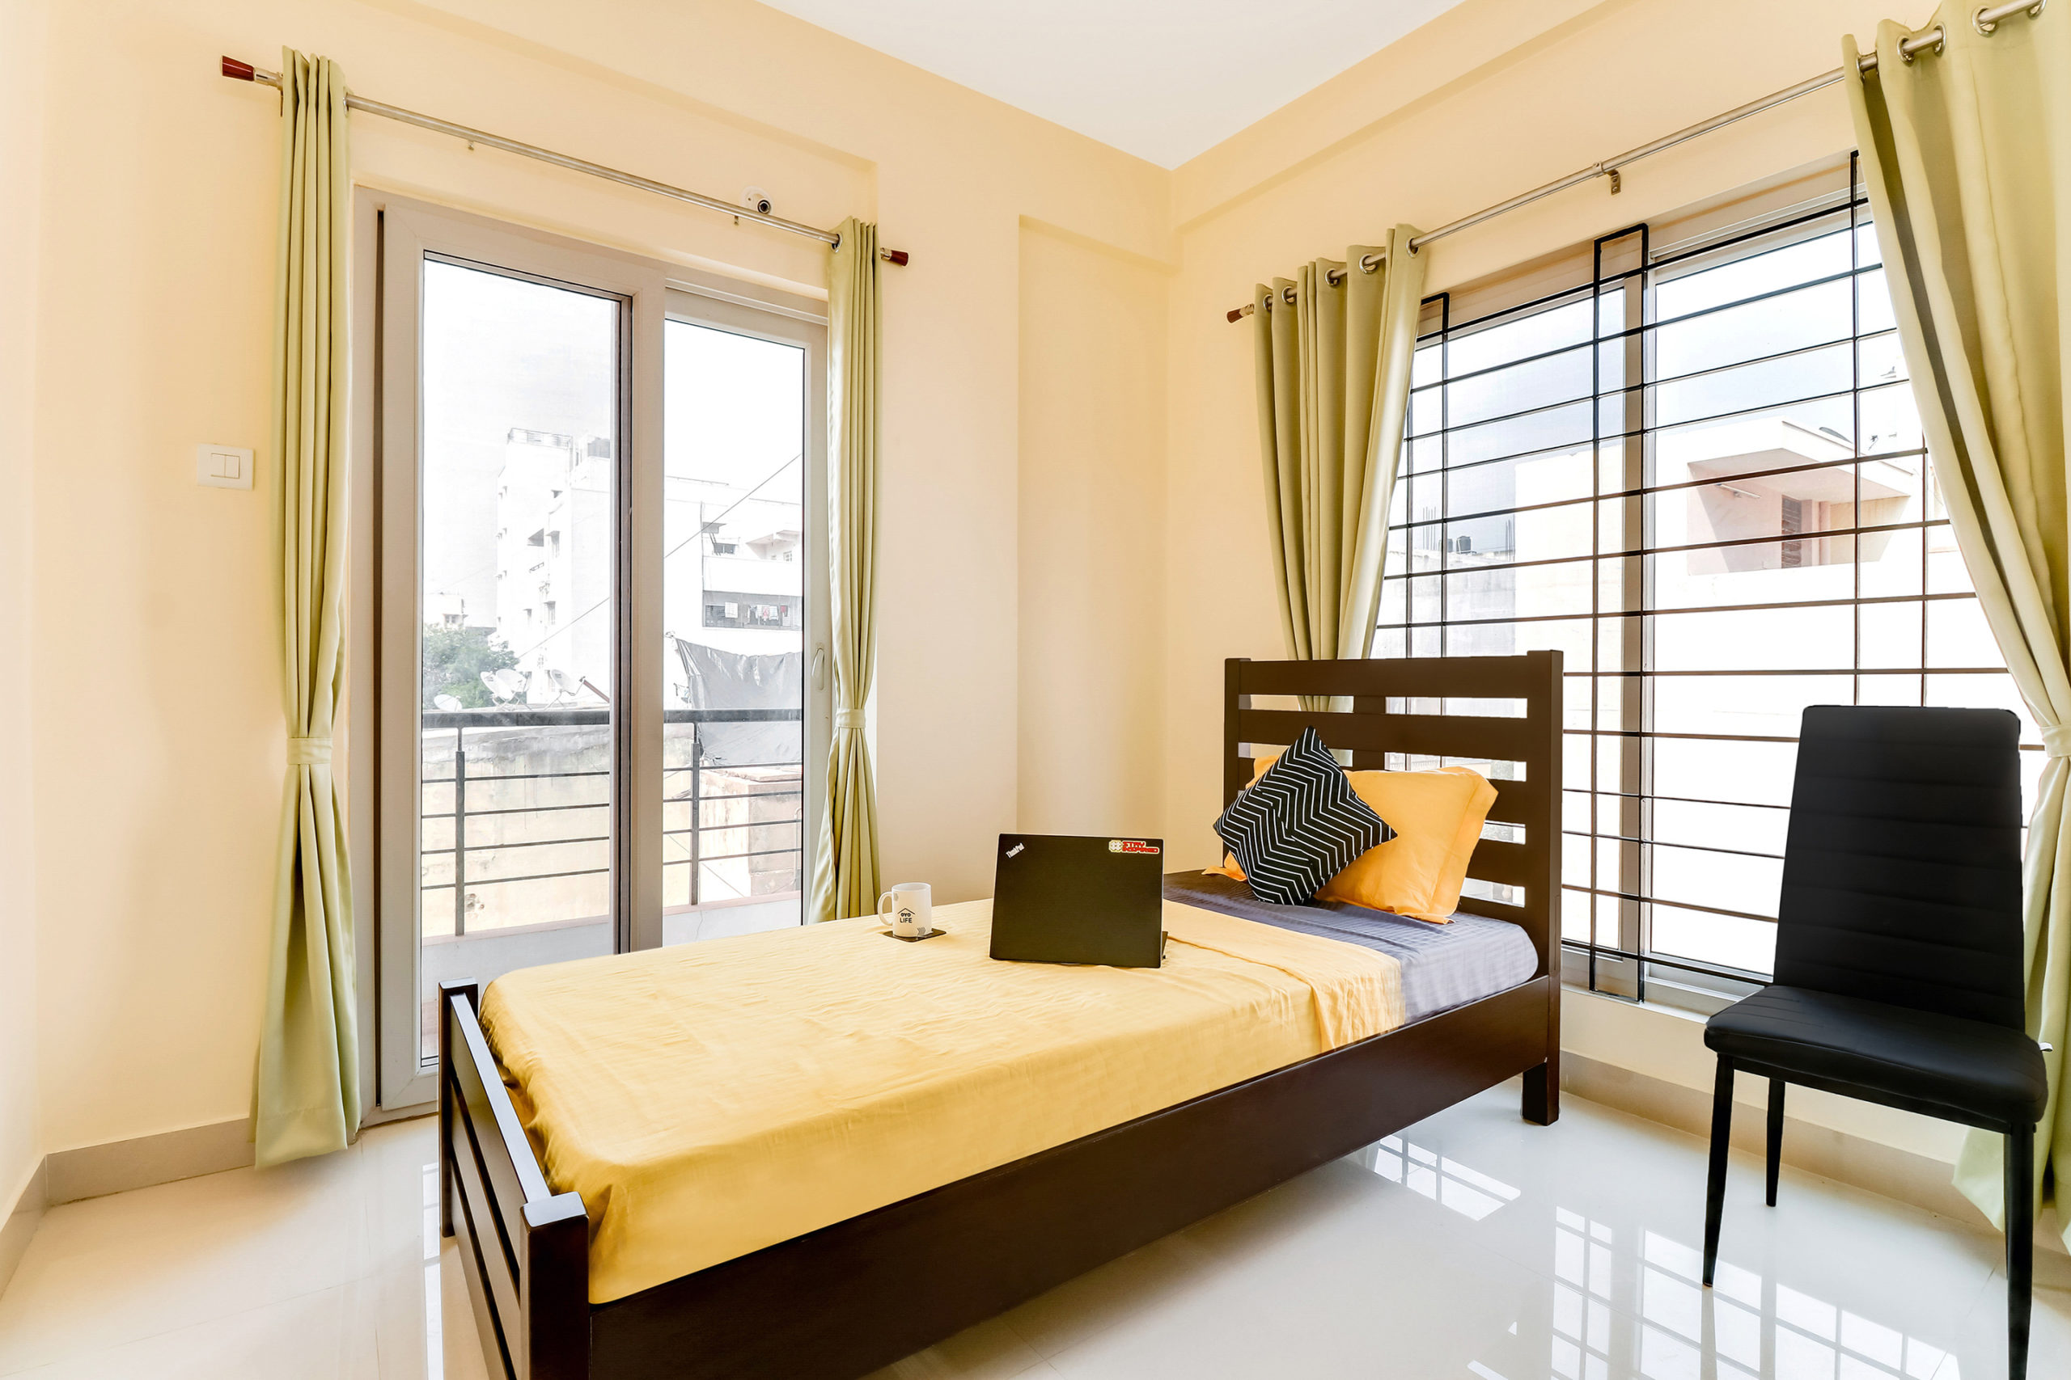
SINGLE ROOM
A single room is a hotel room designed for one person.
It comes with one single bed
Some hotels may offer a double bed as an option.
They are smaller in size compared to other room types

Slide 5
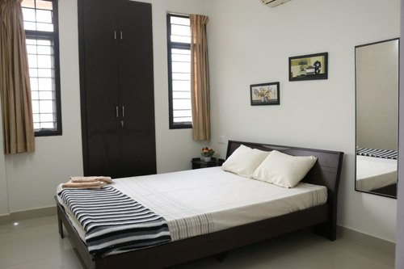
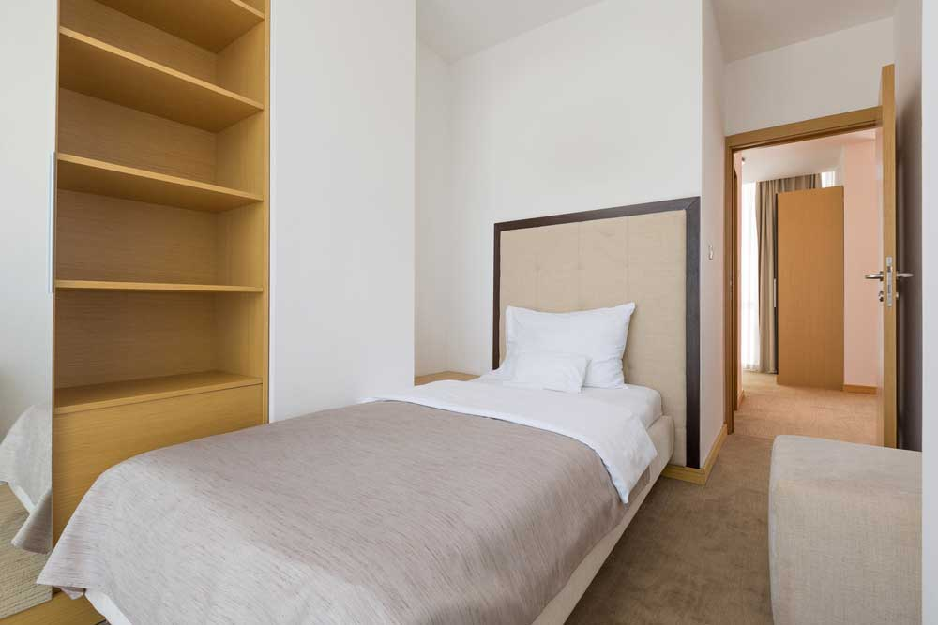
ADVANTAGES
Affordable
Privacy
Availability
Less Noise

Slide 6
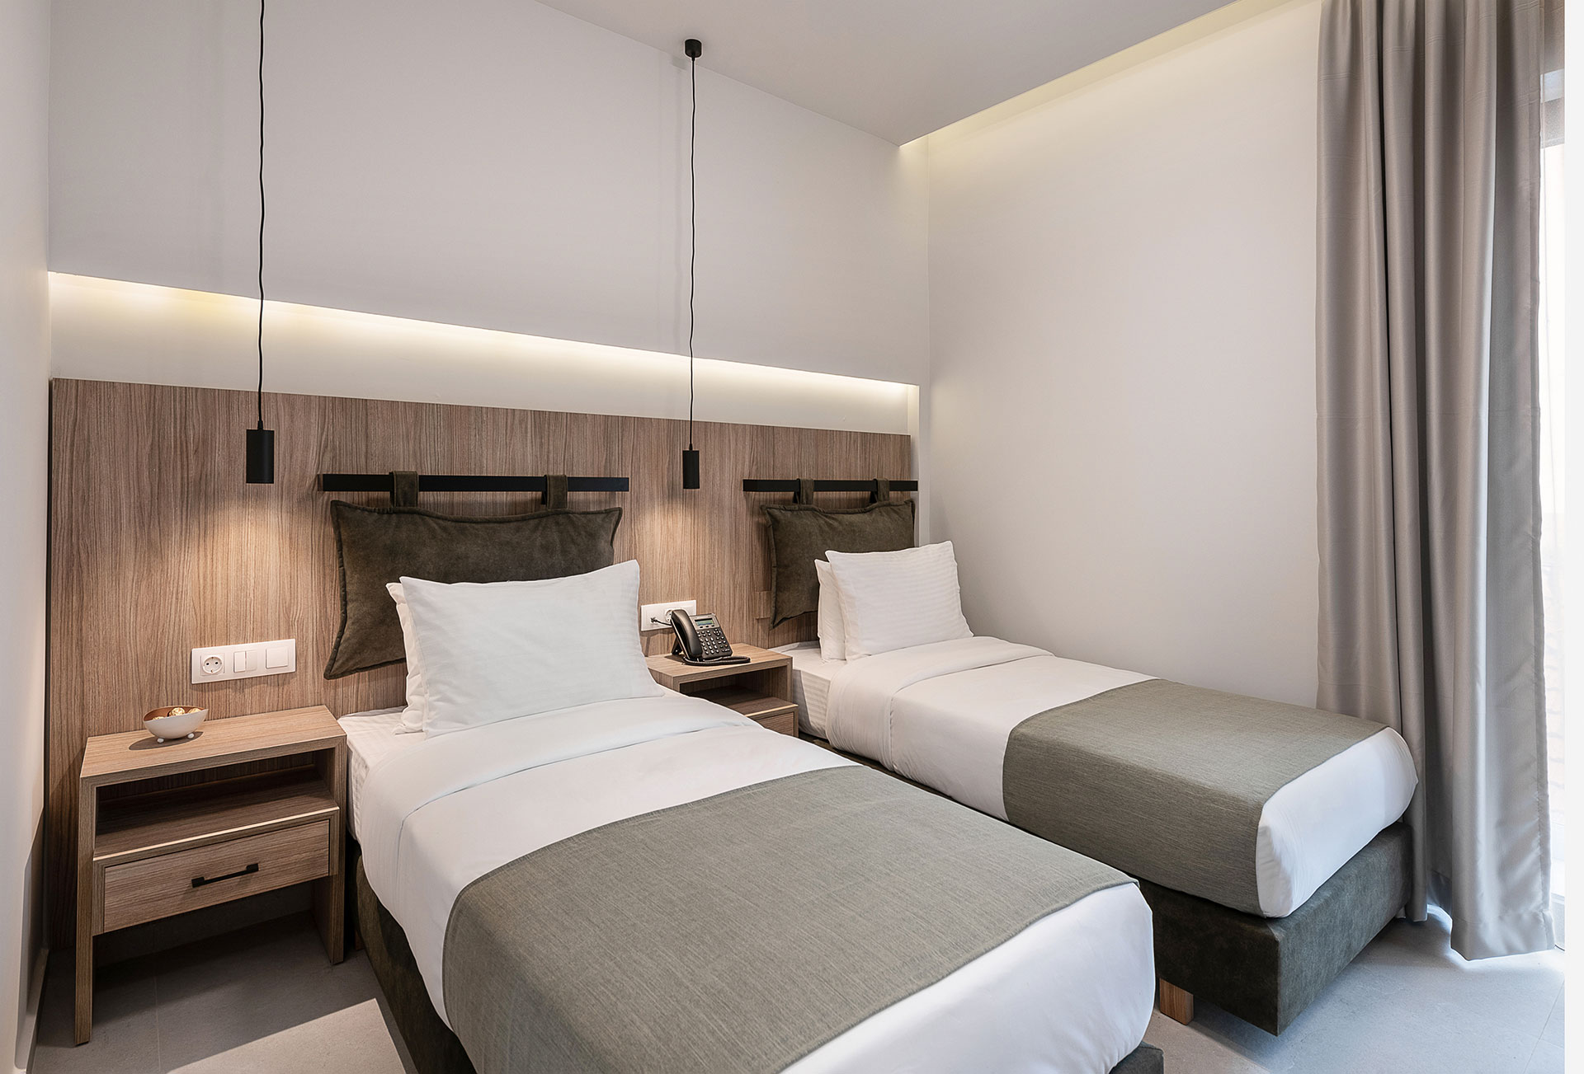
TWIN ROOM
It has two separate beds so that people can sleep apart.
Beds are usually smaller than the beds in double room.
Preferred by friends.

Slide 7
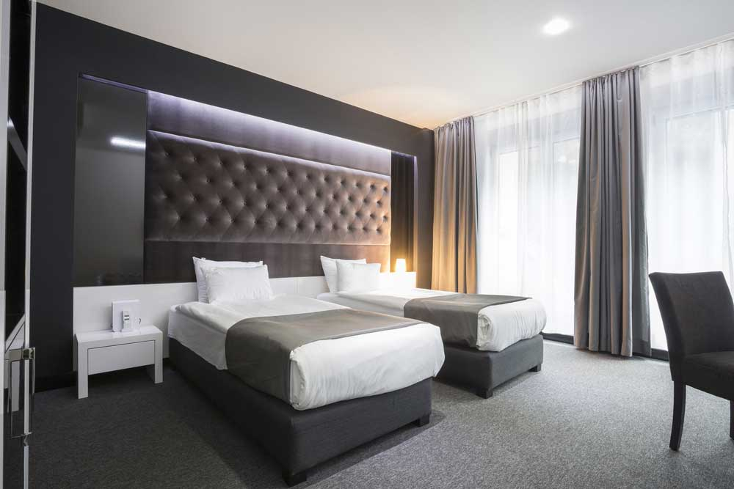
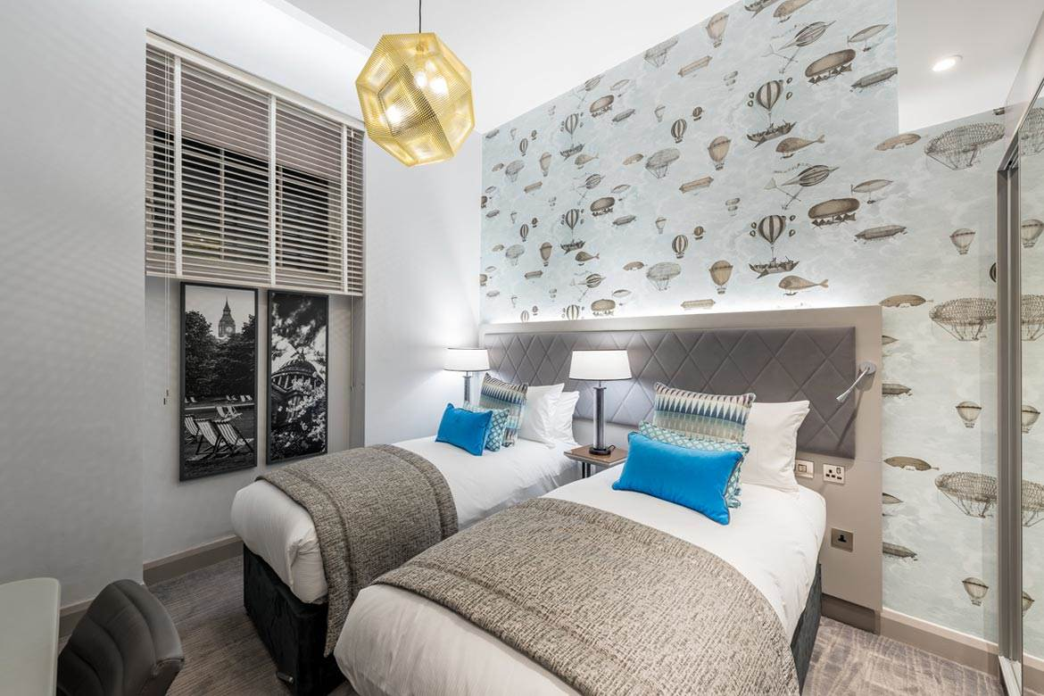
ADVANTAGES
Size
Price
Privacy Balance
Availability

Slide 8
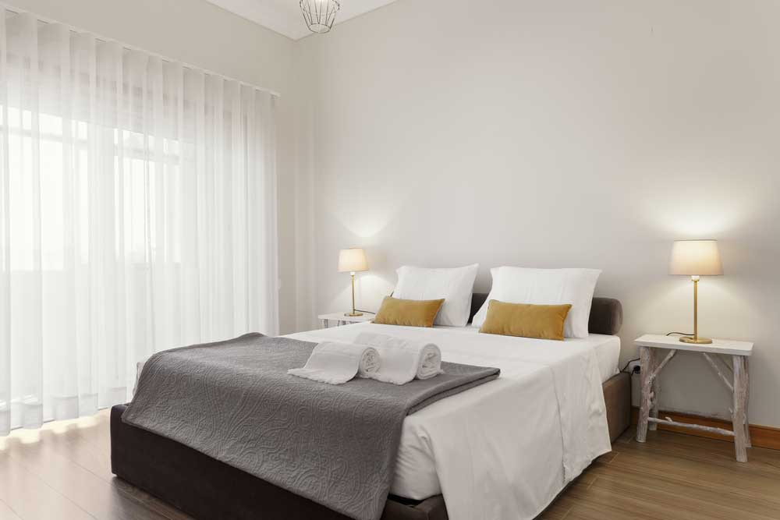
DOUBLE ROOM
A double room is a hotel room with a double bed that can accommodate two people.
It comes in different sizes.
The room size can affect the room rate.
A double room can be a good option for couples or solo travelers who want more space than a single room.

Slide 9
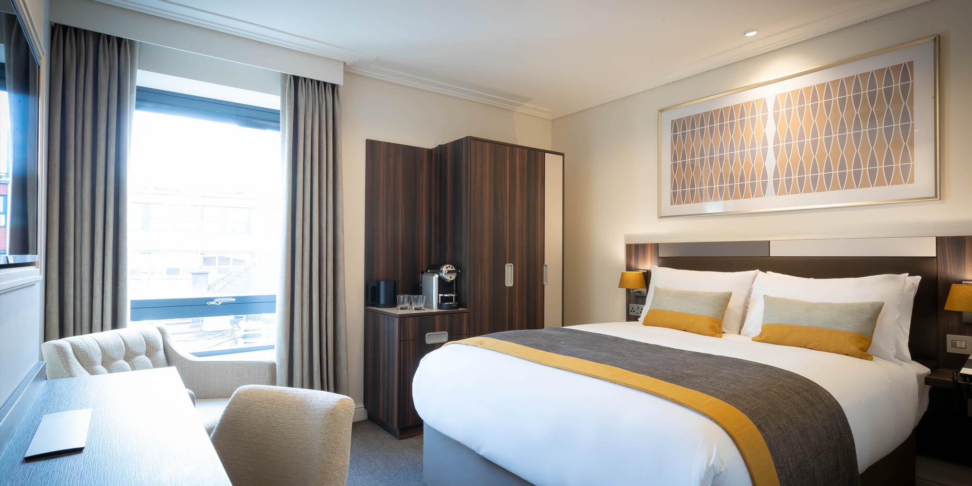
ADVANTAGES
Space for two
Cost saving
Accessibility
Additional Amenities

Slide 10
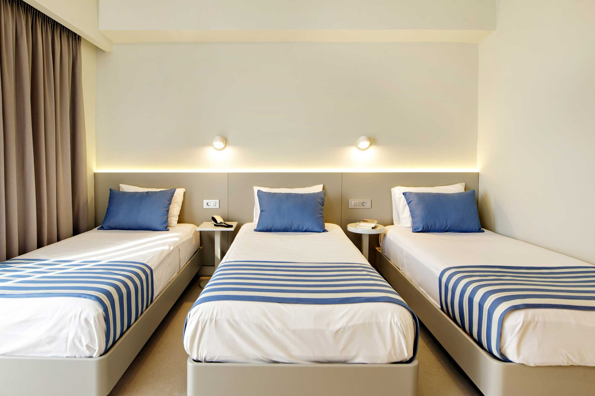
TRIPLE ROOM
A triple room has three separate single beds and can be occupied by three guest.
This type of room is suitable for groups and delicates of meetings and conferences.

Slide 11
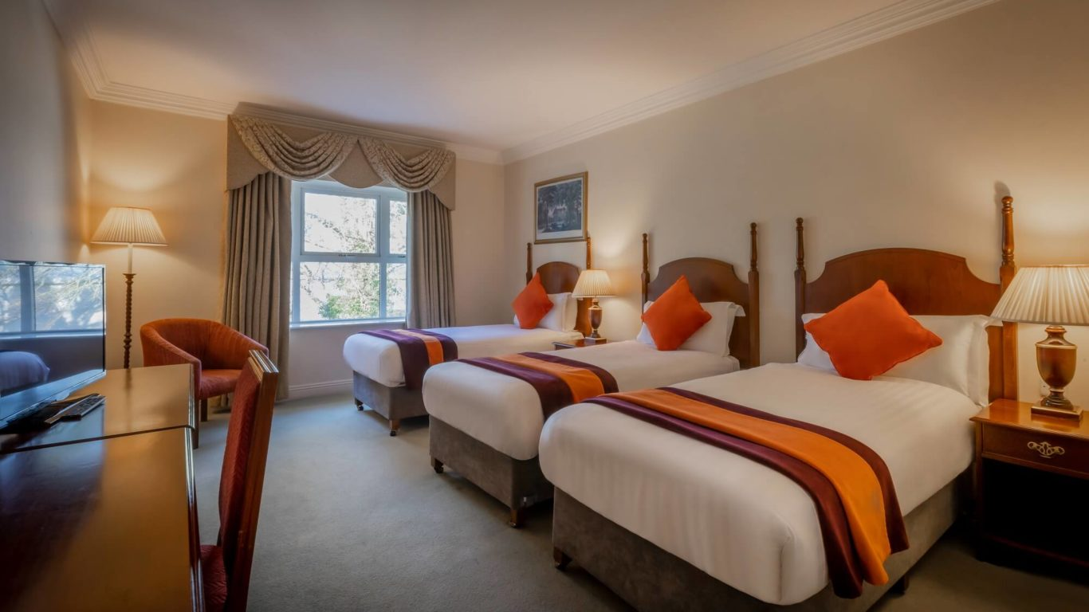
ADVANTAGES
Group Accommodation
Convenience
Ease of communication

Slide 12
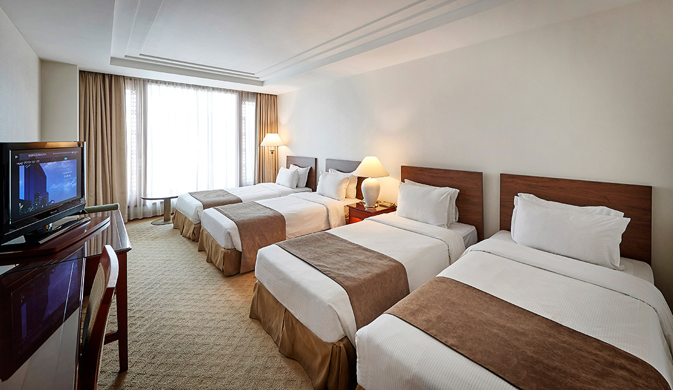
QUAD ROOM
A room intended to house four individuals.
The room might include two double beds, one double and two single beds, or four single beds.

Slide 13
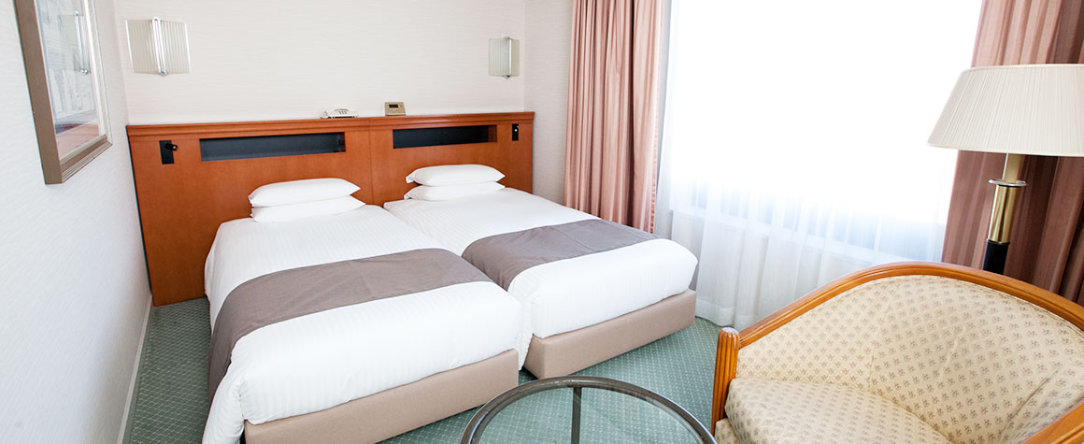
HOLLYWOOD TWIN ROOM
Hollywood Twin rooms feature two single beds which shares a common head board.
Allows the room to be used as a twin or double.
Desks in the rooms also make them ideal for single business travelers.

Slide 14
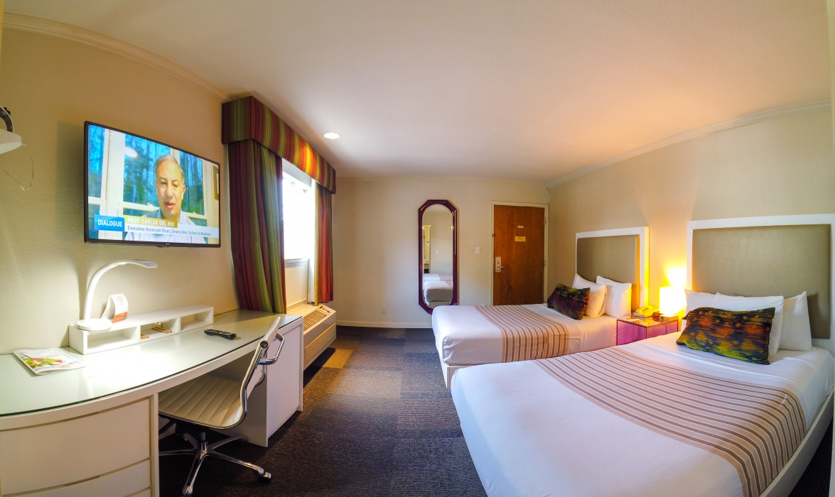
DOUBLE DOUBLE ROOM
These rooms have two double beds (sometimes two queen beds)
Accommodate two to four people.
Preferred for families traveling with young kids.

Slide 15
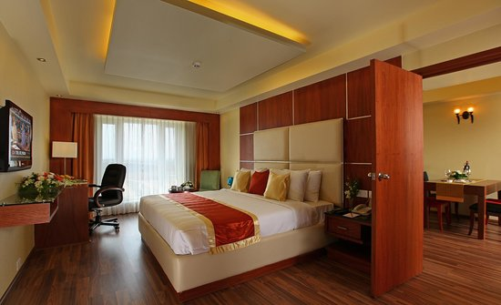
INTERCONNECTING ROOM
Interconnecting rooms are two rooms which are next to each other.
They have an internal door which connects the two rooms from the inside.
It allows the guest to access any of the two rooms without passing through public areas.

Slide 16
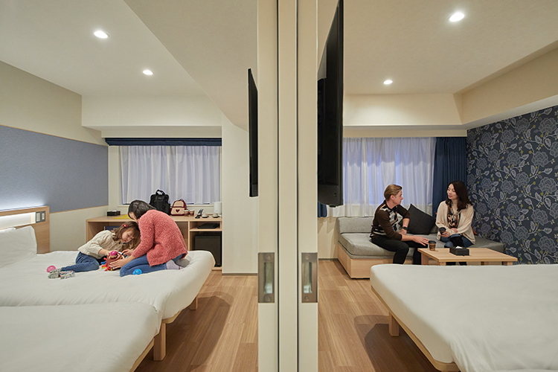
ADJOINING ROOM
An adjoining room is two guest rooms that are located next to each other.
They are connected by a locked door between them.
Adjoining rooms may be booked together by request for one traveling party, or they may be booked separately by two different parties
Preferred by groups.

Slide 17
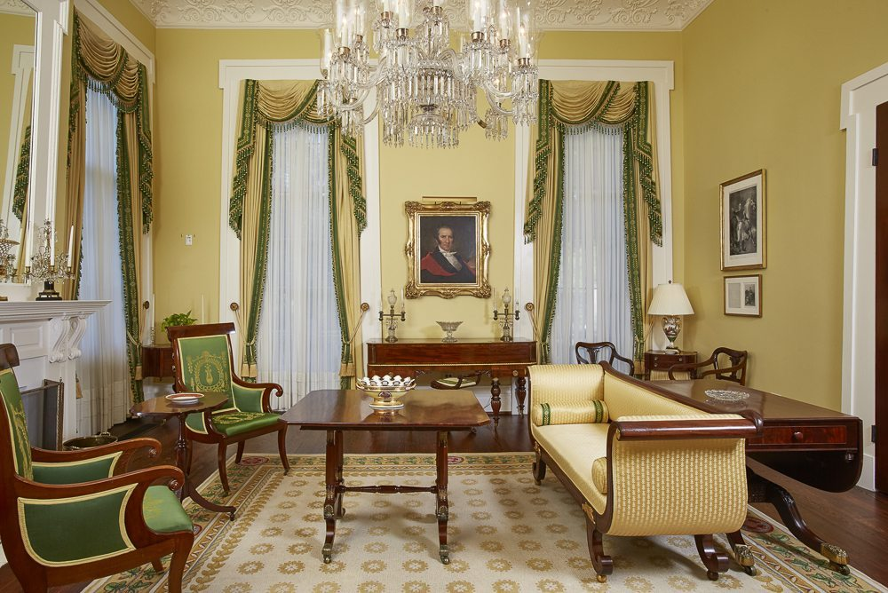
PARLOR ROOM
A parlor is a living room or a sitting room, the place in your house with comfortable chairs and sofas.
You might also decide to put your giant new TV in the parlor.
It is room used primarily for conversation or the reception of guests.

Slide 18
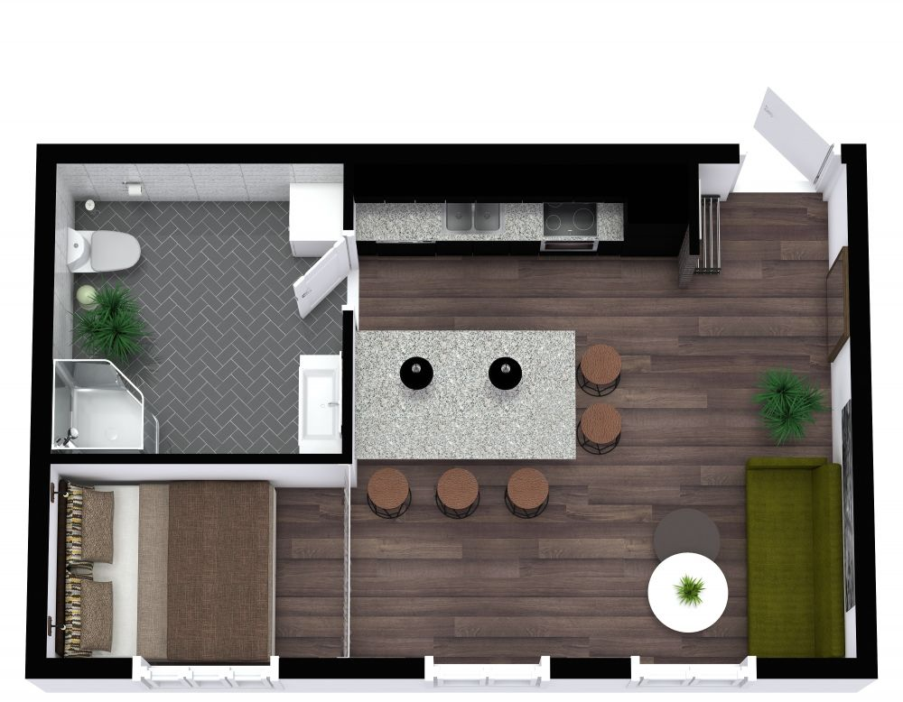
STUDIO ROOM
It is a single-room dwelling that combines the bedroom, kitchen, and living area into one large room.
The open floor plan does not have walls separating the sleeping and living areas.
The kitchen area may or may not be separated by the wall.
Preferred by students and young professionals.

Slide 19
THANK YOU!

