Slide 1
Hexapod robot control system
3rd Meeting – 2019/12/13

Slide 2

EndNote library

Slide 3
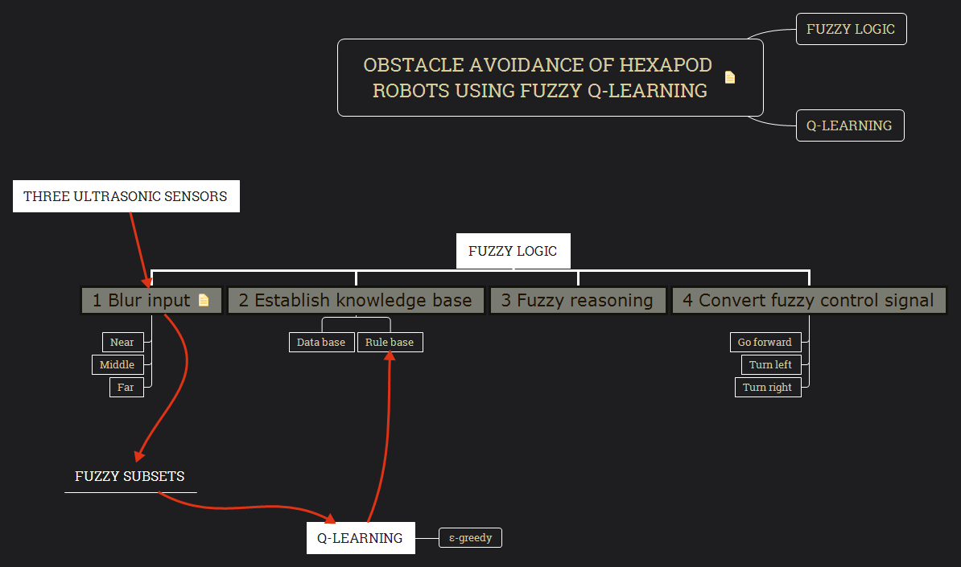
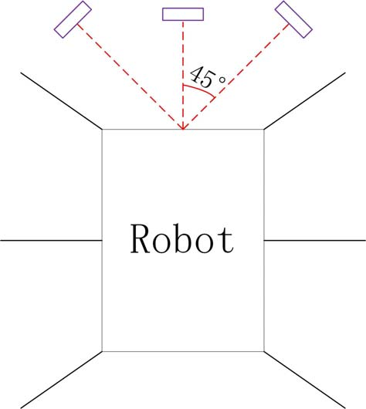
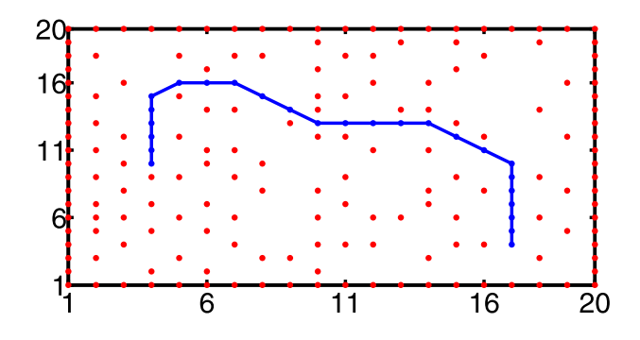
Obstacle Avoidance of Hexapod Robots Using Fuzzy Q-Learning
Notes:
Simple example

Slide 4
Neural Network Dynamics for Path Planning and Obstacle Avoidance
Use Neuronal Space N to store the geometry information (obstacles)
The path finding is done from both the initial position and destination
Can deal with dynamic obstacles
May be used to deal with unknown area with modifications to the neurons
A lot of maths - but not intelligent ?
Notes:
A lot of maths

Slide 5
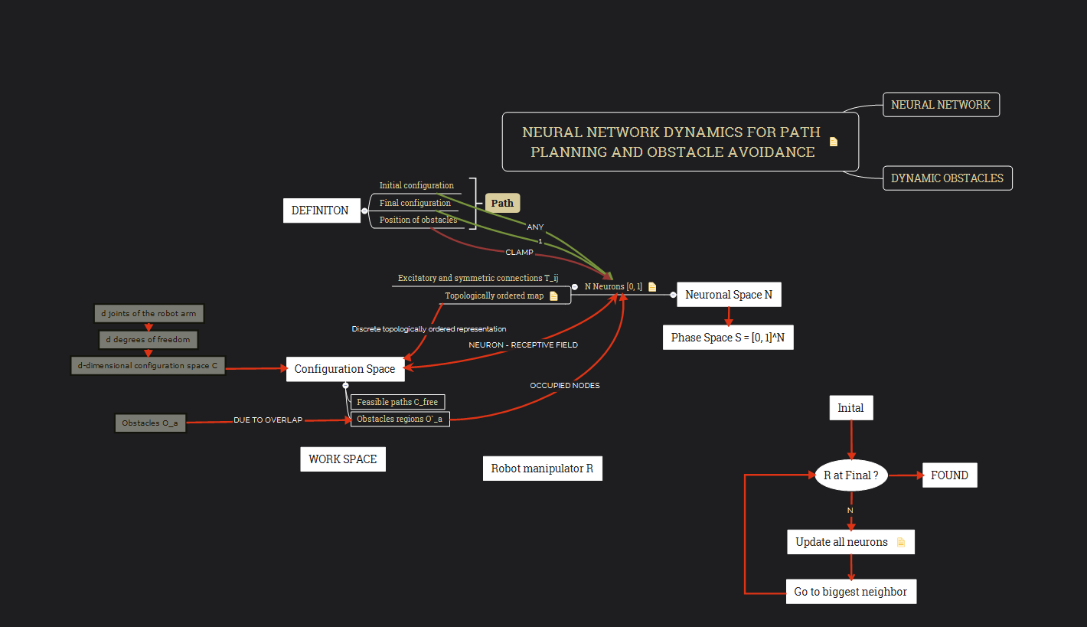

Slide 6
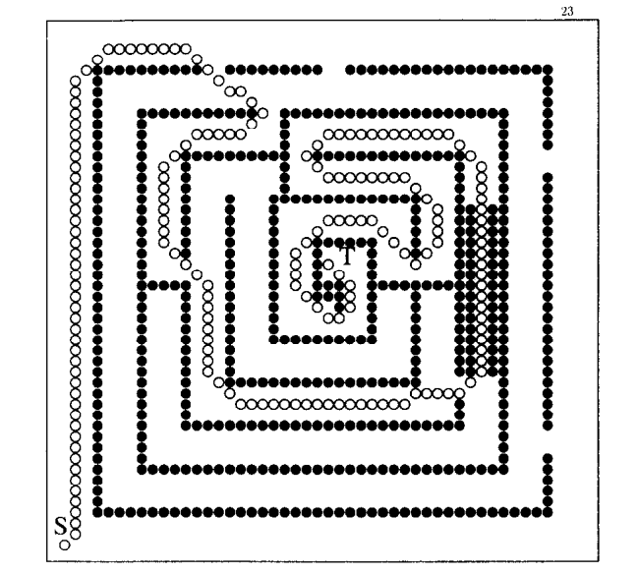
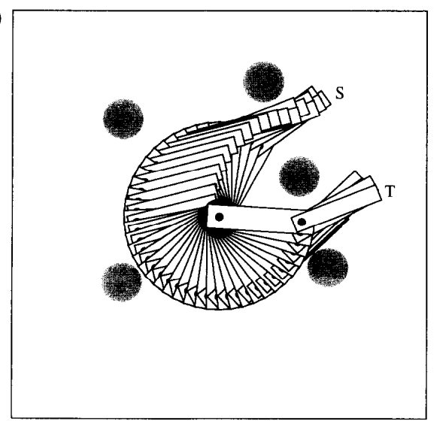
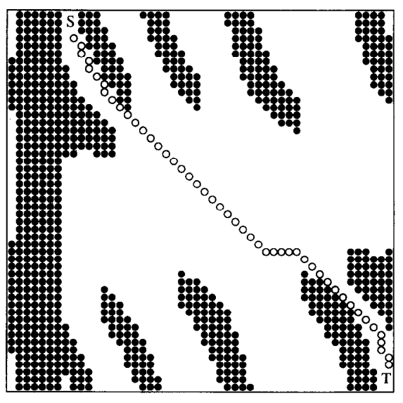
Neural Network Dynamics for Path Planning and Obstacle Avoidance
Complex as well as dynamic
2D Robot arms (can rotate)
How to generate neuronal space ?
Shouldn’t go randomly at first ?
How to quantify arm behavior?

Slide 7
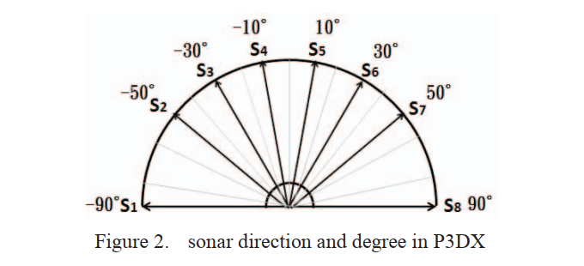
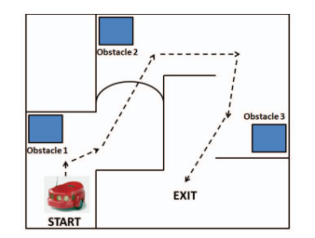
Obstacle avoidance in mobile robot using Neural Network
For data training, we construct all obstacle possibilities and define respond of the output.
Back propagation model (to study)

Slide 8
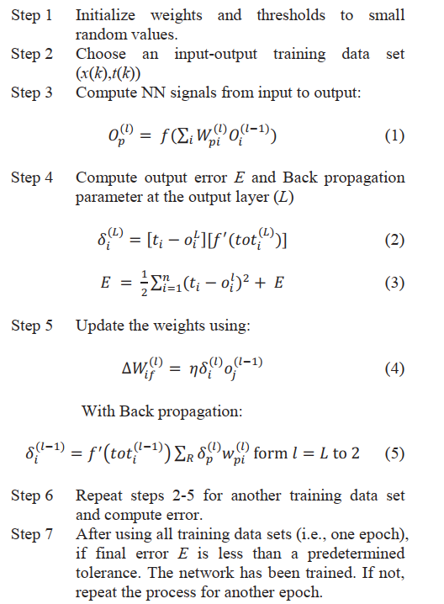
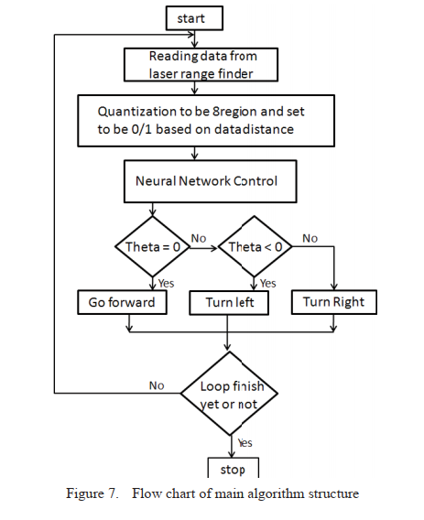

Slide 9
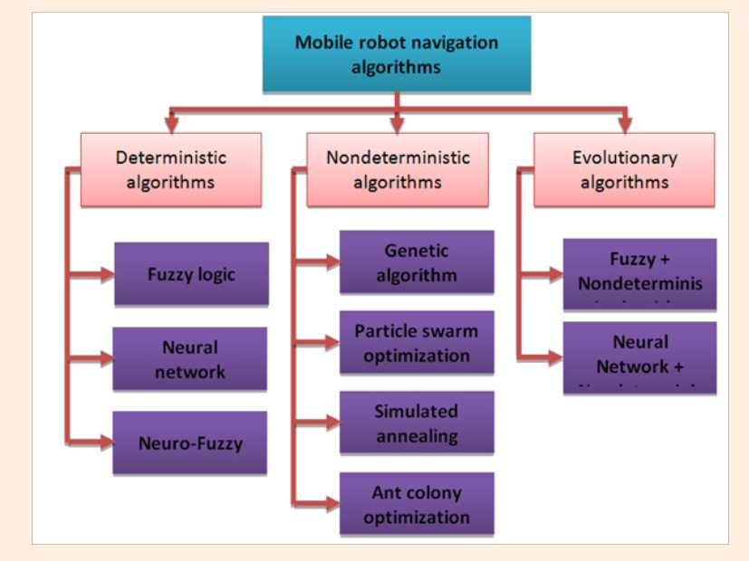
Review
Mobile Robot Navigation and Obstacle Avoidance Techniques: A Review

