Slide 1
Hexapod robot control system
4rd Meeting – 2019/12/27

Slide 2
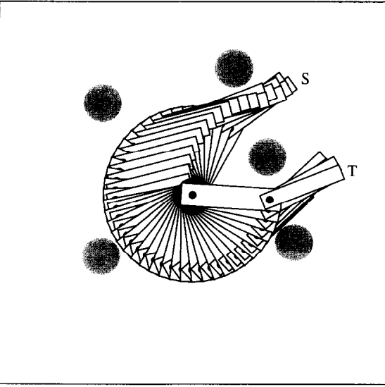
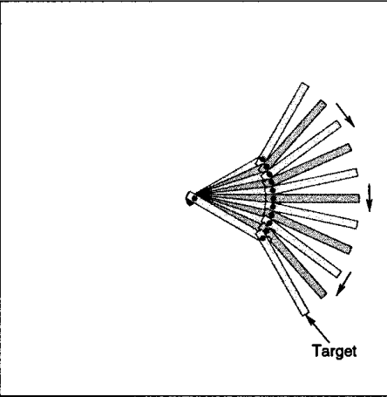
Examples in the papers

Slide 3
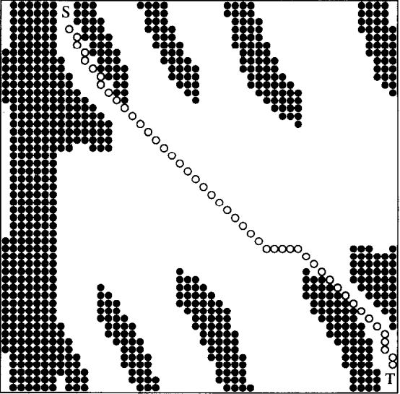
Joint space
Extremely simple
Does not involve distance between the target and the robot
Joint space very easy to calculate directly

Slide 4

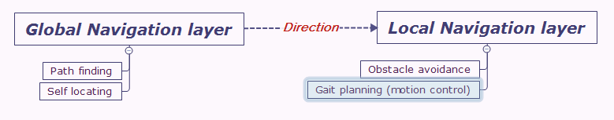
Possible solution
Add (x, y, z) dimensions to the neuronal space or only (x, y) as the robot cannot fly, info of z dimension can be calculated
20 or 21 degrees of freedom, the space is grand, and most of them is blank
Introduce a multi-layer neuronal space
High resolution local navigation layer, include joint space in this layer
Low resolution global navigation layer, traditional path finding techniques
Use a specific modulus to take account of energy and time consumed

Slide 5
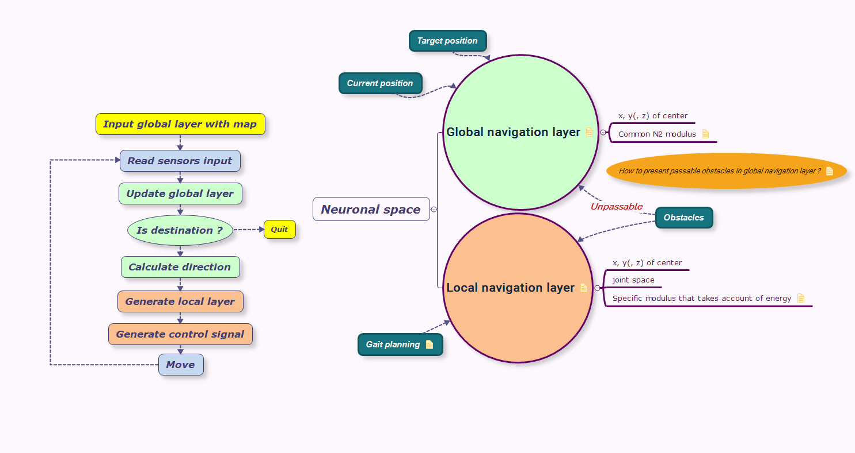
Global design

Slide 6
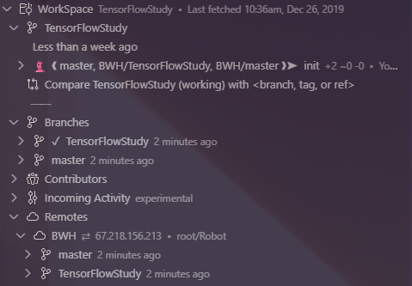
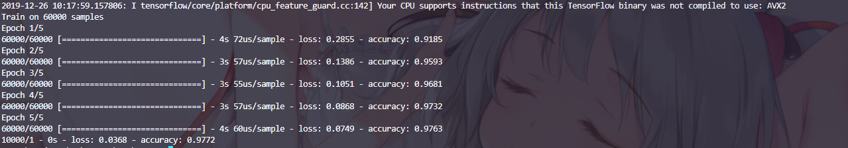
Workspace preparation
Installed Tensorflow (but might not be useful)
Initiated Git repository (for tracking work and working on different computers)

