Slide 1
Follow-up #3
Alessio Liebenguth, Robin Denni, Oscar Frank, Martin D’hérouville, Lucas Binder

Slide 2
01
Objectives
Basic features

Slide 3
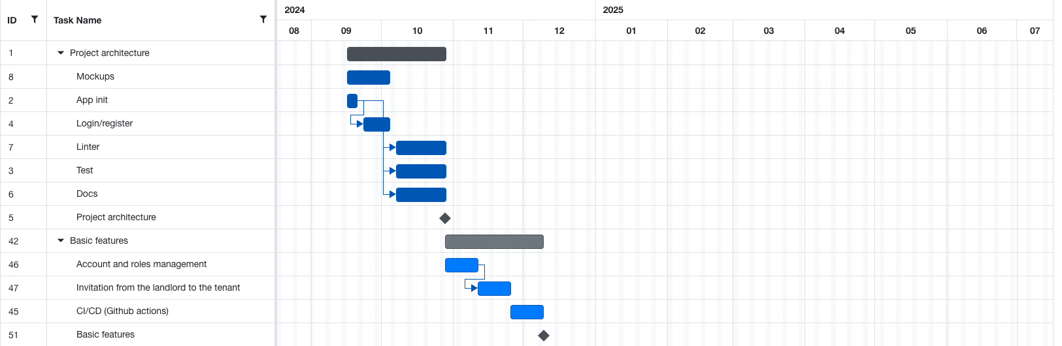

Slide 4
02
Server
Martin D’hérouville

Slide 5
Docker & CI/CD
- Containerization with Docker
- Continuous build and deployment via GitHub Actions
Roles and permissions management
- Clear separation of owner and tenant accounts
- Advanced access rights management
Properties and users
- Centralized tracking of an owner's properties
- Functionality for inviting a tenant to a property
Contract management
Quality and testability
- Unit testing for enhanced reliability

Slide 6
03
Android mobile
Robin Denni

Slide 7
Main pages
- Property page: Detailed property view and information
Management
- Add Property page: Interface for registering new properties
- Profile page: Management of personal information and
Preferences
Tests and quality
- Instrumented testing
Documentation

Slide 8
04
IOS mobile
Alessio Liebenguth

Slide 9
Customization
- Multi-language management
- Theme management
CI/CD
- Builds and automated tests with GitHub Actions
Main pages
- Property page: detailed property view and information management
- Add Property page: Interface for registering new properties
- Property details page: complete view of property information
Testing and quality
- Complete coverage with unit and UI tests

Slide 10
04
Web
Oscar Frank et Lucas Binder

Slide 11
Customization
- Translation corrections
Property management
- Property page: Detailed property view and information management
- Add Property page: Interface for registering new properties
- Property details page: complete view of property information
User management
- Invitation of tenants to a property by the owner
- Creation of tenant accounts
Overview page
- First widget implementation
- Widget creation
Testing and quality
- Complete login and registration tests

