Slide 1
Follow-up #2 Code Quality
Alessio Liebenguth, Robin Denni, Oscar Frank, Martin D’hérouville, Lucas Binder

Slide 2
01
Technical organization
Project initiation

Slide 3
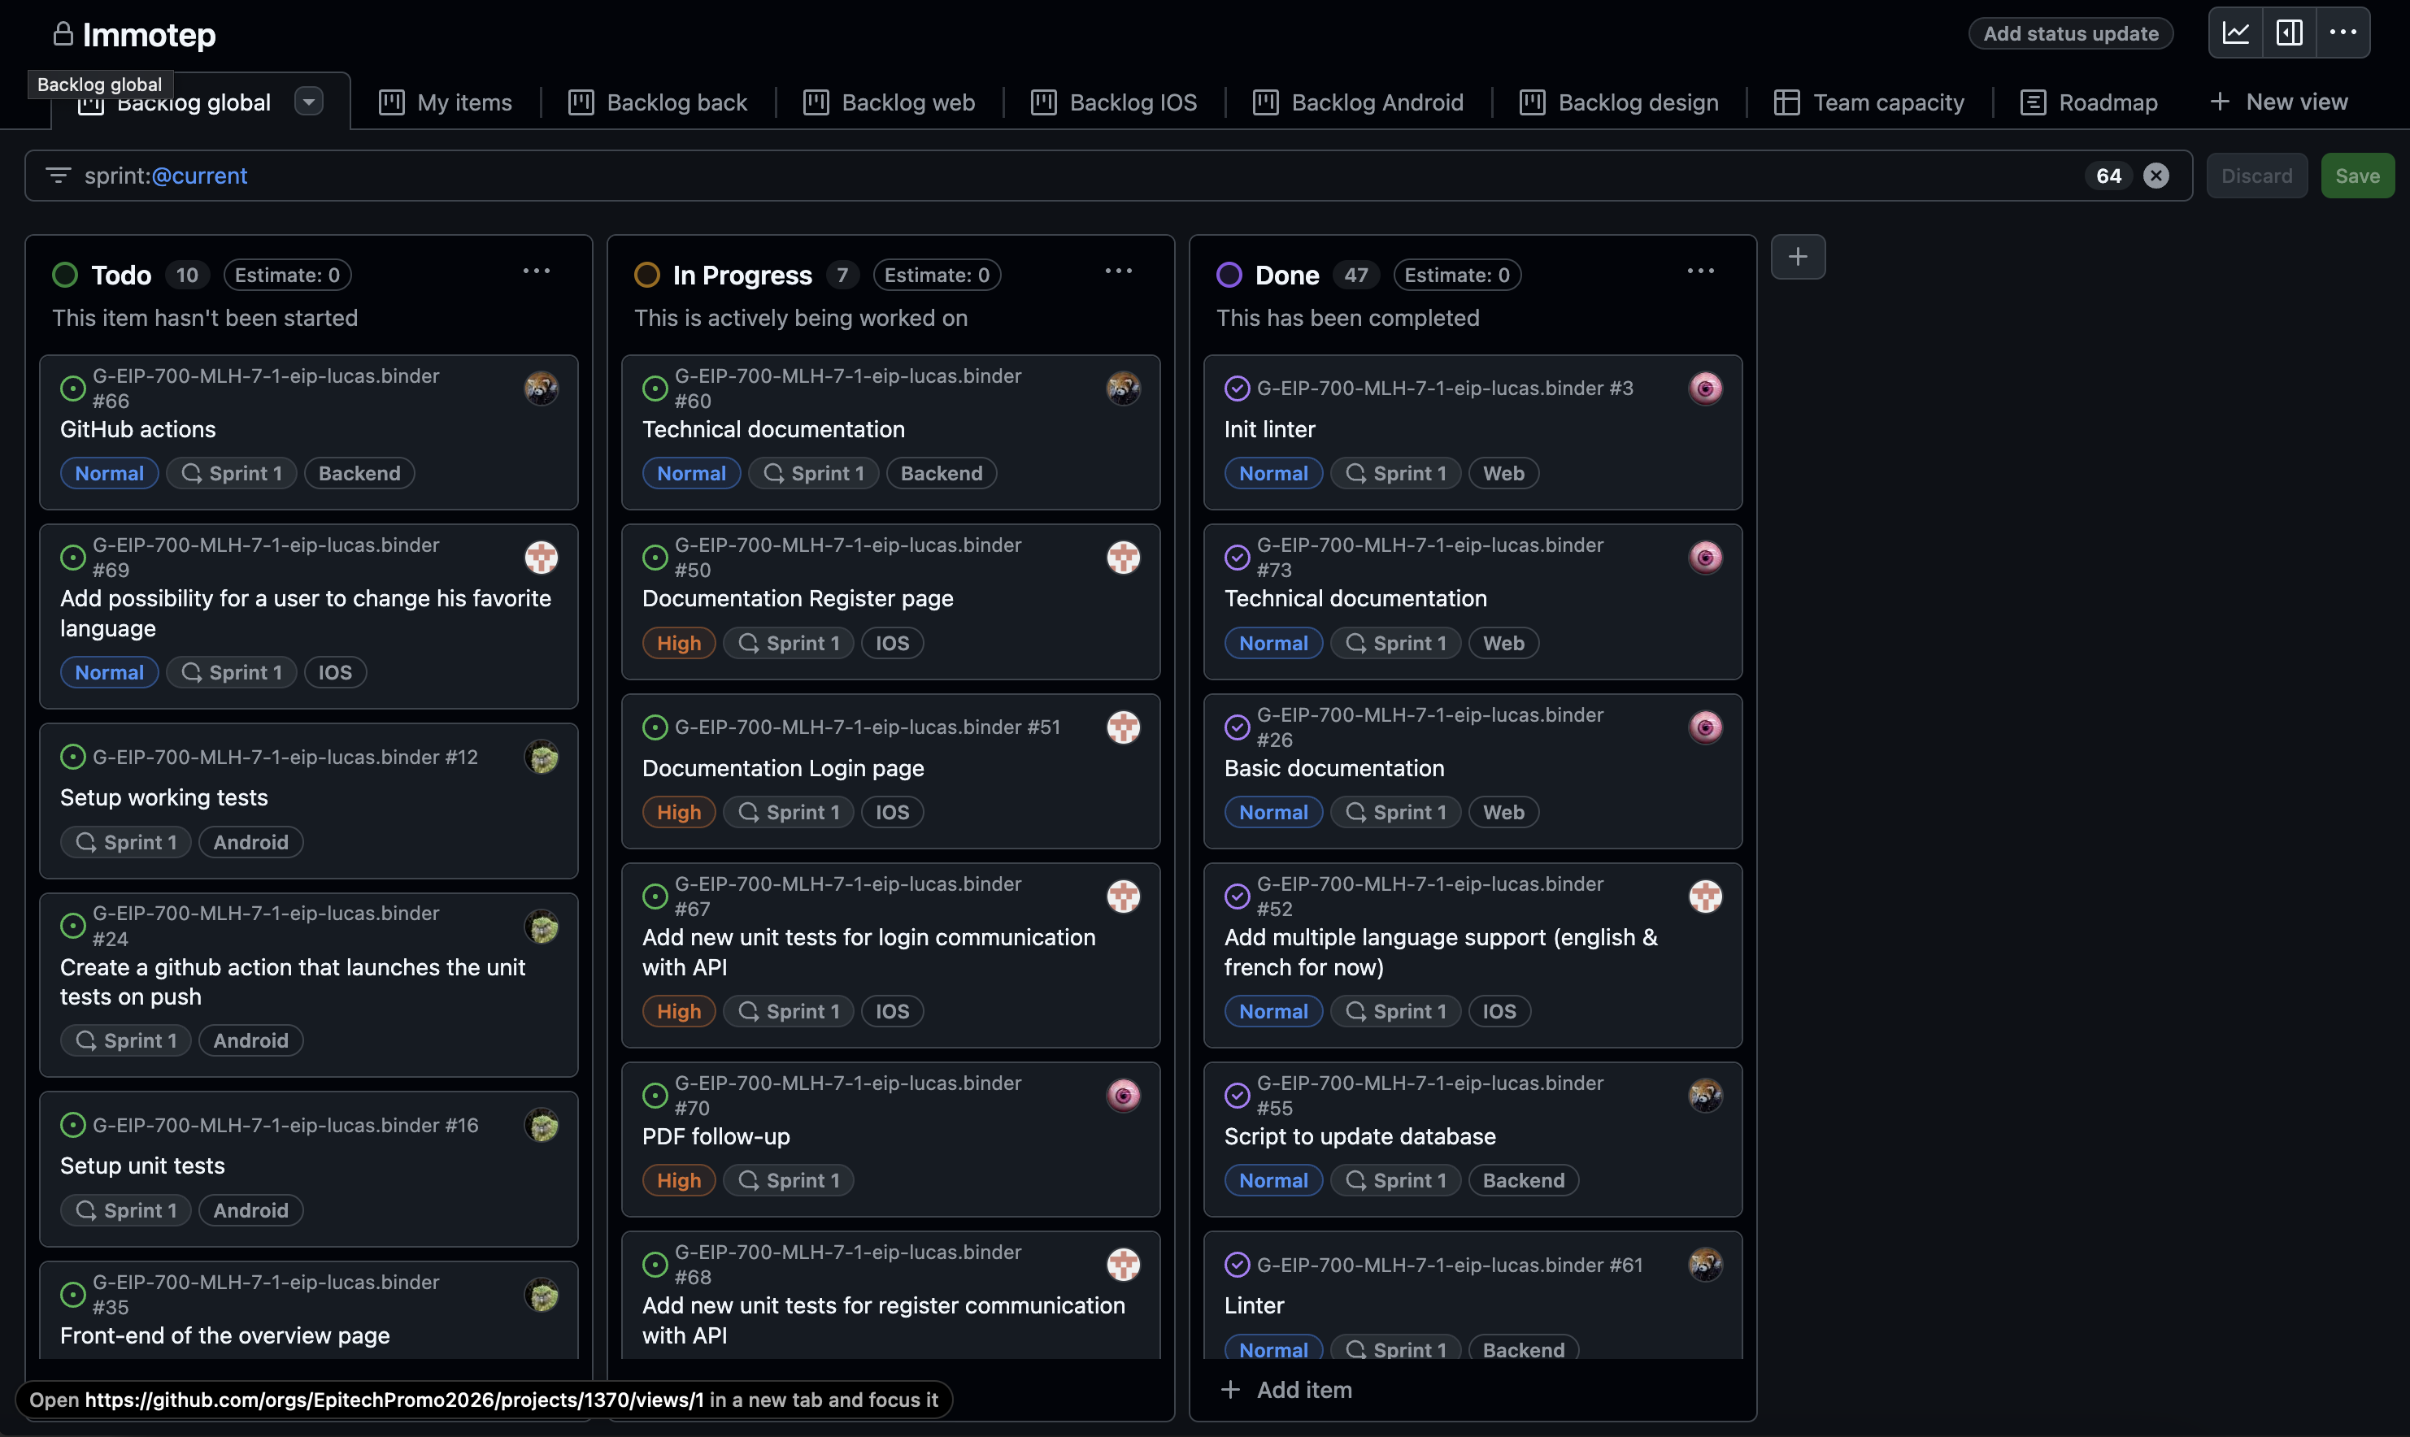
Setting up a github project to manage tasks and sprints

Slide 4
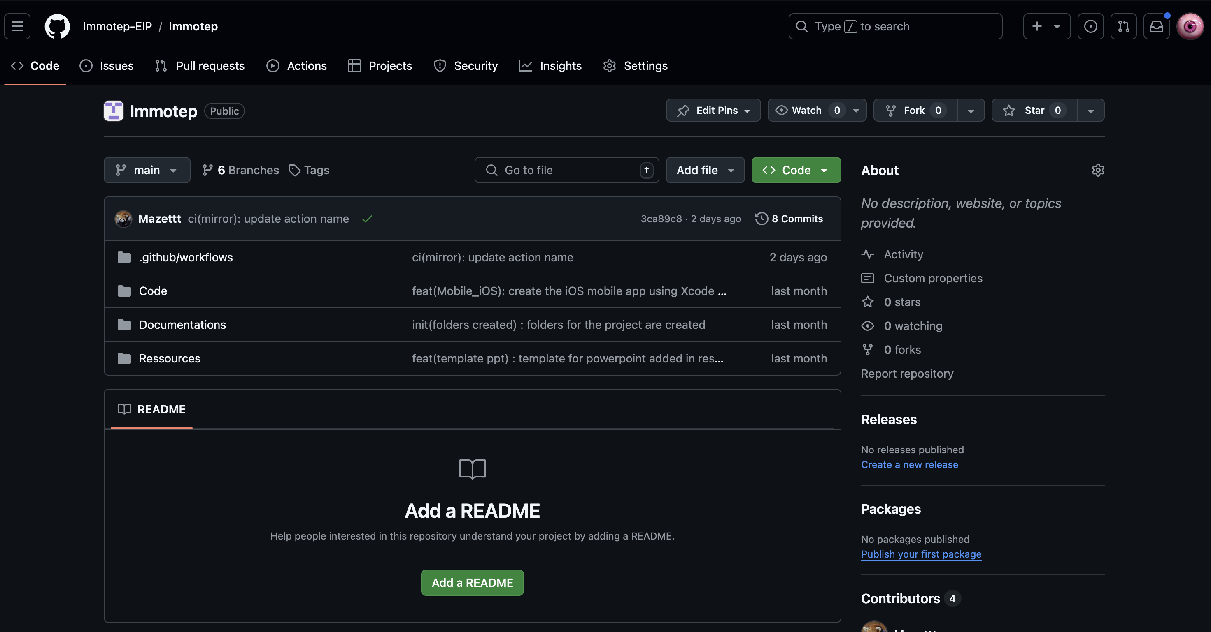
Creation of a mirror repo composed of :
- Code folder
- Documentation folder
- Resources folder
Access to github actions workflows

Slide 5
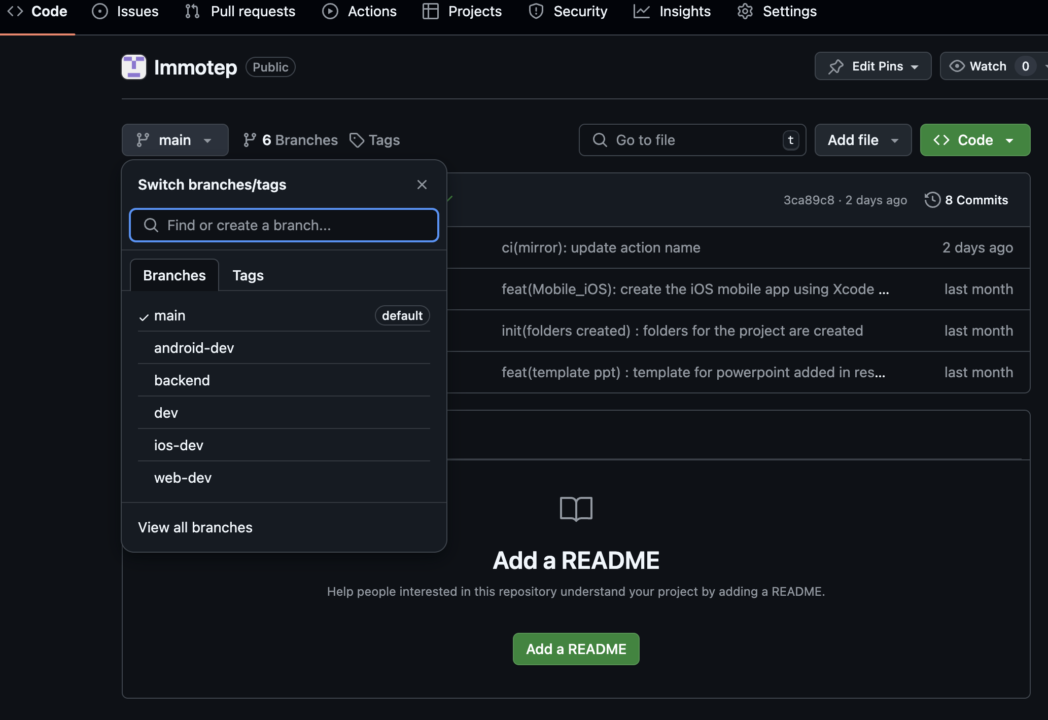
Setting up different git branches to manage different projects

Slide 6
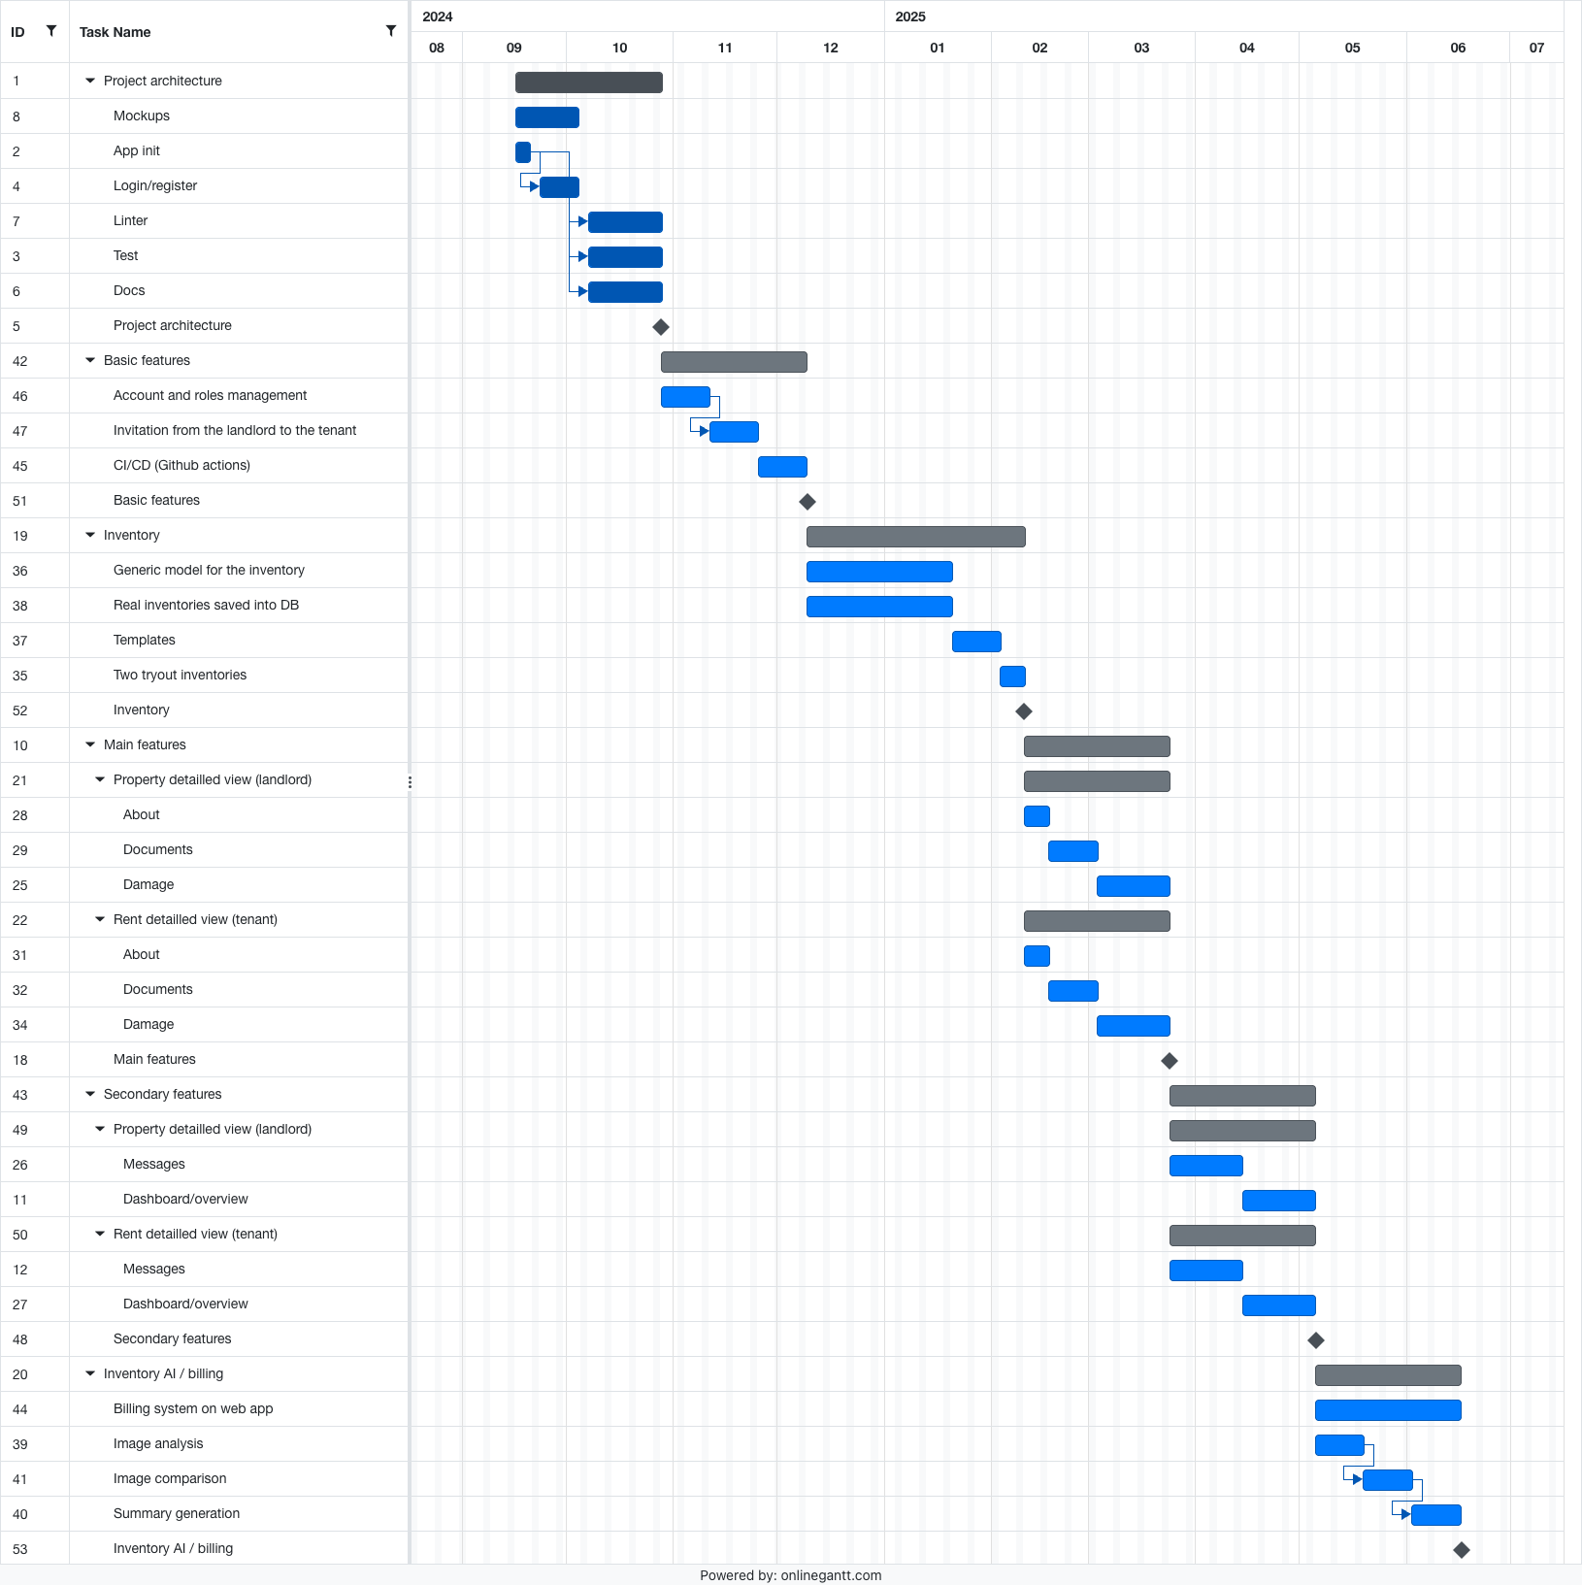
Creating a Gantt chart

Slide 7
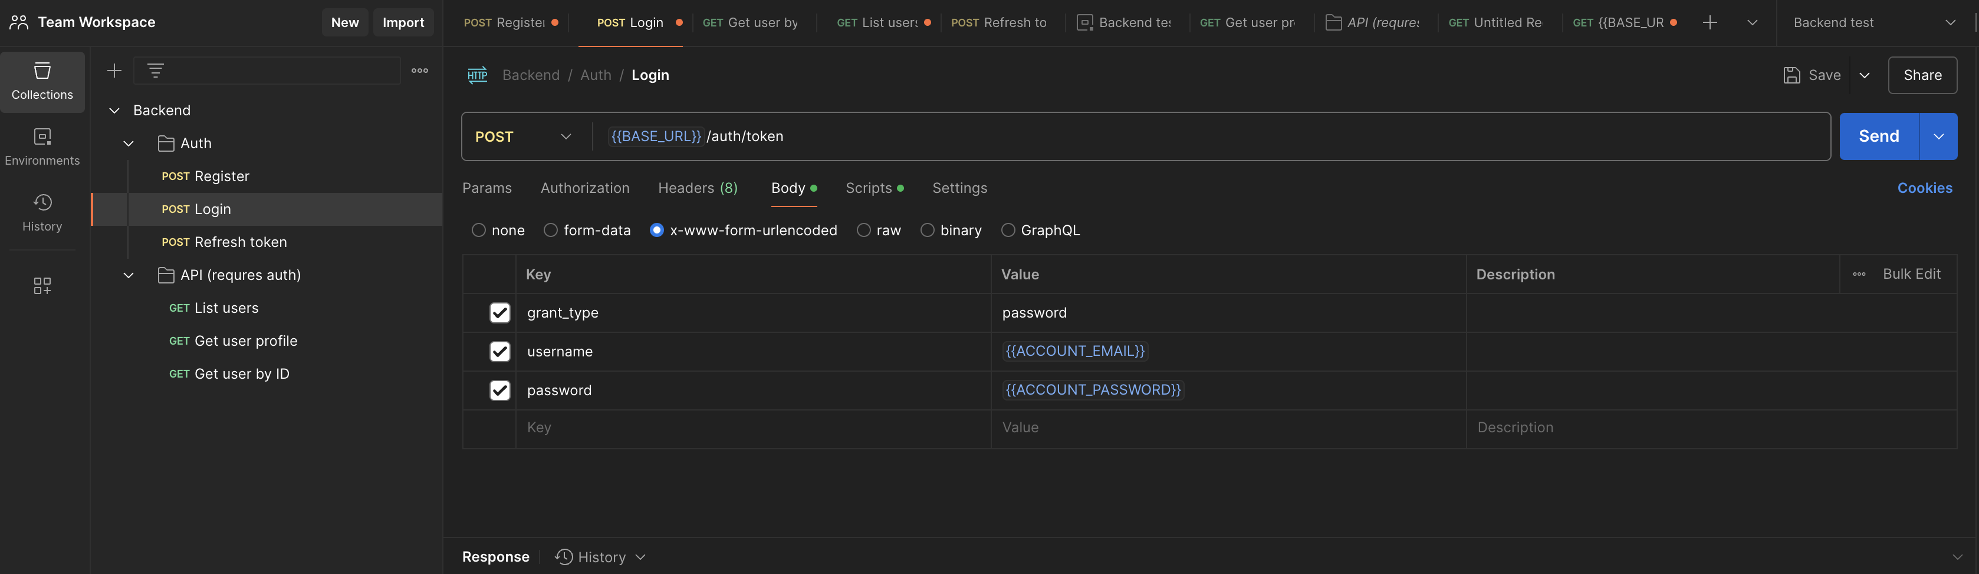
Creating a common space on postman

Slide 8
02
Internal organization
Project initiation

Slide 9
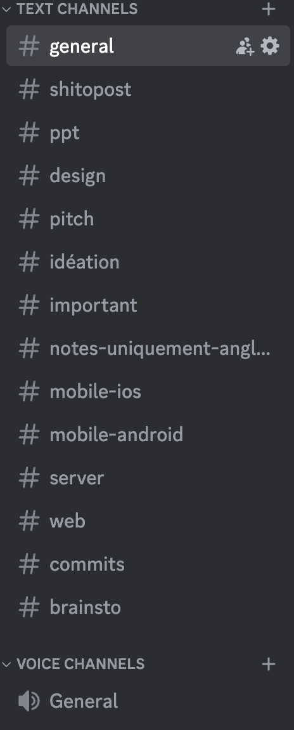
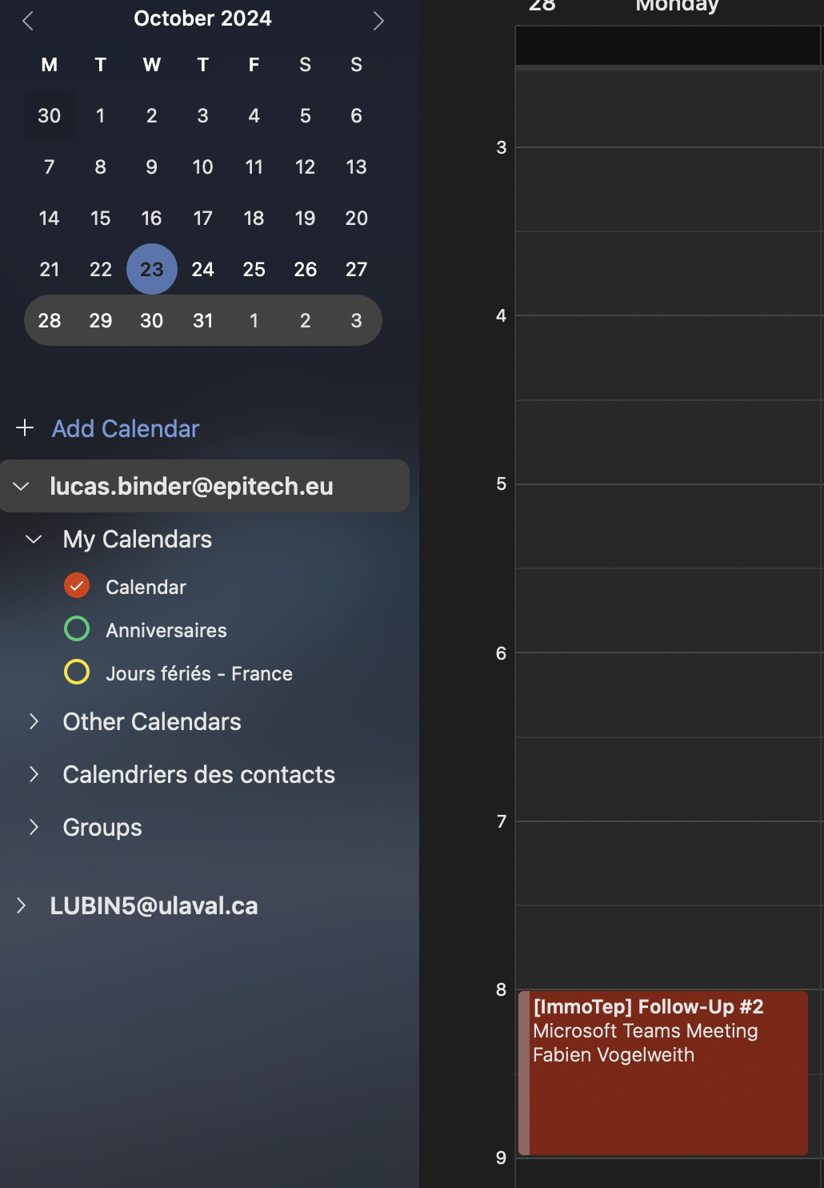
Weekly meeting
Teams
Outlook calendar
Discord

Slide 10
03
Server
Martin D’hérouville

Slide 11
Creation of server architecture and routes
Creation of PostgreSQL database using Prisma
Routes : Login, register, users list, user profile, user by ID
Script: run server, update database
Add linter
Technical documentation

Slide 12
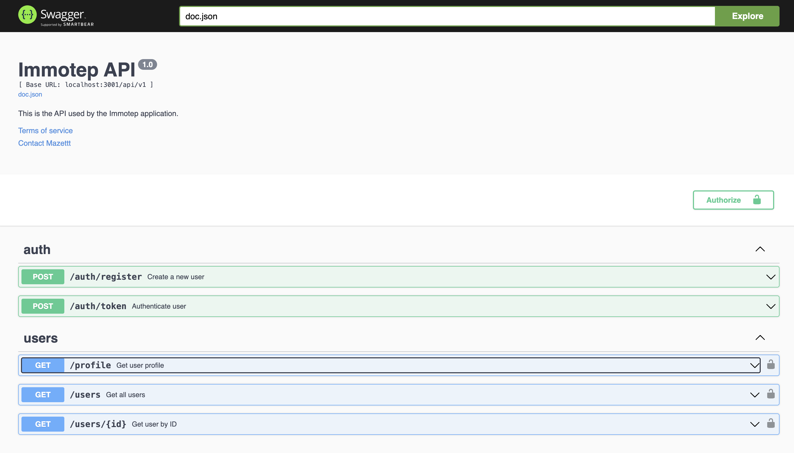
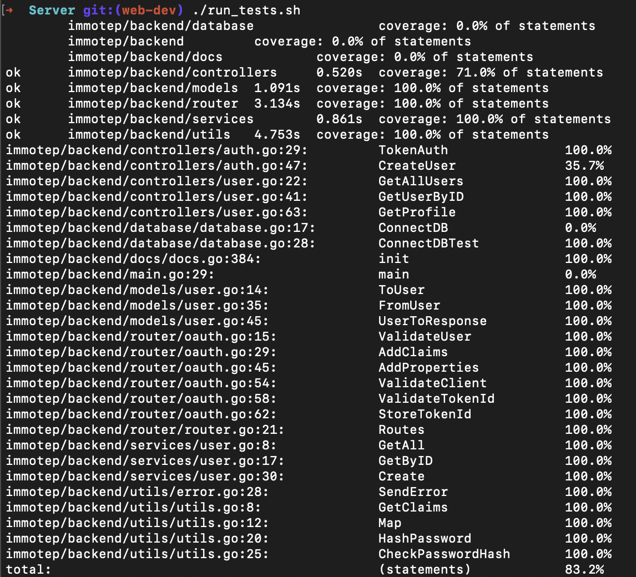
Unit tests
Swagger documentation

Slide 13
04
Android mobile
Robin Denni

Slide 14
Add translation
Add linter
Global documentation (technologies used)
Technical documentation
User documentation
Creation of application architecture
Creation of instrumented tests
Creation of first views (Login, register)
Connecting views to the API

Slide 15
05
IOS mobile
Alessio Liebenguth

Slide 16
Creation of application architecture
Creation of unit tests and UI tests
Creation of first views (Login, register)
Connecting views to the API
Add translation
Add linter
Global documentation (technologies used)
Technical documentation
User documentation

Slide 17
05
Web
Oscar Frank et Lucas Binder

Slide 18
Creation of project architecture
Creation of unit tests and functional tests
Creation of first views (Login, register)
Connect views to API
Added translation with i18n
Added linter
Global documentation (technologies used)
Technical documentation
User documentation

Slide 19
05
Mock-up
Project initiation

Slide 20
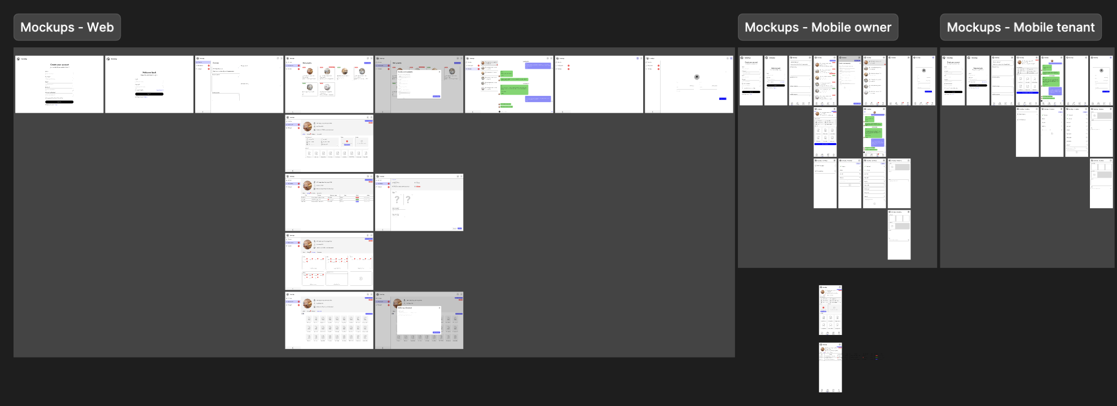

Slide 21
Thank you!

