Slide 1
Gating strategy to label cell-types

Slide 2
General guidelines
We gate on the arcsinh-transformed counts stored in the ‘exprs’ assay slot
We first specify the gates per cell-types, switch between samples and adjust the gates per sample if needed
We make sure to always use the same spelling for the cell-types ;) and use the names as indicated here

Slide 3
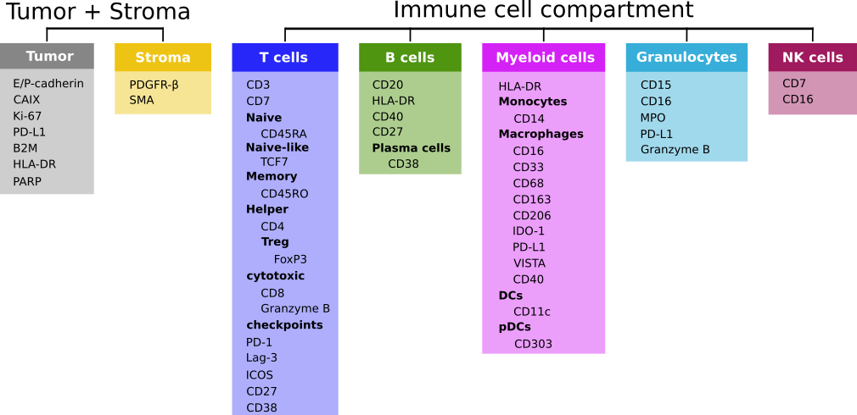
Classify:
-> Mural
Classify:
-> NK cells
Classify:
-> B cells
-> Plasma cells
-> BnT cells
-> Subcluster
Classify:
-> Neutrophils
-> Subcluster
Classify:
-> Tumor cells
-> Tumor Ki67⁺
-> Subcluster
Classify:
-> Macrophage
-> DC
-> pDC
-> Subcluster
Classify:
-> T_CD4_conv cells
-> T_CD8 cells
-> Treg cells
-> Subcluster
-> GMM for GrzB and PD-1

Slide 4
Tumor cells
Plot 1
Plot 2
Plot 3, 4
Plot 3
neg selection:
MPO, CD20, CD303, CD38, PDGFR
Tumor Ki67+
Note:
tumors can often express HLADR. therefore the dataset for labelling should include HLADR+Ead+ cells. The HLADR gate is only for visual control.
HLADR
Ki67
E-cad
Tumor
CD3
sample
sample
Plot 1
Plot 2
Tumor Ki67+
Note:
In RCC samples the tumor cells are often E-cad⁻ but Carbonic anhydrase⁺
CAIX
Ki67
Tumor
CD3
sample

Slide 5
Myeloid cells
Plot 1
Plot 2
Plot 3
Plot 4
Mac_CD163
CD20
CD3
CD303
CD163
HLA-DR+
DC
HLADR
E-cad
CD38
CD11c
Note:
In samples with TLS the negative gates for CD3 and CD20 should not be used in order to obtain DCs in the tight mesh of B and T cells.

Slide 6
Plasmacytoid DCs
Plot 1
E-cad
pDC
CD303

Slide 7
Neutrophils
Plot 1
Neutrophil
CD15
MPO

Slide 8
Plasma cells
Plot 1
Plot 2
CD38
CD7
Plasma
CD11c
CD303
Note:
Use the negative gate to actually not loose any of the labelled pDCs, DCs and later on NK cells

Slide 9
Mural
Plot 1
Plot 2
Plot 3
Plot 4
CD3
CD38
CD303
CD7
Ecad
CD20
Plot 5
MPO
HLADR
Mural
SMA
Mural
PDGFRb

Slide 10
B cells and intermixed B and T cells
Plot 1
Plot 1
B
BnT
CD20
CD11c
B/BnT
CD3
CD303

Slide 11
NK cells
Plot 1
Plot 2
CD7
E-cad
NK
sample
CD3

Slide 12
T cells
Plot 1
Plot 1
Plot 2
Plot 3
Treg
T_CD8
CD3
CD8
CD11c
FoxP3
T_CD4_conv
CD20
CD303
sample
CD4

