Slide 1

Lea ning
Week 4:
Melting, merging, and summarizing

Slide 2
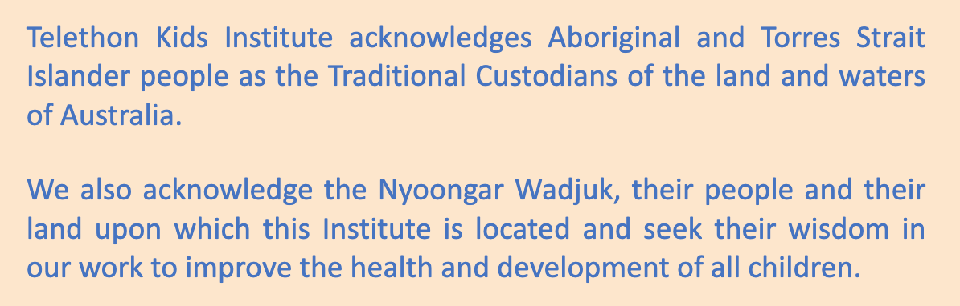

Slide 3
What’s on for today
Recap from last class:
Subsetting data
Basic statistics
Ggplot2 basics
An introduction to the week4 dataset
Long-to-wide and back again (hands-on R lesson)
Merging datasets (hands-on R lesson)
Summarizing data: getting the mean + SD for a bar graph (hands-on R lesson)
Ggplot: bargraphs (hands-on R lesson)

Slide 4
This week’s problem
We submitted some samples to a sequencing core and got back a great data matrix! We are excited to analyze it in R, as the facet wrap will save us tons of time
But all our hopes “melt” away when we realize our data is not in the nice long format that makes ggplot work! And what’s more, our metadata is on another sheet altogether. So now all that stuff we LeaRned already won’t help us.
Week 4 to the rescue!

Slide 5
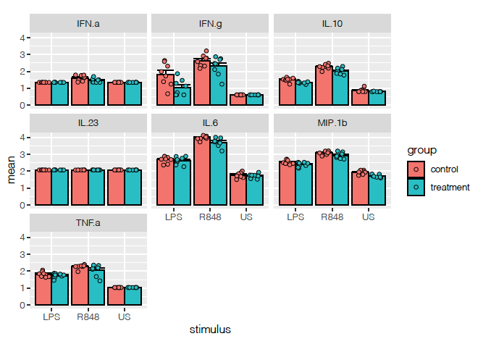
The mission
Combine this data matrix…
With the metadata…
To generate these graphs.

Slide 6
To complete the mission, we must:
Reshape our data
Merge our data
Compute some summary statistics
Plot bar graphs with error bars
YOUR TURN!!!

