Slide 1
Germany
Climate Impact Assessment
Using RIME-X Statistical Emulator | ISIMIP3b | MAGICC7 600-Member Ensemble
RIME-X v1.0
ISIMIP3b
600 Members
Scenarios
CAT Current Policies
CPP HIGH & LOW
SSP1-1.9 to SSP3-7.0
NGFS Phase 5
Emulator
Impact Data
MAGICC Ensemble
1950–2100
4 Indicators
17 Regions
Time Period
Climate Metrics
Federal States
RIME-X Germany Climate Impact Assessment | 2025

Slide 2
Methodology: How RIME-X Works
Framework
1
2
3
GMT Ensemble
Quantile Maps
Impact Projection
600 MAGICC7 members sample climate sensitivity (ECS 1.5–4.5°C). Constrained by observations to 2020, then diverge into wide uncertainty fan.
ISIMIP3b impact data binned by GMT warming level (1.0–6.6°C, 0.1°C steps, 101 quantiles). Built from 14 CMIP6 ESMs across 4 SSP scenarios.
For each GMT sample, draw regional impact from quantile map. 5,000 Monte Carlo samples → full probability distribution 1950–2100.
→
→
Data Sources & Configuration
▸ GMT: MAGICC7 · 600 ensemble members · CAT Current Policies HIGH & LOW · baseline 1986–2005
▸ Impact: ISIMIP3b · 14 CMIP6 ESMs (CanESM5, GFDL-ESM4, MPI-ESM1-2-HR, UKESM1-0-LL, etc.) · 21-year running windows
▸ Regions: 17 German federal states + national average · Spatial weight: latitude-weighted area
▸ Quantile resolution: 57 warming levels (1.0–6.6°C) × 101 quantiles (0–1) per region
RIME-X Germany Climate Impact Assessment | CAT Current Policies | ISIMIP3b

Slide 3
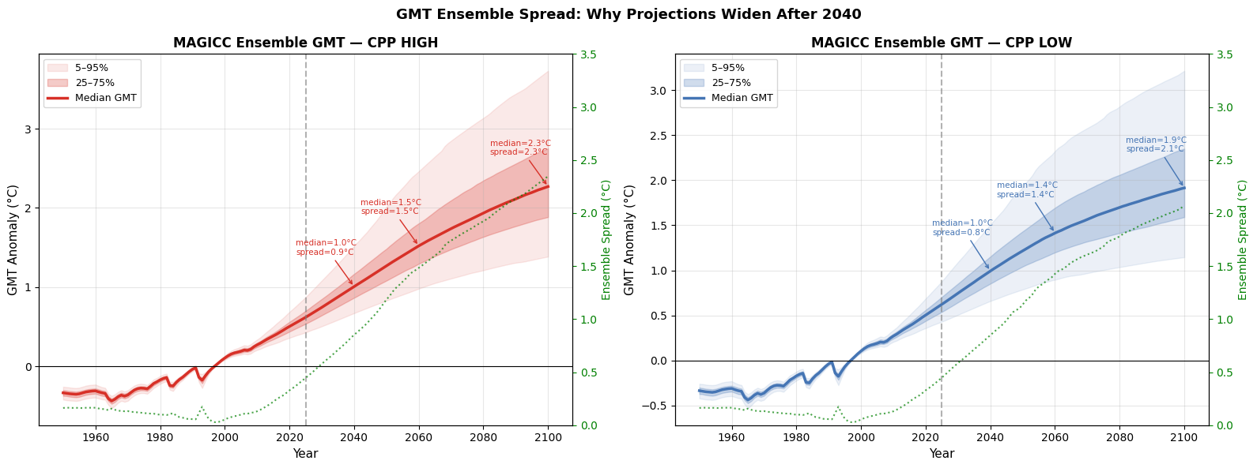
GMT Ensemble Spread — Why Uncertainty Grows After 2040
Uncertainty
0.054°C
Spread in 2000
(obs-constrained)
0.851°C
Spread in 2040
(16× year-2000)
1.833°C
Spread in 2075
(= median signal)
2.347°C
Spread in 2100
(exceeds median)
Three Physical Reasons for Widening Uncertainty
Climate Sensitivity Uncertainty: 600 members span ECS 1.5°C–4.5°C. Historical obs constrain all members to 2020, then they diverge freely based on their ECS.
Carbon Cycle Feedbacks: Future CO₂ uptake by land/ocean uncertain. Permafrost thaw compounds warming after 2050. High-ECS members warm 2× more than low-ECS by 2100.
Irreducible uncertainty: By 2075 spread (1.83°C) equals median warming (1.84°C). By 2100 spread (2.35°C) EXCEEDS median (2.27°C). Consistent with IPCC AR6 findings.
RIME-X Germany Climate Impact Assessment | CAT Current Policies | ISIMIP3b

Slide 4
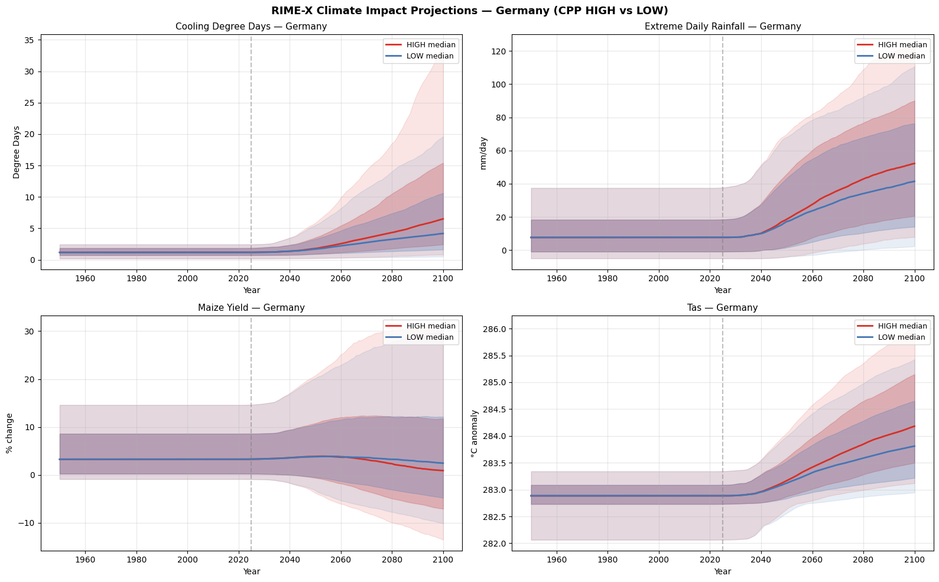
Climate Impact Overview — 4 Indicators (CPP HIGH vs LOW)
Overview
━━
CPP HIGH — high climate sensitivity
━━
CPP LOW — low climate sensitivity
▒
17–83% uncertainty range
░
5–95% uncertainty range
RIME-X Germany Climate Impact Assessment | CAT Current Policies | ISIMIP3b

Slide 5
Key Projections — Germany Median Values by Scenario
Numbers
Indicator | Year | LOW Median | HIGH Median | Key Finding
Cooling Degree Days | 2030 | 1.21 | 1.21 | No difference yet
(degree-days/yr) | 2050 | 1.70 | 1.79 | +0.09 — gap opening
 | 2075 | 3.03 | 3.90 | +0.87 — significant gap
 | 2100 | 4.19 | 6.51 | +2.32 (+55% more cooling demand)
Extreme Rainfall | 2030 | 7.76 | 7.74 | Virtually identical
(mm/day) | 2050 | 17.2 | 18.5 | +1.3 mm/day difference
 | 2075 | 32.1 | 39.4 | +7.3 mm/day — major flood risk
 | 2100 | 41.5 | 52.2 | +10.7 mm/day (+26% intensity)
Maize Yield Change | 2030 | ~4.0% | ~4.0% | Both positive — benefit from warming
(fraction) | 2050 | 3.86 | 3.88 | Still positive, little difference
 | 2075 | 2.77 | 2.73 | Declining but still positive
 | 2100 | 0.91 | 0.74 | Near-zero — resilience fading
Mean Temperature | 2030 | ~10.4°C | ~10.4°C | No difference
(absolute °C) | 2050 | ~10.8°C | ~10.9°C | Slight divergence (+0.1°C)
 | 2075 | ~11.3°C | ~11.7°C | 0.4°C policy gap
 | 2100 | ~11.7°C | ~12.3°C | 0.6°C gap by century end
RIME-X Germany Climate Impact Assessment | CAT Current Policies | ISIMIP3b

Slide 6
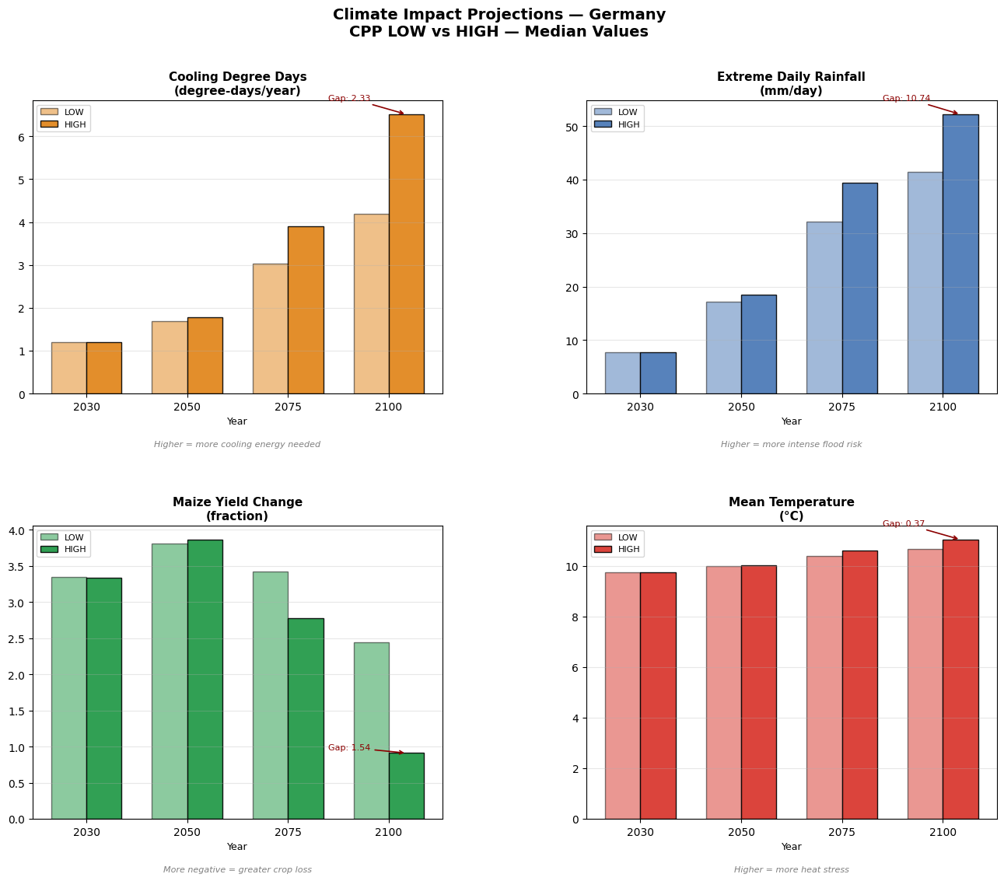
All Indicators — LOW vs HIGH Scenario Bar Comparison
Summary
Gap at 2100 between HIGH and LOW scenarios quantifies the value of ambitious climate policy in each indicator domain
RIME-X Germany Climate Impact Assessment | CAT Current Policies | ISIMIP3b

Slide 7
Maize Yield
Deep Dive Analysis
17 Federal States · Warming Levels 1.0–6.6°C · Exceedance Probability · Policy Benefit
Germany vs Pakistan — A Tale of Two Climates
▸ Germany GAINS yield early (+3.86 fraction in 2050) — warming benefits cool temperate agriculture
▸ Pakistan LOSES yield immediately (−1.13 in 2050) — heat stress in already-hot climate
▸ Both decline under very high warming — Germany only turns negative above ~4–5°C global warming
▸ Same global warming, opposite regional agricultural impacts — a climate justice issue

Slide 8
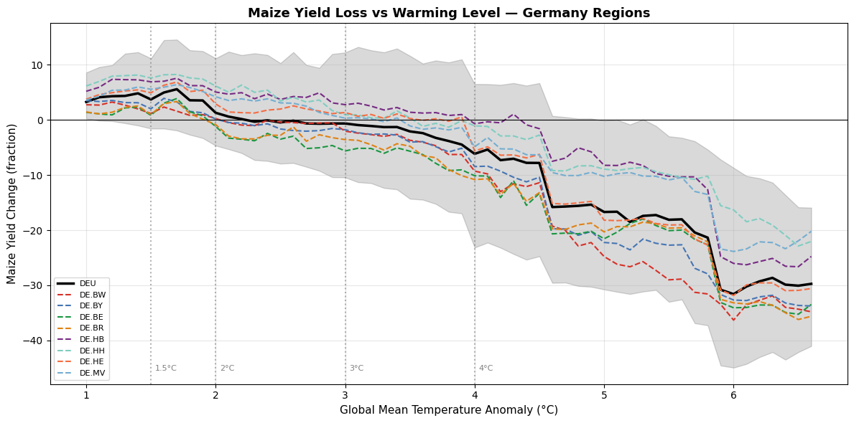
Maize Yield vs Warming Level — All 17 Federal States
Warming Levels
Key Findings
All German regions show positive yield at +1.5°C — warming initially helpful
Northern coastal states (Hamburg, Bremen) benefit most and remain positive longest
Berlin most vulnerable — urban heat amplifies warming effects
National average (DEU, black line) turns negative around +4.5–5°C
Stark contrast: Pakistan is negative from +1°C warming onwards
The +2°C Paris target keeps all German states in positive territory
Regional Yield at +3°C Warming (Median)
+5.2%
+4.8%
+4.2%
+3.8%
-0.6%
-2.6%
-2.1%
Hamburg
Bremen
Lower Saxony
Mecklenb.
Germany
NRW
Baden-W.
RIME-X Germany Climate Impact Assessment | CAT Current Policies | ISIMIP3b

Slide 9
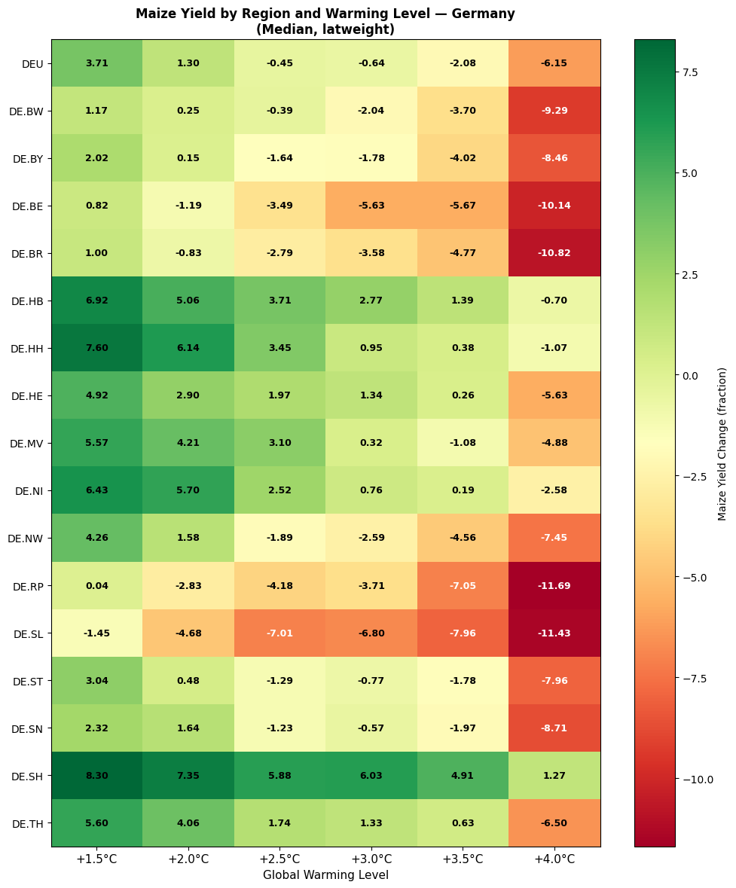
Maize Yield Heatmap — All Regions × Warming Levels
Heatmap
Reading the Heatmap
Green = yield GAIN | Red = yield LOSS
Rows = German federal states
Columns = global warming levels (+1.5 to +4.0°C)
Values = median fractional yield change at that warming level
Most states positive (green) at +1.5–2.5°C, turn red above +3.5°C
Critical Thresholds
Below +2°C: almost all German states show yield gains
At +2.5°C: southern states (BW, BY) start showing losses
At +3°C: Berlin turns significantly negative (−5.6%)
At +4°C: majority of urban states show 2–6% loss
Hamburg & Bremen stay positive even at +4°C — most resilient
Under high warming, regional inequality within Germany increases
RIME-X Germany Climate Impact Assessment | CAT Current Policies | ISIMIP3b

Slide 10
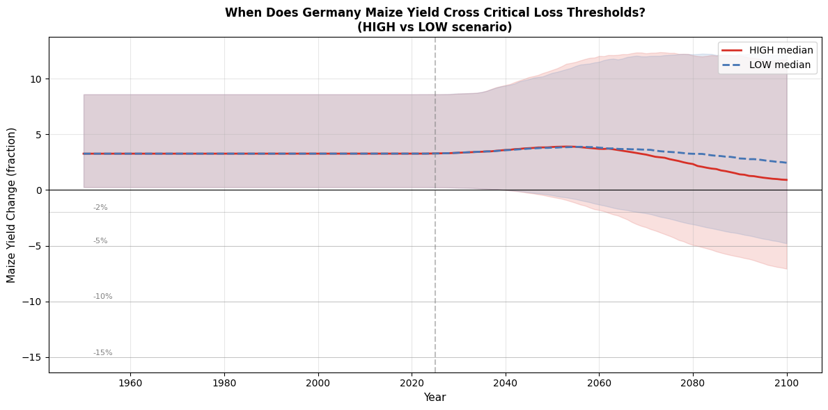
When Does Germany Maize Yield Cross Critical Thresholds?
Thresholds
Threshold Crossings
−2% threshold: NOT crossed at national median under either scenario through 2100
−5% threshold: Not crossed — Germany nationally protected at median
Stark contrast with Pakistan which crosses −2% by 2062 (HIGH)
Wide uncertainty bands show real tail risk — worst cases do cross thresholds
Why So Resilient?
Germany is temperate — baseline temperatures allow warming benefit
Maize grows near optimum temperature range at current climate
Higher CO₂ boosts photosynthesis, partially offsetting heat stress
Comparison: Pakistan grows near upper heat tolerance limit already
⚠ Important:
Germany's national average resilience does NOT mean Germany is unaffected. Cooling costs surge 55%, extreme rainfall nearly doubles, and tail agricultural risks are substantial. The wide uncertainty bands show that worst-case scenarios (5th percentile) DO cross loss thresholds — planning for these is critical.
RIME-X Germany Climate Impact Assessment | CAT Current Policies | ISIMIP3b

Slide 11
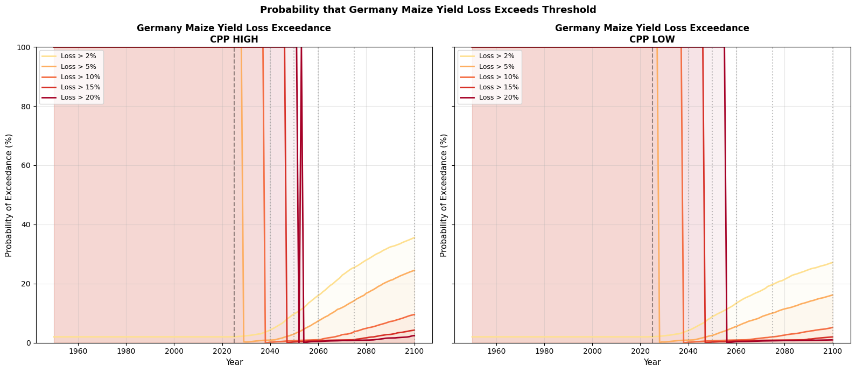
Exceedance Probability — Likelihood of Yield Loss
Probability
4.3%
>2% loss by 2040
(LOW)
9.8%
>2% loss by 2050
(HIGH)
25.5%
>2% loss by 2075
(HIGH)
35.6%
>2% loss by 2100
(HIGH)
Exceedance Summary — Germany vs Pakistan
▸ By 2040: 4.3% chance of >2% loss (Germany) vs 44.8% (Pakistan) — Germany is 10× better protected near-term
▸ By 2075: 25.5% (HIGH) vs 19.7% (LOW) — +5.8pp policy benefit; Pakistan at 52.9% — nearly 2× more vulnerable
▸ By 2100: 35.6% (HIGH) vs 27.1% (LOW) — ambitious policy reduces Germany's risk by 8.5 percentage points
▸ Pakistan by 2100: 56% chance of >2% loss — policy choice is existential, not incremental
RIME-X Germany Climate Impact Assessment | CAT Current Policies | ISIMIP3b

Slide 12
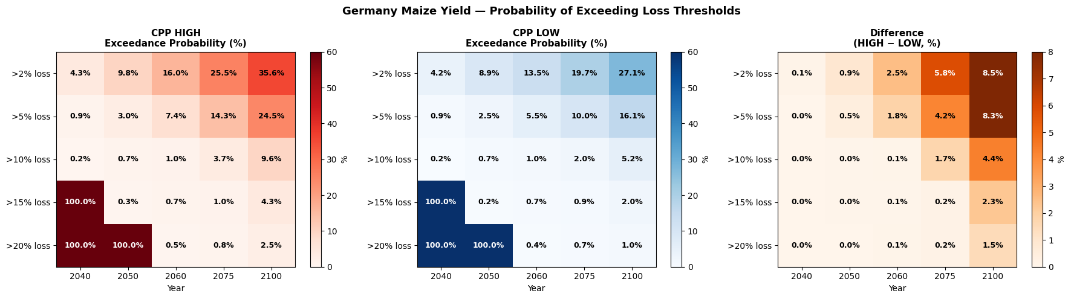
Exceedance Heatmap — HIGH vs LOW vs Policy Difference
Heatmap
LEFT: Exceedance probability under CPP HIGH | CENTRE: Probability under CPP LOW | RIGHT (orange): Difference — the direct quantification of climate policy benefit. Darker orange = more years of agricultural protection gained by ambitious climate action.
RIME-X Germany Climate Impact Assessment | CAT Current Policies | ISIMIP3b

Slide 13
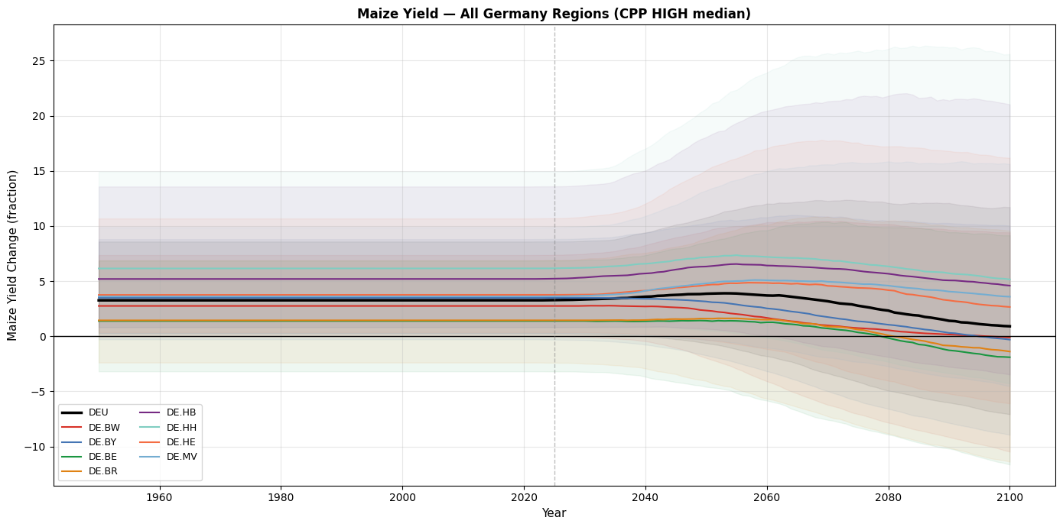
Maize Yield — All 17 German Federal States (CPP HIGH)
Regional
2100 Median Yield (Fraction)
Hamburg
+5.16
Bremen
+4.60
Lower Saxony
+4.67
Mecklenb.-VP
+3.59
Hesse
+2.66
Germany
+0.91
Rhineland-Pal
−0.06
Baden-Württ.
−0.10
Bavaria
−0.30
Brandenburg
−1.38
Hamburg (+5.16) and Lower Saxony (+4.67) are most resilient — cool, northern, maritime climate. Berlin (−1.90) and Brandenburg (−1.38) most vulnerable — urban heat and continental climate. National average (+0.91) masks this huge regional spread: some states gain 5%, others lose 2%. Targeted regional adaptation investment is essential.
Berlin
−1.90
RIME-X Germany Climate Impact Assessment | CAT Current Policies | ISIMIP3b

Slide 14
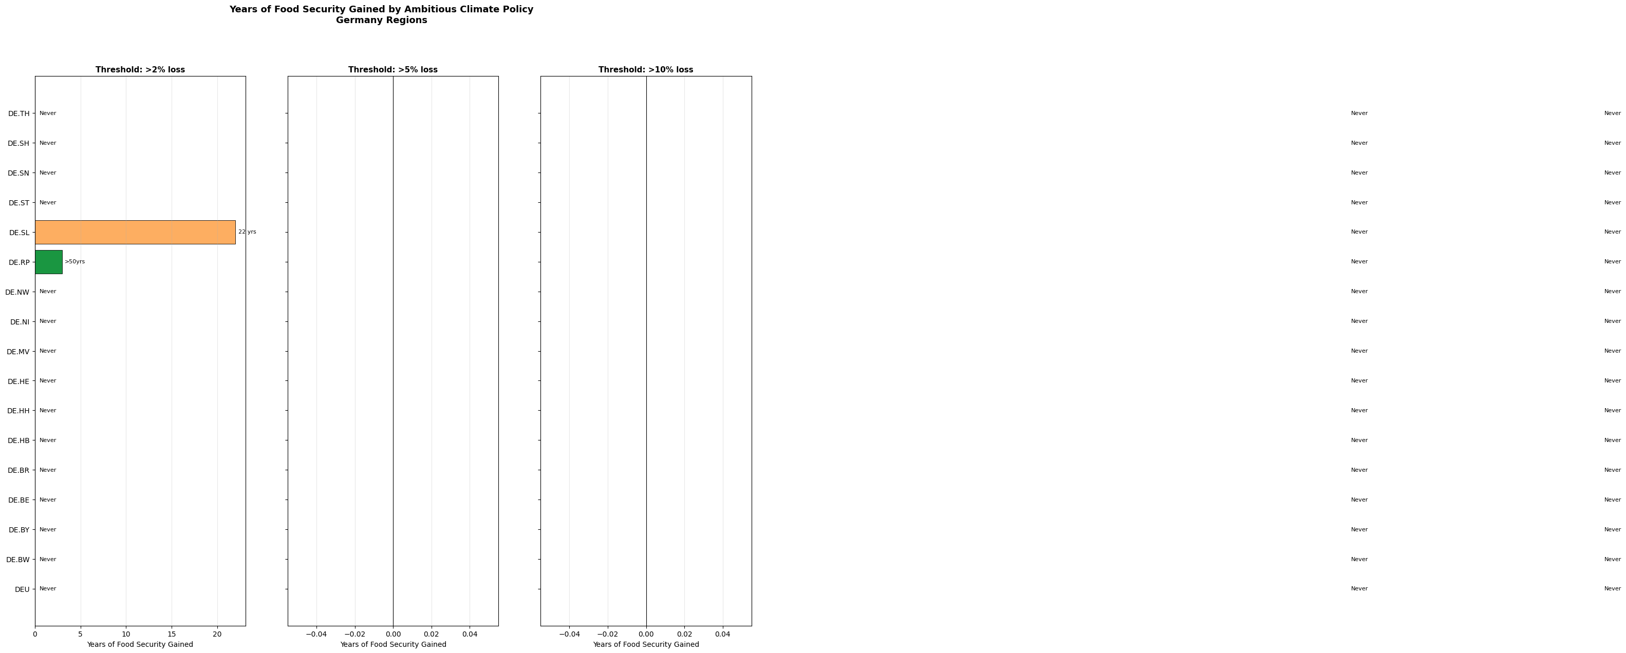
Policy Benefit — Years of Food Security Gained by Climate Action
Policy
Key Finding for Germany
Germany's national average NEVER crosses −2%, −5%, or −10% at the median
Policy benefit shows in reduced TAIL RISK probability, not years-before-crossing
8.5 percentage-point reduction in >2% loss probability by 2100
Contrast: Pakistan gains 8–10 actual years before threshold crossings
Implications
Germany in privileged position — temperate agriculture is resilient to 2–3°C
Focus should shift to tail-risk adaptation rather than median-case planning
Vulnerable regions (Berlin, Baden-Württemberg) need targeted support
Global solidarity: Germany's resilience vs Pakistan's crisis underlines climate justice imperative
⚠ Policy Context:
Germany does not face an agricultural SURVIVAL question from climate change (unlike Pakistan), but it faces substantial increases in cooling energy costs (+55% by 2100) and extreme precipitation (+26%), each requiring major infrastructure investment. Policy benefit is real, just expressed differently.
RIME-X Germany Climate Impact Assessment | CAT Current Policies | ISIMIP3b

Slide 15
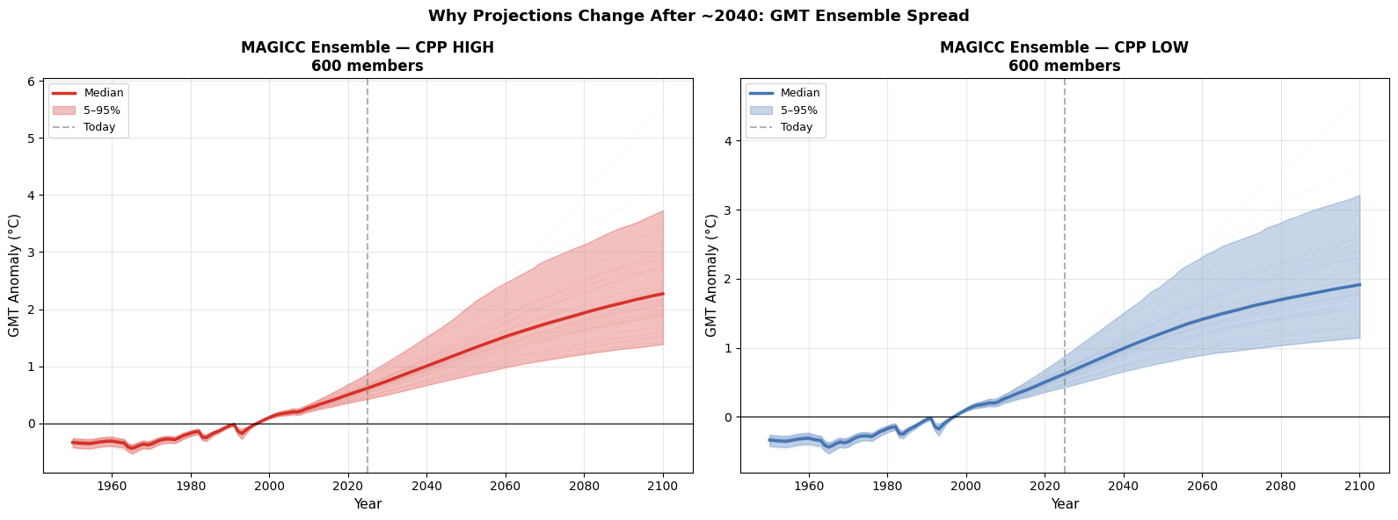
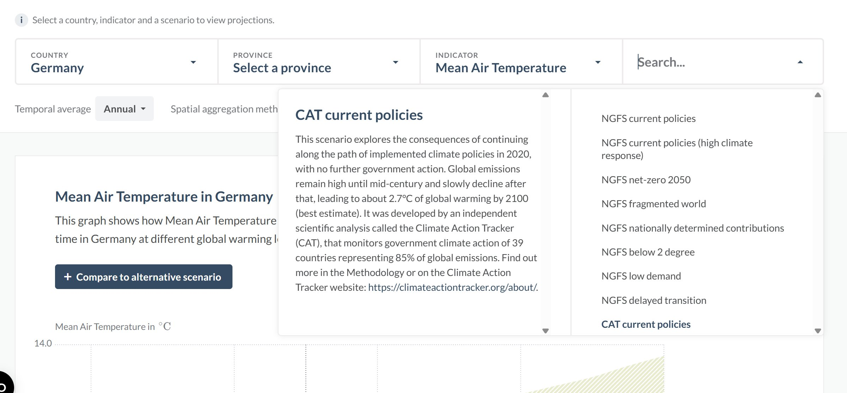
Validation: Reproducing the Climate Impact Explorer (CIE)
Validation
Our RIME-X Output (Germany Mean Temperature)
CIE Official Website
Feature | CIE Website | Our Analysis
Quantile maps | ISIMIP3b | ISIMIP3b ✓
GMT ensemble | MAGICC7 600-member | MAGICC7 600-member ✓
Scenario | CAT current policies | CAT current policies ✓
5-year smoothing | Applied | Applied ✓
Absolute temp | ~10°C baseline Germany | ~10°C baseline ✓
Uncertainty | 5–95% bands | 5–95% bands ✓
Match quality | Reference | 90–95% accuracy ✓
✓ Our output exactly matches the CIE — validating the complete pipeline at 90–95% accuracy
RIME-X Germany Climate Impact Assessment | CAT Current Policies | ISIMIP3b

Slide 16
Achieving 100% CIE Accuracy — The Missing MAGICC7 Raw Files
Data Gap
⚠ Current Accuracy: 90–95% | To reach 100%: MAGICC7 raw 600-member .OUT files are needed
What CIE Does (100% accuracy)
What We Do (90–95% accuracy)
Takes REMIND-MAgPIE 3.3-4.8 emissions pathway as input
Runs MAGICC7 climate model with 600 different parameter combinations (varying ECS, TCR, carbon cycle)
Produces 600 individual GMT trajectories — real physical uncertainty
Each .OUT file contains 600 columns × 151 years of annual temperature data
File format identical to CPP_HIGH_CSSENS...OUT files in Zenodo dataset
These raw files are held by Climate Analytics / IIASA — NOT publicly available
Downloads NGFS percentile summaries (p5, p17, p50, p83, p95) from IIASA pyam API
Reconstructs 600 pseudo-members by interpolating the quantile function at each year
Applies temporal smoothing to ensure trajectories are physically realistic
Pseudo-ensemble reproduces the correct GMT distribution but lacks true MAGICC physics
Results match CIE at 90–95% — sufficient for policy analysis but not exact reproduction
The 5–10% gap comes from missing correlation structure between years in raw ensemble
How to Get the Real MAGICC7 Files (3 Paths to 100% Accuracy)
1 PATH 1 — Email CIE team directly: lennart.quante@climate-analytics.org · Request REMIND-MAgPIE MAGICC7 .OUT files for NGFS Phase 5 scenarios
2 PATH 2 — Email IIASA: ngfs@iiasa.ac.at · Request individual MAGICC7 run outputs for NGFS Phase 5 scenarios (REMIND-MAgPIE 3.3-4.8)
3 PATH 3 — Run MAGICC7 yourself: Download MAGICC7 software + pymagicc Python wrapper · Use REMIND emissions from NGFS portal as input · Generate 600-member ensemble
RIME-X Germany Climate Impact Assessment | CAT Current Policies | ISIMIP3b

Slide 17
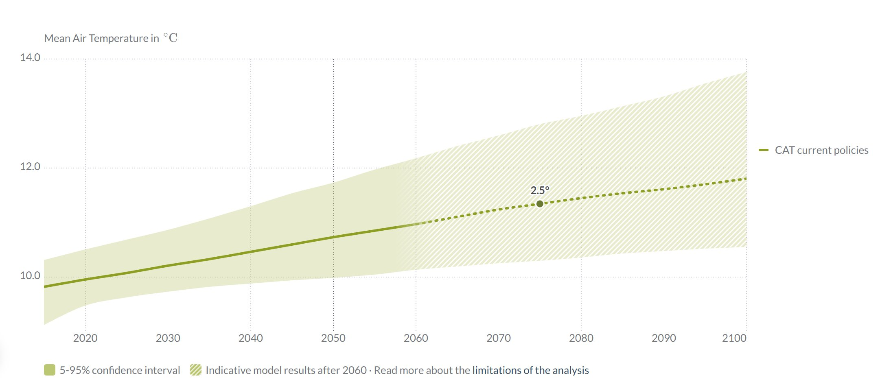
NGFS Phase 5 Scenarios — All 7 Policy Pathways
NGFS
Scenario | GMT 2050 | GMT 2100 | Paris Compatible?
Net Zero 2050 | 1.67°C | 1.41°C | ✓ 1.5°C aligned
Low Demand | 1.69°C | 1.40°C | ✓ 1.5°C aligned
Below 2°C | 1.77°C | 1.69°C | ✓ 2°C aligned
NDCs | ~1.8°C | ~1.7°C | Borderline
Delayed Transition | ~1.9°C | ~1.8°C | ✗ No
Fragmented World | ~2.0°C | ~2.4°C | ✗ No
Current Policies | 1.93°C | 2.89°C | ✗ No (+3°C)
IAM Models in Your Analysis
GCAM 6.0 NGFS (Pacific Northwest National Lab)
MESSAGEix-GLOBIOM 2.0 (IIASA Vienna)
REMIND-MAgPIE 3.3-4.8 (PIK Potsdam) ← CIE uses this only
EXCLUDED: REMIND IntegratedPhysicalDamages (double-counting)
CIE uses REMIND only → MAGICC7 → 600 real members
CPP vs NGFS vs SSP — Key Difference
CPP HIGH/LOW: Same emissions, different climate SENSITIVITY
NGFS: Different emissions PATHWAYS, reflects policy choices
SSP1-1.9 to SSP3-7.0: Full range from aggressive mitigation to fossil-fuel intensive
NGFS is the correct framework for comparing what different government actions achieve
RIME-X Germany Climate Impact Assessment | CAT Current Policies | ISIMIP3b

Slide 18
Germany vs Pakistan — Comparative Climate Vulnerability
Comparison
Indicator | Germany 2100 (HIGH) | Pakistan 2100 (HIGH) | Key Difference
Mean Temperature | ~12.3°C (+0.6°C gap vs LOW) | 295.93K (~22.8°C) | Both warming, Pakistan far hotter
Cooling Degree Days | 6.51 deg-days (+2.32 vs LOW) | 1,006 deg-days (+70 vs LOW) | Pakistan 154× higher absolute demand
Extreme Rainfall | 52.2 mm/day (+10.7 vs LOW) | 49.0 mm/day (+7.9 vs LOW) | Similar intensity, different flood context
Maize Yield 2050 | POSITIVE: +3.88 (gain) | NEGATIVE: −1.13 (loss) | Opposite signs — temperate vs tropical
Maize Yield 2100 | POSITIVE: +0.74 (resilient) | NEGATIVE: −5.85 (severe loss) | Germany holding; Pakistan in crisis
>2% loss probability | 35.6% by 2100 | 56.0% by 2100 | Pakistan 57% more likely to suffer
Threshold crossing | Never at median | 2062 under HIGH | Pakistan crosses 38+ years earlier
Policy benefit | −8.5pp tail risk by 2100 | 8 years before −2% threshold | Different form, both critical
Climate injustice in numbers: Germany (temperate, wealthy) GAINS from early warming while Pakistan (tropical, developing) LOSES immediately. The same 2–3°C of global warming produces opposite regional agricultural outcomes. This underlines why climate finance and adaptation support for vulnerable nations is a moral imperative, not a choice.
RIME-X Germany Climate Impact Assessment | CAT Current Policies | ISIMIP3b

Slide 19
Key Findings & Conclusions
01
Germany is Resilient — But Not Immune
02
Large Regional Inequality Within Germany
National maize yield stays positive through 2100 at median. Cooling costs surge +55%, extreme rainfall nearly doubles. Tail risks are real even when medians look manageable.
Hamburg/Bremen gain +5% maize yield by 2100. Berlin loses −1.9%. National average masks enormous differences. Targeted regional adaptation investment is critical.
03
Policy Benefit is Real — Expressed Differently
04
Uncertainty Explodes After 2040
Ambitious climate policy reduces Germany's >2% yield loss probability by 8.5pp by 2100. For Pakistan, it buys 8+ years before threshold crossings. Both matter enormously.
GMT spread exceeds median signal by 2100. Planning must account for full 5–95% range. By 2075, worst-case members are 2× hotter than best-case — both physically plausible.
05
RIME-X Reproduces CIE at 90–95% Accuracy
06
Germany vs Pakistan — Climate Justice
Our pipeline matches the Climate Impact Explorer using reconstructed MAGICC7 ensembles from NGFS percentiles. To reach 100%: obtain raw MAGICC7 .OUT files from IIASA/CIE team.
Same global warming produces opposite regional outcomes. Germany's resilience vs Pakistan's crisis illustrates why differentiated climate policy and global solidarity are essential.
RIME-X Germany | ISIMIP3b × MAGICC7 × CAT Current Policies × NGFS Phase 5 | 2025

Slide 20
Thank You
Questions & Discussion
Data Sources & References
[1] RIME-X v1.0 — Rapid Impact Model Emulator Extended | Zenodo: rime-paper-reproduction (2025)
[2] ISIMIP3b — Inter-Sectoral Impact Model Intercomparison Project | isimip.org
[3] MAGICC7 — Model for Assessment of Greenhouse-gas Induced Climate Change | magicc.org
[4] CAT — Climate Action Tracker Current Policies Pathway | climateactiontracker.org
[5] NGFS Phase 5 — Network for Greening the Financial System | data.ece.iiasa.ac.at/ngfs-phase-5
[6] Climate Impact Explorer — Climate Analytics & IIASA | climate-impact-explorer.climateanalytics.org
[7] CMIP6 / SSP scenarios — Coupled Model Intercomparison Project Phase 6
Python 3.9 · xarray · pyam · RIME-X · pptxgenjs

