Slide 1
Dental data pack
July 2021

Slide 2
Calendar data explanation
Slides 4-7 & 10-11 are based on calendar month data
Calendar data is based on courses of treatment completed within a entire month, for example 1st February to 28th Feb
For calendar data if a COT was completed in February but not declared till March, that activity would still be registered as occurring in February.
Scheduled data explanation
Slides 8 and 9 are based on scheduled data​​
​
The scheduling time period is usually between the 20th of one month and the 20th of the next month i.e., 21st April to the 19th May. That means that any Mandatory contract COT completed after this period will not be included in the May scheduled data. However, if for example a COT was completed on May 1st, but reported to the BSA after the end of the reporting period (April 21st – May 19th), that activity would go into the following scheduled period. As a result, the scheduling period can be considered fixed. ​

Slide 3
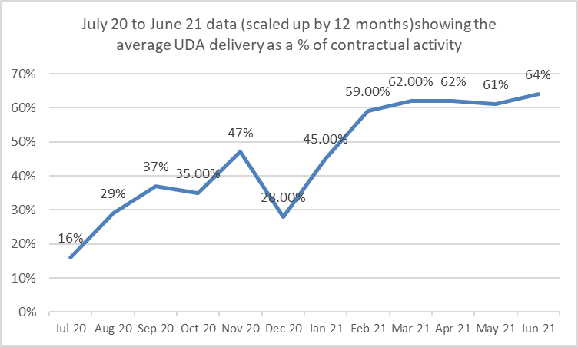
UDA delivery July-20 to June-21
This graph shows the average UDA delivery as a % of contracted activity when each month has been scaled up to 12 months.​ The graph uses scheduled data to measure the activity.
The table below shows the proportion of practices delivering between a certain % group of contracted UDA activity from July 2020 to June 2021 if performance for that month is annualised.​​ As with the graph the table uses scheduled data.
[note – schedule April data]

