Slide 1
SMT Dental Data Pack - changes
NHS England and NHS Improvement

Slide 2
Contents
Calendar data 2021/2022 (explanation slide 3)
April to September data only:
UDA contracts achieving 60% (4)
UOA contracts achieving 80% (6)
Scheduled data activity slides (explanation slide 3)
Total UDA activity scales up by 12 (5)
Total UOA activity scaled up by 12 (7)
Historic banded Courses of Treatment comparison (8)
Total urgent FP17 form count 2019/2020 to 2020/2021 (9)
Please Note: Slides 4 and 6 use calendar data as a measure of activity for the first half of the 2021-2022 year. Slides 5, 7 and 8-9 use scheduled data, as per previous SMT data packs. The scheduled data is from 16th June – 16th July and is fixed.

Slide 3
Calendar data explanation
Slides 4 & 6 are based on calendar month data
Calendar data is based on courses of treatment completed within an entire month, for example 1st February to 28th Feb
For calendar data if a COT was completed in February but not declared till March, that activity would still be registered as occurring in February.
Calculation has changed from last month- rather than taking an average of all providers percentage activity to date, the activity % is now based on total number of UDA/Os delivered as a % of the total number of UDA/Os expected by September (60%/80% threshold).
Scheduled data explanation
Slides 5,7, 8 and 9 are based on scheduled data
The scheduling time period is usually between the 20th of one month and the 20th of the next month i.e., 21st April to the 19th May. That means that any Mandatory contract COT completed after this period will not be included in the May scheduled data. However, if for example a COT was completed on May 1st, but reported to the BSA after the end of the reporting period (April 21st – May 19th), that activity would go into the following scheduled period. As a result, the scheduling period can be considered fixed.

Slide 4
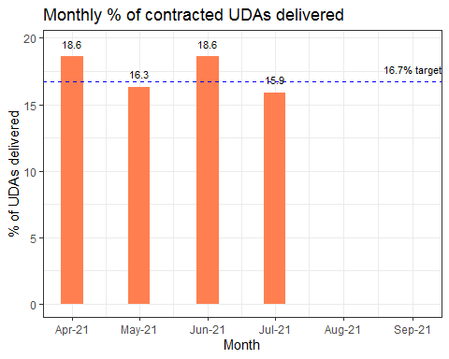
UDA activity data for 2021/2022

Slide 5
This chart shows the average monthly performance of the 6851 GDS/PDS/PDS+ contracts (with annual contracted UDAs of greater than or equal to 100) measured against the minimum activity required (16.7%) to reach the 60% threshold by September.
In the month of July 3089 contracts (45%) achieved at least 16.7% towards their 60% threshold (if they achieved this each month then they would reach 60% in September)

Slide 6
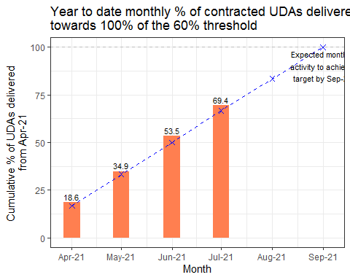
UDA cumulative activity data for 2021/2022

Slide 7
This chart shows the cumulative (Year-to-date) activity of the 6851 GDS/PDS/PDS+ contracts) measured against the expected monthly total activity to achieve the 60% threshold by September. The graph measures the total cumulative UDAs performed divided by the total expected activity of the 60% threshold.
From April to July 4282 contracts (62%) are at least two thirds towards delivering the 60% threshold.

Slide 8
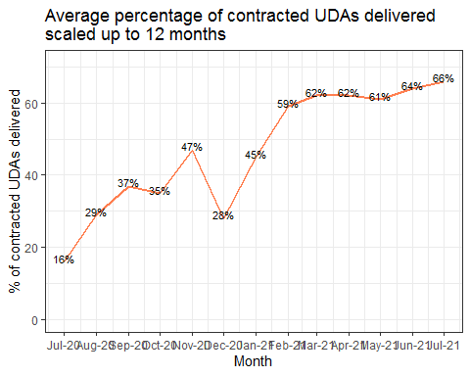
UDA delivery July-20 to July-21

Slide 9
This graph shows the average UDA delivery as a % of contracted activity when each month has been scaled up to 12 months. The graph uses scheduled data to measure the activity
The table below shows the proportion of practices delivering between a certain % group of contracted UDA activity from July 2020 to July 2021 if performance for that month is annualised. As with the graph the table uses scheduled data.

Slide 10
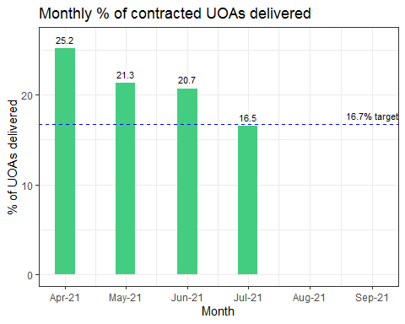
UOA activity data for 2021/2022

Slide 11
This chart shows the average monthly performance of the 757 GDS/PDS contracts (with annual contracted UDAs of greater than or equal to 100) measured against the minimum activity required (16.7%) to reach the 80% threshold by September
In the month of July 230 contracts (30%) achieved at least 16.7% towards their 80% threshold (if they achieved this each month then they would reach 80% in September)

Slide 12
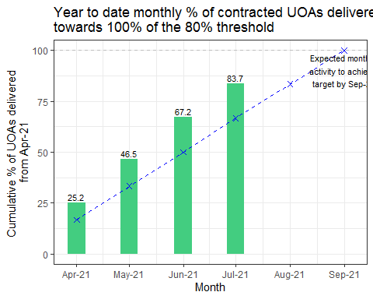
UOA cumulative activity data for 2021/2022

Slide 13
This chart shows the cumulative (Year-to-date) average activity of the 757 GDS/PDS contracts) measured against the expected monthly activity to achieve the 80% threshold by September. The graph measures the total cumulative UOAs performed divided by the total expected activity of the 80% threshold.
From April to July 359 contracts (47%) are at least two thirds towards delivering the 80% threshold

Slide 14
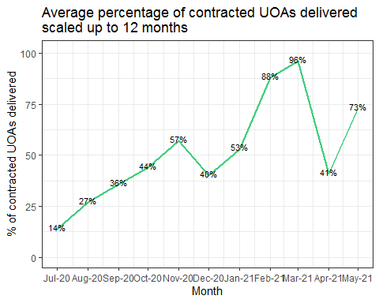
UOA delivery July-20 to July-21

Slide 15
This graph shows the average UOA delivery as a % of contracted activity when each month has been scaled up to 12 months. The graph uses scheduled data to measure the activity.
The table below shows the proportion of practices delivering between a certain % group of contracted UOA activity from July 2020 to July 2021 if performance for that month is annualised. As with the graph the table uses scheduled data.

Slide 16
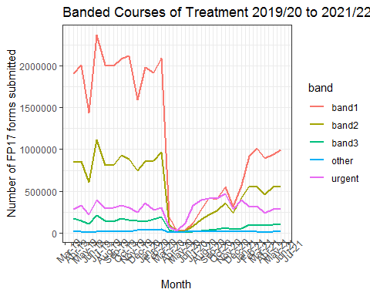
Time series of banded Courses of Treatment 2019-20 to 2021-22

Slide 17
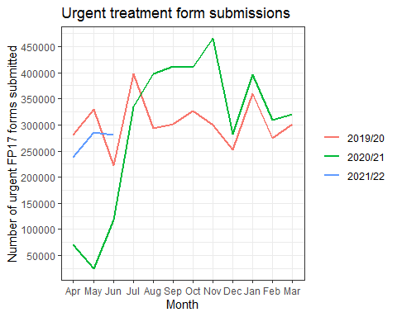
Urgent treatment form submissions in July 2021 saw an increase from June 2021

Slide 18
This graph shows the number of urgent treatment forms declared per month from April to March in both 2019/2020 and 2020/2021, and just for April to July in 2021/2022.
The urgent treatment form count in July 2021 was 356,885, whilst in July 2019-20 this number was 395,931, which is a 10% decrease from the pre-COVID world.

