Slide 1
Dental Health Inequalities
NHS England and NHS Improvement

Slide 2
Ethnicty breakdown

Slide 3
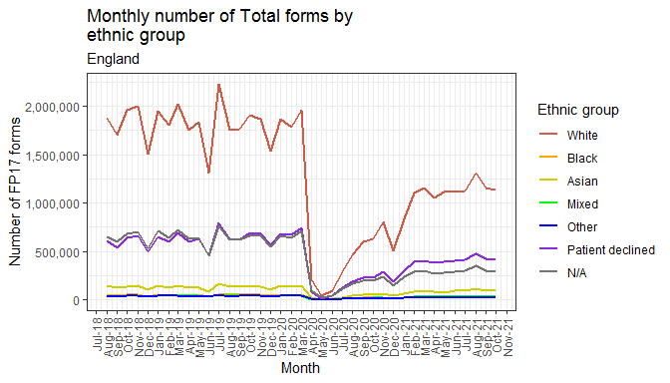
Total FP17s by ethnic group

Slide 4
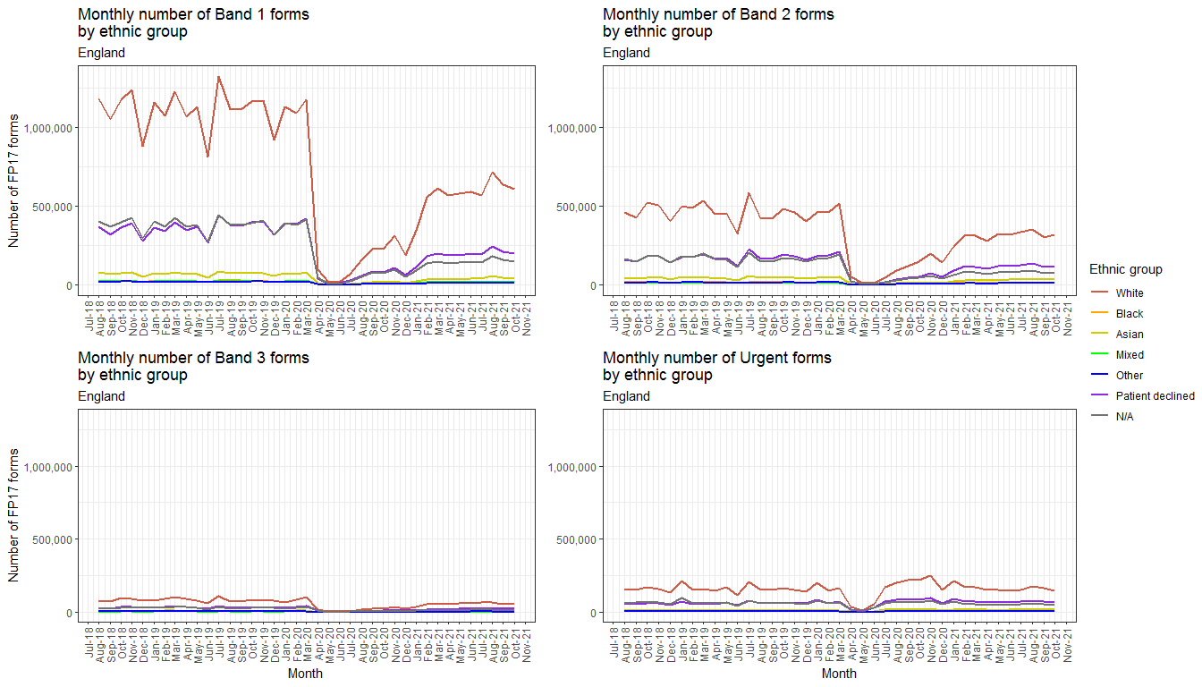
Banded FP17s by ethnic group

Slide 5
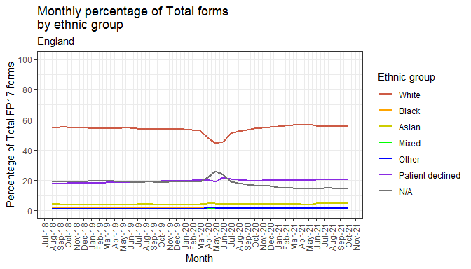
Percentage of total FP17s by ethnic group

Slide 6
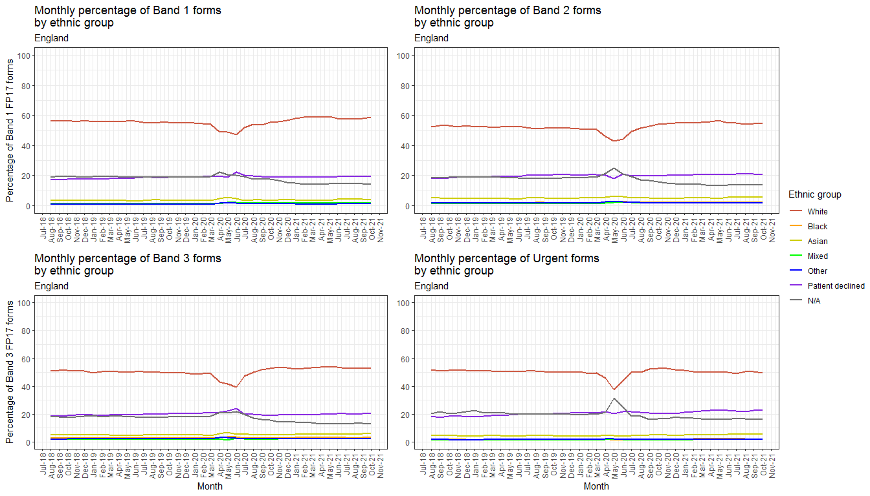
Banded ercentage of total FP17s by ethnic group

Slide 7
Gender breakdown

Slide 8
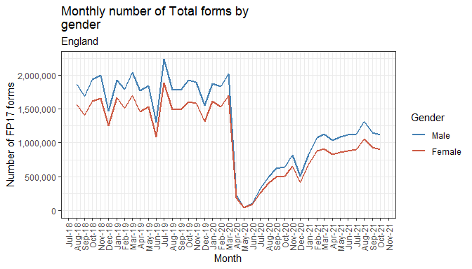
Total FP17s by gender

Slide 9
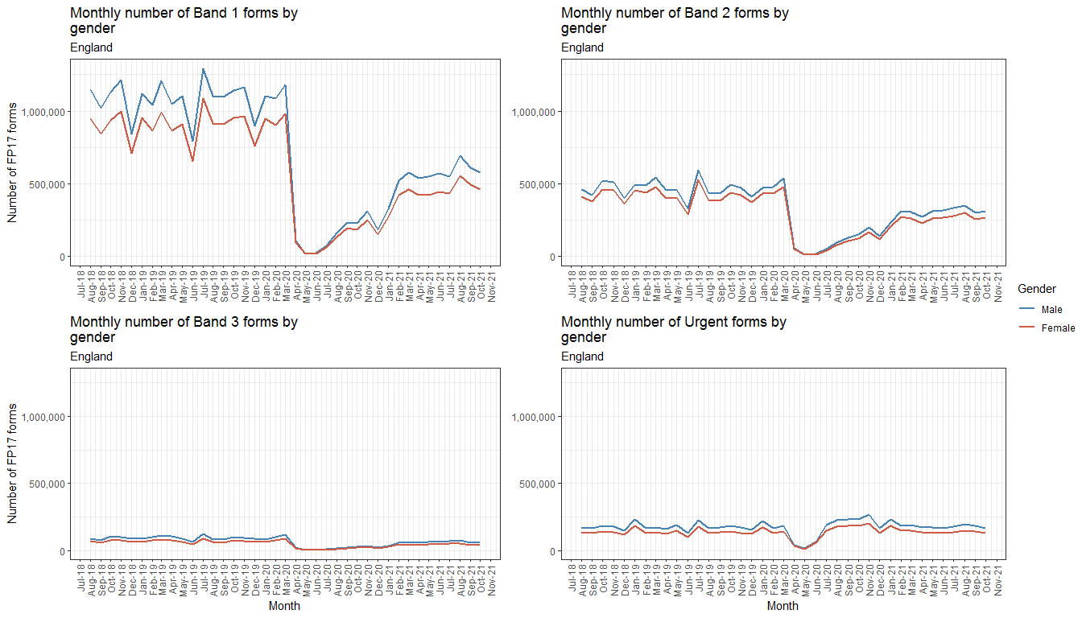
Banded FP17s by gender

Slide 10
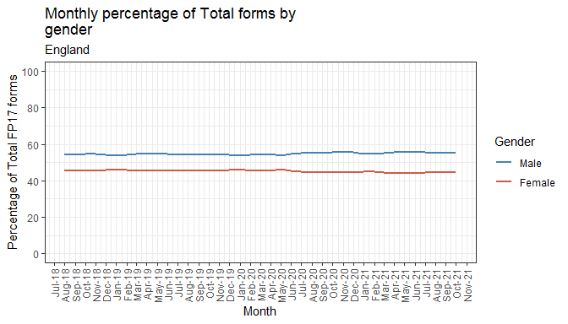
Percentage of total FP17s by gender

Slide 11
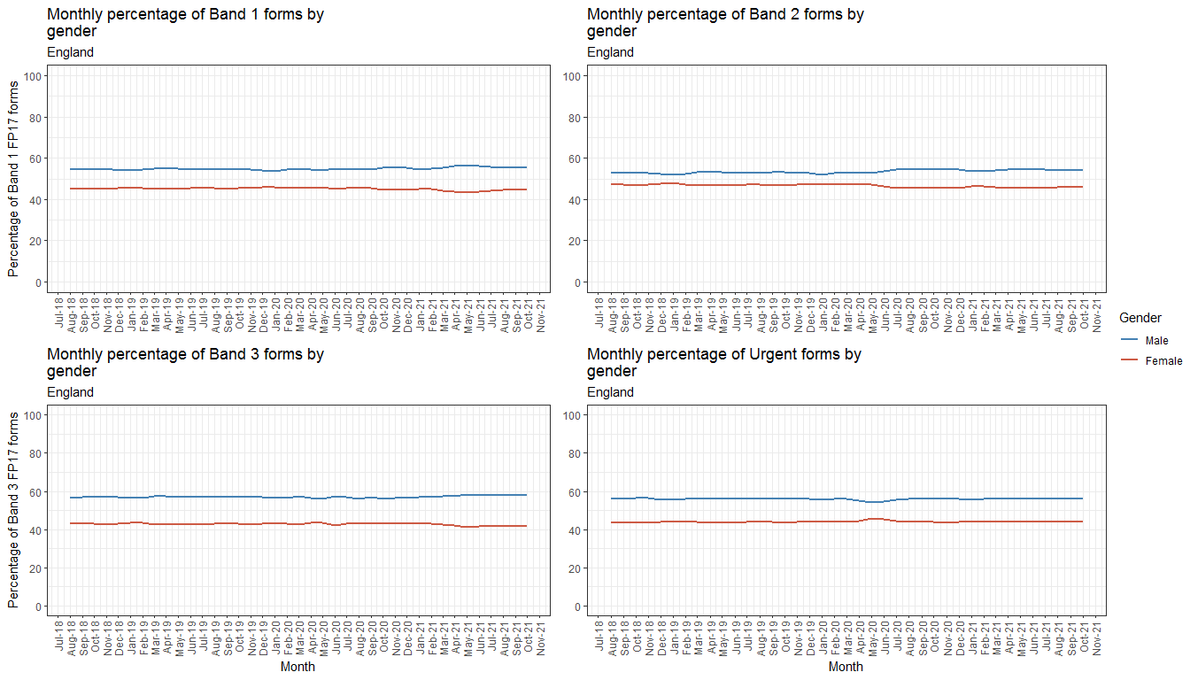
Percentage of banded FP17s by gender

Slide 12
Patientcharge status breakdown

Slide 13
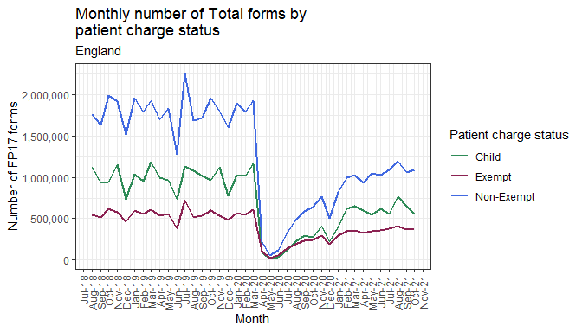
Total FP17s by patient charge status

Slide 14
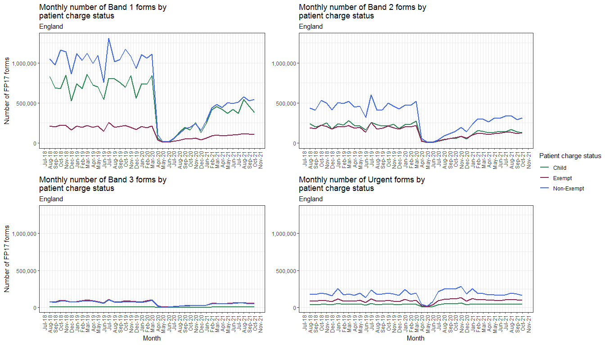
Banded FP17s by patient charge status

Slide 15
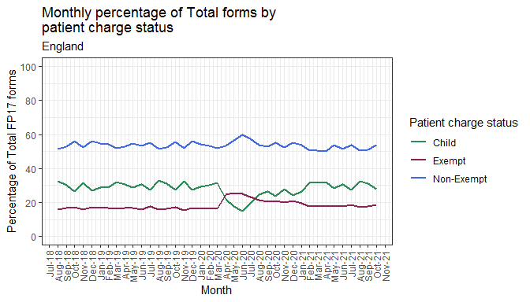
Percentage of total FP17s by patient charge status

Slide 16
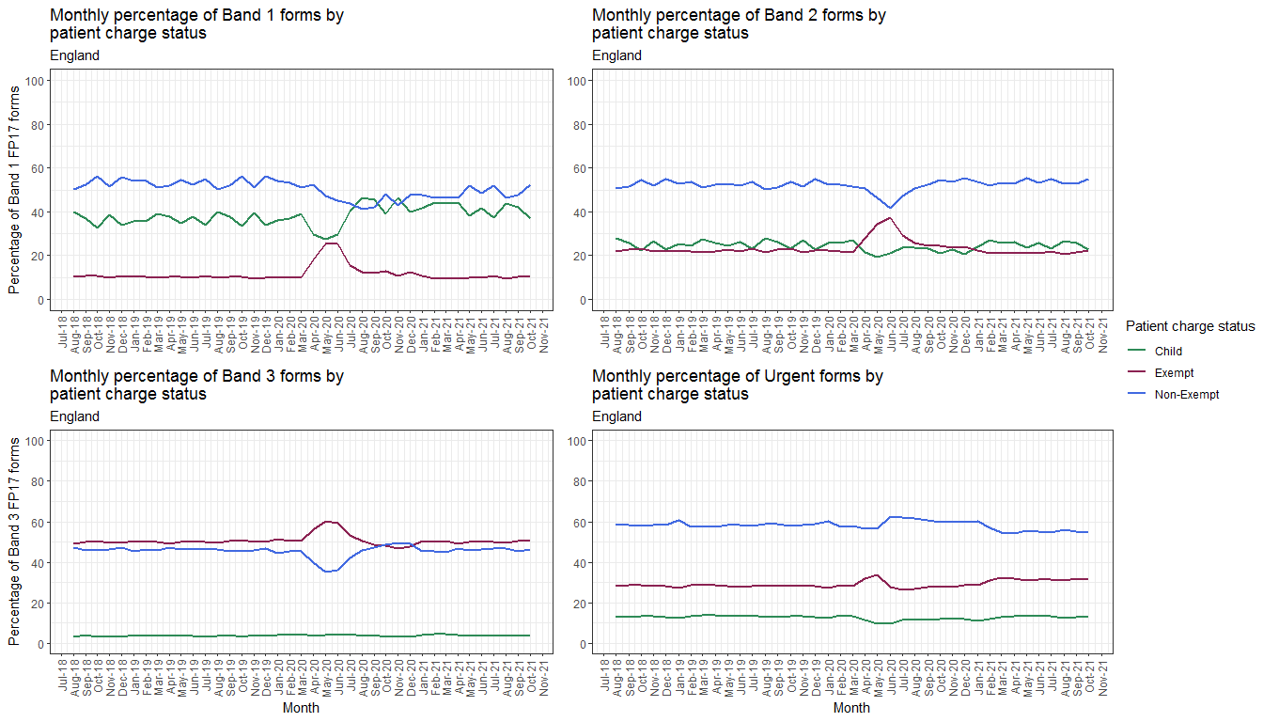
Percentage of banded FP17s by patient charge status

Slide 17
Exemption/remission type breakdown

Slide 18
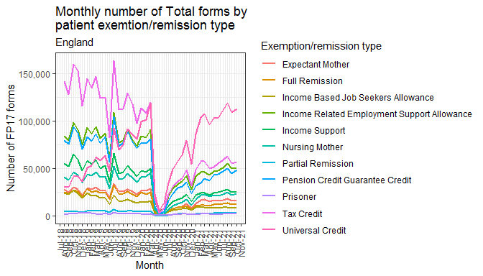
Total FP17s by patient exemption/remission type

Slide 19
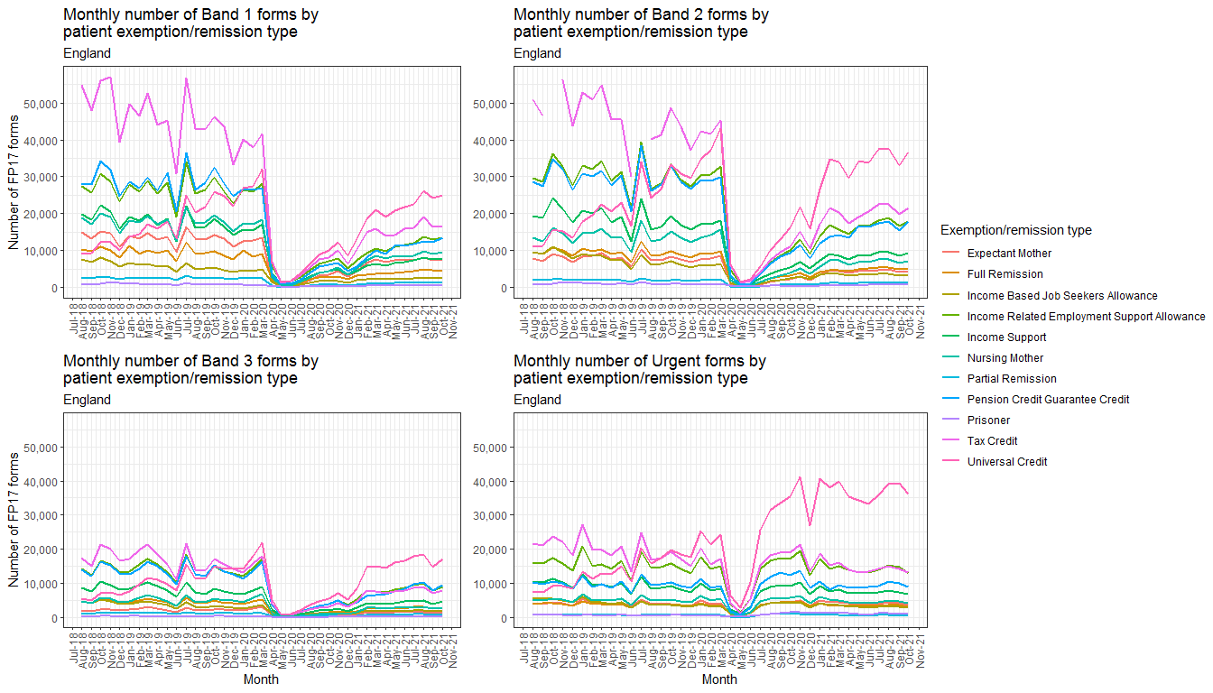
Banded FP17s by patient exemption/remission type

Slide 20
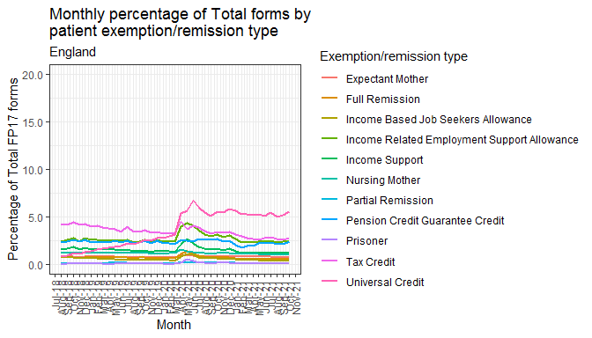
Percentage of total FP17s by exemption/remission type

Slide 21
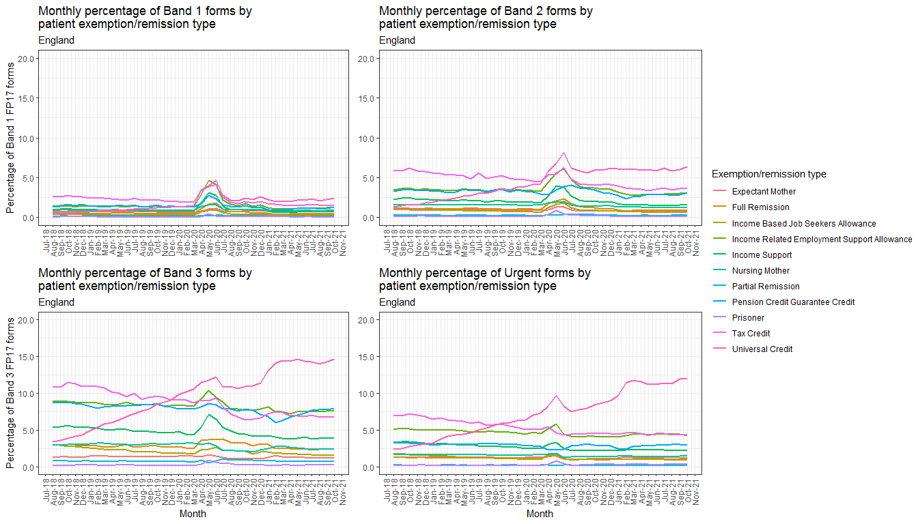
Percentage of banded FP17s by exemption/remission type

Slide 22
Age group breakdown

Slide 23
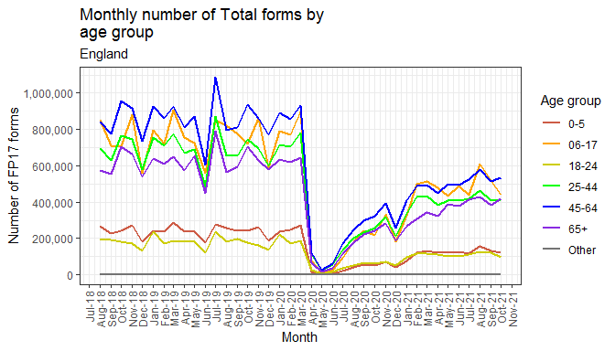
Total FP17s by age group

Slide 24
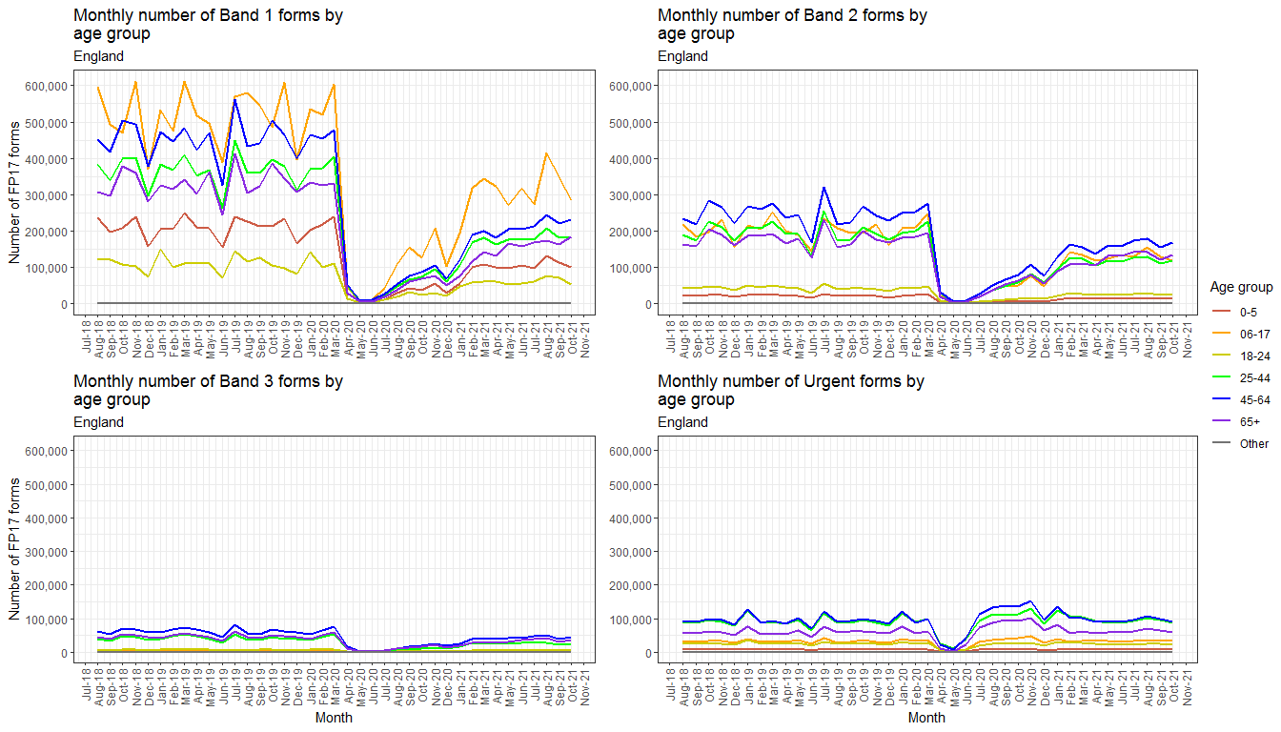
Banded FP17s by patient age group

Slide 25
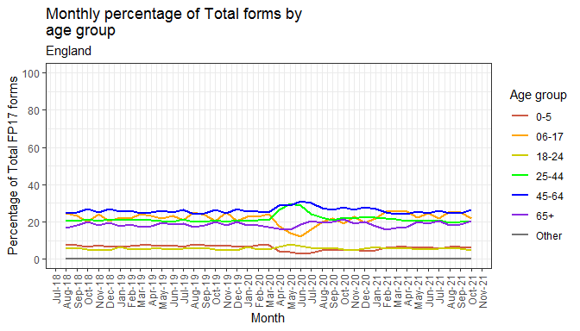
Percentage of total FP17s by age group

Slide 26
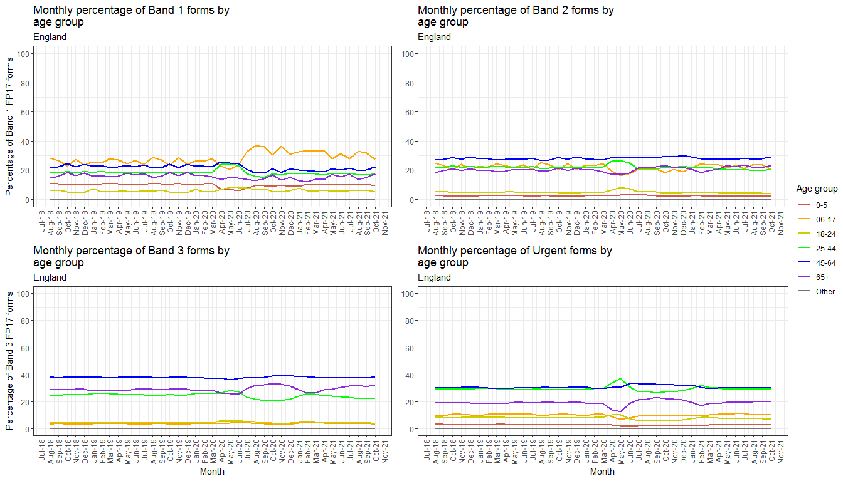
Percentage of banded FP17s by age group

