Slide 1
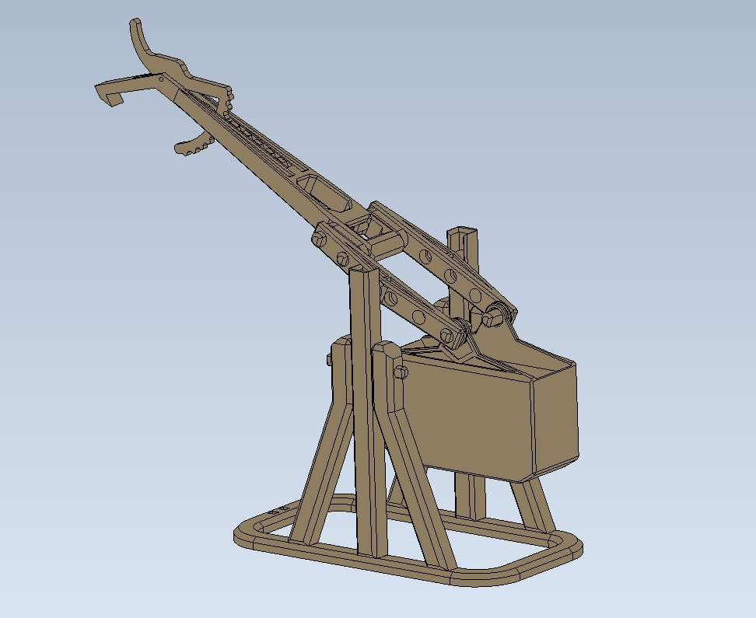
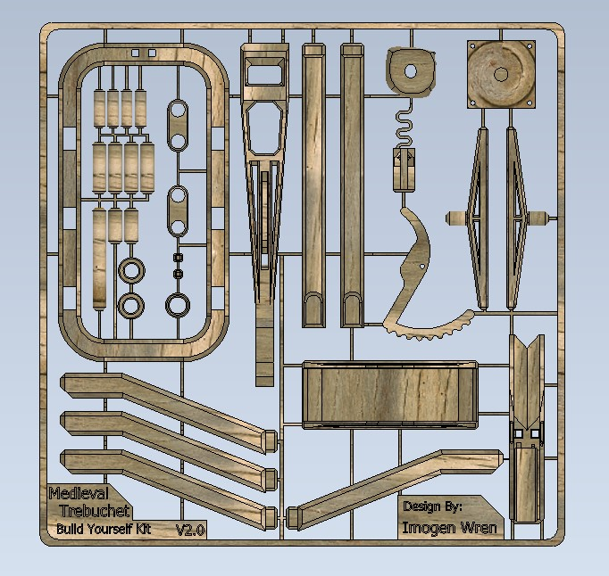
Medieval Style Trebuchet: Assembly Instructions

Slide 2
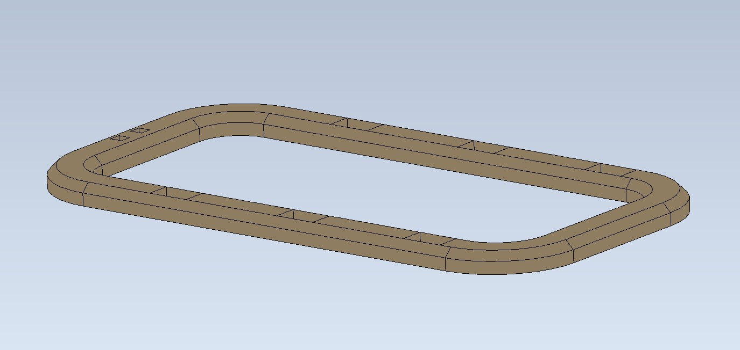
Step 1: Place ground plate

Slide 3
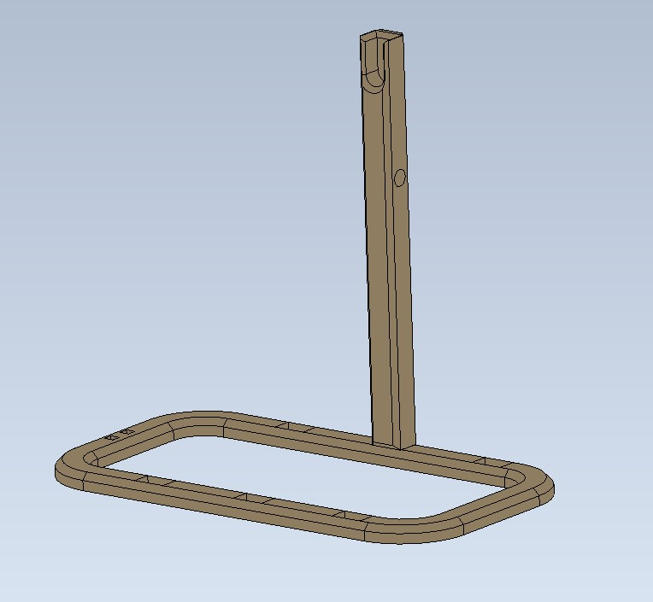
Step 2: Insert Vertical Upright

Slide 4
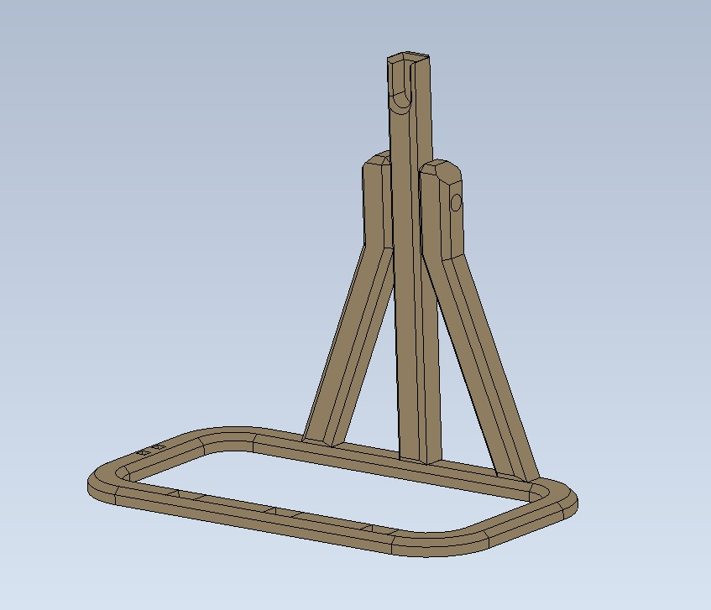
Step 3: Insert A-frame pieces

Slide 5
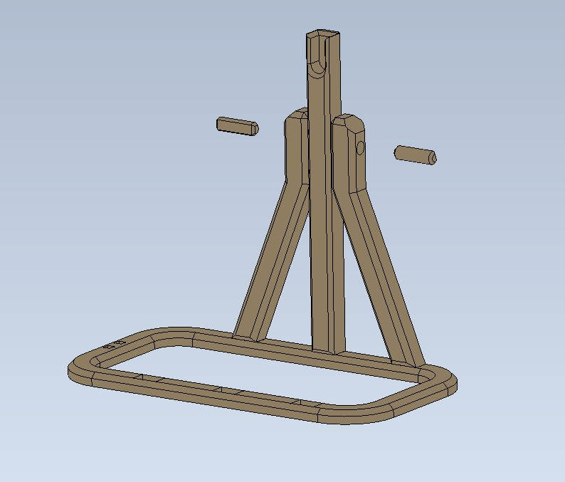
Step 4: Insert 2x
5*17mm pegs

Slide 6
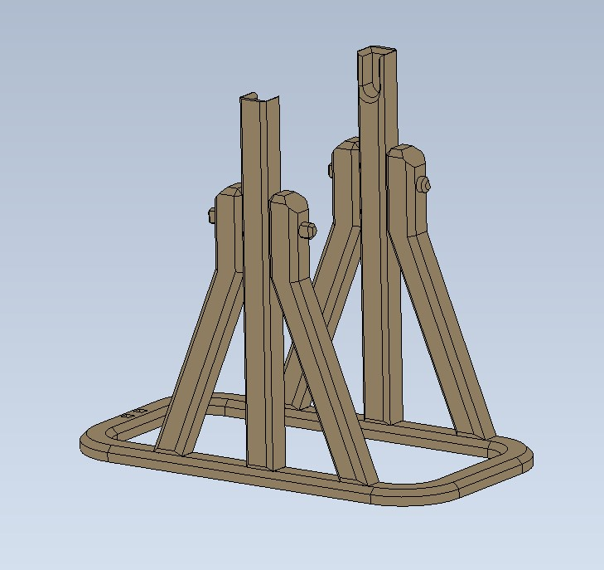
Step 5: Repeat process for other upright
then
Place assembly to side to build throwing arm

Slide 7
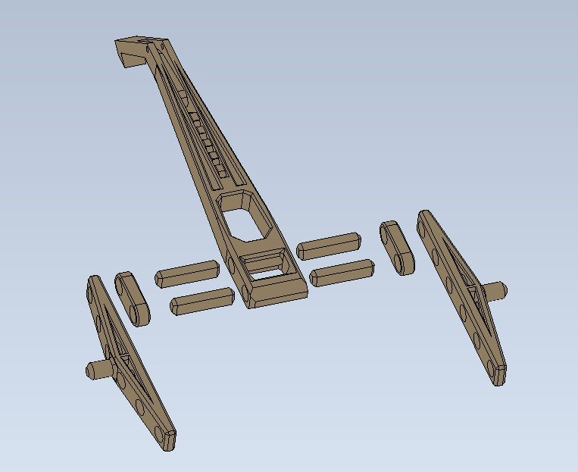
Step 6: Assemble throwing arm as shown using
4x
6*23mm pegs

Slide 8
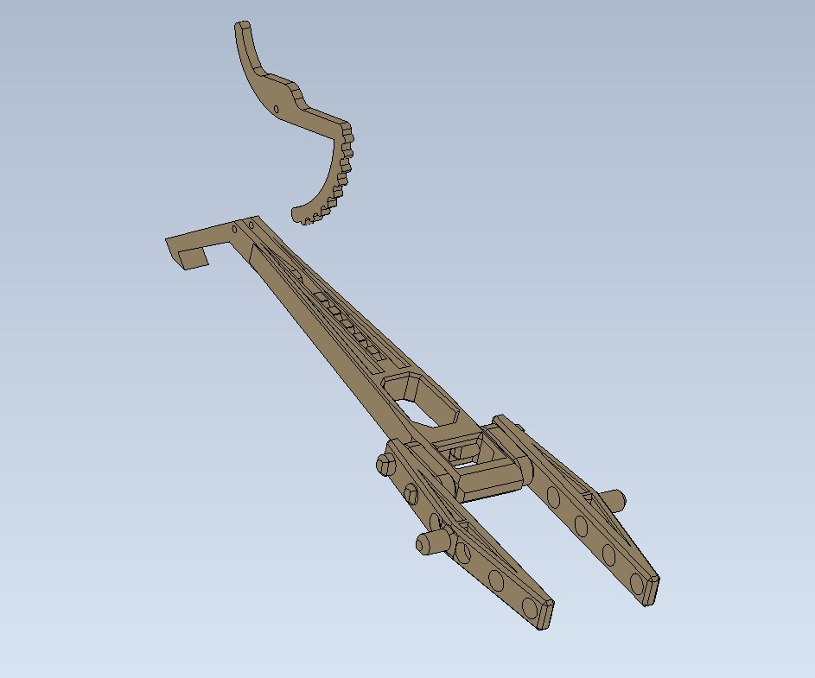
Step 7: Insert ratchet mechanism in slot shown. Use 1.75mm filament offcut to secure pivot point

Slide 9
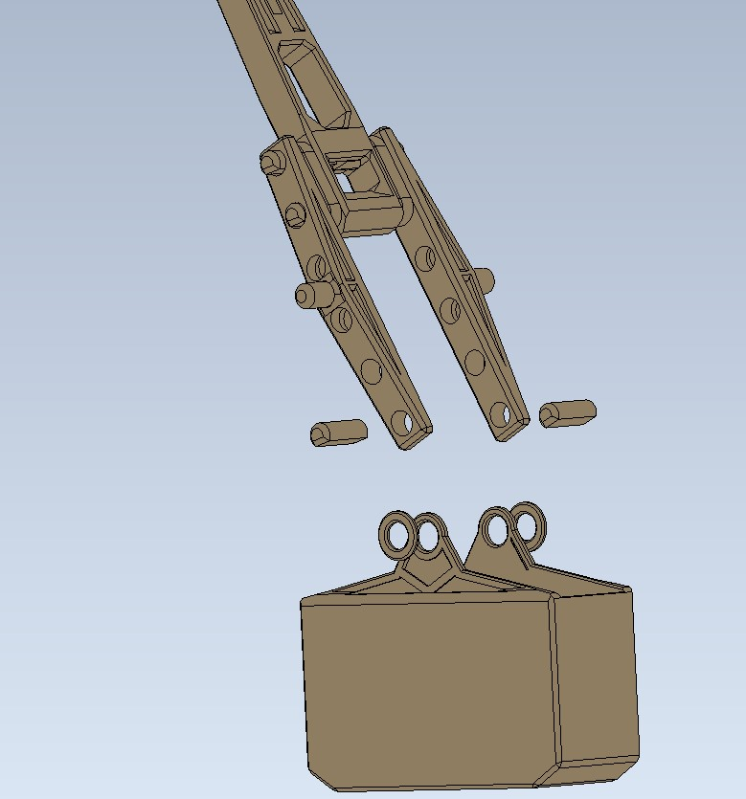
Step 8: Secure Counterweight to throw arm assembly using 2x
6*16mm pegs
Washers should be placed between counterweight and throw arm assembly to allow free rotation of counterweight

Slide 10
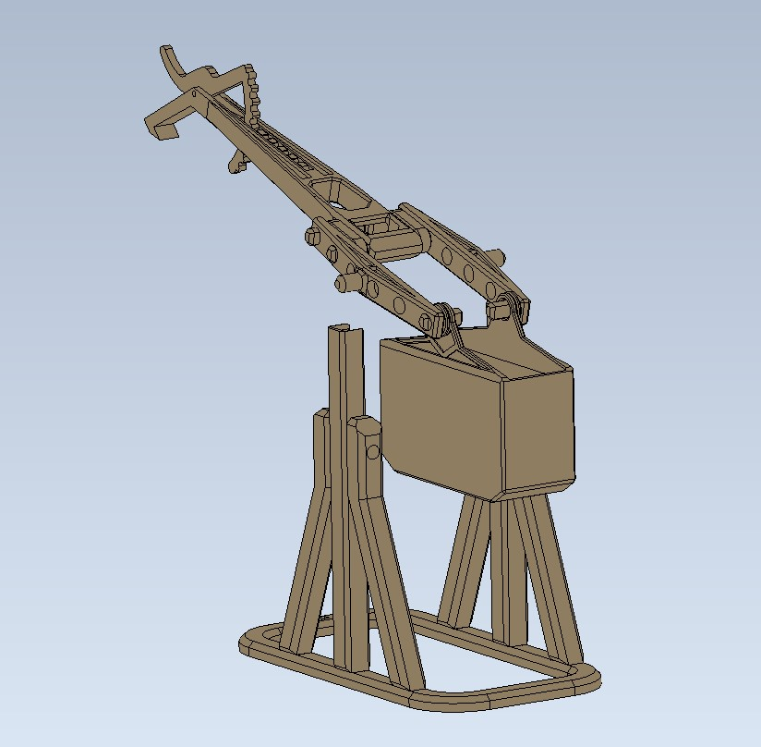
Step 9:
Place throw arm assembly on base assembly Place weights (coins, screws, lead shot etc) in empty counterweight ≥ 200g
(The more weight added the better the trebuchet will work)
~200g

Slide 11
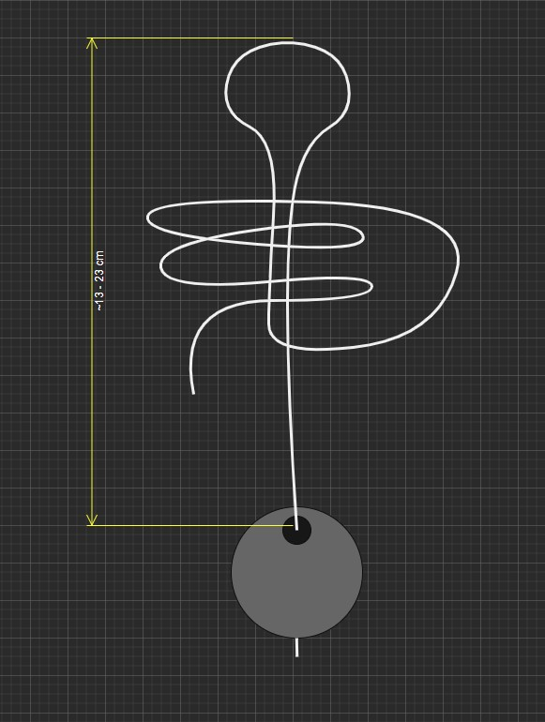
Step 10:
Tie string to boulder using any method. Create loop in free end and tie slip knot as shown, such that the length of the finished string, including loop is between approximately 13, and 23cm String length can be adjusted by moving position of slip knot

Slide 12
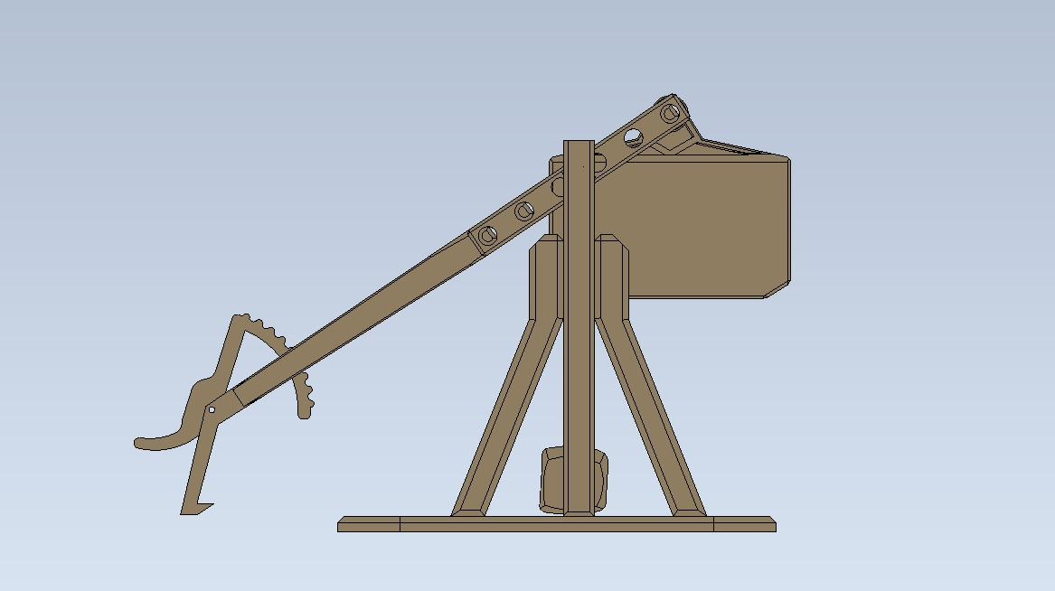
Step 11:
Place free loop of string over the adjustable angle throwing pin (A)
Set release angle using ratchet mechanism B
Place boulder in throwing position (as shown C)
Aim trebuchet at target
Pull back to full extent available, and release to launch boulder
Warning! Use Trebuchet Responsibly
- Do not launch at pets!
- Not suitable for conducting Siege warfare
A
B
C

