Slide 1

Multi-variate time series classification with specialized kernels
Advanced Topics in Machine Learning
Data Science and Scientific Computing
Final Project
Imola Fodor SM3500474
21/09/2023

Slide 2
Introduction
Dataset
Unstructured data such as graphs, time-series, networks require specific systems to be modelled, if not summarized by expert’s feature vectors.
One technology that enables this are kernels, i.e. projecting the input into a space, where classification/regression can be performed, indirectly modelling raw data.
In this work approaches to Multi-variate Time-series Classification(MTS) with template-extraction are presented. MTS can usually be viewed as consisting of multiple Uni-variate Time-series (UTS)

Slide 3
Agenda
Dataset
Overview of methods from research
Approach 1. Extended Frobenius norm as Gram matrix
Approach 2. Feature vector derived from Gram matrix
Approach 3. Fisher Kernel as Gram Matrix
Results

Slide 4
Overview of methods from research
Linear Time Warping Kernel - LTW
Dynamic Time Warping Kernel - DTW
SAX Kernels
Global Alignment Kernel -GA
Better than above, but for long series better the LTW
Fisher Kernels (Approach 3.)
Extended Frobenius norm – Keros (Approach 1.)
Feature vector with Kernel + Manifold (Approach 2.)

Slide 5

Approach 1. Extended Frobenius norm as Gram matrix
The Extended Frobenius norm (Eros) computes the similarity between two matrices using the principal components (PCs).
With PCs, directions where orthogonal projections of data points are maximized are identified.
It has been asserted that the Gram matrix is symmetric positive definite.
Using the dual form of an SVM Classifier, we can use the similarity matrix $NxN$, where$N$is the number of series, as the Gram matrix, i.e. kernel matrix in the decision function.
In inference, we use the support vectors to construct the Kernel with the new test point.
Notes:
The Extended Frobenius norm (Eros) computes the similarity between two matrices using the principal components (PCs), i.e., the eigenvectors of either the covariance or the correlation coefficient matrices, and the eigenvalues as weights. Since correlation would give a shift invariant measure, for this work, the covariance matrix is used.
PCA is a process to identify the directions, i.e., principal components (PCs), where the variances of scores (orthogonal projections of data points onto the directions) are maximized and the residual errors are minimized assuming the least square distance. These directions, in non-increasing order, explain the variations underlying original data points; the first principal component describes the maximum variation, the subsequent direction explains the next maximum variance and so on.
Geometrically, the principal component is a linear transformation of original variables and the coefficients defining this transformation are called loadings.

Slide 6

Approach 1. Extended Frobenius norm as Gram matrix
Each cell of the Gram matrix, $K(x,x′)$is the Eros similarity for MTS series $A$ and $B$ with $n$ sensors:
$$Eros\left(V_{A},V_{B},w\right)=\sum_{i=1}^{n}{w_{i}}{\left|<a_{i},b_{i}>\right|}_{1}=\sum_{i=1}^{n}{w_{i}}|cosθ_{i}|$$
, where $V_{A}$ and $V_{B}$ are the two right eigenvector matrices obtained by applying SVD to the covariance matrices of $A$ and $B$ respectively. $V_{A}=[a_{1}, a_{2},..a_{n}]$, where $a_{i}$is a column orthonormal vector, idem for $V_{B}$.
The weight vector of $D$ entries is unique for all $K\left(x, x′\right)$ and it’s calculated by:
Create $S$, an $n x N$matrix, where each column is the vector of eigenvalues for the given series.
Aggregate values in each row of S by averaging and construct the w vector from the means. Successively normalize the vector.
Notes:
The Extended Frobenius norm (Eros) computes the similarity between two matrices using the principal components (PCs), i.e., the eigenvectors of either the covariance or the correlation coefficient matrices, and the eigenvalues as weights. Since correlation would give a shift invariant measure, for this work, the covariance matrix is used.
PCA is a process to identify the directions, i.e., principal components (PCs), where the variances of scores (orthogonal projections of data points onto the directions) are maximized and the residual errors are minimized assuming the least square distance. These directions, in non-increasing order, explain the variations underlying original data points; the first principal component describes the maximum variation, the subsequent direction explains the next maximum variance and so on.
Geometrically, the principal component is a linear transformation of original variables and the coefficients defining this transformation are called loadings.

Slide 7

Approach 2. Feature vector derived from Gram matrix
Compute Gram matrix for each MTS ( compare UTS-s)
Map matrix into tangent space of Riemannian manifold
Use vector as feature vector in SVM primal form Classification
For linear kernel:
$$K\left(x,x’\right)= σ_{b}^{2}+ σ^{2}\left(x − c\right)\left(x^{′} −c\right)$$
Or, e.g., for Gaussian kernel:
$$K\left(x,x’\right)= σ^{2}exp\left(− \frac{\left\|x−x′\right\|}{2l^{2}}\right)$$
where $σ$, $σ_{b}$,$l$, $c$ are the associated parameters.
Finally, the feature vector is:
$$z=\log\left(K\right)=M^{1/2}\log\left(M^{\frac{1}{2}} K{ M}^{\frac{1}{2}}\right)M^{1/2}$$
, where M is the mean of the kernel matrices on the manifold M
Notes:
This approach extracts vectors that can be used as features in the SVM’s primal formulation. After computing a Kernel which represents similarity between the dimensions of the MTS, the kernel matrix is mapped into the tangent space of Riemannian manifold and the vector from that space is used as the feature vector

Slide 8

Approach 3. Fisher Kernel as Gram Matrix
Generate the probabilistic model, the Gaussian Mixture Model (GMM), that explains the training data $P\left(X | θ\right)$. Training data being all the $n$ inputs of all the MTS of the set $\{X_{1}, X_{2},…, X_{N}\}$. Then the likelihood that a specific sequence X of length $n$ has been generated by class c is $P\left(X | Class=c\right)= \prod_{i=1}^{n}{p\left(x_{i}\right|Class=c).}$
Calculate $U_{X}=Δlog⁡(P(X|θ))$ w.r.t. to each parameter in $θ$.
Get a feature vector 6x1 parameters if the generative model is a GMM for two classes, K = 2. The three params in $θ$ being prior probability for each mixture Gaussian, each component of the mean vector $µ_{l}$and the diagonal covariance matrix $Σ_{l,c}$.
3. Fisher Kernel
$$K\left(x,x^{′}\right)=U_{X}^{T}IU_{X^{′}}^{ }$$
,where I is the Fisher information matrix.
Notes:
This approach extracts vectors that can be used as features in the SVM’s primal formulation. After computing a Kernel which represents similarity between the dimensions of the MTS, the kernel matrix is mapped into the tangent space of Riemannian manifold and the vector from that space is used as the feature vector

Slide 9
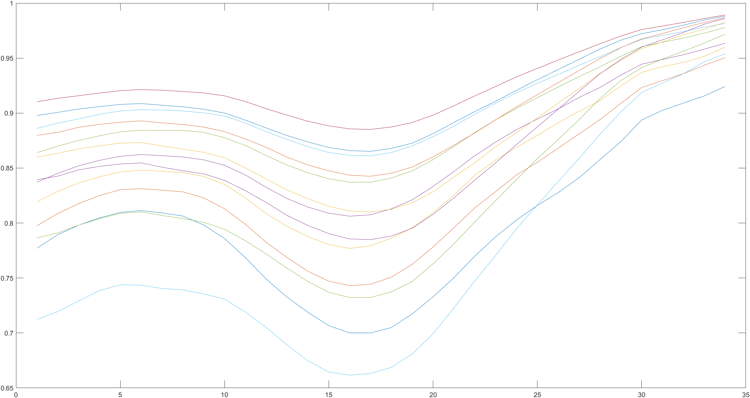
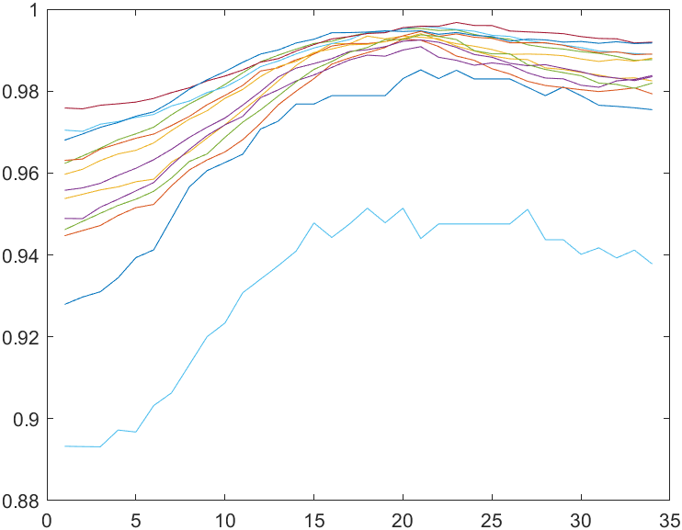
Data
Each datapoint (experiment) is a Multivariate Time-series acquired from n = 13 sensors. Each experiment is performed in one of the two conditions.
The raw data has been normalized by dividing each univariate series by its own max value. Further, a moving mean was performed.
Category 2. sample
Category 1. sample

Slide 10
Results
Implementation can be found at https://github.com/ImolaFodor/MTS-Classification-Kernels , written in Matlab.
 | 1. Keros Kernel | 2. Feature vector in M | 3. Fisher Kernel
Correctly classified | 0/4 | 4/4 | 0/4

Slide 11
Bibliography
Approach 1. A PCA-based Similarity Measure for Multivariate Time
Series by Yang and Shahabi, 2004
Approach 2. Multivariate time series classification using kernel matrix by Jiancheng Sun, Huimin Niu, 2022
Approach 3. "USING THE FISHER KERNEL METHOD FOR WEB AUDIO CLASSIFICATION" by Pedro J. Moreno and Ryan Rifkin, 2000
Kernel Methods for Time Series Classification and Regression by Mourtadha Badiane et al.
Video lectures of Julien Mairal and collaborators.

Slide 12
Thank you for the attention!

