Slide 1
Fetch
Key points to remember

Slide 2
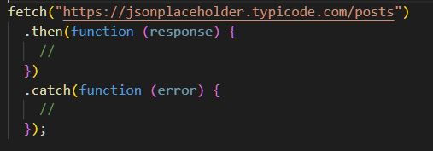
What is a fetch?
Fetch is a promise based Javascript API for making asynchronous HTTP requests. It is a clean, simple, powerful and a flexible API to get/send data from/to a server.
Note- The Response returned by the fetch() method contains the information about the request and the response of the network request including headers, status code, and status message

Slide 3
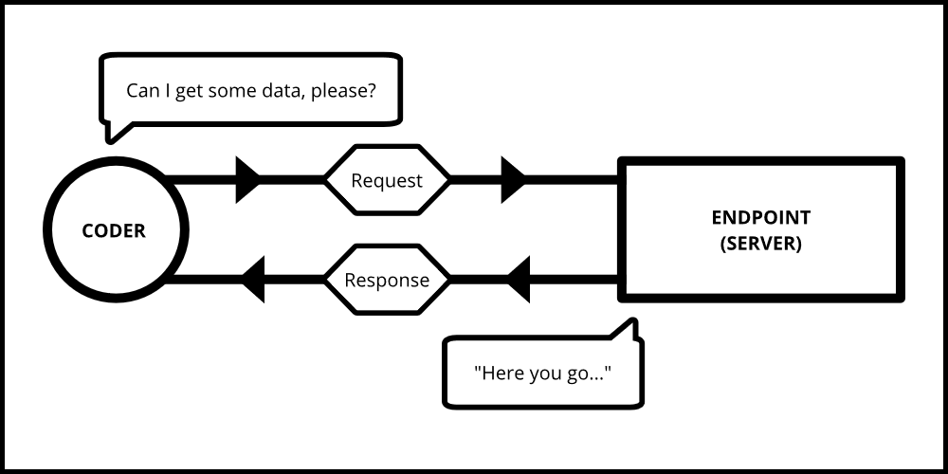
Most of the time if you have an application, there will be a need to get some data from different sources like a server, API endpoint, etc.

Slide 4
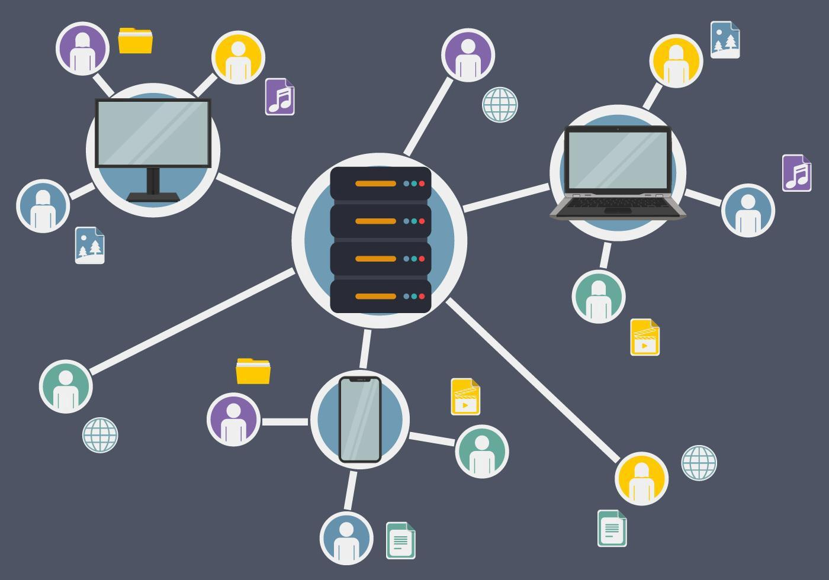
Let's say you have an API endpoint from where you need to get all the blogs. The fetch() method available in javaScript helps us to fetch data from this endpoint and it is very easy to do

Slide 5
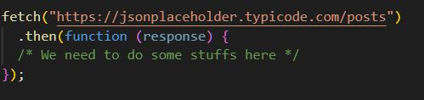
How are we going to get the data? 🤔
To get the data, we need to attach a then() method to the fetch() method, because fetch methods are asynchronous and only returns a Promise if the request is successful or unsuccessful.
Inside the then() method we will provide a callback function to process the response or the blog data coming from the server.

Slide 6
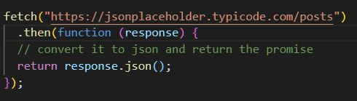
When we get the response from the API endpoint we are getting something called a Response object which is of no use to us because we won't be able to work with that.
So We need to convert the Response object into something we can work with, like JSON or a text.
To convert into JSON, there is a method called json() available in the response object.

Slide 7
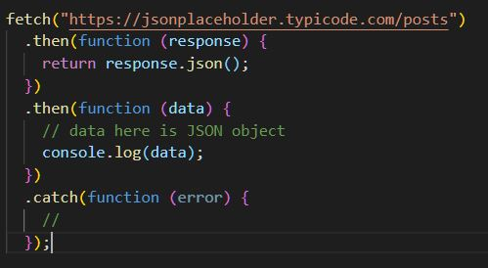
Fetch syntax to get data
use Fetch to request JSON data from server:

Slide 8
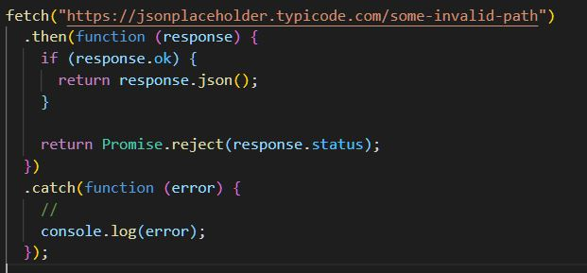
Error Handling
We can use the catch() method of the promise to intercept any error that is thrown during the execution of the request.
However, no error will be thrown if the request hits the server and comes back, regardless of what response was returned by the server

