Slide 1
Vision Guided Kuka5(KR5) Robotic Manipulator
Motion Planning and Trajectory Using Bounding Box Detection with machine learning
EMMANUEL, ISRAEL OKPARA
476160
ADZEMBEH JOSHUA
481790

Slide 2
Introduction
For a smart warehousing and human-robot collaboration, there is high demand for visual aided robotic system.
One of such system is a robotic arm that follows and track particular features from a video frame and plan a precise trajectory.
Goal: To Achieve precise motion planning/control of a 6-DOF KR5 robotic arm using visual feedback.
Motivation: This project is motivated by moving objects/products in a warehouse

Slide 3

Dynamic Modeling
The dynamic model used is base on Euler-Lagrange (or Newton-Euler) equation of motion
$$τ=M\left(q\right)\ddot{q}+C\left(q,\dot{q}\right)\dot{q}+G(q)$$
$$\ddot{q}=M{\left(q\right)}^{−1}[τ−C\left(q,\dot{q}\right)\dot{q}−G(q)]$$
Where:
$q$: joint position vector $(n×1)$
$\dot{q}$: joint velocity vector
$\ddot{q}$​: joint acceleration vector
$M(q)$: inertia matrix $(n×1)$
$C\left(q,\dot{q}\right)\dot{q}$​: Coriolis/centrifugal term $(n×1)$
$G(q)$: gravity loading vector $(n×1)$
$τ_{fric}$​: friction torque vector
$τ$: total input torque vector (computed by controller)

Slide 4
System Architecture
Camera captures real-time video/image.
Image processed to detect QR/barcode using a machine learning Model trained on YOLO5.
Bounding box coordinates extracted and processed by OpenCv.
Boundary box coordinates Mapped to world coordinates using spatialmath (SE3)
Manipulator motion computed based on coordinates.

Slide 5

Barcode to World Coordinate Conversion
The vision system detects a barcode and returns its center pixel coordinates in the camera frame.
$P\text{ython}$:
$\text{pixel}\text{_}\text{center}\text{ = }\text{get}\text{_}\text{barcode}\text{() \# }\text{Returns}\text{ ((}\text{x}\text{, }\text{y}\text{), "}\text{corners}\text{")}$
The pixel coordinates are scaled to meters and adjusted relative to the camera's optical center.
Finally, the barcode's position in the robot's world frame is now known as `target_world`.
This coordinate is used for inverse kinematics to plan the robot's motion.

Slide 6
Trajectory Planning
Bounding box center used as motion target.
Use Inverse kinematics to solve for joint positions
Generate Trajectory using quintic polynomial interpolation and simulated trajectory.
The project uses two trajectory models,
For planning the motion using quintic and
For simulation using a control model based on the system dynamic parameters with the planned trajectory in the first model.

Slide 7

Trajectory Planning (Cont’D)
The planning of the motion using quantic was done with this quation:
$trajectory=rtb.mtraj(rtb.quintic, q_{start}, q_{end}, time)$
The simulation using a control model based on the system dynamic parameters with the planned trajectory in the first model above :
$$solution=odeint(contolfunction, q0, time, args=(robot, trajectory, Kp, Kd))$$
Constraints: Collision avoidance not implemented, End-effector remains within arms link length

Slide 8

Manipulator Control Synthesis
The project uses a PD controller with feedforward inverse dynamics. Here we looked at designing a control law that governs how inputs (torques) are applied to ensure the robot follows a desired trajectory accurately and stably.
$$τ=τ_{ff}+τ_{pd}$$
Where:
$τ$: total control input (joint torques)
$τ_{ff}$​: feedforward torque to follow the desired acceleration
$τ_{pd}$​: feedback torque to correct errors in real-time
$$\ddot{q}=M{\left(q\right)}^{−1}[τ−C\left(q,\dot{q}\right)\dot{q}−G(q)]$$

Slide 9
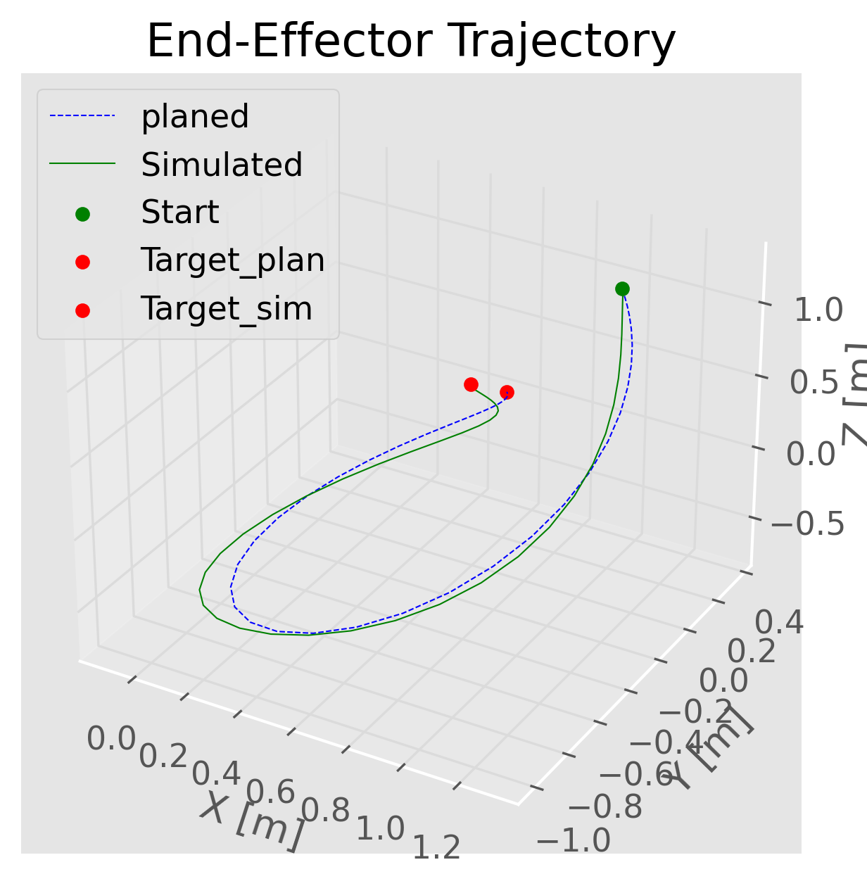
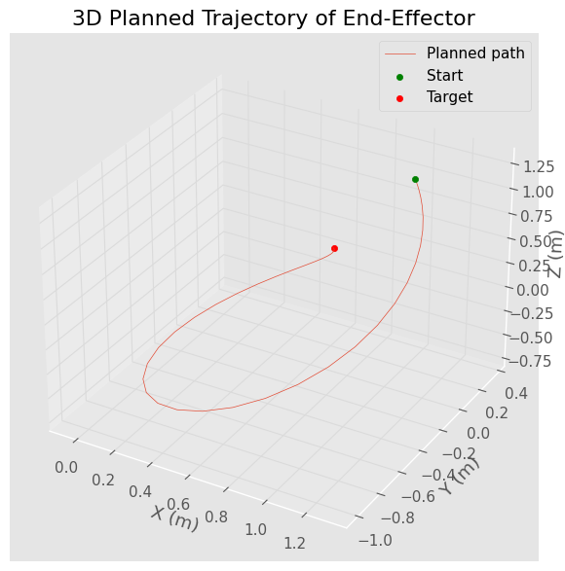
Trajectory Planning: Results

Slide 10
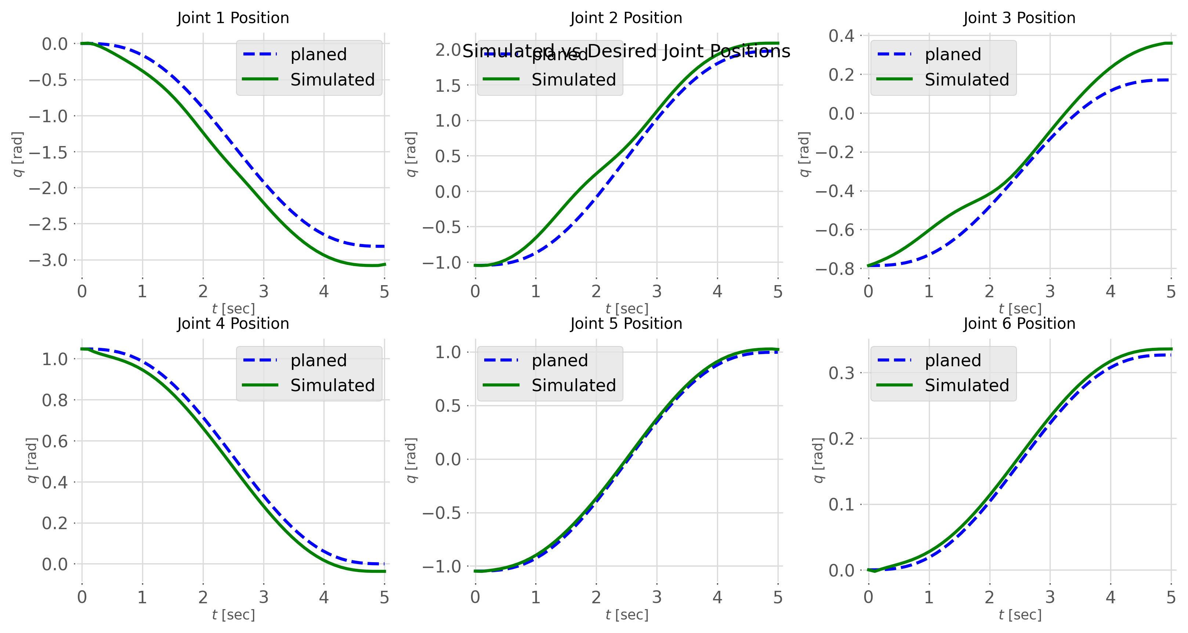
Results & Visual Demonstrations
Joint Positions during simulation vs planned

Slide 11
Challenges & Future Work
Improving detection speed and accuracy.
Enhancing manipulator flexibility.
Adding obstacle avoidance and 3D tracking.

Slide 12
Conclusion
Vision-guided manipulators are effective in dynamic environments.
Combining computer vision with robotics offers powerful automation.
Features extraction will increase system robustness.

