Slide 1
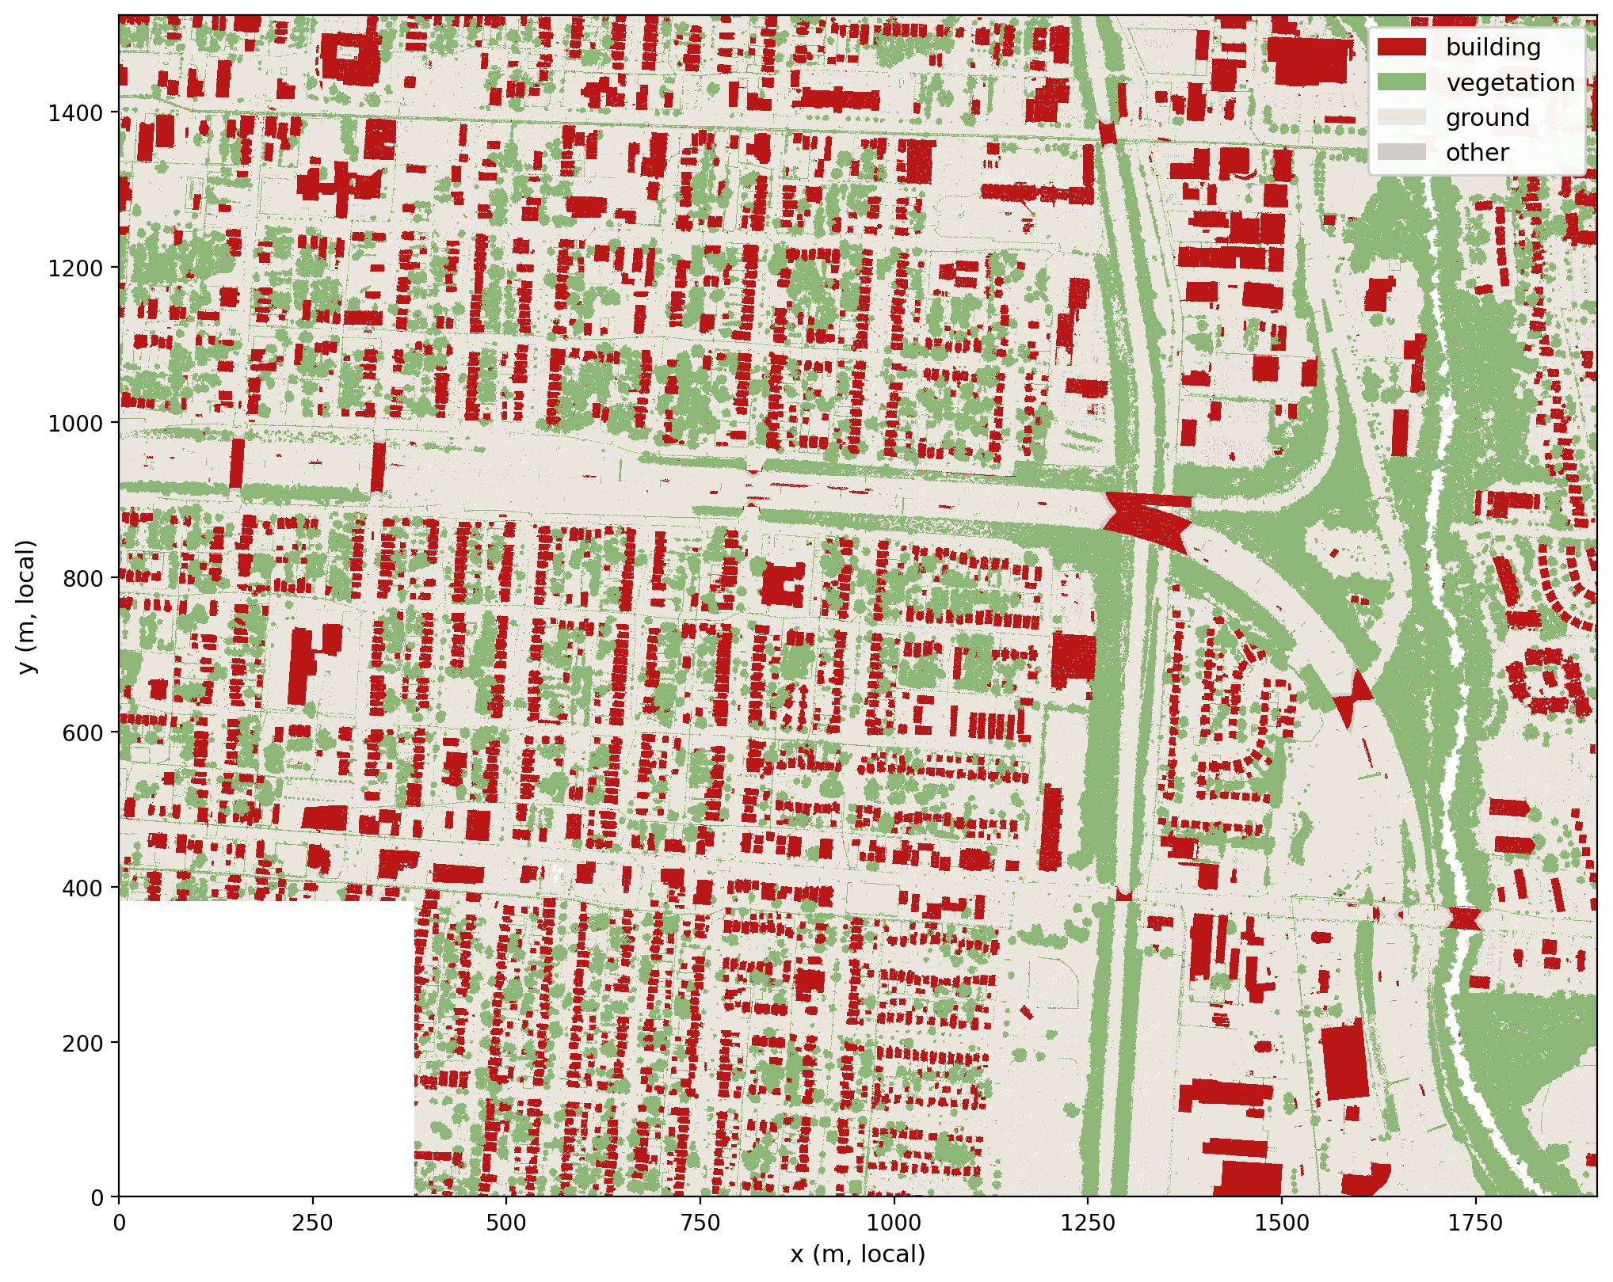
Last time: semantic segmentation with RandLA-Net
2.76 km² east Columbus, OH
19 USGS 2019 tiles · 76.35 M points (~30 pts/m²)
4 classes: ground / vegetation / building / other
building IoU 0.978 (training tiles, checkpoint metric)
→ 8.6 M building points (11.3 %) = input to this stage
Notes:
Quick recap: 19 tiles, 76 million points, RandLA-Net four-class semantic segmentation over the full study area. Building IoU 0.978 is a checkpoint-selection number on the labeled training tiles — a proper spatial hold-out is still future work. The 8.6 million building-labeled points are the input to this stage.

Slide 2
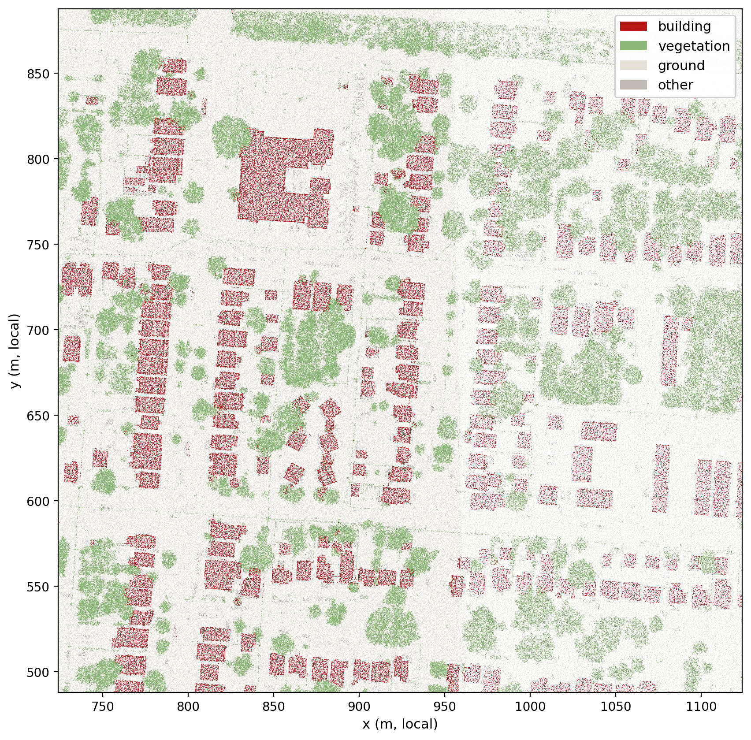
This stage: split the building points into individual buildings
Goal: one instance ID per building.
tree bridges weld neighboring houses together
occlusion fragments split one house apart
parking lots, bridges, power lines hide in the mask
Notes:
The semantic mask is noisy in both directions: mislabeled tree points bridge neighboring houses into one blob, tree-shadowed porches break off into fragments, and some objects in the mask were never buildings at all. The method has to handle all three.

Slide 3
Method: a 2.5-D raster pipeline
1 · Select building points
class 6 from all 19 tiles · 8.6 M pts
2 · Rasterize
0.5 m grid · cell counts if ≥ 2 pts
3 · Connected components
8-connectivity → candidate blocks
4 · Erosion → cores
shrink 1.5 m · keep cores ≥ 6 m²
2,283 building instances
IDs written back to every point
7 · Noise filter (Gate A)
DTM · height above ground · shape rules
6 · Fragment absorption
piece < 20 m² joins anchor within 3 m
5 · Marker watershed
flood from cores · cut at height valleys
Each step is illustrated next on a 25 × 18 m synthetic scene built with the same operations and parameters.
Notes:
The whole method runs on a half-meter 2-D grid: find candidate blocks, split blocks that contain several buildings, absorb over-segmented fragments, and filter out non-buildings. The next slides walk through the steps on a small synthetic scene that uses exactly the same operations and parameters as the real pipeline.

Slide 4
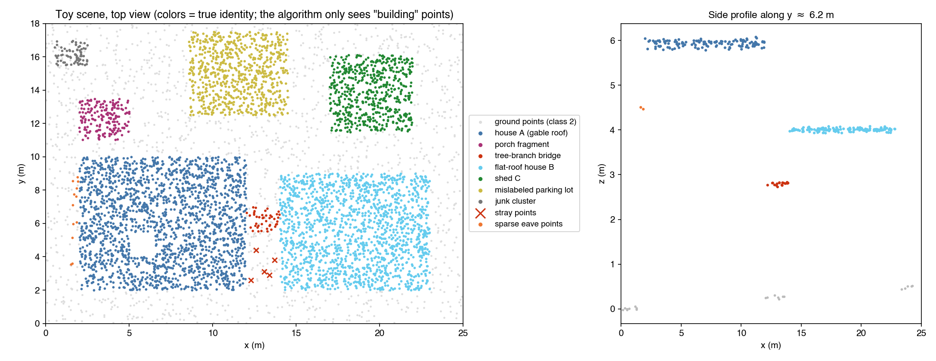
The toy scene
Two houses joined by a mislabeled tree bridge, a porch fragment, a shed, a ground-level parking lot, stray points.
Notes:
Every failure mode from the real data has a representative here: house A and house B are connected by a strip of mislabeled tree points; a porch fragment sits 1 meter from A; the shed is a small but real building; the parking lot is labeled building but lies on the ground; five stray points and a sparse eave band round it out. The algorithm sees only 'building' points — the colors are ground truth it cannot access.

Slide 5
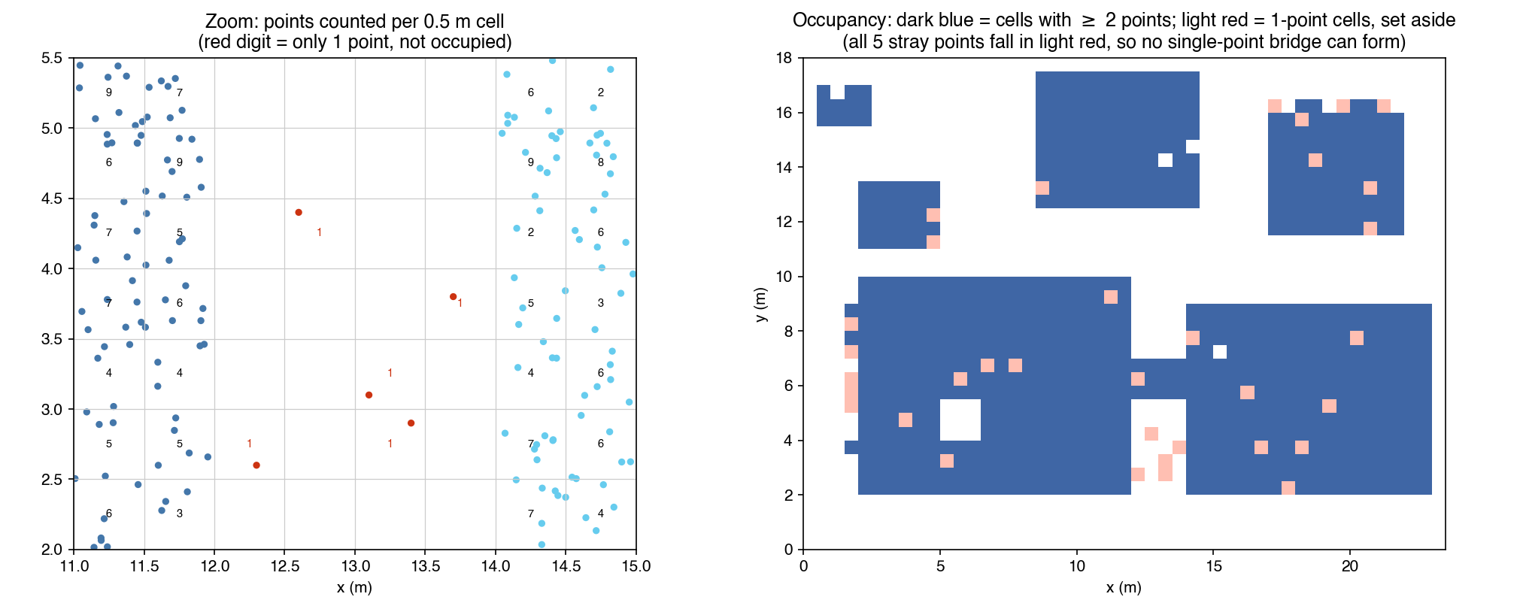
Step 2 · Rasterize: 0.5 m grid, a cell needs ≥ 2 points
Real data: 8.6 M points collapse into one occupancy image.
Notes:
Each point falls into a half-meter cell. A cell counts as occupied only with at least two points — that single rule kills all five stray points, so a lone misclassified point can never bridge two houses. On the real data this turns 8.6 million points into a manageable image.

Slide 6
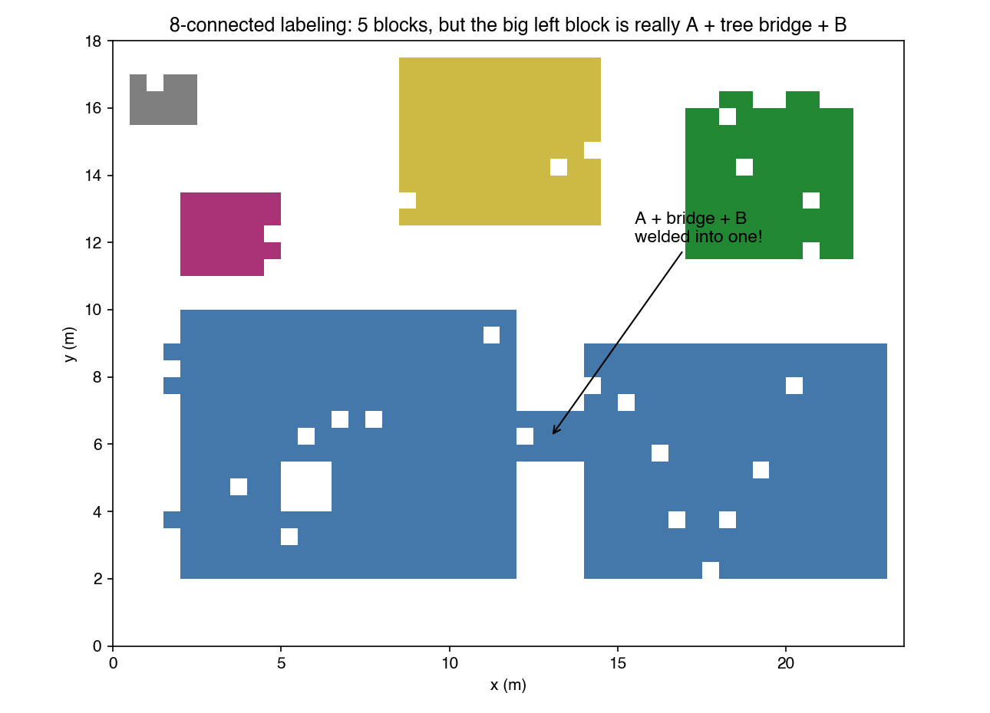
Step 3 · Connected components
Real data: thousands of blocks — some hide several buildings behind a tree bridge.
Notes:
Standard 8-connected labeling on the occupancy image. Most blocks are exactly one building, but whenever anything sits between two houses — here the tree bridge — they are welded into one block. Detecting and splitting those blocks is the job of the next two steps.

Slide 7
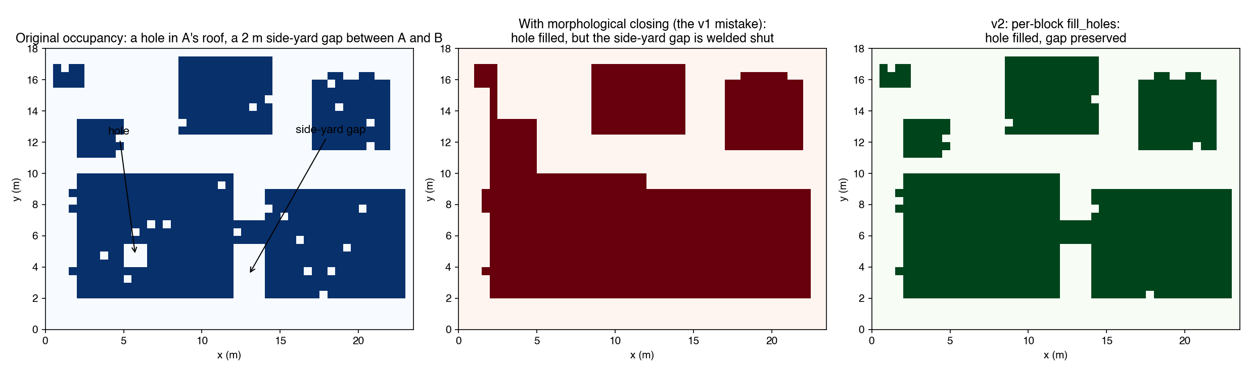
Why not morphological closing (the v1 lesson)
v1 used closing and welded whole rows of houses — v2 fills holes per block instead.
Notes:
Version 1 closed the whole occupancy image to fill roof holes — and in doing so it also welded the 1.5 to 2.5 meter side-yard gaps between houses; entire rows merged into single instances. That is what we caught in CloudCompare. Version 2 fills holes per block instead: holes get filled, gaps stay open.

Slide 8
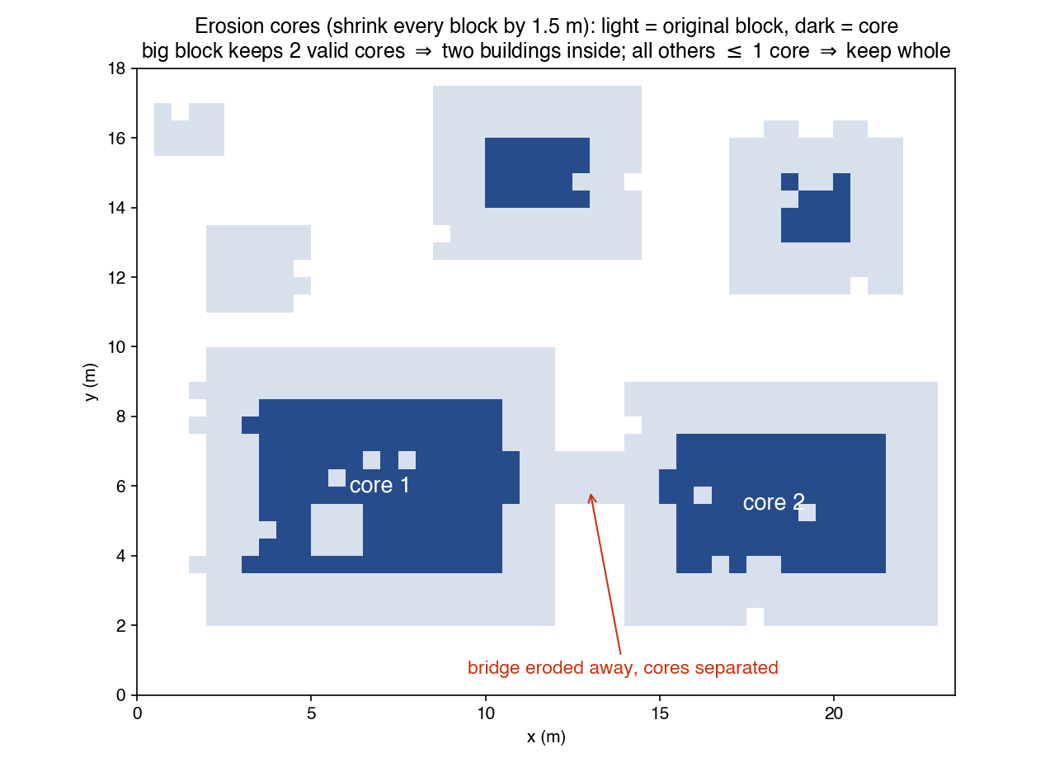
Step 4 · Erosion: how many buildings hide in a block?
Real data: 168 blocks kept ≥ 2 cores — flagged for splitting.
Notes:
Shrink every block inward by 1.5 meters. A normal house keeps a solid core; a connection thinner than about 3 meters — the tree bridge — is destroyed. If two or more cores of at least 6 square meters survive, the block must contain several buildings. On the real data 168 blocks were flagged this way.

Slide 9
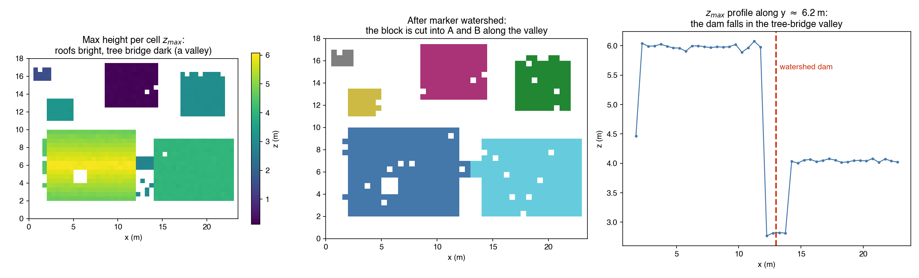
Step 5 · Marker watershed: cut along the height valley
Real data: 168 merged blocks split into 383 buildings.
Notes:
Where exactly to cut? Roofs are high; whatever connects them — tree branches, shrubs — is low. Flooding the per-cell max-height surface from the cores places the boundary in the height valley, right on the bridge. The profile on the right verifies it: the dam falls exactly in the low corridor between the two roofs. 168 real blocks became 383 buildings.

Slide 10
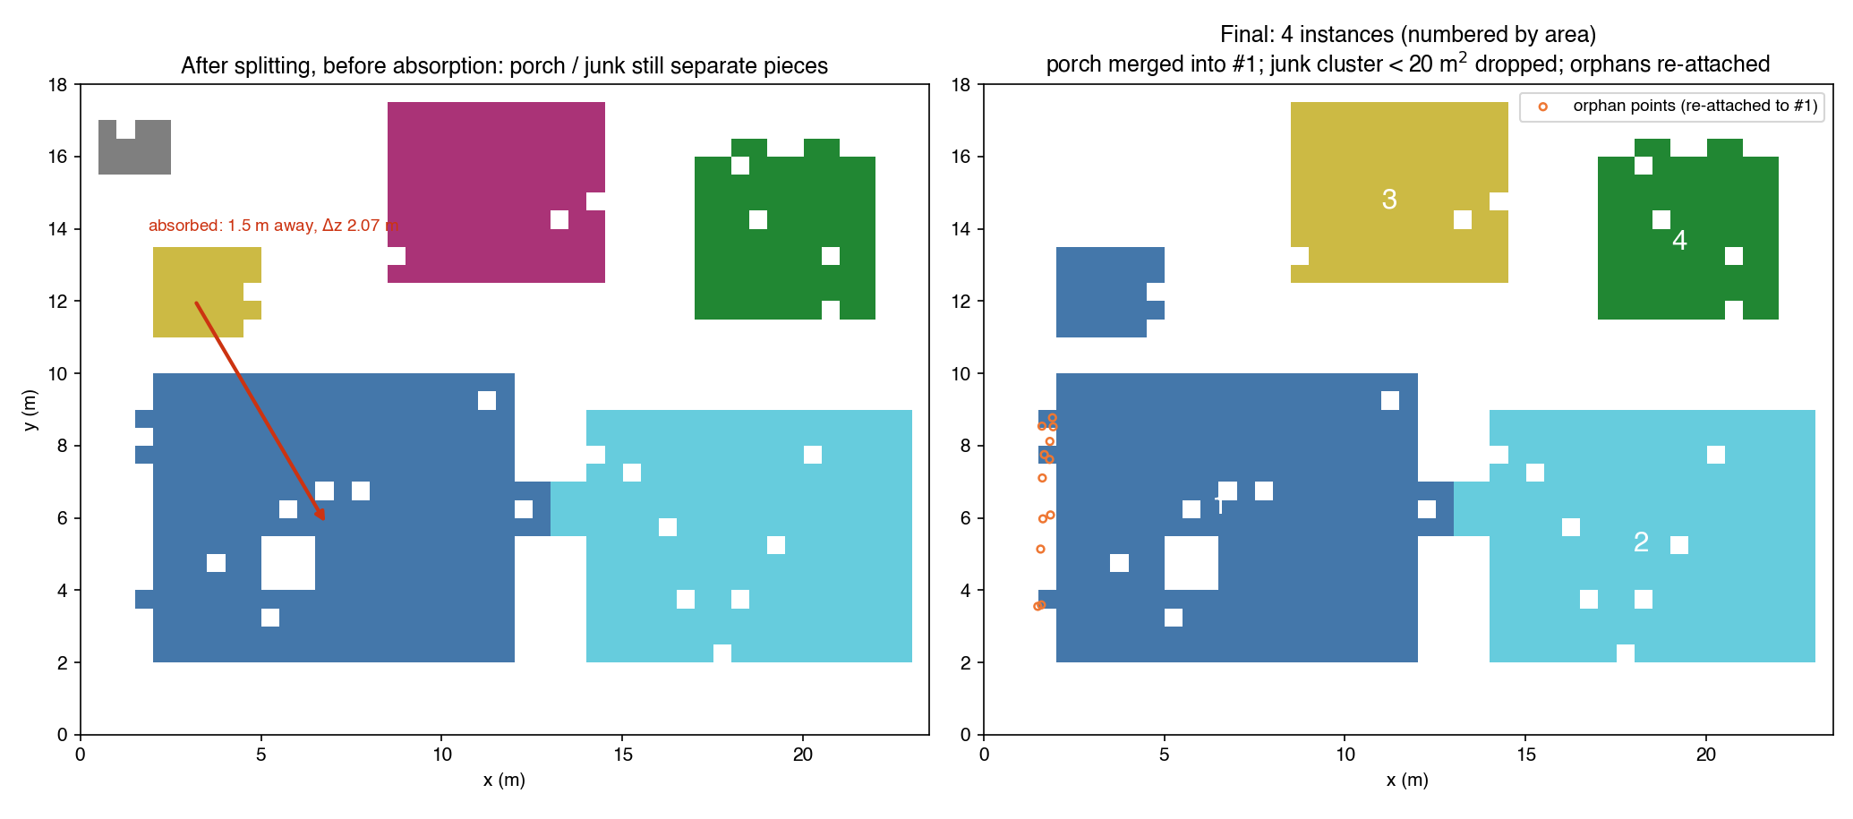
Step 6 · Fragment absorption, then final IDs
Real data: 2,296 instances after this step.
Notes:
A piece smaller than 20 square meters joins the nearest instance of at least 50 square meters if it lies within 3 meters and the median heights differ by at most 3 meters — asymmetric, so two real houses can never merge, but the porch comes home. Tiny leftovers are dropped as noise, survivors get final IDs, and sparse orphan points are re-attached to the nearest instance. The real data ends this step with 2,296 instances.

Slide 11
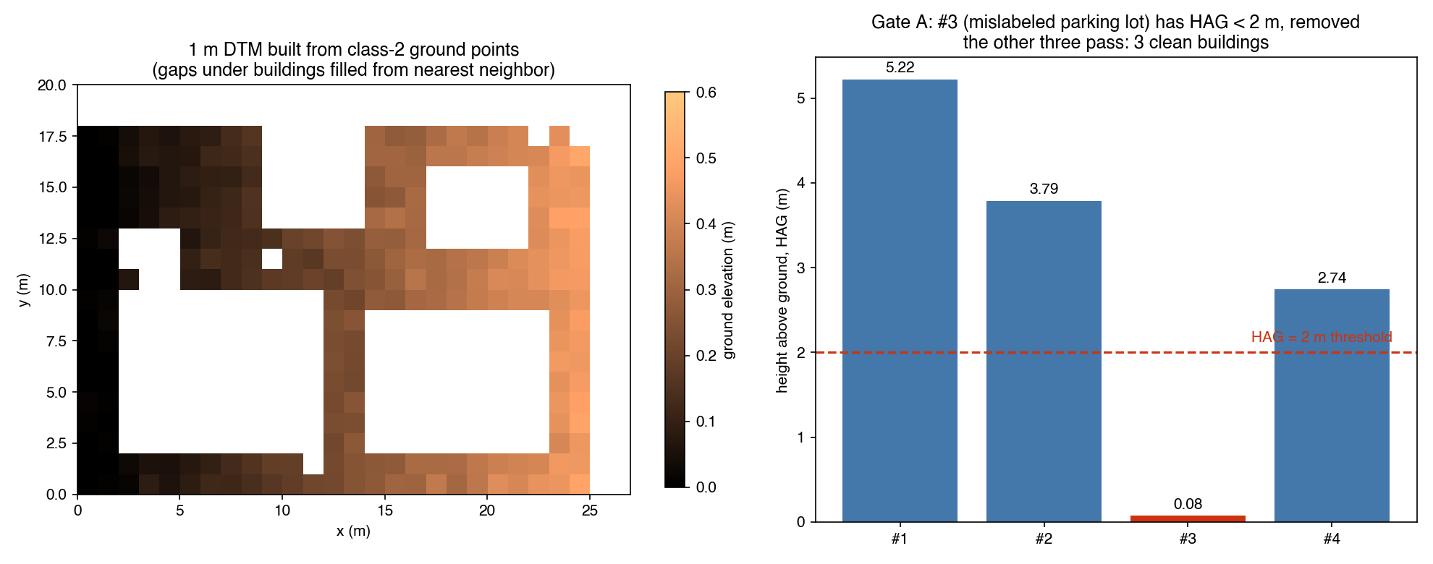
Step 7 · Gate A: height above ground kills fake buildings
Real data: shape rules + manual review removed 13 (bridges, ramps, tree rows, power lines) → 2,283 buildings.
Notes:
A 1-meter DTM built from ground-class points gives every instance a height above ground; the parking lot sits at 8 centimeters and is removed. On the real data the survivors of this rule set were shortlisted by shape rules — solidity and inscribed width — and a manual review removed 13 non-buildings: bridge decks, highway ramps, tree rows, power lines. Every removal is logged with a reason code.

Slide 12
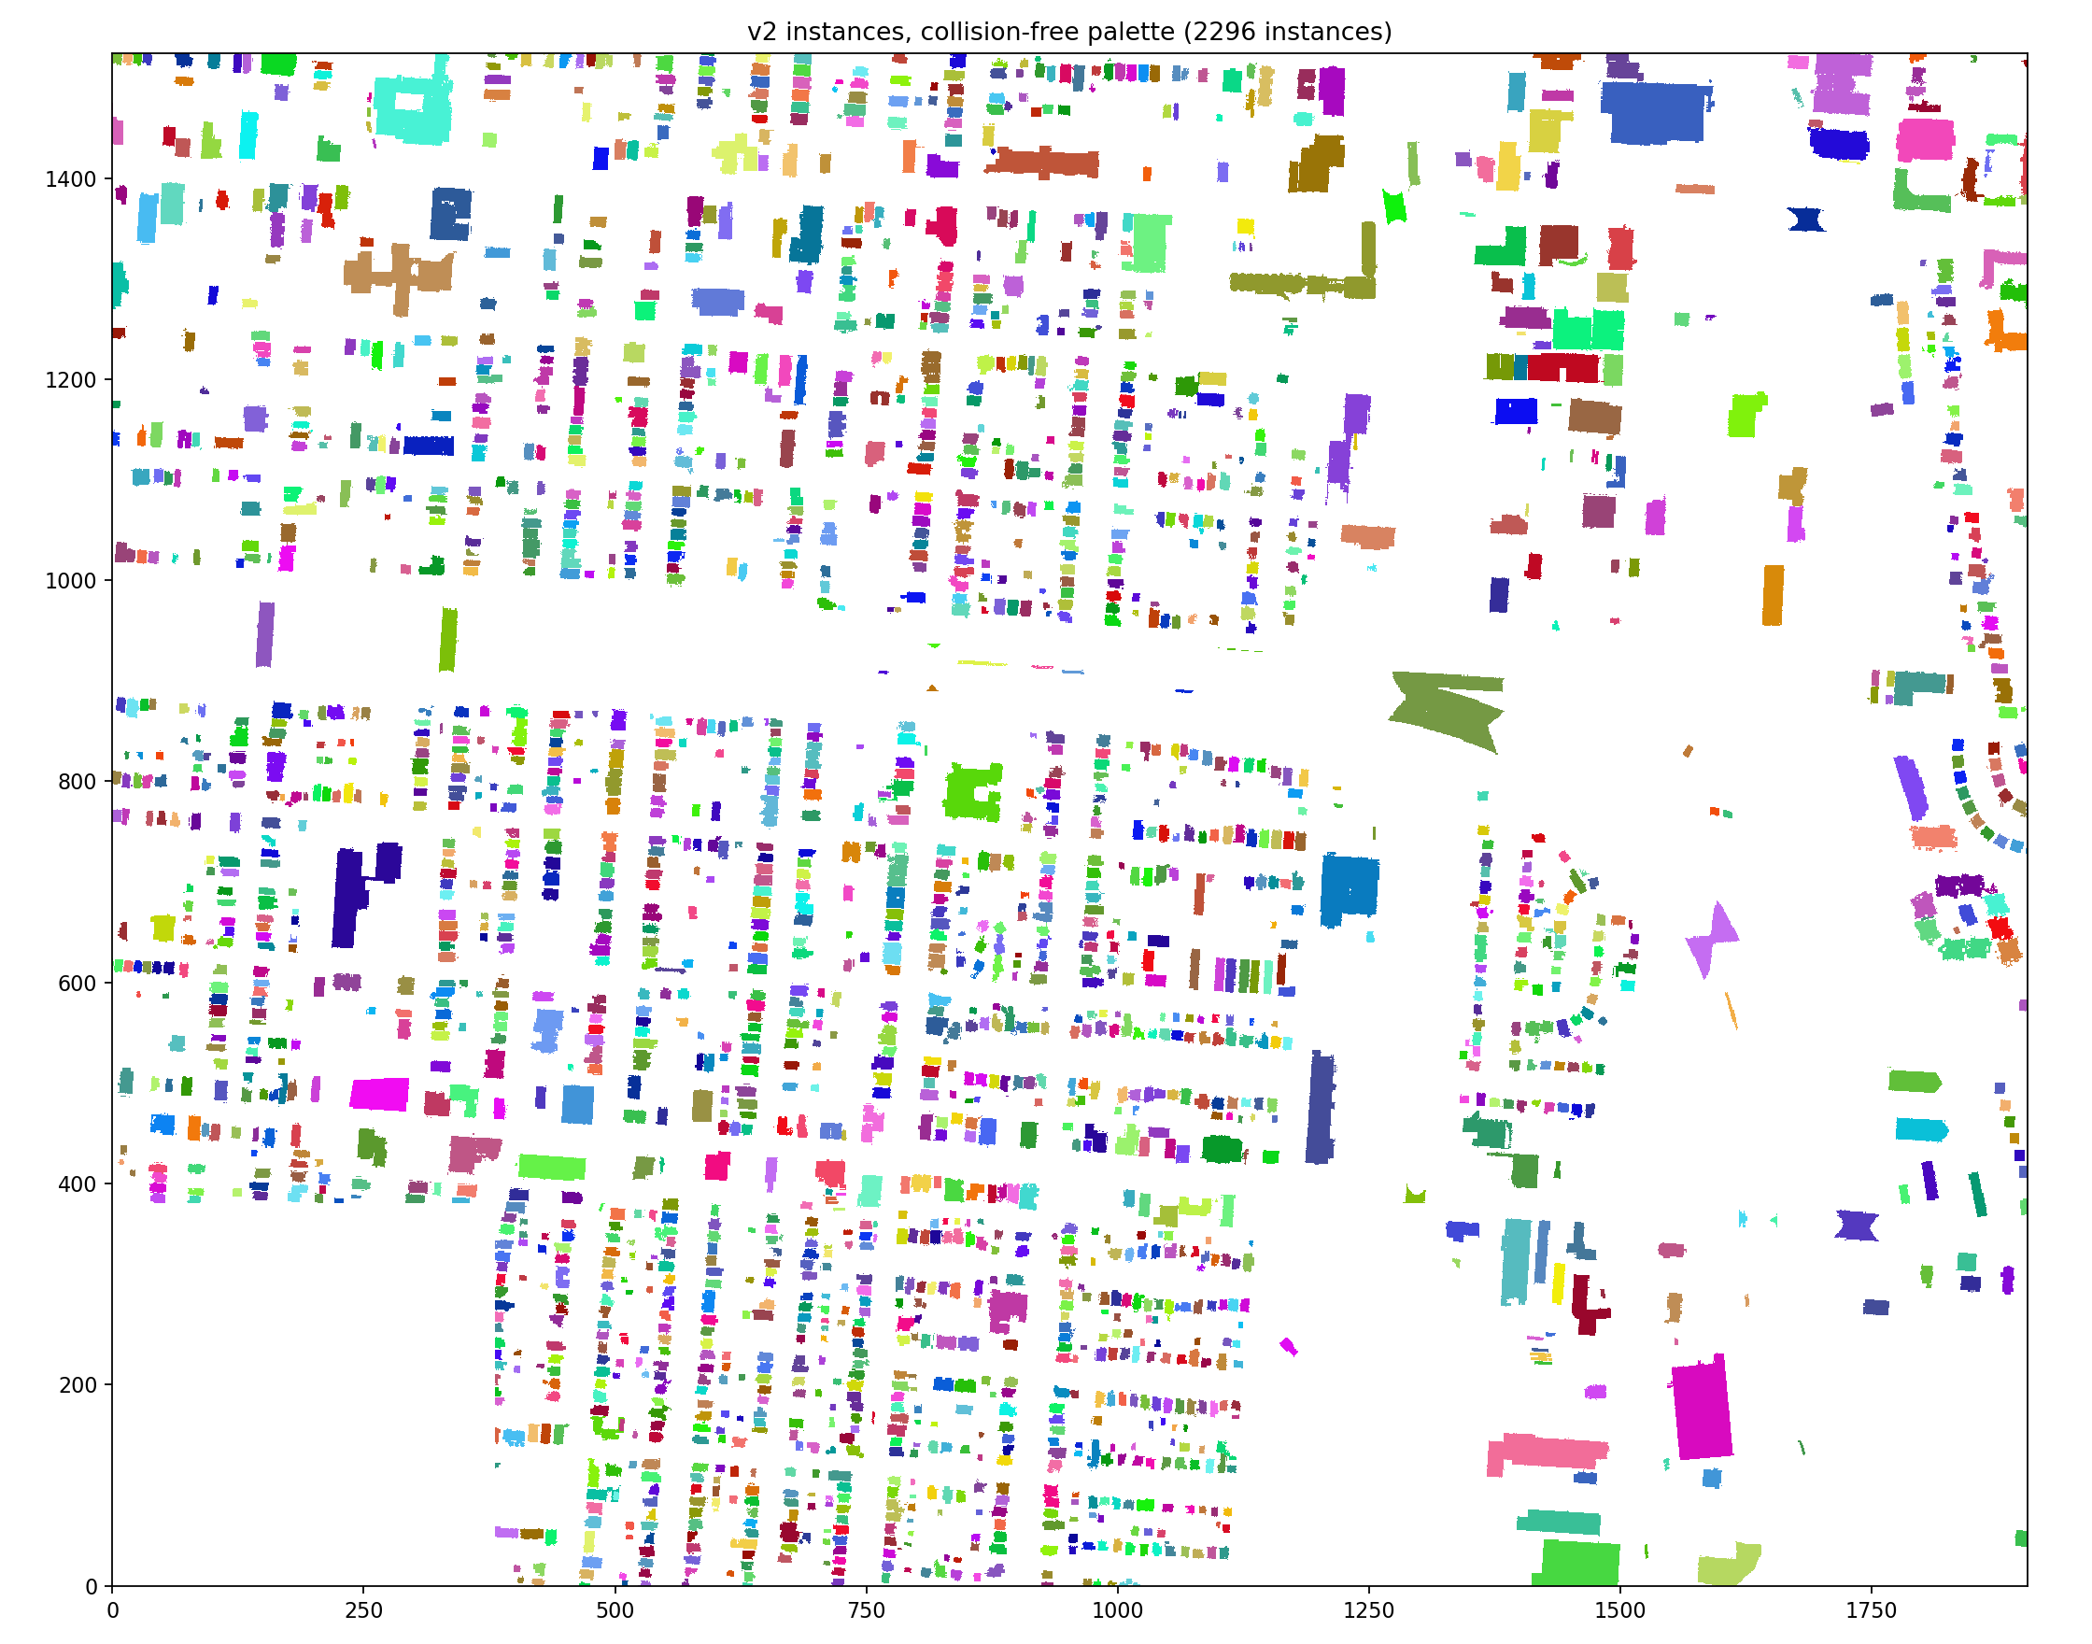
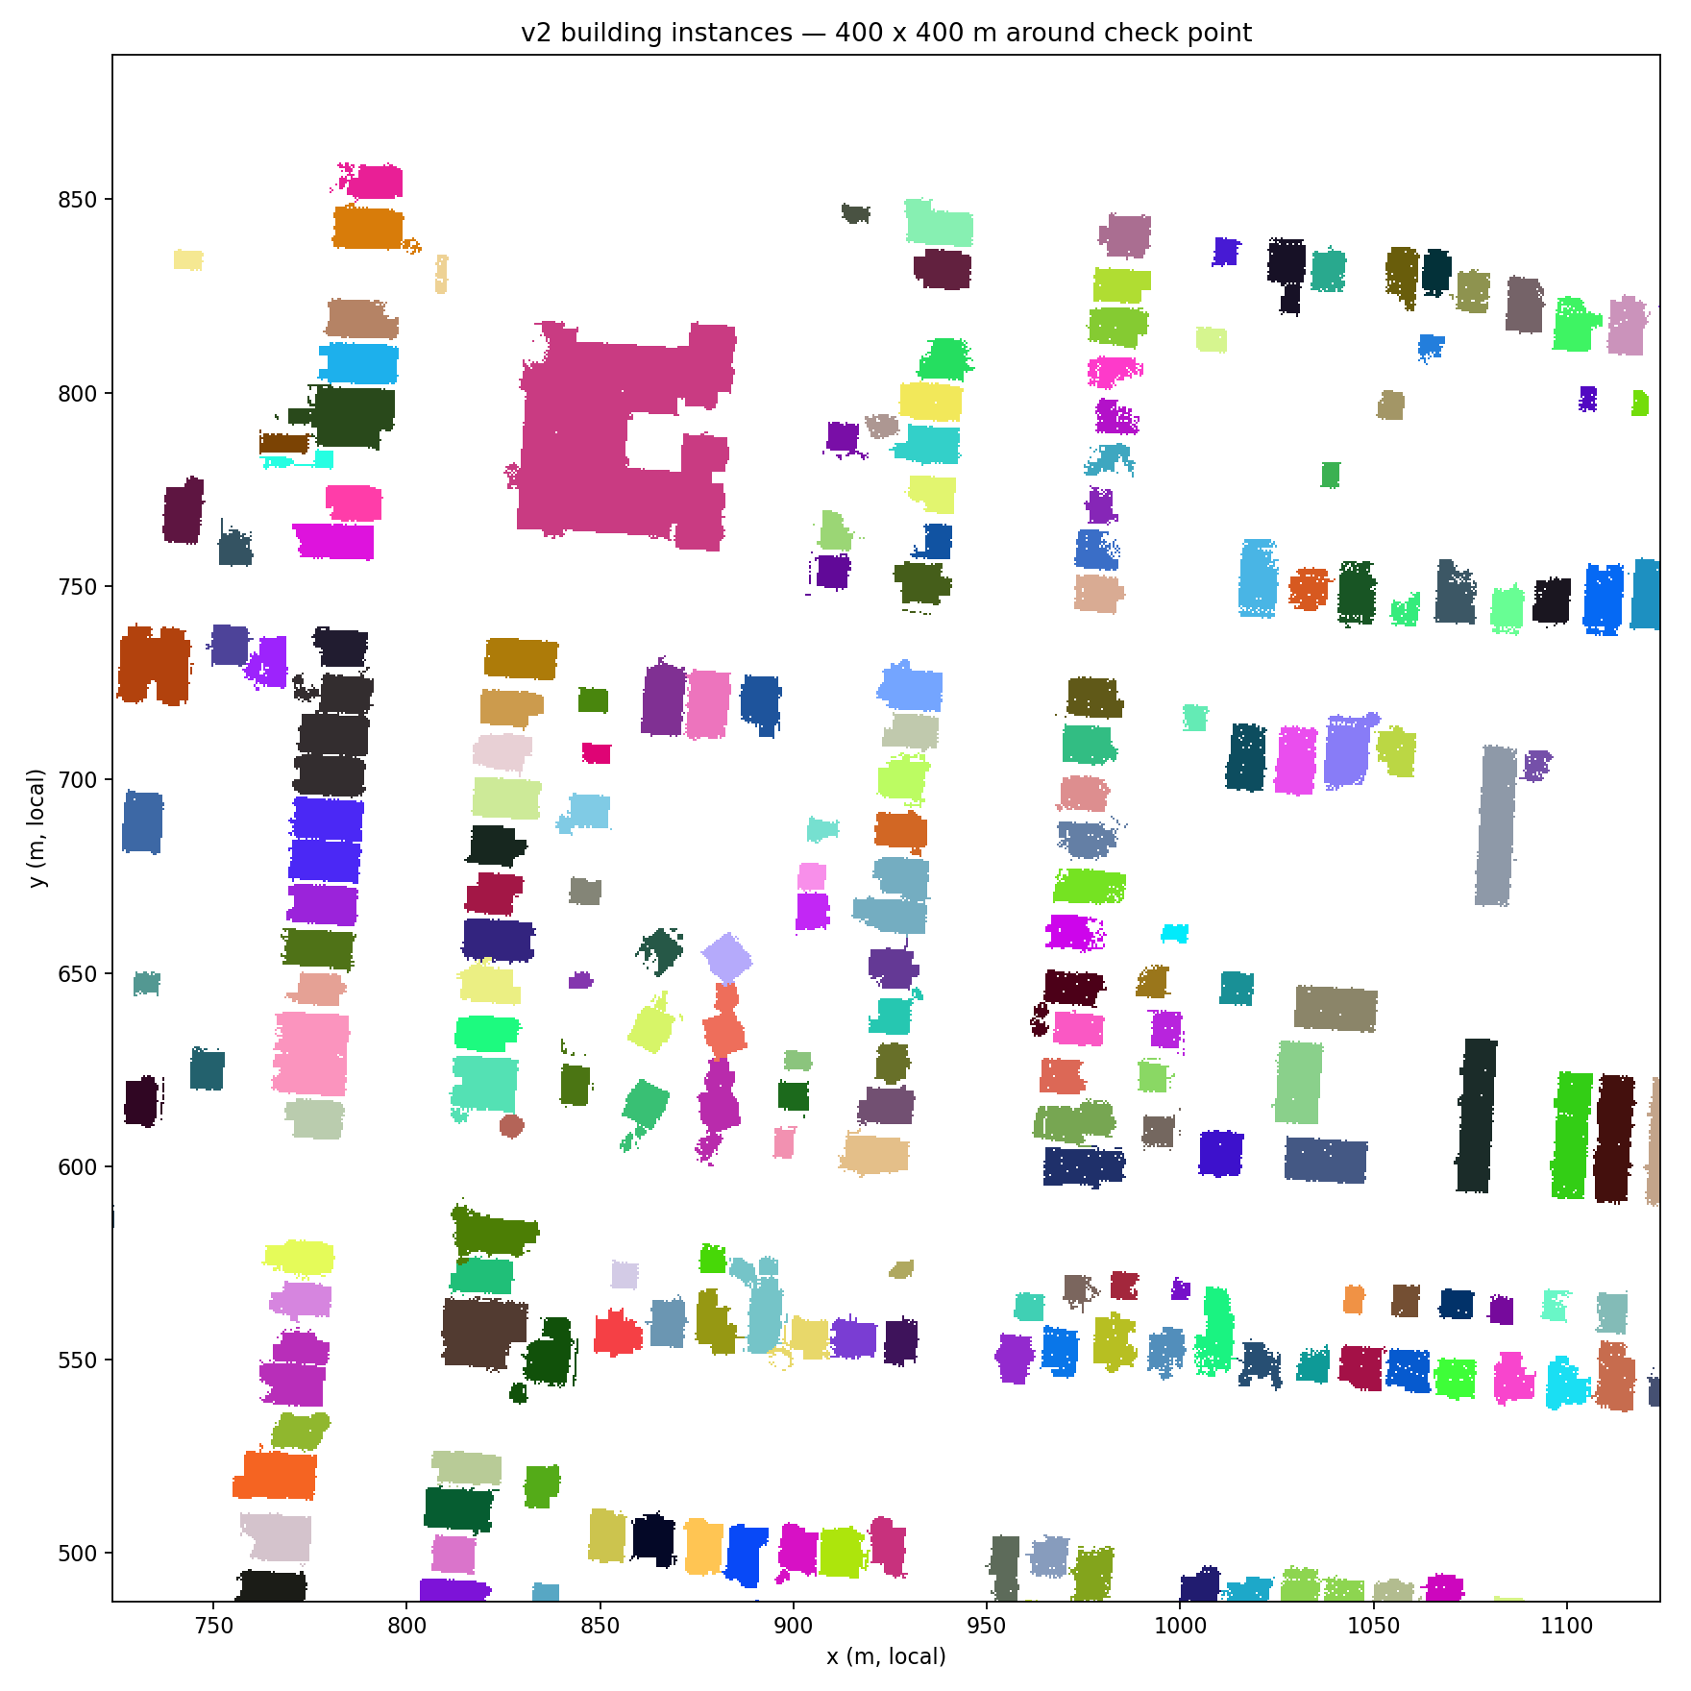
Result: 2,283 clean building instances
2,296
raw instances
168 → 383
merged blocks split
13
non-buildings removed
2,283
Same 400 × 400 m window as slide 2 — the tree-bridged houses are now separate. Collision-free palette: neighbors never share a color (verified in CloudCompare).
clean building instances
Notes:
2,296 instances come out of the raster pipeline; Gate A removes 13 non-buildings, leaving 2,283. On the right, the same window as the semantic view at the start — the tree-bridged houses are separated. I verified the result building by building in CloudCompare; the collision-free coloring makes any merge error visible at a glance.

Slide 13
Next: from instances to LOD2 building models
Semantic segmentation
done
Instance segmentation
this report
Roof plane extraction
region growing
Roof structure lines
plane intersections
LOD2 assembly + evaluation
CityJSON · county footprints
Notes:
The clean instances are the unit of work for everything downstream: planar roof faces per building via region growing, ridge, valley and step edges from plane intersections, then watertight LOD2 assembly with CityJSON export, and a quantitative evaluation against Franklin County footprints plus manually annotated reference buildings.

