Slide 1
实验4：Hbase使用及编程实践

Slide 2
实验内容
（一）操作参考http://dblab.xmu.edu.cn/blog/2442-2/（HBase1.1版本源代码见钉钉群），练习Shell命令部分及Java编程部分内容
（二）练习使用Shell命令
（1）练习scores表相关命令（参见附录）
（2）把书上P96-97的三张表（表4-22、表4-23、表4-24）设计成适合HBase存储的表结构，建表并录入数据
（三）针对书上P96-97的三张表设计的HBase表，实现书上P97指定的(1)、(2)、(3)、(5)的功能

Slide 3
Shell命令的使用
一、表结构操作
1.建立一个表scores，有两个列族grade和course
hbase(main):006:0> create 'scores','grade','course'
2.查看Hbase中的所有表
hbase(main):007:0> list
3.查看scores表结构
hbase(main):008:0> desc 'scores‘
4.查询表scores是否存在
hbase(main):009:0> exists 'scores'

Slide 4
Shell命令的使用
5.判断表scores是否enable
hbase(main):010:0> is_enabled 'scores'
6.判断表scores是否disable
hbase(main):011:0> is_disabled 'scores'
7.使表scores不可用
hbase(main):012:0> disable 'scores'
8.恢复表scores可用
hbase(main):013:0> enable 'scores'

Slide 5
Shell命令的使用
9.增加一个school列族
hbase(main):002:0> alter 'scores',{NAME=>'school',VERSIONS=>3}
10.删除一个school列族
hbase(main):005:0> alter 'scores',{NAME=>'school',METHOD=>'delete'}
11.删除表scores
操作步骤：先禁用表，再删除表
hbase(main):004:0> disable 'scores' #先将scores表改为offline状态
hbase(main):005:0> drop 'scores' #再删除表

Slide 6
Shell命令的使用
二、DML操作（数据操纵）
1.添加scores数据
其scores表数据如下：
Tom grade: 5 Jim grade: 4
Tom course:math 97 Jim course:chinese 89
Tom course:art 87 Jim course:english 80
Tom course:english 80
hbase(main):006:0> put 'scores','Tom','grade','5'
hbase(main):007:0> put 'scores','Tom','course:math','97'
hbase(main):009:0> put 'scores','Tom','course:art','87'
hbase(main):010:0> put 'scores','Tom','course:english','80'
hbase(main):012:0> put 'scores','Jim','grade','4'
hbase(main):013:0> put 'scores','Jim','course:chinese','89'
hbase(main):014:0> put 'scores','Jim','course:english','80'

Slide 7
Shell命令的使用
2.查看数据
a.全表scores扫描
hbase(main):015:0> scan 'scores'
ROW COLUMN+CELL
Jim column=course:chinese, timestamp=1464871444954, value=89
Jim column=course:english, timestamp=1464871467549, value=80
Jim column=grade:, timestamp=1464871414324, value=5
Tom column=course:art, timestamp=1464871299895, value=87
Tom column=course:english, timestamp=1464871325997, value=80
Tom column=course:math, timestamp=1464871198158, value=97
Tom column=grade:, timestamp=1464871151963, value=5

Slide 8
Shell命令的使用
b.查看表scores中Jim的一行的数据
hbase(main):015:0> get 'scores','Jim'
COLUMN CELL
course:chinese timestamp=1525517153708, value=89
course:english timestamp=1525517175237, value=80
grade: timestamp=1525517135348, value=5

Slide 9
Shell命令的使用
c.查看一个单元格的数据
hbase(main):016:0> get 'scores','Tom',{COLUMN=>'course:math'}
COLUMN CELL
course:math timestamp=1464871198158, value=97
1 row(s) in 0.0900 seconds
d.查看一个course列族的数据
hbase(main):017:0> scan 'scores',{COLUMN=>'course'}
ROW COLUMN+CELL
Jim column=course:chinese, timestamp=1464871444954, value=89
Jim column=course:english, timestamp=1464871467549, value=80
Tom column=course:art, timestamp=1464871299895, value=87
Tom column=course:english, timestamp=1464871325997, value=80
Tom column=course:math, timestamp=1464871198158, value=97
2 row(s) in 0.0170 seconds

Slide 10
Shell命令的使用
e.查看表scores中的course:english列的数据
hbase(main):019:0> scan 'scores',{COLUMN=>'course:english'}
ROW COLUMN+CELL
Jim column=course:english, timestamp=1464871467549, value=80
Tom column=course:english, timestamp=1464871325997, value=80
2 row(s) in 0.0260 seconds
f.统计表scores的行数
hbase(main):020:0> count 'scores'
2 row(s) in 0.0890 seconds
=> 2

Slide 11
Shell命令的使用
3.修改数据
a.修改scores表中的Tom的math值为100
hbase(main):021:0> put 'scores','Tom','course:math','100'
0 row(s) in 0.0140 seconds

Slide 12
Shell命令的使用
b.修改scores表中列族course的VERSIONS=>3
hbase(main):022:0> alter 'scores',{NAME=>'course',VERSIONS=>3}
Updating all regions with the new schema...
0/1 regions updated.
1/1 regions updated.
Done.
0 row(s) in 2.2190 seconds
再进行修改cores表中的Tom的math值为90，80，70
hbase(main):023:0> put 'scores','Tom','course:math','100'
.......
0 row(s) in 0.0490 seconds
再按VERSIONS=>3查看该表中course:math的值
hbase(main):025:0> get 'scores','Tom',{COLUMN=>'course:math',VERSIONS=>3}
COLUMN CELL
course:math timestamp=1464872264511, value=70
course:math timestamp=1464872264509, value=80
course:math timestamp=1464872264507, value=90

Slide 13
Shell命令的使用
4.删除数据
a.删除scores表Jim的course:chinese的值
hbase(main):027:0> delete 'scores','Jim','course:chinese'
b.删除scores表Tom的course:english的值
hbase(main):029:0> delete 'scores','Tom','course:english'
c.删除scores表Tom一行
hbase(main):032:0> deleteall 'scores','Tom'
d.清空scores表中的内容
hbase(main):031:0> truncate 'scores'

Slide 14
（二）（2）HBase表设计
Student表
Row_Key | CF | CF
 | info | course
S_No | Info:S_Name Info:S_Sex Info:S_Age | course:<C_No>=Score

Slide 15
（二）（2）HBase表设计
Course表
Row_Key | CF | CF
 | info | student
C_No | Info:C_Name Info:C_Credit | student:<S_No>=Score

Slide 16
（二）（2）HBase表设计
Student表（列名及个数不固定）
Row_Key | info |  |  | course
2015001 | S_Name | S_Sex | S_Age | 123001 | 123003
 | Zhangsan | male | 23 | 86 | 69
2015002 | S_Name | S_Sex | S_Age | 123002 | 123003
 | Mary | female | 22 | 77 | 99
2015003 | S_Name | S_Sex | S_Age | 123001 | 123002
 | Lisi | male | 24 | 98 | 95

Slide 17
（二）（2）HBase表设计
Course表
Row_Key | info |  | student
123001 | C_Name | C_Credit | 2015001 | 2015003
 | Math | 2.0 | 86 | 98
123002 | C_Name | C_Credit | 2015002 | 2015003
 | Computer Science | 5.0 | 77 | 95
123003 | C_Name | C_Credit | 2015001 | 2015002
 | English | 3.0 | 69 | 99

Slide 18
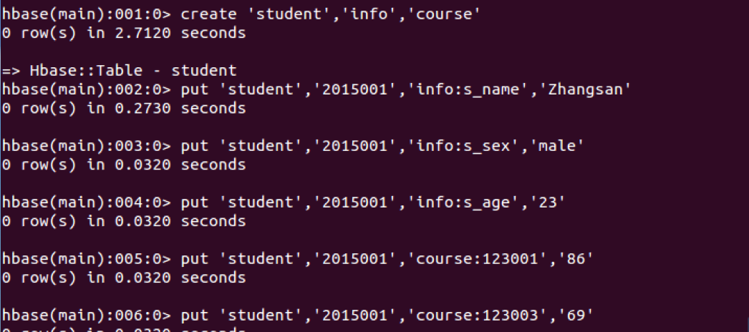
（二）（2）HBase表设计
Student表的创建及录入

Slide 19
（三）② addRecord的实现
public static void addRecord(String tableName,String row,String[] fields,String[] values) throws IOException {
init();
Table table = connection.getTable(TableName.valueOf(tableName));
for(int i = 0;i != fields.length;i++){
Put put = new Put(row.getBytes());
String[] cols = fields[i].split(":");
put.addColumn(cols[0].getBytes(), cols[1].getBytes(), values[i].getBytes());
table.put(put);
}
table.close();
close();
}

Slide 20
（三）③ scanColumn的实现
public static void scanColumn(String tableName,String column)throws IOException{
init();
Table table = connection.getTable(TableName.valueOf(tableName));
Scan scan = new Scan();
scan.addFamily(column.getBytes("UTF8"));
ResultScanner scanner = table.getScanner(scan);
for (Result result = scanner.next(); result != null; result = scanner.next()){
showCell(result);
}
table.close();
close();
}

Slide 21
（三）③ scanColumn
//格式化输出
public static void showCell(Result result){
Cell[] cells = result.rawCells();
for(Cell cell:cells){
System.out.println("RowName:"+new String(CellUtil.cloneRow(cell))+" ");
System.out.println("Timetamp:"+cell.getTimestamp()+" ");
System.out.println("column Family:"+new String(CellUtil.cloneFamily(cell))+" ");
System.out.println("column Name:"+new String(CellUtil.cloneQualifier(cell))+" ");
System.out.println("value:"+new String(CellUtil.cloneValue(cell))+" ");
}
}

