Slide 1
ONLINE VOTING SYSTEM Software Project Lab-2

Slide 2
Md Alamgir Kabir, BSSE0907
Md Samsarabbi, BSSE0916

Slide 3
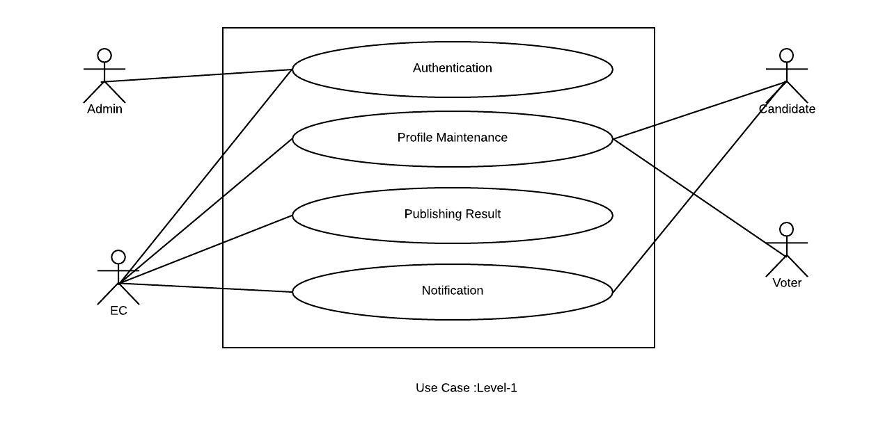
USE DIAGRAM

Slide 4
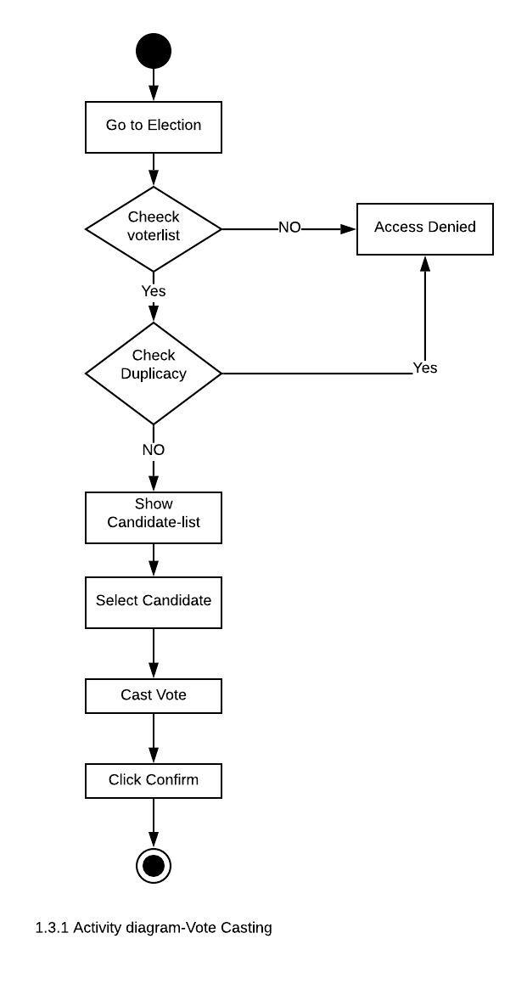
ACTIVITY DIAGRAM

Slide 5
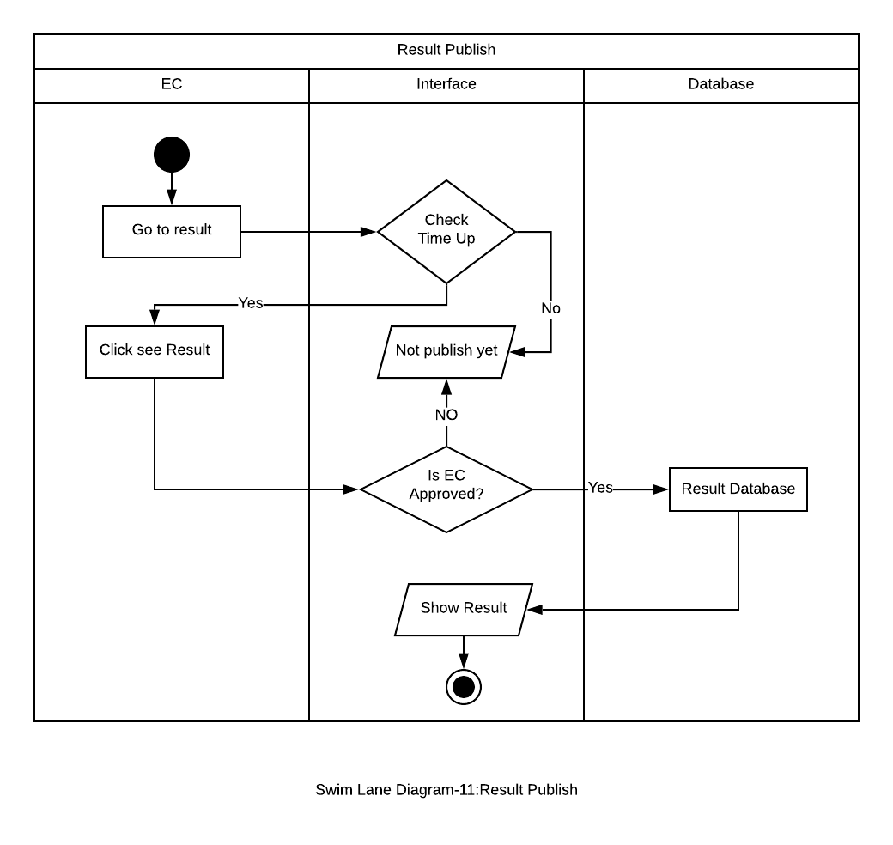
SWIMLANE DIAGRAM

Slide 6
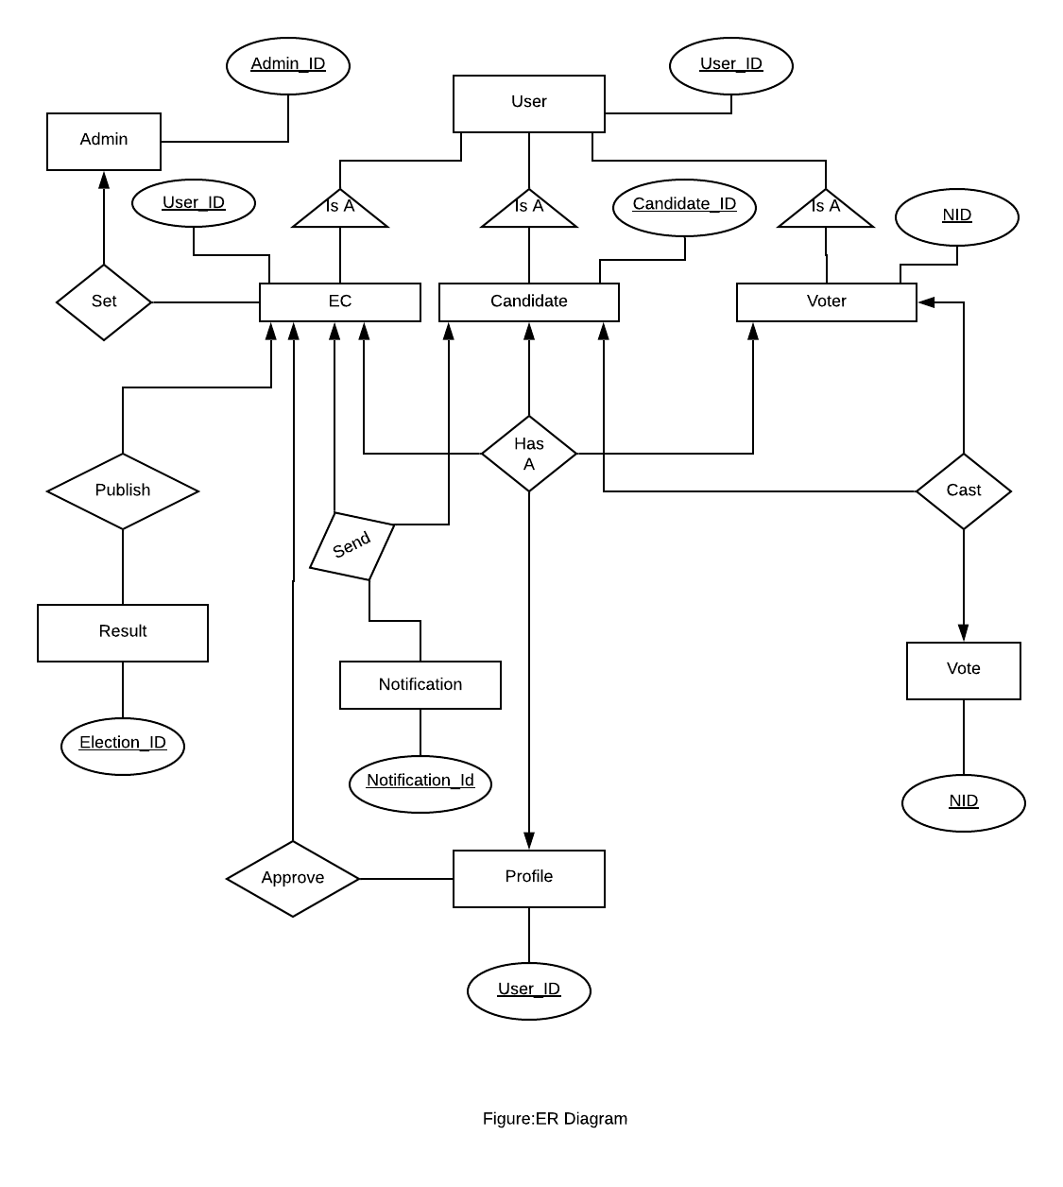
ER DIAGRAM

Slide 7
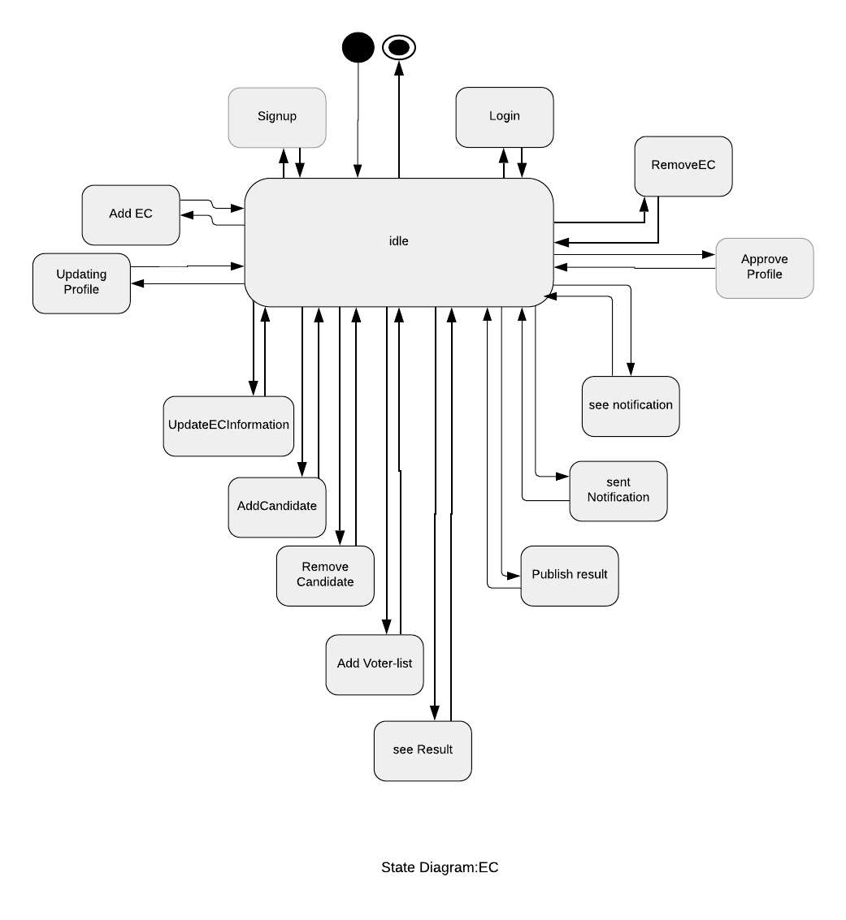
STATE DIAGRAM

Slide 8
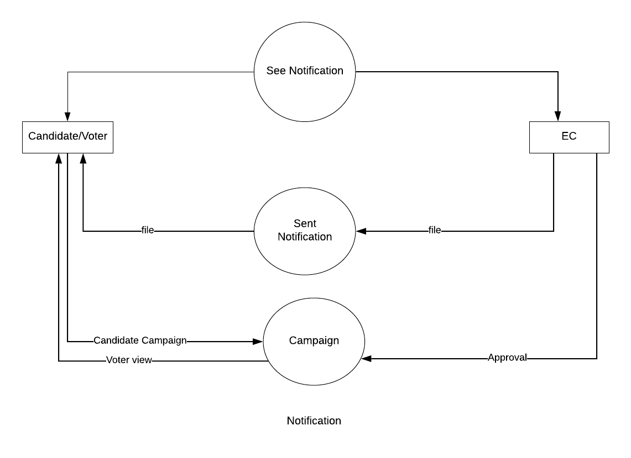
DFD

Slide 9
THANK YOU

Slide 10
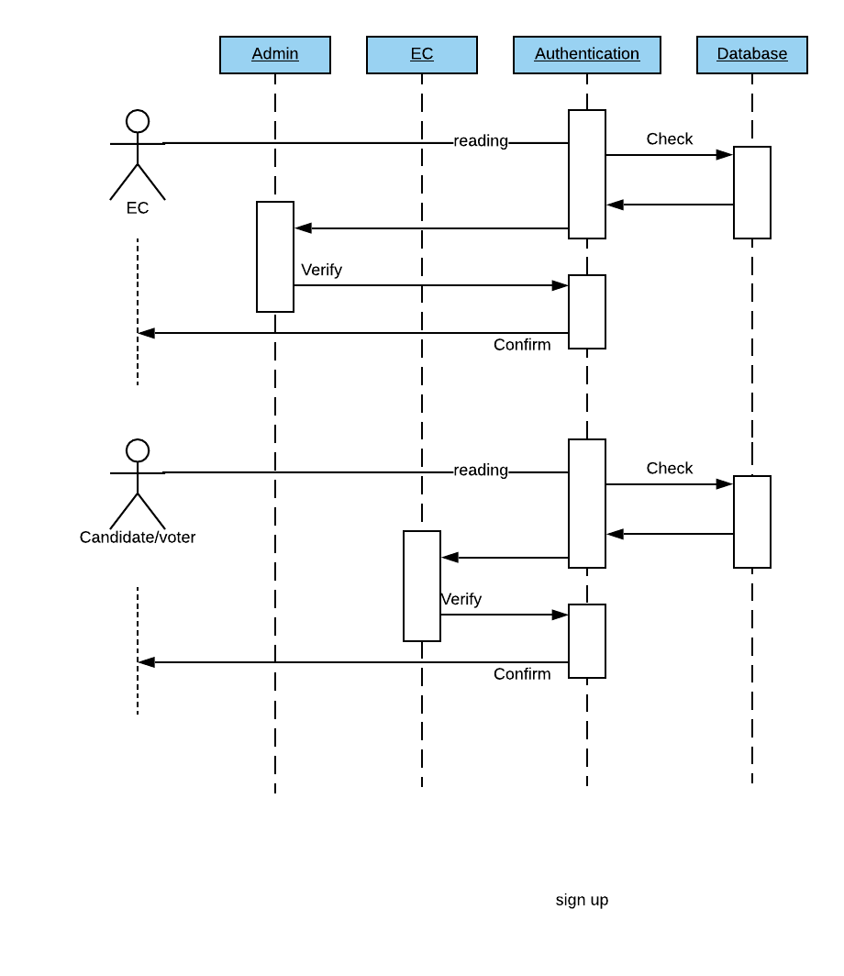
SEQUENCE DIAGRAM

