Slide 1
Imperative Programming
2019-2020 Spring Semester
Charles Ferrari
ferrari (at) caesar.elte.hu

Slide 2

The main Channel
All classes and official dates will be informed on the GitHub repo for the course: https://github.com/ImperativeProgramming/Practices2020
Students can apply for Github student package here: https://education.github.com/pack

Slide 3

Gears
You are free to use your computer during classes
Buuuut, exams must be done on lab machines (so use them every now and then);
It’s recommended to save the class files into your own GitHub repository;
You can use Lovarda lab to practice out of class;

Slide 4
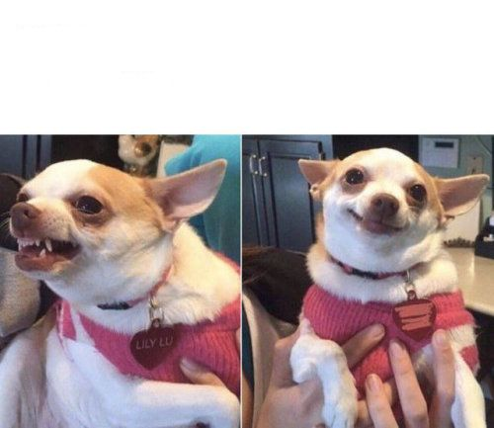
Course Rules

Slide 5


Interaction With the Teachers
Do`s:
Contact via Uni e-mails (the ones w/ .elte.hu)
Come a little early or stay a little late in the classroom
Book an appointment for consultation
Don’t’s:
Send Personal e-mails (e.g. Gmail)
Show up in the teacher office without appointment
Send repeated e-mails every 3 minutes
Notice: Your e-mail may be simply filtered straight to trash folder
Contact teachers on social media
Stop teachers in a party to ask class things

Slide 6
Interaction With the Teachers

Slide 7
Grade (TBC)
30% Class Exercises
Hackerrank challenges
Quizzes
Homeworks
30% Practice Exam
40% Lecture Exam
Lecture and practice exams will be done together in the same date during exam period.

Slide 8

Class Presence
3 Unjustified absences;
Justified absences are fore recovering content;
You are responsible for your agenda;
Exam period is still academic period;
If a trip home or a leisure trip is booked in the period of class, that’s totally under the responsibility of the student no teacher will adapt calendar or make new exams for it.
This Photo by Unknown Author is licensed under CC BY-SA

Slide 9

NO QUESTION IS A STUPID QUESTION
Interrupt, ask, question, make your point
Just don’t be the annoying one who interrupts an explanation to ask the exam dates.
Feedbacks are always welcome
WE ARE ALL HERE TO LEARN
This Photo by Unknown Author is licensed under CC BY-SA

Slide 10
Today’s Class

Slide 11

Command Line thing
You need to be proficient on using the command line to pass this course;
Assignments and Exams MUST run on command line to be considered;
Command line is cool and I’ll show you why…

Slide 12
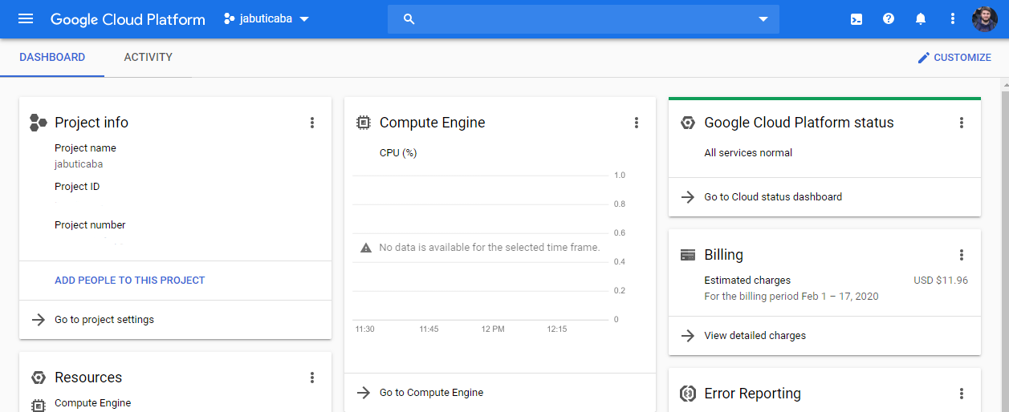
Why Command Line?
Google Cloud Platform Interaction

Slide 13
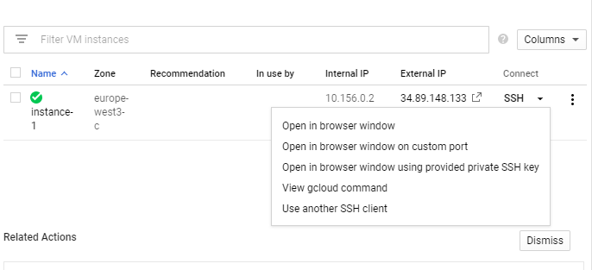
Why Command Line?
Would you like to do anything on a Cloud VM?

Slide 14
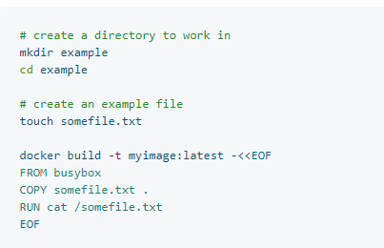
Why Command Line?
Would you like to containerize your application?

Slide 15
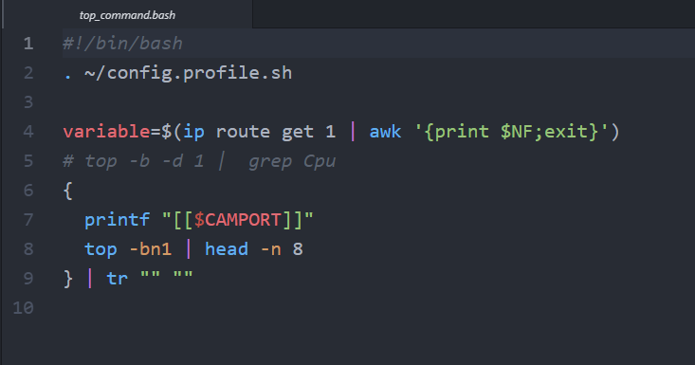
Why Command Line?
Make your life easier?

Slide 16
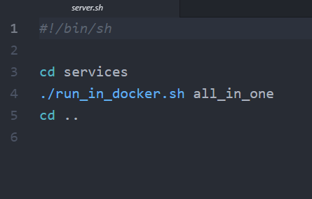
Why Command Line?
Make a script for the noob colleague (and avoid being the noob colleague)?

Slide 17
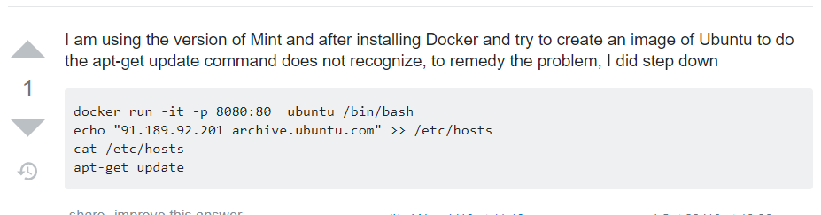
Why Command Line?
Avoid the copy and paste with no clue of your actions

