Slide 1
Empowering Obi Academy’s EdTech Vision with AWS
Scalable, Secure, and Innovative Cloud Solutions

Slide 2

Introduction
Obi’s Academy: Pioneering EdTech platform.
Cloud infrastructure: The backbone of modern education technology.
Our mission: Demonstrate why AWS is the ideal choice for Obi’s Academy.

Slide 3
AWS vs. Digital Ocean - At a Glance
AWS | DIGITAL OCEAN
200+ comprehensive services | Limited service offerings
Global leader in cloud computing | Focused on simplicity
Tailored solutions for education | General-purpose cloud platform

Slide 4
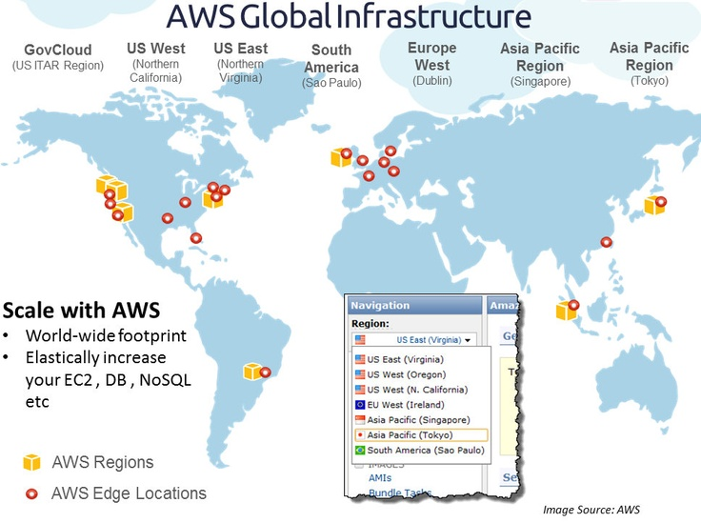
Global Reach
AWS:
84 Availability zones.
26 geographic regions.
Global network of edge locations.
Impact for Obi’s Academy:
Lower latency for international students.
Improved content delivery worldwide.
Expansion-ready infrastructure.

Slide 5
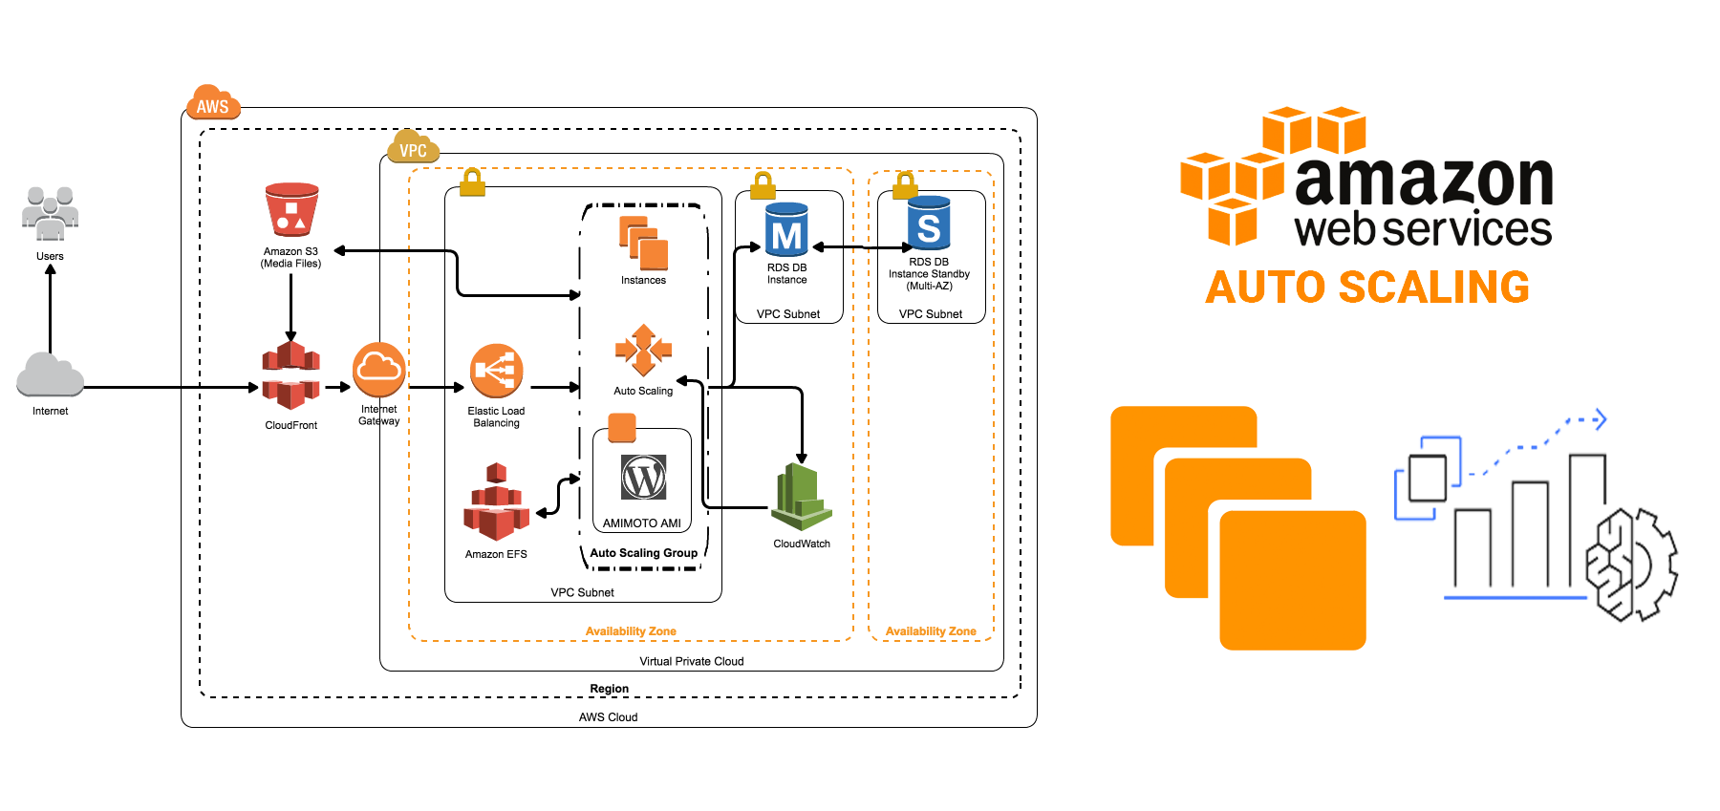
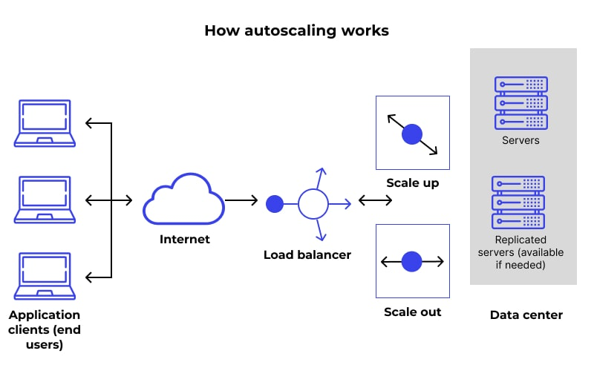
Unmatched Scalability
AWS Auto Scaling:
Automatically adjust resources based on demand.
Handle traffic spikes during peak times.
Optimize costs during low-usage periods.
Example for Obi’s Academy:
Seamlessly manage sudden influx of users during popular course launches.
Ensure smooth performance during live global webinars.

Slide 6
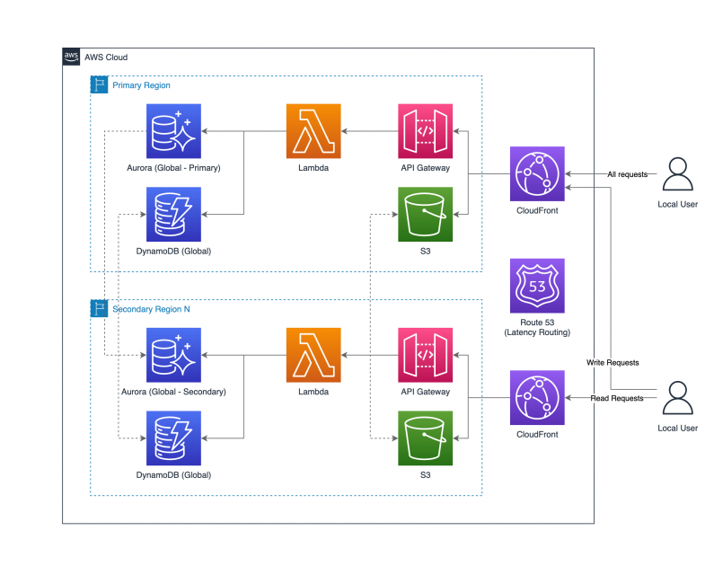
Lightning-Fast Content Delivery
Amazon CloudFront:
Global Content Delivery Network (CDN).
Optimized for video streaming.
Integrated security features.
Benefits for Obi’s Academy:
Faster video playback for online courses.
Reduced buffering and improved user experience.
Secure content delivery.

Slide 7
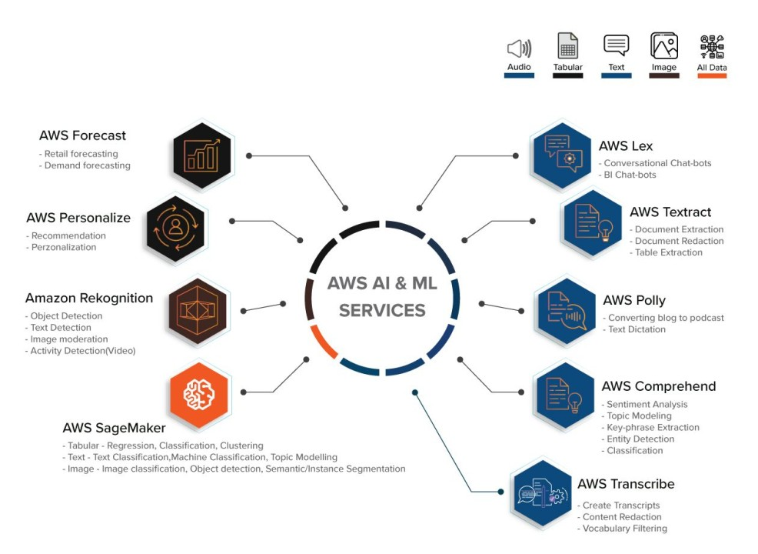
AI-Powered Learning Experience
AWS AI Services:
Amazon Rekognition: Image and video analysis.
Amazon Polly: Text-to-speech.
Amazon Transcribe: Speech-to-text.
Obi Academy's Potential Applications:
Automated video captioning.
Multi-language course translations.
Intelligent content recommendations.

Slide 8
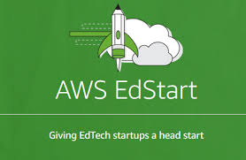
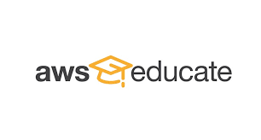
Education-Specific Advantages
AWS EdStart:
Tailored support for EdTech startups.
Mentorship and networking opportunities.
AWS Educate:
Free cloud computing courses.
Resources for educators and students.
Value for Obi’s Academy:
Accelerated growth in the education sector.
Access to education-specific best practices.

Slide 9

Robust Security and Compliance AWS Security
Features:
Advanced encryption
Identity and Access Management (IAM).
DDoS protection.
Compliance Certifications:
FERPA (Family Educational Rights and Privacy Act).
GDPR (General Data Protection Regulation).
ISO 27001.
Obi Academy's Benefit:
Protecting sensitive student data.
Meeting global education compliance standards.

Slide 10
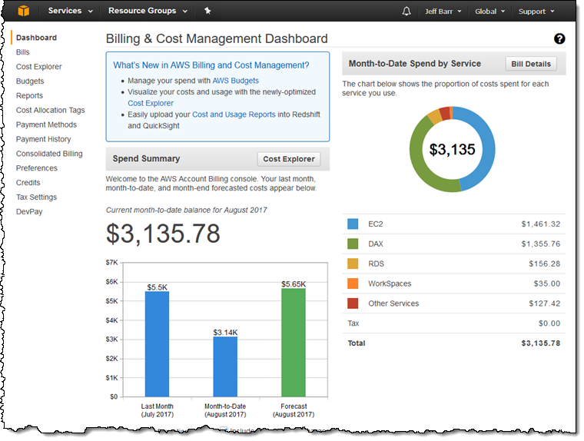
Optimized Costs, Maximum Value
AWS Cost Management Tools:
AWS Cost Explorer: Visualize and manage cloud spend.
AWS Budgets: Set custom cost and usage budgets.
Cost Optimization for Obi’s Academy:
Identify and eliminate resource waste.
Implement automated cost-saving measures.
Pay only for resources you use.

Slide 11
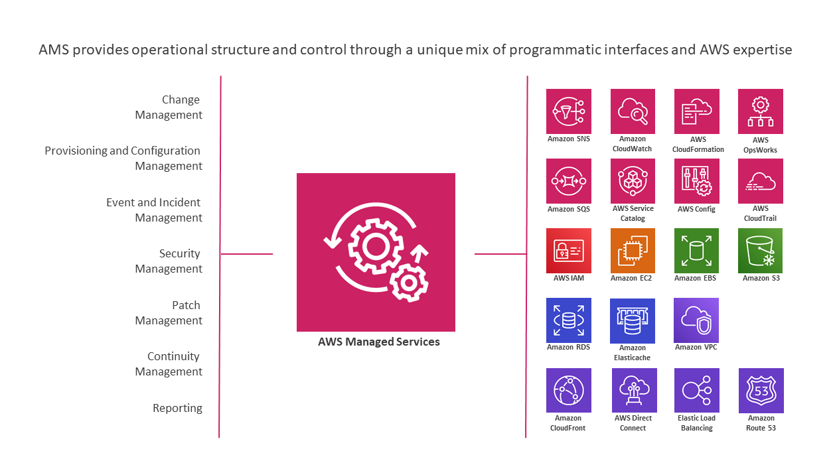
Simplified Operations with Managed Services
Key AWS Managed Services:
Amazon RDS: Automated database management.
Amazon ECS/EKS: Streamlined container orchestration.
Obi Academy's Operational Benefits:
Reduced database administration overhead.
Simplified deployment and scaling of applications.
More time for innovation, less on maintenance.

Slide 12
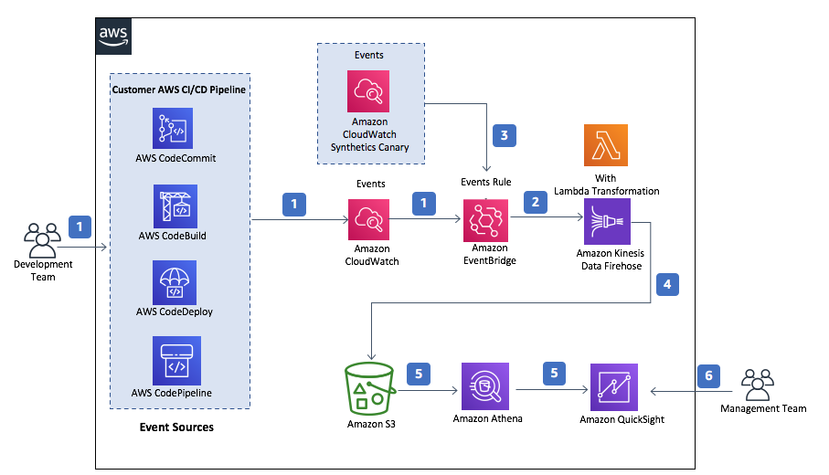
Streamlined Development Workflow
AWS Developer Tools:
AWS CodePipeline: Continuous integration and delivery.
AWS CodeBuild: Fully managed build service.
AWS CodeDeploy: Automated application deployments.
Advantages for Obi Academy's Team:
Faster time-to-market for new features.
Reduced errors in deployment process.
Improved collaboration between development and operations.

Slide 13
Unparalleled Support and Community
AWS Support:
24/7 technical support.
Optional dedicated Technical Account Manager.
AWS Community:
Extensive documentation and tutorials.
Active forums and user groups.
Regular webinars and virtual events.
Value for Obi’s Academy:
Rapid issue resolution.
Continuous learning and improvement.
Access to cloud experts and best practice.

Slide 14
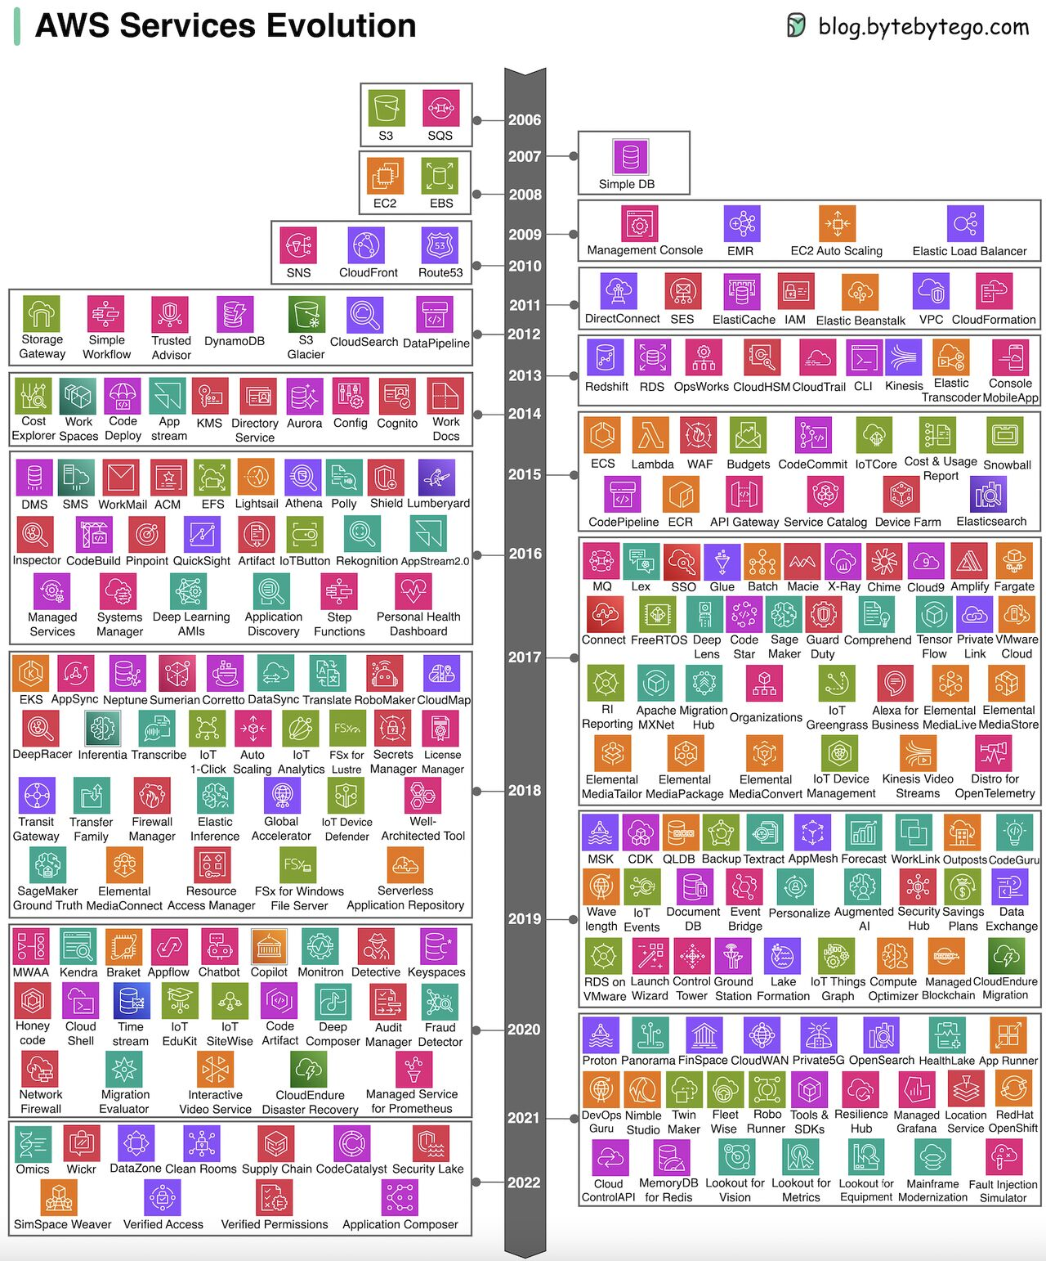
Future-Proofing Obi Academy's Platform
AWS Innovation:
Regular release of new services and features.
Cutting-edge technologies (e.g., quantum computing, blockchain)
Potential Future Integrations for Obi’s Academy:
VR/AR for immersive learning experiences.
AI-driven personalized learning paths.
Advanced analytics for educational outcomes.

Slide 15
Conclusion - Why AWS is the Clear Choice
Recap of Key Advantages:
Unmatched scalability and global reach.
Comprehensive services tailored for education.
Advanced security and compliance.
Cost-effective and future-ready platform.
Call to Action: "Choose AWS to build the future of education with Obi’s academy."

