Slide 1

Classification problems and logistic regression

Slide 2


Slide 3
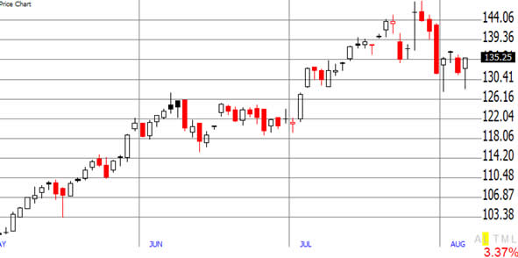
Regression vs classification
Regression: response variable is continuous
Temperature forecast for tomorrow
Company growth prediction for the next quarter

Slide 4
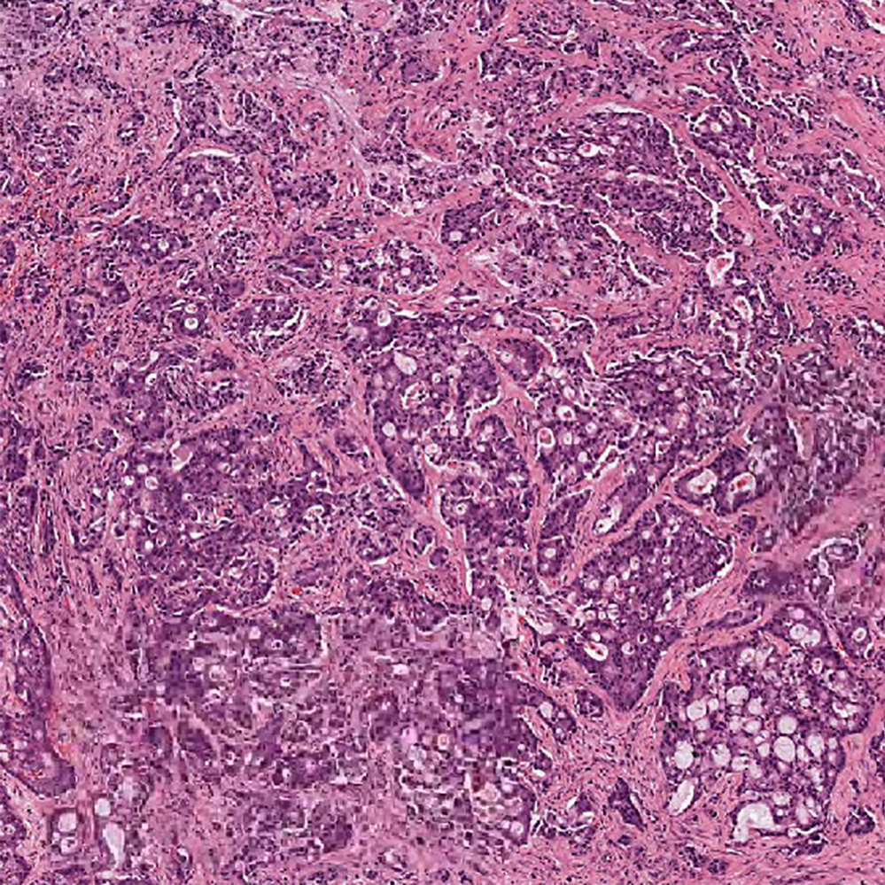
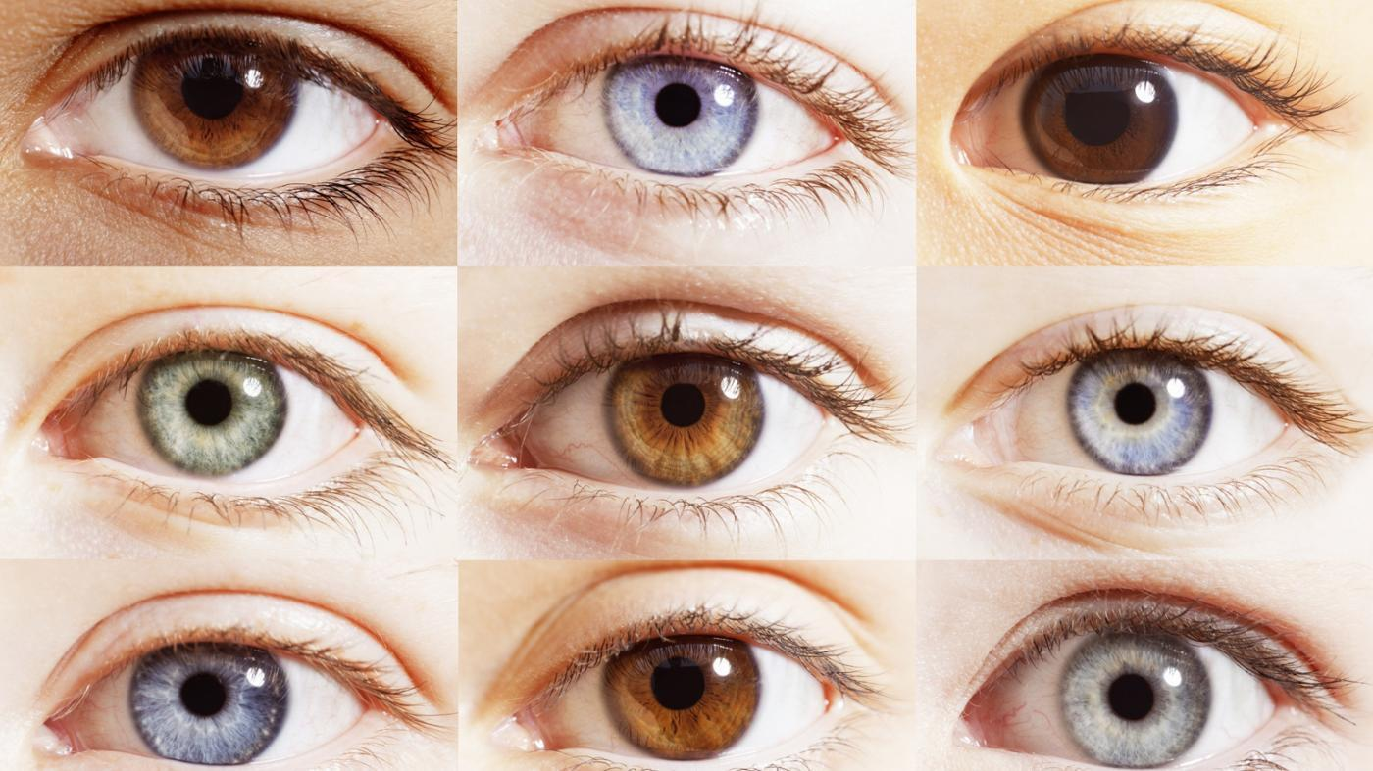
Regression vs classification
Classification: response variable is discrete
Detection of cancer in human tissue (cancer / no cancer)
Prediction of eye colour using DNA sequencing

Slide 5
Regression vs classification
Regression: response variable is continuous
Temperature forecast for tomorrow
Company growth prediction for the next quarter
Classification: response variable is discrete
Detection of cancer in human tissue (cancer / no cancer)
Prediction of eye colour using DNA sequencing

Slide 6
Problem statement
Efficient recycling requires separation of plastics / glass by their type, use data science to do this automatically.
Data set: “Glass Identification Data Set from UCI. It contains 10 attributes including id. The response is glass type.”
The goal is to predict if a glass sample is recyclable or not!

Slide 7
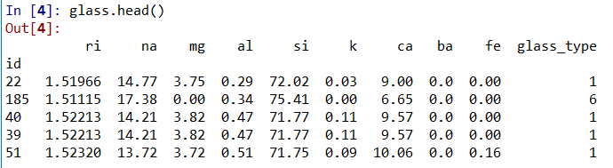
Data set
9 features:
ri – refractive index na – sodium mg – magnesium
al – aluminum si – silicon k – potassium
ca – calcium ba – barium fe - iron

Slide 8
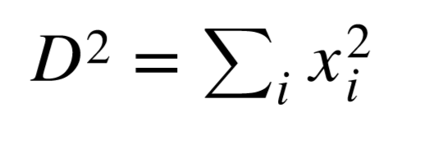
K-Nearest Neighbours (KNN)
x1
Given a set of classified points and a new point to be classified
Take ‘k’ nearest neighbours of the point in question according to some distance (usually Euclidian distance)
The category of the point in question is the mode category of it’s k nearest neighbours.
K = 3
x0

Slide 9
KNN in practice
Assuming that all the features are independent
Normalize the features

Slide 10
KNN Pros and Cons
Pros:
No training time (non parametric model)
Simple
Cons:
Time: can take a long time to classify (since all data is used)
Space: need to store the whole dataset in order to be able to predict things

Slide 11
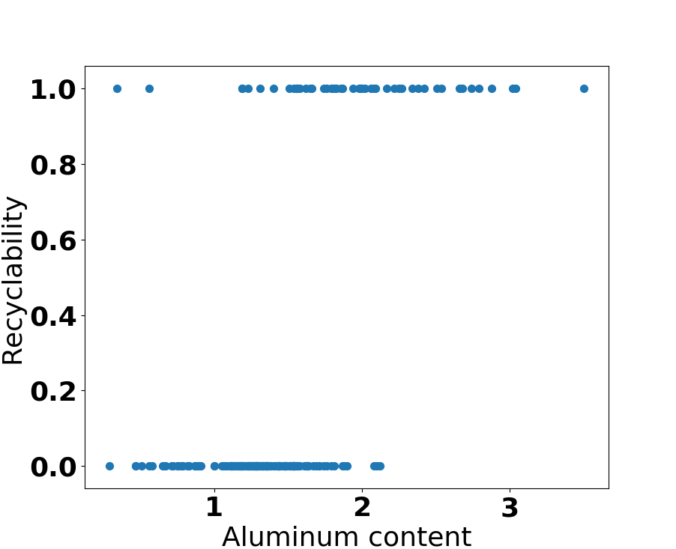
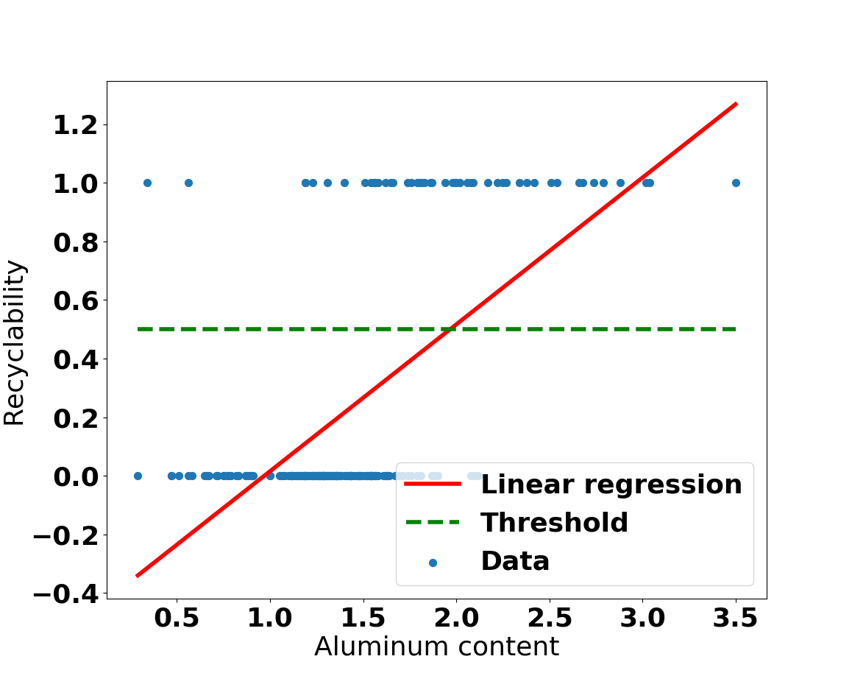
Linear Regression (bad)

Slide 12
Predicted values can be mapped:
> 0.5 → 1
< 0.5 → 0
Key questions:
What is the significance of the predicted values?
What happens with more than two labels?

Slide 13
Why not linear regression?
Cannot predict probability of the sample’s label, linear function is not bounded between [0,1].
In case of more than two labels, labeling sets inherent order.

Slide 14
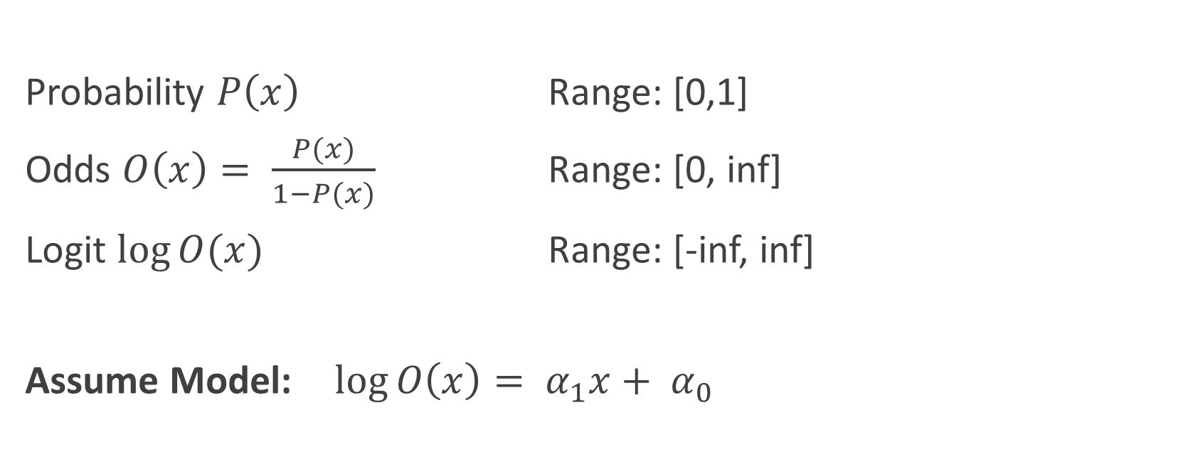
Logistic Regression
Probability $P\left(x\right)$ Range: [0,1]
Odds $O\left(x\right)= \frac{P(x)}{1−P(x)}$ Range: [0, inf]
Logit $\log{O(x)}$ Range: [-inf, inf]
Assume Model: $\log{O\left(x\right)= α_{1}x+ α_{0}}$

Slide 15
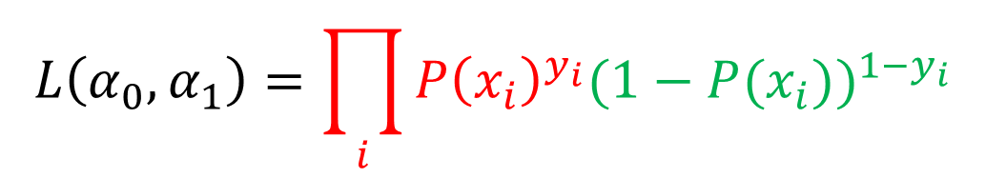

Assume: $\log{O\left(x\right)= α_{1}x+ α_{0}}$
Implies: $P\left(x\right)=\frac{e^{α_{1}x+ α_{0}}}{1+e^{α_{1}x+ α_{0}}}$
We use the likelihood function to find $α_{0},α_{1}$:
$$L\left(α_{0},α_{1}\right)=\prod_{i}{{P\left(x_{i}\right)}^{y_{i}}{(1−P(x_{i}))}^{{1−y}_{i}}}$$
We want to maximize the likelihood function

Slide 16
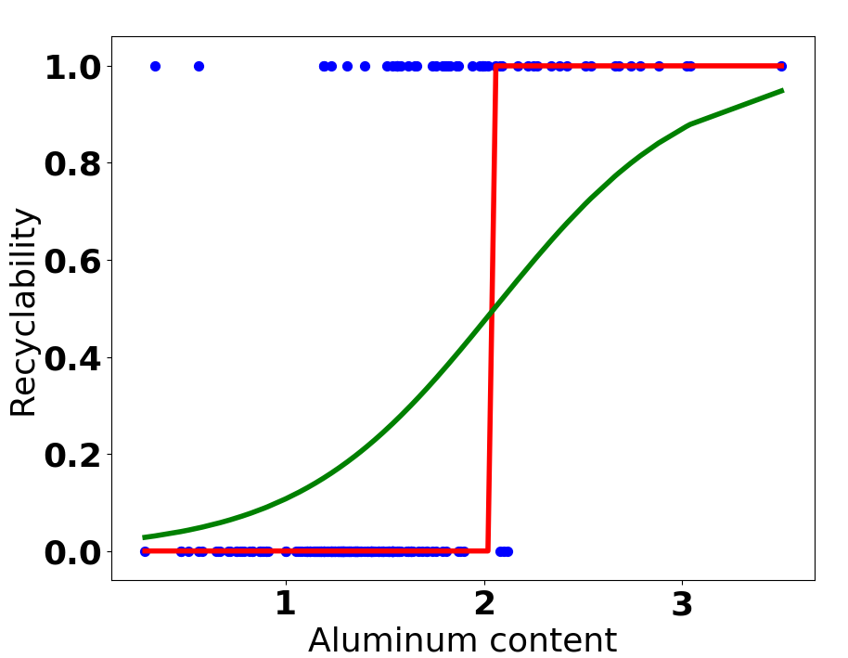
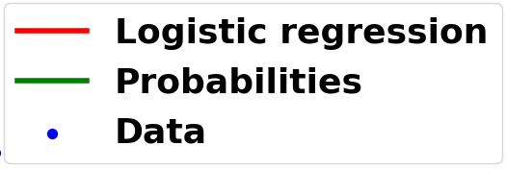
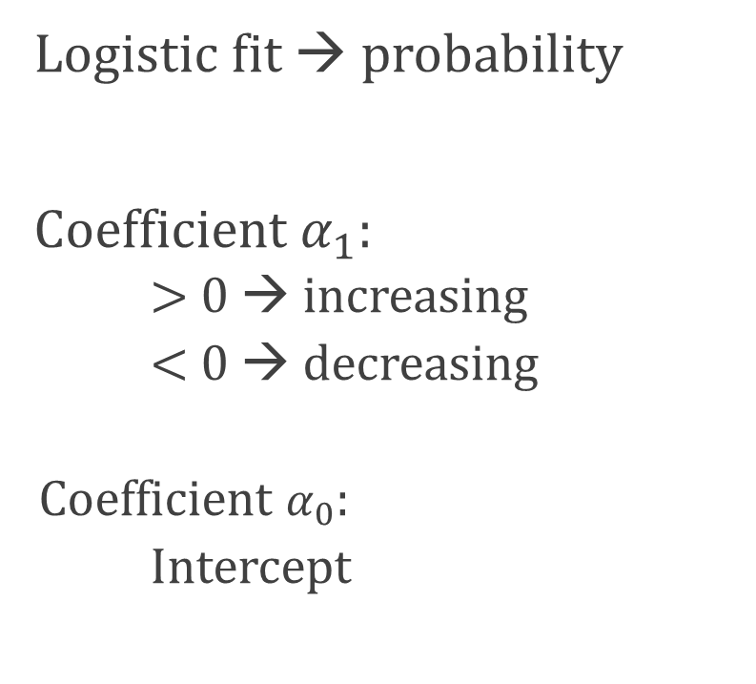
Apply logistic regression on the previous data set:
Logistic fit → probability
Coefficient $α_{1}$:
> 0 → increasing
< 0 → decreasing
Coefficient $α_{0}$:
Intercept

Slide 17

Extension I: What if there are multiple features and two labels?
Assume: $\log{O\left(x\right)=α_{0}+\sum_{i=1}^{n}{α_{i}x_{i}}}$, follow the same algorithm!

Slide 18
K-fold cross-validation
Predict how well the model generalizes to an independent set of data:
Dataset
Training set
Testing set
Rinse and repeat!

Slide 19
fold 1
TEST
Error 1
fold 2
TEST
Error 2
Average error
fold 3
TEST
Error 3
fold 4
TEST
Error 4

