Slide 1
American Express Campus Analyze This 2017
Team Envible – VIT Vellore

Slide 2
Team Details
Team Name :
Name | Campus | Roll No. | Mobile No. | Email Id
Rohan Chopra | VIT, Vellore | 14BCE0749 | 9944203800 | 09rohachopra@gmail.com
Akhil Punia | VIT, Vellore | 14BEE0100 | 8851271748 | akp1596@gmail.com

Slide 3
Index
Choosing the Target Variable.
Naïve Attempt – Shortcomings and Inferences.
Basic Objective
Model Layout
Step 1: Preprocessing Steps
Step 2: Binary Classifier
Step 3: Multi Class Classifier

Slide 4
1. Choosing the Target Variable
We have formatted the variables ‘mvar49’, ’mvar50’ & ‘mvar51’ to variables ‘target2’ & ‘target4’.
We have not used the variable ‘mvar46’, ‘mvar47’ & ‘mvar48’.
mvar49 | mvar50 | mvar51
0 | 1 | 0
0 | 0 | 0
1 | 0 | 0
0 | 0 | 1
target2 | target4
Card | Elite
None | None
Card | Supp
Card | Creidt

Slide 5
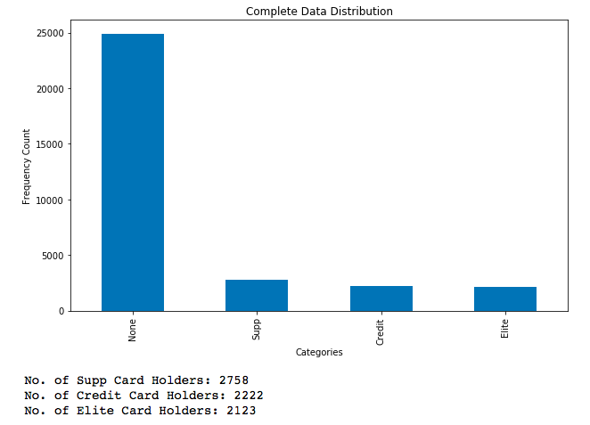
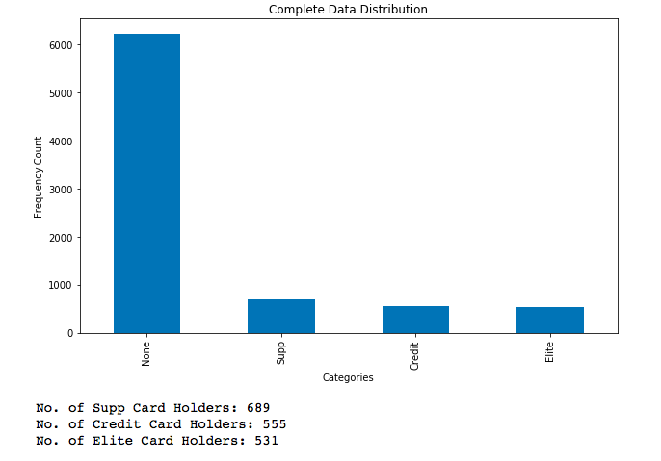
2.1 Naïve Attempt – Random Forest Classifier
In our initial attempt of the problem statement, we trained a vanilla RF Classifier to classify for 4 categories - Supp, Credit, Elite & None.
Then, we removed the customers whose predicted value was ‘None’.
From the remaining card holders ,we predict the first 1000 users.
With the above model, we achieved a score of 22400.
In order to analyse our performance, we did a stratfied split of our dataset into Train and Test.
TRAIN SET
TEST SET

Slide 6
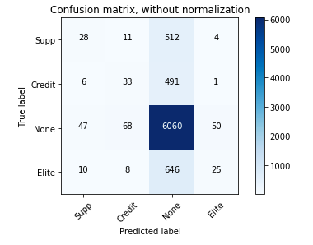
2.2 Shortcomings and Inferences
SHORTCOMINGS
The Confusion Matrix hints that a lot of Card Users are being classified as None. The Classifier might be performing poorly because it can be Overfitting.
Another reason is that the features have a lot of noise and can be cleaned.
INFERENCE
We need to perform feature cleaning and implement regularization to prevent Overfitting.
We should try model Gradient Boosting Method like XGBoost and LightGBM.
Confusion Matrix

Slide 7
3.Basic Objective
We believe that the first logical performance our model should deliver is to reach the score of 50,000.
Why ?
“ If our algorithm learns to perfectly identify who buys the card even though it doesn’t specify which of the three, then assuming the worst case where it suffers a penalty of 2 calls for 1 customer. It can help us predict 500 clients correctly. Thus, earning us 50,000. This is the first performance mark we should try to reach.”
[ NOTE: As our, Final Leadership Board score is 40,600; we have not been able to achieve this objective.]

Slide 8
4. Model Layout
We have developed a 3 Fold Model that starts with feature cleaning and feature engineering.
Then, we try to solve the imbalance of the Positive (Buying Card) to Negative cases by training a Binary Classifier that tries to eliminate negative classes thereby helping us to build a balanced dataset.
The 1000 entries with the highest probability are shortlisted by Classifier 1 and is passed onto Classifier 2.
Then, this Balanced Dataset is used for prediction using a 3 Class Classifier – Supp, Credit, Elite.
Input Data
Feature Preprocessing
Classifier #1:
Binary Classifier
Classifier #2:
Multi Class Classifier
Output Prediction

Slide 9
5. Step 1: Feature Preprocessing
Feature Preprocessing
Our Main job is to remove redundant features from the Dataset. For this we followed the following steps.
# 1 – Summing Quarterly Expenditures
mvar16-mvar19 -> Total Elec. Spend
mvar20-mvar23 -> Total Travel Spend
mvar24-mvar27 -> Total House Spend
mvar28-mvar31 -> Total Car Spend
mvar32-mvar35 -> Total Retail Spend
Mvar36-mvar39 -> Total Spend
# 2– Removing NANs
mvar3 -> column is removed since there are a lot of missing values in it.
mvar9 -> rows with missing values are removed (~1500/ 40,000)
# 3- Label Encoding on Categorical Variable ‘mvar12’
Since, mvar12 has a set of unique categories, we can use Label Encoding here.

Slide 10
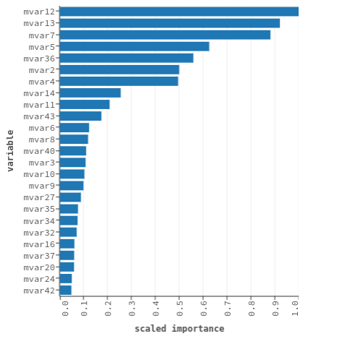
6. Step 2: Binary Classifier
Classifier #1: Binary Classifier
By making a classifier to remove customers that do not purchase cards, we can solve the big problem of Class imbalance that existed in the naïve implementation.
We have used a Gradient Boosting Classifier here.
Earlier, our classifier was just learning to classify the None Class at the cost of misclassifying the really important prediction classes.
Now, after predicting the users that can but the cards, we choose top 1000 users with the highest probability.
The Feature Importance for this classifier is displayed on the Left.

Slide 11
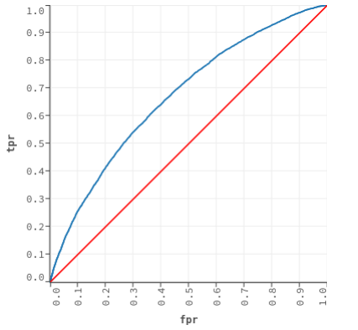
Performance Evaluation
We have used Area Under the Curve as the metric to improve our classifier performance. (AUC)
Since, our AUC value is 0.71, it is fair enough to use it pass it to predict the next step.
http://gim.unmc.edu/dxtests/roc3.htm
We believe there is further scope to improve the classifier performance by increasing the AUC Score.

Slide 12
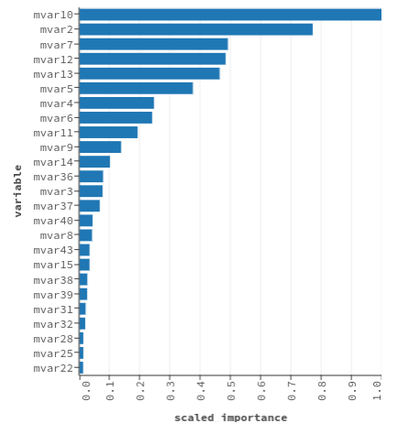
7. Step 3: Multi Class Classifier
Classifier #2: Multi Class Classifier
For training our Second Classifier, we will remove all the customers with ’None’ in the Training Data according to Target4 variable.
Then, we will train a 3 class classifier over this reduced dataset.
Again, we have used GBM Classifier.
We will use this model to predict the categories of the 1000 customers that were predicted by the first classifier.
The output received will be our final solution.

Slide 13
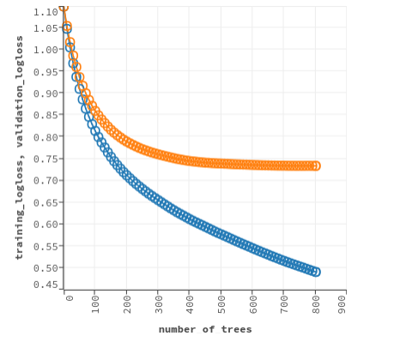
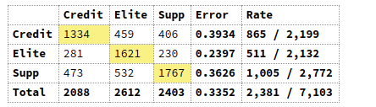
Performance Evaluation
We can find the optimal vale of the number of trees using the logloss score on the training and testing sets.
We can then use these tuned hyper parameters to make the final predictions.
We can observe that even after so much training and cross validation, we have significant error rates as seen in the Confusion Matrix.
We observe the best performance is for the Elite class. So we would put it ahead in the prediction.

