Slide 1
Introduction : Q-learning is an off policy reinforcement learning algorithm that seeks to find the best action to take given the current state. It’s considered off-policy because the q-learning function learns from actions that are outside the current policy, like taking random actions, and therefore a policy isn’t needed. More specifically, q-learning seeks to learn a policy that maximizes the total reward.
What’s ‘Q’ : The ‘q’ in q-learning stands for quality. Quality in this case represents how useful a given action is in gaining some future reward.
Create a q-table
When q-learning is performed we create what’s called a q-table or matrix that follows the shape of [state, action] and we initialize our values to zero. We then update and store our q-values after an episode. This q-table becomes a reference table for our agent to select the best action based on the q-value.

Slide 2
Q-learning and making updates
The next step is simply for the agent to interact with the environment and make updates to the state action pairs in our q-table Q[state, action].
An agent interacts with the environment in 1 of 2 ways. The first is to use the q-table as a reference and view all possible actions for a given state. The agent then selects the action based on the max value of those actions. This is known as exploiting since we use the information we have available to us to make a decision.
The second way to take action is to act randomly. This is called exploring. Instead of selecting actions based on the max future reward we select an action at random. Acting randomly is important because it allows the agent to explore and discover new states that otherwise may not be selected during the exploitation process.

Slide 3
The updates occur after each step or action and ends when an episode is done(i.e reaching terminal state).
The agent will not learn much after a single episode, but eventually with enough exploring (steps and episodes) it will converge and learn the optimal q-values or q-star (Q∗).
Here are the 3 basic steps:
1. Agent starts in a state (S1 ) takes an action (A1) and receives a reward (R1).
2. Agent selects action by referencing Q-table with highest value (max) OR by random(epsilon)
3. Update q-values
We are assigning (
←
←), or updating, the Q-value of the agent's current state and action by first taking a weight (
1−α
1−α) of the old Q-value, then adding the learned value. The learned value is a combination of the reward for taking the current action in the current state, and the discounted maximum reward from the next state we will be in once we take the current action.

Slide 4
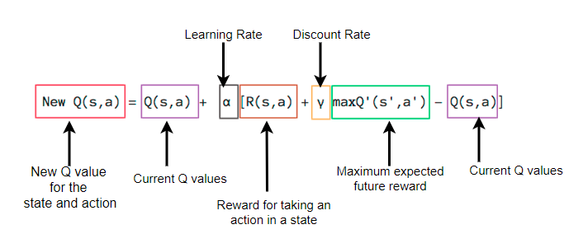
Update Rule

Slide 5
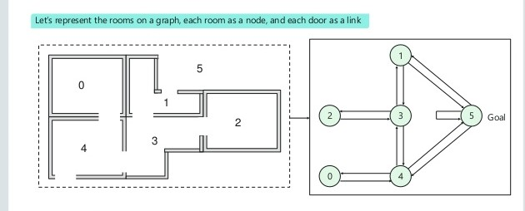
Example :

Slide 6
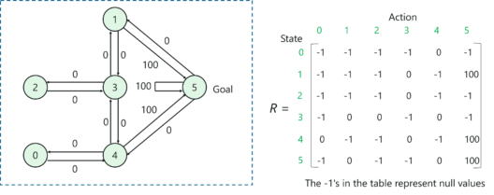
Q(state,action) = R(state,action) + Gamma * MAX(Q(next state,all actions))

Slide 7
Algorithm 1
--------------------------------------
The Q-learning algorithm
----------------------------------------
Input: For each state-action pair (s, a), initialize the table entry Q(s, a) arbitrarily, e.g., to zero. Observe the current state s, initialize a value for the learning rate α and the discount factor γ.
for t := 1 to T do
From the current state-action pair (s, a), execute action a and obtain the immediate reward r and a new state s 0 . Select an action a 0 based on the state s 0 and then update the table entry for Q(s, a) as follows:
Q_{t+1}(s, a) ← Q_{t}(s, a) + α_{t} [r_{t}(s, a)+ γ* max(Qt(s’ , a’ ) − Q_{t}(s, a) ]
Replace s ← s’ .
end for
Output: π ∗ (s) = arg maxa Q∗ (s, a)

Slide 8
Software Defined Networks
Current networks are vertically integrated: the control and data planes are bundled together. Software-defined networking (SDN) is an emerging paradigm(set of ideas) that promises to change this state of affairs, by breaking vertical integration, separating the network’s control logic from the underlying routers and switches, promoting (logical) centralization of network control, and introducing the ability to program the network.

Slide 9
SDN elements -
An SDN architecture delivers a centralized, programmable network and consists of the following:
A controller, the core element of an SDN architecture, that enables centralized management and control, automation, and policy enforcement across physical and virtual network environments
Southbound APIs that relay(to receive and then pass on a signal or message) information between the controller and the individual network devices (such as switches, access points, routers, and firewalls)
Northbound APIs that relay information between the controller and the applications and policy engines, to which an SDN looks like a single logical network device

Slide 10
Feature and Benefits :
Simplify operations :
-Reduce complexity by decoupling the control and data planes, while making automation highly secure and scalable.
Achieve faster time to market :
-Deploy applications and services faster by leveraging open APIs. Easily integrate third-party products.
Build programmable networks :
-Eliminate manual configuration. Provision and manage data centers, campuses, and wide-area networks.

Slide 11
Software-defined networking (SDN) is an emerging networking paradigm that gives hope to change the limitations of current network infrastructures.
First, it breaks the vertical integration by separating the network’s control logic (the control plane) from the underlying routers and switches that forward the traffic (the data plane).
Second, with the separation of the control and data planes, network switches become simple forwarding devices and the control logic is implemented in a logically centralized controller (or network operating system), simplifying policy enforcement and network (re)configuration and evolution.

Slide 12
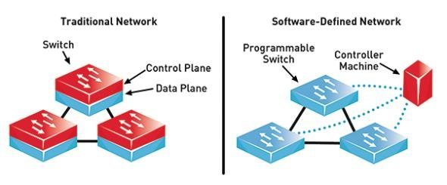

Slide 13
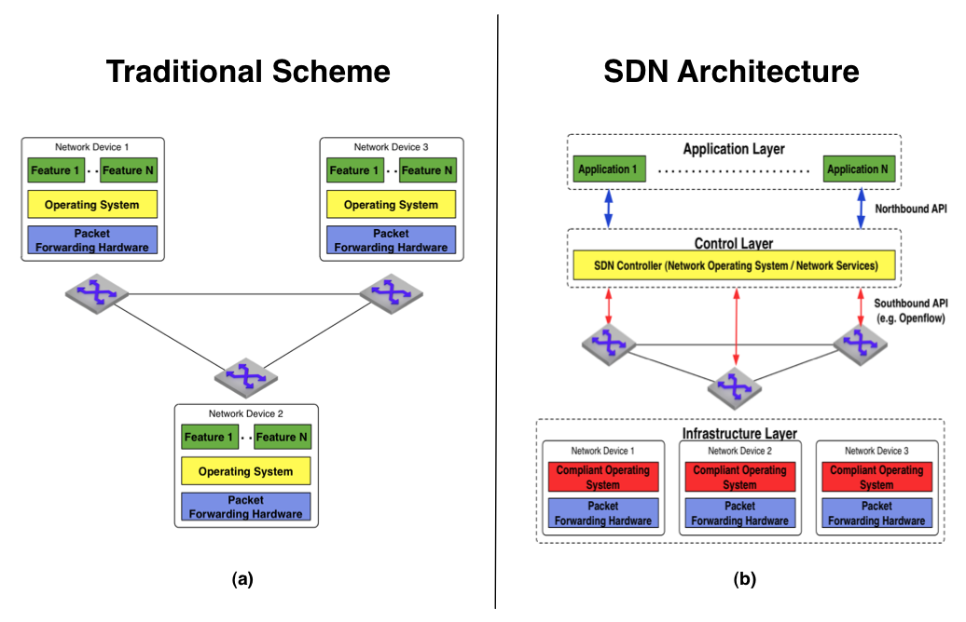

Slide 14
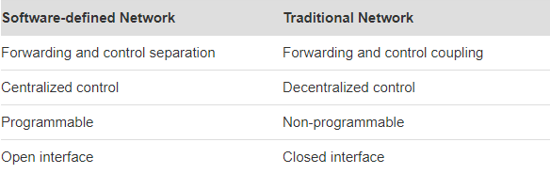

Slide 15
Computer Networks can be divided into three planes :
Data Plane Control Plane Management planes
-The data plane corresponds to the networking devices, which are responsible for (efficiently) forwarding data.
- The control plane represents the protocols(set of rules) used to populate the forwarding tables of the data plane elements.
- The management plane includes the software services, such as simple network management protocol (SNMP)-based tools, used to remotely monitor and configure the control functionality.
Network policy is defined in the management plane, the control plane enforces the policy, and the data plane executes it by forwarding data accordingly.

Slide 16
Problem with Traditional Networks :
It’s a very complex and relatively static architecture. It is also the fundamental reason why traditional networks are rigid and complex to manage and control.These two characteristics are largely responsible for vertically integrated industry where innovation is difficult.
Open Flow -
OpenFlow as the first standard communications interface defined between the control and forwarding layers of an SDN architecture. OpenFlow allows direct access to and manipulation of the forwarding plane of network devices such as switches and routers, both physical and virtual (hypervisor-based).

Slide 17
Forwarding Plane : In routing, the forwarding plane, sometimes called the data plane or user plane, defines the part of the router architecture that decides what to do with packets arriving on an inbound interface. Most commonly, it refers to a table in which the router looks up the destination address of the incoming packet and retrieves the information necessary to determine the path from the receiving element, through the internal forwarding fabric of the router, and to the proper outgoing interface(s).
In certain cases the table may specify that a packet is to be discarded. In such cases, the router may return an ICMP "destination unreachable" or other appropriate code. Some security policies, however, dictate that the router should drop the packet silently, in order that a potential attacker does not become aware that a target is being protected.

Slide 18
Control Plane :
In Routing control plane refers to the all functions and processes that determine which path to use to send the packet or frame. Control plane is responsible for populating the routing table, drawing network topology, forwarding table and hence enabling the data plane functions. Means here the router makes its decision. In a single line it can be said that it is responsible for How packets should be forwarded.
- The network is programmable through software applications running on top of the plane that interacts with the underlying data plane devices. This is a fundamental characteristic of SDN, considered as its main value proposition.

Slide 19
Benefits of Decoupling :
It becomes easier to program these applications since the abstractions provided by the control platform and/or the network programming languages can be shared.
All applications can take advantage of the same network information (the global network view), leading (arguably) to more consistent and effective policy decisions, while reusing control plane software modules.
These applications can take actions (i.e., reconfigure forwarding devices) from any part of the network. There is therefore no need to devise a precise strategy about the location of the new functionality.

Slide 20
Terminology :
1) Forwarding Devices (FD) :- These are hardware- or software-based data plane devices that perform a set of elementary operations. The forwarding devices have well defined instruction sets (e.g., flow rules) used to take actions on the incoming packets (e.g., forward to specific ports, drop, forward to the controller, rewrite some header). These instructions are defined by southbound interfaces (e.g., OpenFlow) and are installed in the forwarding devices by the SDN controllers implementing the southbound protocols.
2) Data Plane (DP): Forwarding devices are interconnected through wireless radio channels or wired cables. The network infrastructure comprises the interconnected forwarding devices, which represent the data plane.

Slide 21
3) Southbound Interface (SI): The instruction set of the forwarding devices is defined by the southbound API, which is part of the southbound interface. Furthermore, the SI also defines the communication protocol between forwarding devices and control plane elements. This protocol formalizes the way the control and data plane elements interact.
4) Control Plane (CP): Forwarding devices are programmed by control plane elements through well-defined SI embodiments. The control plane can therefore be seen as the ‘‘network brain.’’ All control logic rests in the applications and controllers, which form the control plane.

Slide 22
5) Northbound Interface (NI): The NOS can offer an API to application developers. Typically, a northbound interface abstracts the low-level instruction sets used by southbound interfaces to program forwarding devices.
6) Management Plane (MP): The management plane is the set of applications that leverage the functions offered by the NI to implement network control and operation logic. This includes applications such as routing, firewalls, load balancers, monitoring, and so forth. Essentially, a management application defines the policies, which are ultimately translated to southbound-specific instructions that program the behavior of the forwarding devices.

Slide 23
In an SDN/OpenFlow architecture, there are two main elements, the controllers and the forwarding devices -
A data plane device is a hardware or software element specialized in packet forwarding, while a controller is a software stack (the ‘‘network brain’’) running on a commodity hardware platform.
An OpenFlow enabled forwarding device is based on a pipeline of flow tables where each entry of a flow table has three parts:-
1) a matching rule
2) actions to be executed on matching packets
3) counters that keep statistics of matching packets

Slide 24
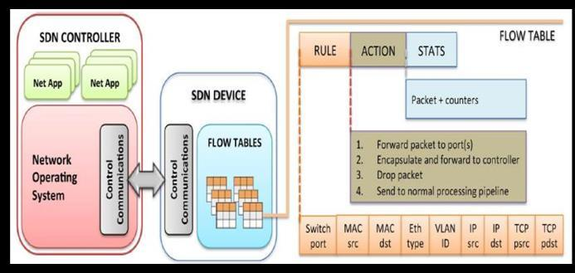

Slide 25
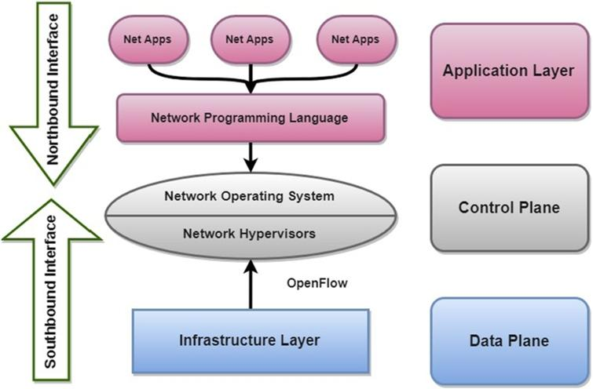

Slide 26
A. Layer I: Infrastructure
Inside an OpenFlow device, a path through a sequence of flow tables defines how packets should be handled. When a new packet arrives, the lookup process starts in the first table and ends either with a match in one of the tables of the pipeline or with a miss (when no rule is found for that packet).
A flow rule can be defined by combining different matching fields, as illustrated in Fig . If there is no default rule, the packet will be discarded. However, the common case is to install a default rule which tells the switch to send the packet to the controller.

Slide 27
Possible actions include:
1) forward the packet to outgoing port(s)
2) encapsulate it and forward it to the controller
3) drop it
4) send it to the normal processing pipeline
5) send it to the next flow table or to special tables
B. Layer II: Southbound Interfaces
Southbound interfaces (or southbound APIs) are the connecting bridges between control and forwarding elements, thus being the crucial instrument for clearly separating control and data plane functionality.
OpenFlow is the most widely accepted and deployed open southbound standard for SDN. It provides a common specification to implement OpenFlow-enabled forwarding devices, and for the communication channel between data and control plane devices (e.g., switches and controllers).

Slide 28
The OpenFlow protocol provides three information sources for NOSs :
Event based messages are sent by forwarding devices to the controller when a link or port change is triggered
flow statistics are generated by the forwarding devices and collected by the controller
packet-in messages are sent by forwarding devices to the controller when they do not known what to do with a new incoming flow or because there is an explicit ‘‘send to controller’’ action in the matched entry of the flow table.

Slide 29
Network Hypervisor : A network hypervisor is a program that provides an abstraction layer for network hardware. Network hypervisors allow network engineers to create virtual networks that are completely decoupled and independent from the underlying physical network.

Slide 30
2.An Overview : DRL
Markov Decision Process - MDP is a discrete time(A discrete-time random process involves a system which is in a certain state at each step, with the state changing randomly between steps) stochastic control process. MDP provides a mathematical framework for modeling decision making problems in which outcomes are partly random and under control of a decision maker or an agent.
Typically, an MDP is defined by a tuple (S, A, p, r) where
- S is a finite set of states
A is a finite set of actions
p is a transition probability from state s to state s 0 after action a is executed
r is the immediate reward obtained after action a is performed
The goal of an MDP is to find an optimal policy to maximize the reward function.

