Slide 1

Input
Generator
Fake image
x’
Discriminator/
classifier
Real
Loss
Fake
Training set
x
Real image

Slide 2
Latent space
Input image
Output image
μ
x
x’
Encoder
μ+σε
Decoder
σ
N(0,1)
ε

Slide 3
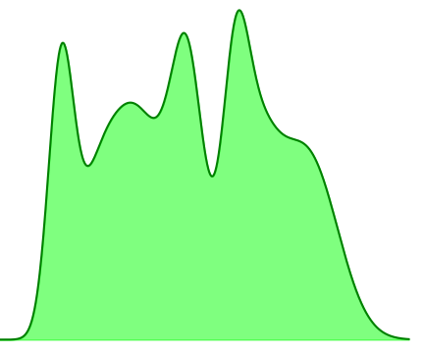
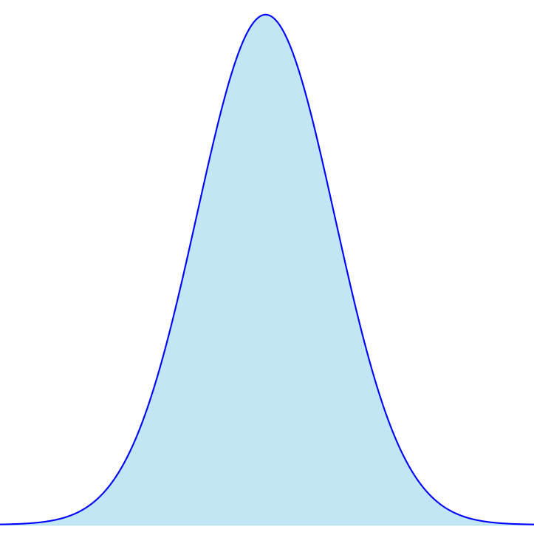
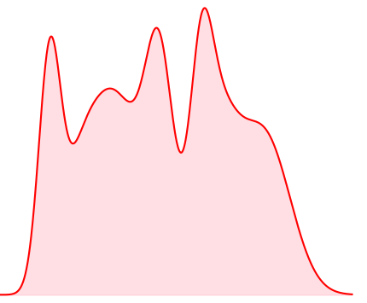
Input image
F(x)
F ⁻¹(z)
Output image
x
Encoder
z
x’

Slide 4
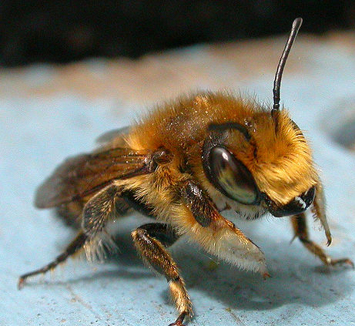
Input image
F(x)
F ⁻¹(z)
Output image
Encoder

Slide 5
Highly parallelizable
Input sentence (English)
Output sentence (French)
Encoder
Decoder
x
x’
Encoder

