Slide 1
Introduction to Machine Learning Part 2: Evaluating and improving performance
John Pinney
November 2020

Slide 2
Intended learning outcomes
After attending this workshop, you will be better able to:
Explain the difference between supervised and unsupervised learning.
Select a suitable machine learning method for a given application.
Prepare your own training and testing data sets.
Evaluate the performance of a machine learning experiment.

Slide 3
Overview
Evaluating performance
Train/Validate/Test
Cross-validation
Regression metrics
Classification metrics
ROC curve
Improving performance
Bias vs variance
Feature selection
Tree pruning
Ensemble methods
Bagging
Boosting

Slide 4
Evaluating performance

Slide 5
How can we compare different ML methods for the same task?
We need performance metrics that measure the similarity between the model’s predictions and the ground truth.
You are probably already familiar with the metric R² for assessing the fit between a linear model and the data.
A good model would have R² close to 1.

Slide 6
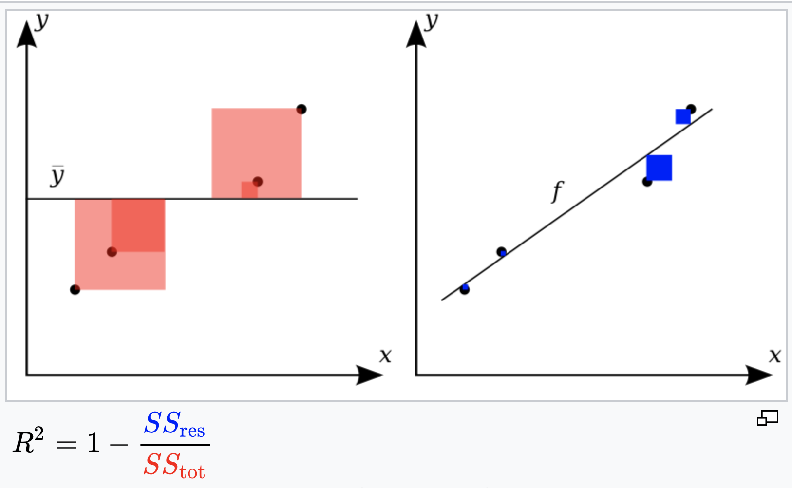
Coefficient of determination, R²

Slide 7
R² example
With the abalone dataset,
Use a tree to predict rings from the other features.
What is R² for this model?

Slide 8
Overfitting
We saw in the example that the evaluation might look very different depending on whether we use the training dataset or an unseen dataset.
A complex model might perform very well on the training data, but if it is overfitted then it will extend poorly to unseen data.
We must always be careful to make sure that our evaluation metrics are calculated on a separate testing dataset.

Slide 9
Avoiding contamination
In some circumstances, we need to take extra care to ensure that the test data is truly independent of the training data.
Part of the skill in designing a good machine learning experiment is in recognising how to filter data to avoid this kind of contamination.
e.g. if predicting protein function from sequence, ensure that there are no pairs of protein sequences that are too closely related.

Slide 10
Train / validate / …. and test !
It is crucial that the test data remains unseen during the development of the ML model.
However, we may need to “tune” various hyperparameters or model architectures to arrive at an effective model.
After the testing data is removed, we can therefore split the remaining data into “training” and “validation” sets so that we can get an idea of the performance of the current iteration of the model.

Slide 11
Cross-validation
A very commonly used technique is to apply k-fold cross-validation, where
the data is split into k equally sized subsets.
we train on (k-1) subsets and evaluate on the remaining subset.
we repeat so that each subset is used in validation.
we report the mean performance metric over the k folds.

Slide 12
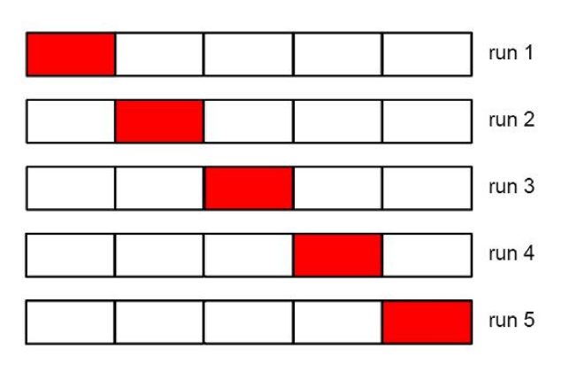
Cross-validation (k=5)

Slide 13
Other metrics for regression
There are several other metrics we can use to evaluate regression, e.g.
Mean absolute error (MAE)
(smaller is better)
Root mean squared error (RMSE)
(more sensitive to outliers than MAE)
Adjusted R²
(useful when comparing models with different numbers of variables)

Slide 14
R² exercise
With the abalone dataset,
Use a tree to predict rings from the other features.
What is R² for this model
using 5-fold cross-validation?
Does a linear regression perform better?
What is R² when the model is just a constant?
Evaluate on the test data and report a final R² for your preferred model.

Slide 15
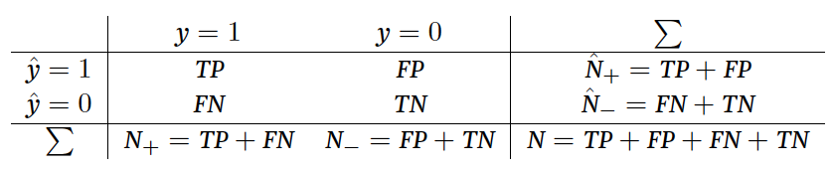
Metrics for classification
Consider this confusion matrix for a binary classification
(ground truth)
(predictions)
We can define a number of metrics from these numbers, which capture different aspects of performance.

Slide 16
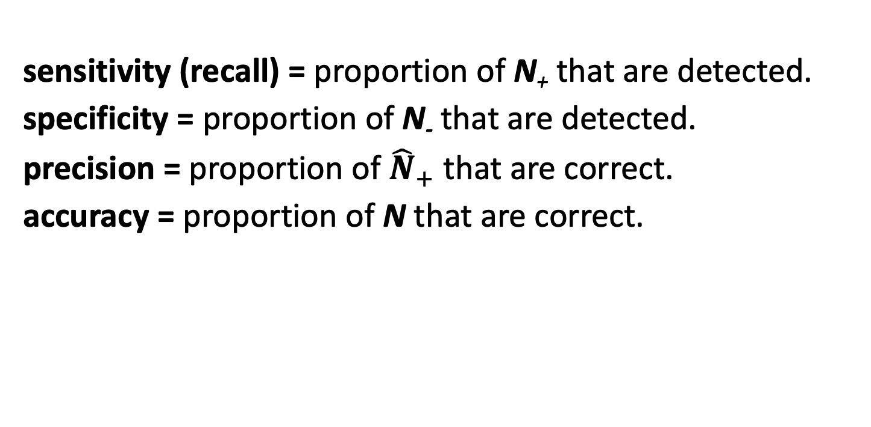
(ground truth)
(predictions)
sensitivity (recall) = proportion of N₊ that are detected.
specificity = proportion of N₋ that are detected.
precision = proportion of ${\hat{N}}_{+}$that are correct.
accuracy = proportion of N that are correct.

Slide 17
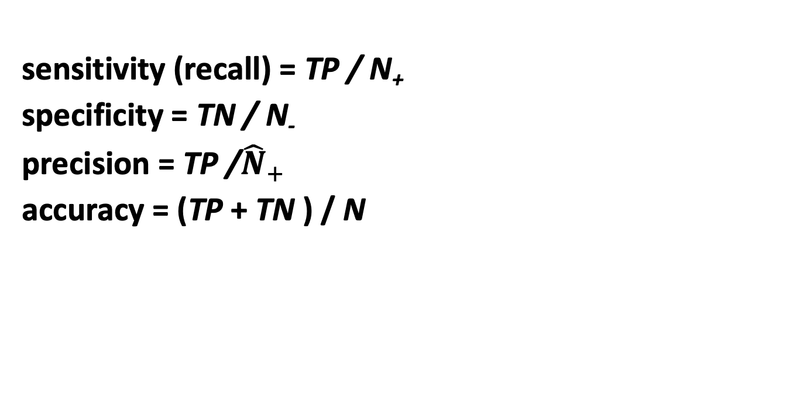
(ground truth)
(predictions)
sensitivity (recall) = TP / N₊
specificity = TN / N₋
precision = TP /${\hat{N}}_{+}$
accuracy = (TP + TN ) / N

Slide 18
Receiver operating characteristic
There is always a trade-off between sensitivity and specificity. If a method reports some kind of probability score for its predictions then we could adjust a threshold to tune between maximum sensitivity and maximum specificity.
The receiver operating characteristic is a graphical way to examine performance in terms of this trade-off.
The area under the ROC curve (AUC) is often given as an overall performance metric that is easy to compare between different methods (1 = perfect classifier)

Slide 19
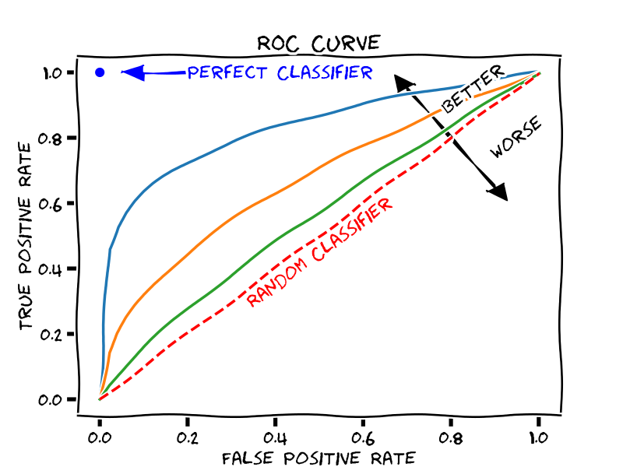
Receiver operating characteristic
sensitivity
1 - specificity

Slide 20
Classification metrics exercise
With the breast cancer dataset,
Compare the performance of a tree and a logistic regression for the task of predicting recurrence.
Visualise the performance of the two methods (over 5-fold validation) on a ROC curve.

Slide 21
Improving performance

Slide 22
Bias versus variance
These terms have a special meaning when talking about about ML performance.
Consider a set of regression predictions made from your testing dataset. There are two different ways in which these can be wrong:
high bias => the model is too simple to describe the training data well (under-fitting), so there is a systematic error in the predictions.
high variance => the model tries to replicate the training data in too much detail (over-fitting), leading to a lot of noise in the predictions.

Slide 23
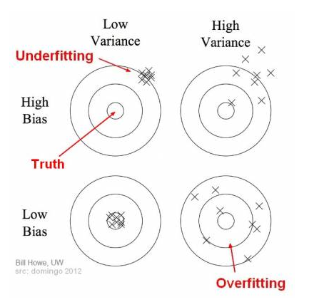
Bias versus variance

Slide 24
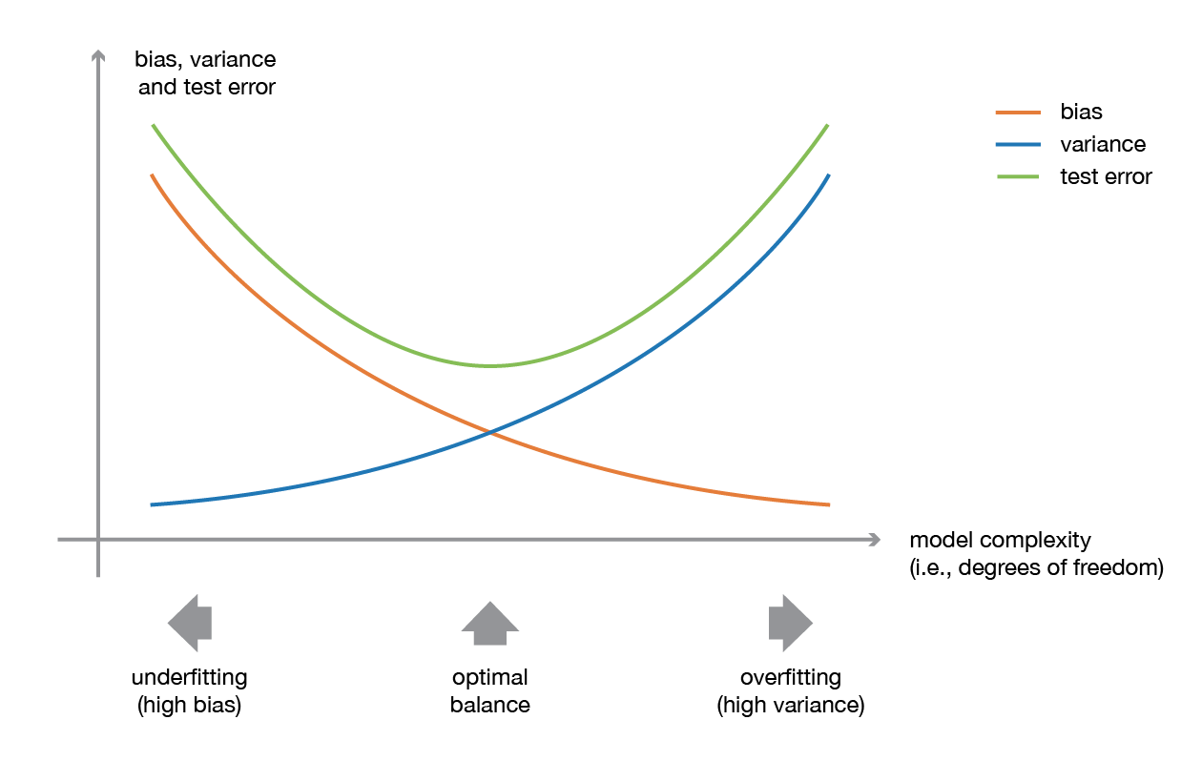
Bias versus variance

Slide 25
What can we do to improve performance?

Slide 26
What can we do to improve performance?
A larger training dataset (if available) will reduce bias.
Feature selection tries to eliminate uninformative features. This makes models simpler and less prone to over-fitting.
Tree pruning is used to reduce the variance of a decision tree, by limiting the complexity of the model.
Ensemble methods combine multiple weak learners (also called base models) to make better overall predictions.

Slide 27
Feature selection
In situations with large p + small n (i.e. many features but comparatively few data), over-fitting is difficult to avoid.
However, if we can constrain the model to a simpler form, we might be able to reduce its variance. There are many methods for feature selection or dimensionality reduction that can help.
Intuitively, a good set of informative features would all be strongly correlated with the target, but uncorrelated with each other.

Slide 28
Feature selection example
With the bone marrow mononuclear cells with AML dataset,
Using a tree to predicting disease state, find its AUC under 5-fold cross-validation.
Now using the box plot widget, identify the five features that are most predictive of disease state.
Using select columns, make a new model using only these five features and compare its performance to your original model.
Use correlations to investigate relationships between the features – can you improve the model further?

Slide 29
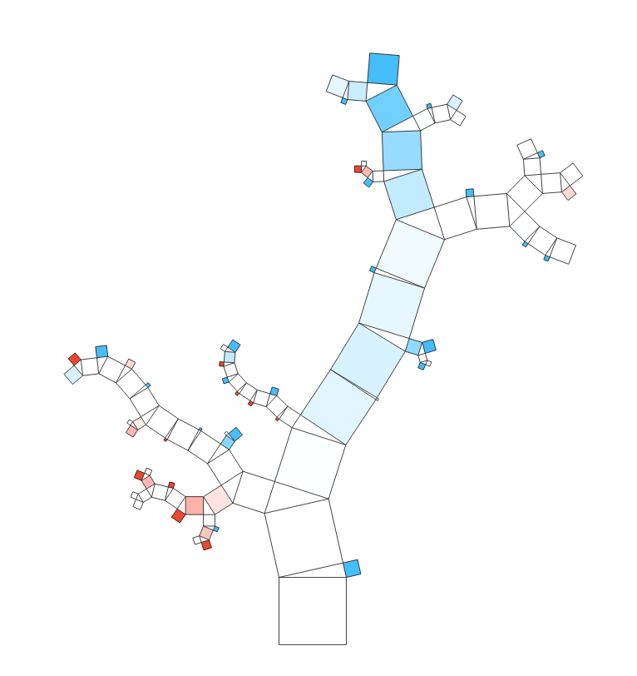
Tree pruning
Left unconstrained, a decision tree will be able to correctly classify every instance in the training data.
This results in a very complex model, with a large depth (number of splits before reaching a leaf node).

Slide 30
Tree pruning
A deep model is very likely to be overfitted, so will have high variance.
By controlling the maximum tree depth, or pruning the last few splits, we can simplify the model to reduce its variance.

Slide 31
Tree pruning exercise
With the breast cancer dataset,
Evaluate the performance of a tree for the task of predicting recurrence.
Can you improve performance by limiting the depth of the tree?

Slide 32
Ensemble methods
In an ensemble method, we combine multiple weak learners to produce an overall strong learner. Usually the component models are all of the same type.
We will need to choose
the base model, and
the way in which models are combined
here we will consider bagging and boosting.

Slide 33
Bagging
”Bagging” refers to bootstrap aggregating, i.e. a way to train many different versions of a model in parallel, then combine them to (hopefully) generate an ensemble model that has less variance than each component model.
Bootstrap sampling just means to sample data with replacement. This is a way to generate multiple datasets with similar properties to the original training data.
Once trained, the overall prediction of the ensemble on the testing data is obtained by majority voting.

Slide 34
Random forest
A very popular bagging method is called random forest.
This is an ensemble of trees, each built from a different bootstrap sample from the training data.
At each split in the tree-building process, the algorithm chooses a random subspace of features to consider. This ensures that each tree is sufficiently different from the others.

Slide 35
Trees vs forest example
With the breast cancer dataset,
Set aside test and validation datasets.
Use data samplers to create three bootstrap datasets from the remaining training data.
Train three corresponding trees to predict recurrence on the validation data and compare results. Would an ensemble model with majority vote improve performance?
Use the random forest to explore what happens when we introduce the random subspace method and supply more trees to the ensemble.

Slide 36
Boosting
In contrast to the parallel training performed in bagging, “boosting” methods train multiple models sequentially. The aim is to produce an ensemble model that is less biased than the base model.
The basic idea is that each model in the sequence gives more importance to the training examples that were poorly predicted by the model before.

Slide 37
AdaBoost
Adaptive boosting is one widely used boosting algorithm.
It works by building up an ensemble model from sequentially fitted weak learners, e.g. decision stumps.
As well as fitting each component model, we need to decide how much it should contribute to the overall model, known as its weight.

Slide 38
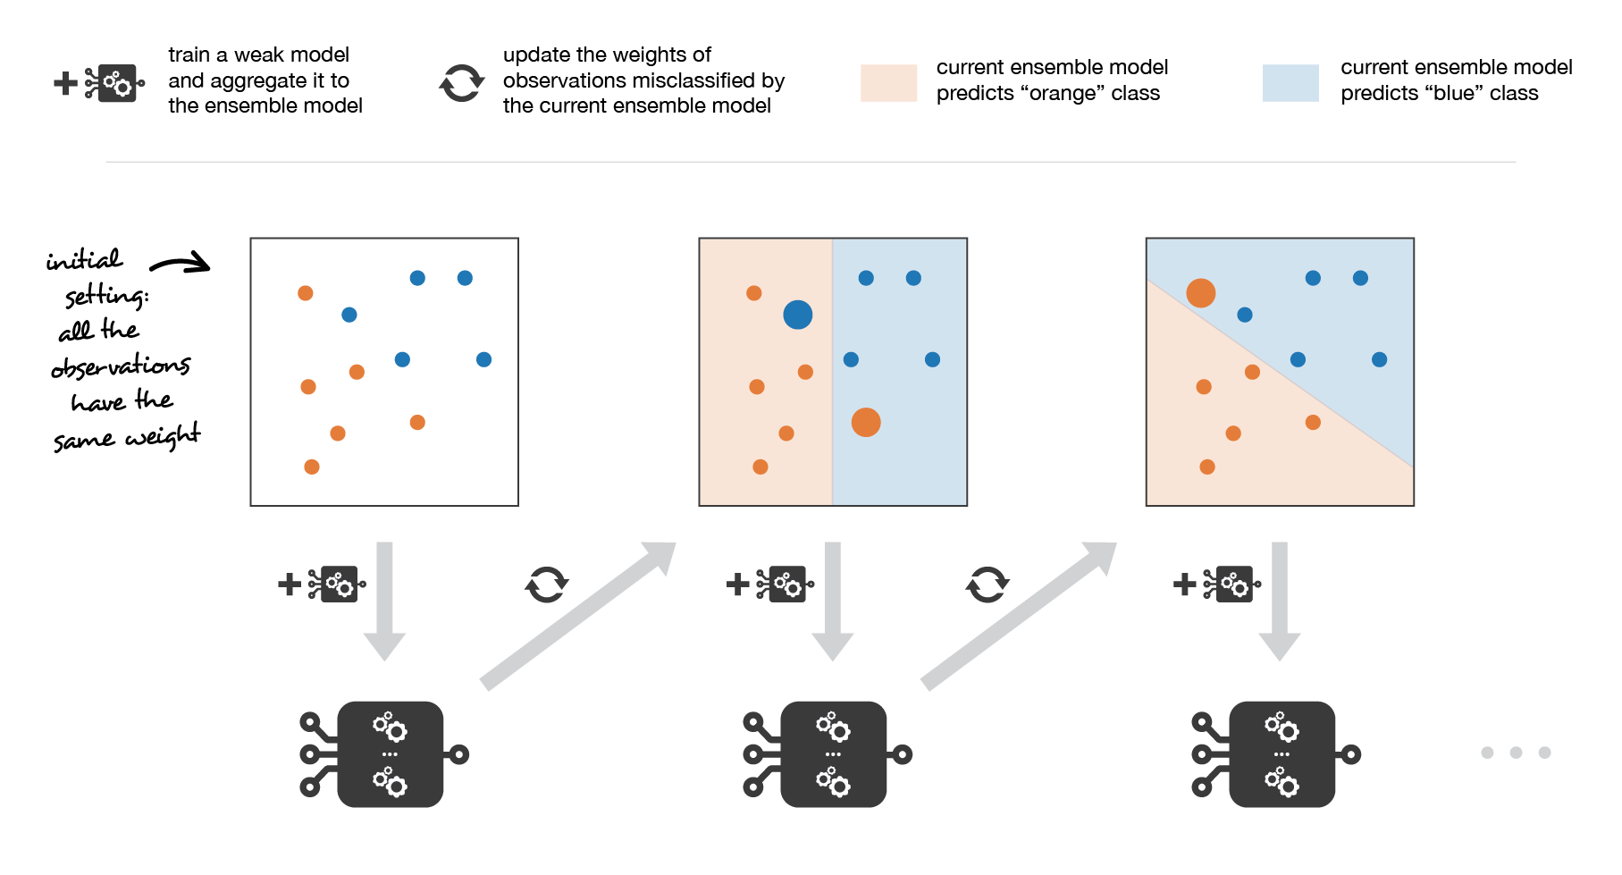
AdaBoost

Slide 39
AdaBoost
model 1
weight 1

Slide 40
AdaBoost
model 1
model 2
weight 1
weight 2

Slide 41
Summary of Part 2
Performance in supervised learning is evaluated using a variety of metrics, using a test dataset.
Cross-validation can be used to assess models during development.
Performance is affected by both bias and variance.
Feature selection is one way to reduce variance when there are many uninformative features.
Bagging and boosting are examples of ensemble methods, which combine multiple weak learners to improve performance.

Slide 42
Next time…
What are neural networks and how do they work?
How does deep learning differ from the supervised methods we have seen so far?

