Slide 1
Introduction to Machine Learning Part 1: Supervised and Unsupervised Learning
John Pinney
November 2020

Slide 2
Intended learning outcomes
After attending the three sessions of this workshop, you will be better able to:
Explain the difference between supervised and unsupervised learning.
Select a suitable machine learning method for a given application.
Prepare your own training and testing data sets.
Evaluate the performance of a machine learning experiment.

Slide 3
Overview
What is machine learning?
Types of data
Unsupervised learning
Clustering
k-means
Supervised learning
Regression
linear models
Classification
logistic regression
decision trees

Slide 4
What is machine learning?

Slide 5
What is machine learning?

Slide 6
Statistical learning theory
Theory was introduced in the late 1960s.
Became an applied science in 1990s.
Allows us to
detect or learn structures and relationships in data.
assign observations to different classes.
make predictions based on current knowledge.

Slide 7
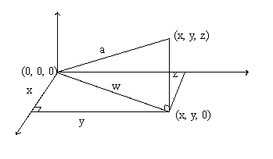
Some essential vocabulary…
vector
A quantity within a multidimensional space.

Slide 8
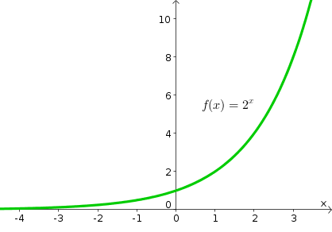
Some essential vocabulary…
function
A mapping from one vector space (input) to another (output).

Slide 9
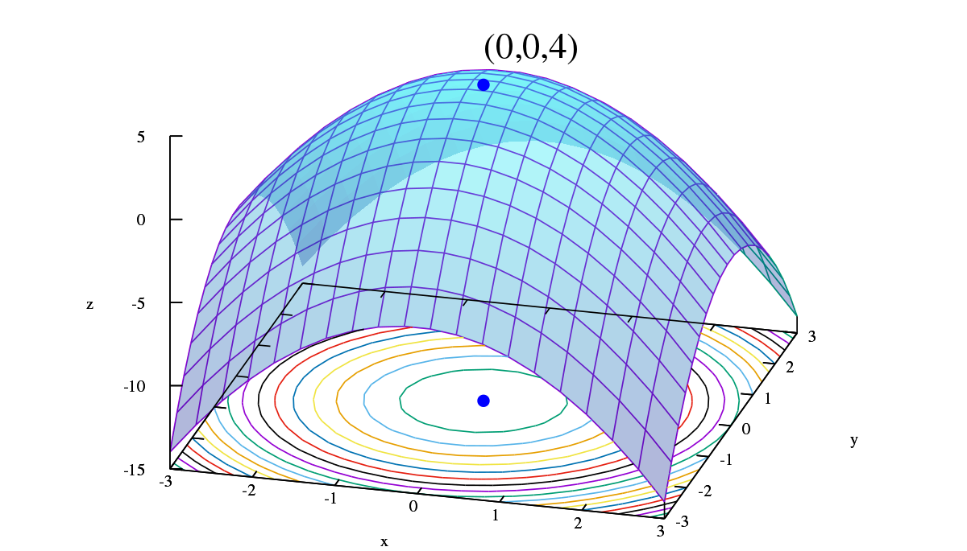
Some essential vocabulary…
optimisation
A procedure that attempts to find the minimum (or maximum) of a function.

Slide 10
A ‘machine’ has inputs and outputs.
input feature vector, x
output vector, y
machine
(acts like a function)

Slide 11
The machine has parameters that we might need to fit (optimise) using training data.
training data
input vector, x
output vector, y
machine

Slide 12
Types of data

Slide 13
Categorical data (no numerical relationship between values)
Nominal data: no obvious ordering of categories.
e.g. class of vertebrate:
amphibian / bird / fish / mammal / reptile
When there are only 2 possible categories, data is called dichotomous or binary.
Ordinal data: there is a natural order for the categories.
e.g. opinion on a Likert scale:
strongly disagree / disagree / neutral / agree / strongly agree

Slide 14
Quantitative data (numerical data from counts or measurements)
Discrete data: can only take specified values.
e.g. number of children in a family (integer)
Continuous data: can take any value in an interval.
e.g. blood pressure

Slide 15
Example dataset
Take a look at the iris dataset.
What are the features and what are their data types?

Slide 16
Unsupervised learning

Slide 17
Unsupervised learning
In unsupervised learning, we are looking for structure in the inputs without any knowledge of associated outputs: the data are considered to be unlabelled.
We are seeking to “discover new knowledge”
Examples include:
Dimensionality reduction, e.g. principal component analysis
Self-organising map
Clustering

Slide 18
Clustering
To look for structure within a dataset, we often make use of clustering techniques.
A set of objects is grouped in such a way that objects in the same cluster are more similar (in some sense) to each other than to those in other clusters.
It is a central task in exploratory data mining.

Slide 19
Clustering
0
0
2
1
machine
2
1
1
2
2
output cluster labels, y
input dataset, x

Slide 20
Clustering
Feature-based clustering
takes as input the set of input feature vectors.
Distance-based clustering
takes as input a matrix of distances that are calculated between each pair of input feature vectors.
e.g. Euclidean distance.
Clustering methods may be flat (just reporting cluster labels) or hierarchical (reporting a dendrogram of nested clusters).

Slide 21
k-means clustering
A feature-based technique for flat clustering.
Requires a prior decision of the number of clusters (k) – in practice a good value for k for a given data set can sometimes be found by post-hoc analysis (e.g. silhouette score).
k-means clustering aims to partition n observations into k clusters, in which each observation belongs to the cluster with the nearest mean.

Slide 22
k-means clustering algorithm
Initialise positions for k cluster centroids (at random).
Assignment step: Assign each observation to the cluster whose centroid is “nearest” according to the chosen distance metric.
Update step: Calculate the new centroid positions according to the observations assigned to each cluster.
Check for convergence (cluster assignments did not change). If not converged, go to 2.

Slide 23
k-means clustering
k-means is often fast in practice, but is a heuristic method so is not guaranteed to find the global optimum. Re-running several times with different starting points is therefore advisable.
Note that this is an example of an expectation maximisation approach.

Slide 24
k-means example
Using only the numerical features,
cluster the iris dataset.

Slide 25
k-means exercise
Look at the housing dataset.
Considering only the numerical features, perform k-means clustering. Use the silhouette score to determine how many clusters the data appear to fall into.
Does this clustering reveal any insights into the data?

Slide 26
Supervised learning

Slide 27
Supervised learning
Here, labelled data are used to “train” a machine learning algorithm, which is then used to classify or predict the response of new input data.
We want to learn the function

Slide 28
Supervised learning
input vectors, x
output vectors, y
Labelled training data
machine
?
predictions
?

Slide 29
Two types of supervised learning
y is a quantitative value
=> Regression
(estimate the response to a given input)
y is a categorical variable
=> Classification
(identify the class of a given input)

Slide 30
Supervised learning: Regression

Slide 31
Regression
labelled training data
machine
?
predictions
?

Slide 32
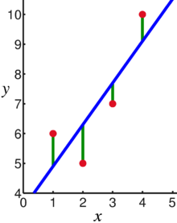
Linear regression
Predict y from the features of x by fitting a linear function.
Fitting is an optimisation procedure: e.g. minimise the sum of squared errors.

Slide 33
Linear regression example
With the iris dataset:
Considering only iris virginica:
1. Split the data into training and testing sets.
2. Use linear regression to predict sepal length from petal length.

Slide 34
Linear regression exercise
With the abalone dataset:
Considering only adults:
1. Split the data into training and testing sets.
2. Use linear regression to predict rings from the numerical features.

Slide 35
Linear regression with many features
We often want to apply some kind of regularisation to our model, so that small coefficients are pushed to zero. E.g. ridge regression, lasso or elastic net.
This makes models simpler and easier to interpret, and potentially shows which features are informative for predicting y.

Slide 36
Supervised learning: Classification

Slide 37
Classification
labelled training data
machine
?
predictions
?

Slide 38
Logistic regression
Confusingly, logistic regression is an algorithm for classification.
Consider a binary classification, with classes labelled 0 and 1.
For our training data, we can plot the probability that a particular value of x is labelled as class 1.

Slide 39
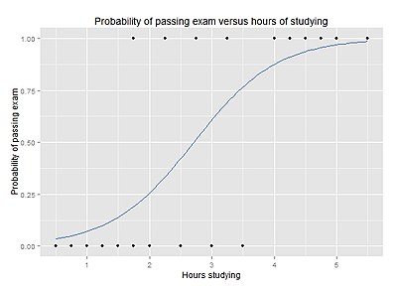
Logistic regression
Passed exam ( 1 = yes )
Hours of study

Slide 40
Logistic regression
Probability of passing exam
fitting a logit (sigmoid) function to the training data
Hours of study

Slide 41
Logistic regression
Probability of passing exam
Predict fail
Predict pass
Hours of study

Slide 42
Logistic regression example
With the iris dataset:
Considering iris versicolor and virginica:
1. Split the data into training and testing sets.
2. Predict iris (the species) from petal length.
3. Use a confusion matrix to examine the results.
4. Do the results improve if the other numerical features are included?
Do the same for a three-class logistic regression.

Slide 43
Logistic regression exercise
With the kickstarter dataset:
1. Split the data into training and testing sets.
2. Predict funded from the numerical features.
3. Use a contingency table to examine the results.
4. How could we make use of the type feature, which is a nominal data type?

Slide 44
‘One-hot’ encoding
Useful for converting a categorical variable into multiple binary features, which can be used in algorithms that require numerical inputs.

Slide 45
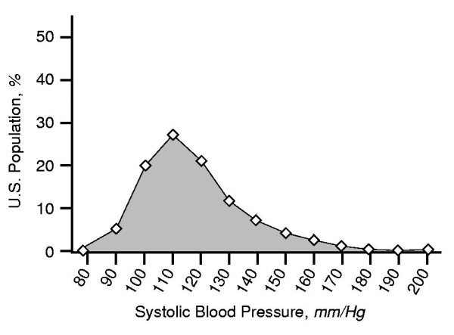
What about non-linear classification?
Which patients will visit the doctor within the next 3 months?

Slide 46
What about non-linear classification?
Visited doctor
Did not visit doctor
Visited doctor

Slide 47
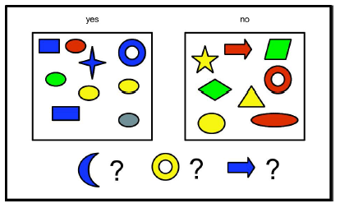
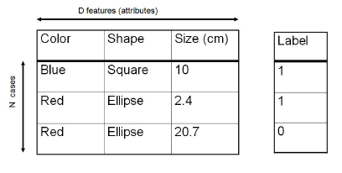

Slide 48
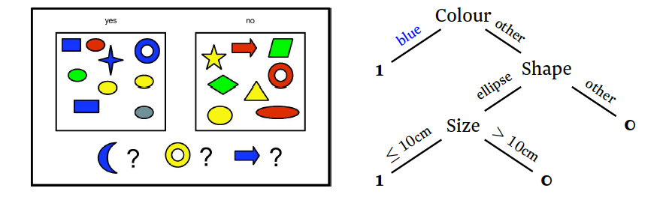
Decision tree
Finding an optimal tree is very difficult. In practice, we use a greedy algorithm, which builds the tree step by step, optimising the result at each stage.

Slide 49
Decision tree example
With the full iris dataset:
1. Split the data into training and testing sets.
2. Predict iris (the species) from the other features.
3. Use a tree viewer to examine the resulting decision tree.
4. Use a confusion matrix to examine the results.

Slide 50
Decision tree exercise
With the titanic dataset:
1. Split the data into training and testing sets.
2. Predict survived from the other features.
3. Use a tree viewer to examine the resulting decision tree.
4. Use a confusion matrix to examine the results.

Slide 51
Summary of Part 1
Machine learning is a subfield of artificial intelligence, concerning data-driven predictions.
Clustering (e.g. k-means) is an unsupervised approach. It can be used to discover structure in unlabelled data.
Regression (e.g. linear regression) is a supervised approach. It predicts a numerical output from the input features.
Classification (e.g. logistic regression, decision tree) is also a supervised approach. It predicts a categorical output from the input features.

Slide 52
Next time…
How can we evaluate and compare performance in supervised learning?
How can we improve performance beyond the basic algorithms?

