Slide 1
Introduction to Machine Learning Part 3: Neural networks and deep learning
John Pinney
November 2020

Slide 2
Intended learning outcomes
After attending this workshop, you will be better able to:
Explain the difference between supervised and unsupervised learning.
Select a suitable machine learning method for a given application.
Prepare your own training and testing data sets.
Evaluate the performance of a machine learning experiment.

Slide 3
Overview
Neural networks
Perceptron
Multiple layers
Gradient descent
Backpropagation
Activation functions
Deep learning
Deep networks
Unstructured data
Convolution
Embedding
Special architectures

Slide 4
Neural networks

Slide 5
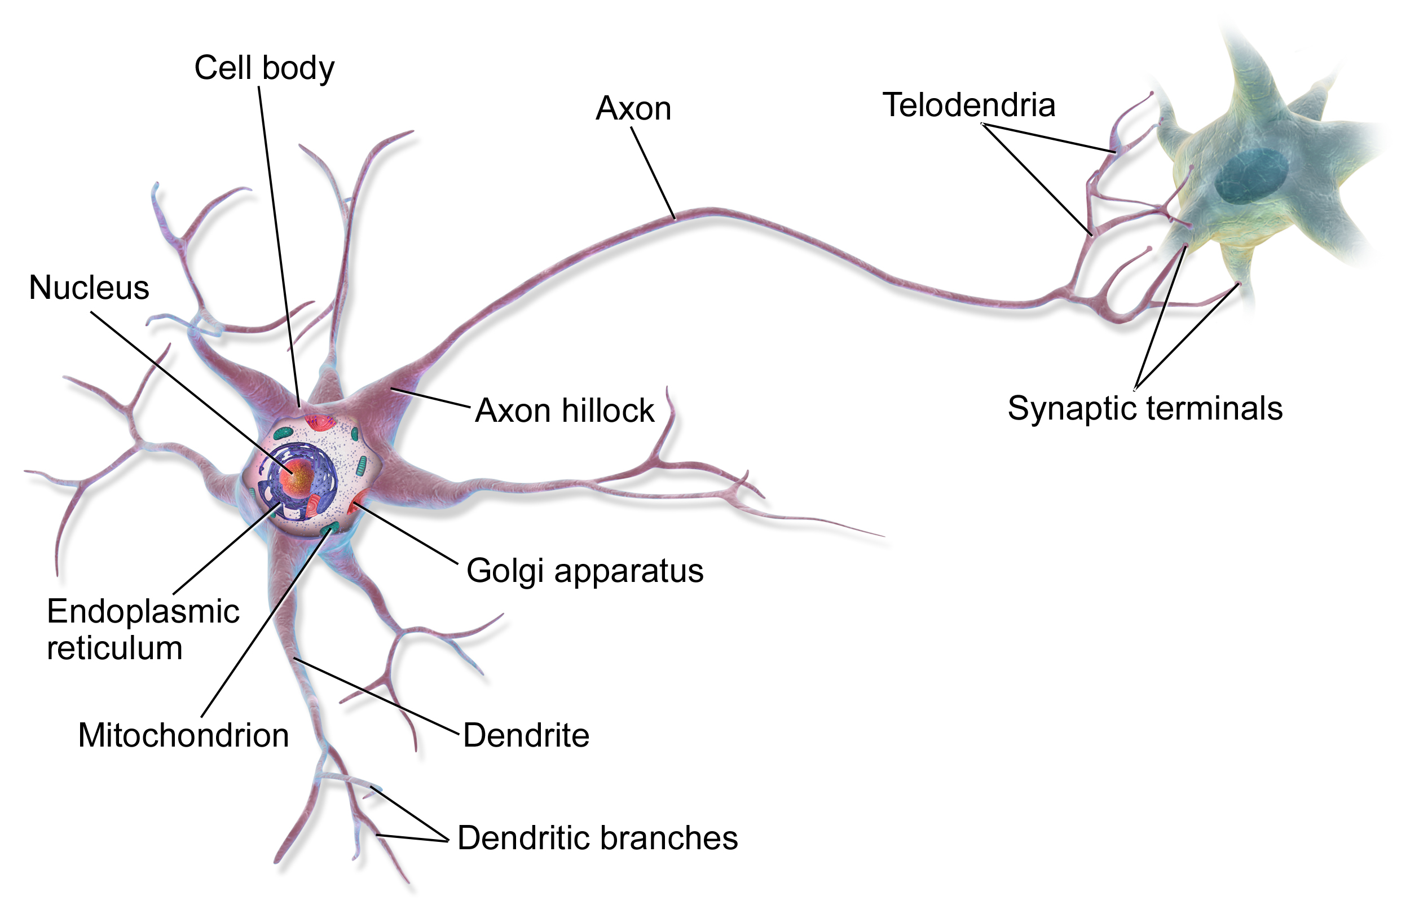
Biological neuron
single output: “all or nothing”
signal processing
multiple inputs

Slide 6
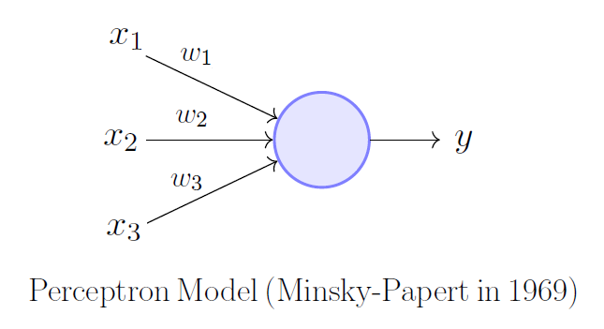
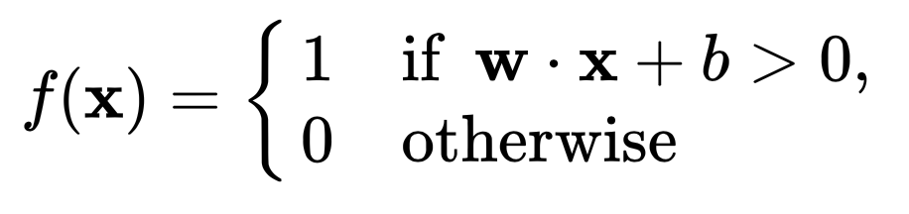
Perceptron (1958)
weighted sum of inputs
multiple inputs
single output: 0 or 1
arc
bias provides a threshold
activation function

Slide 7
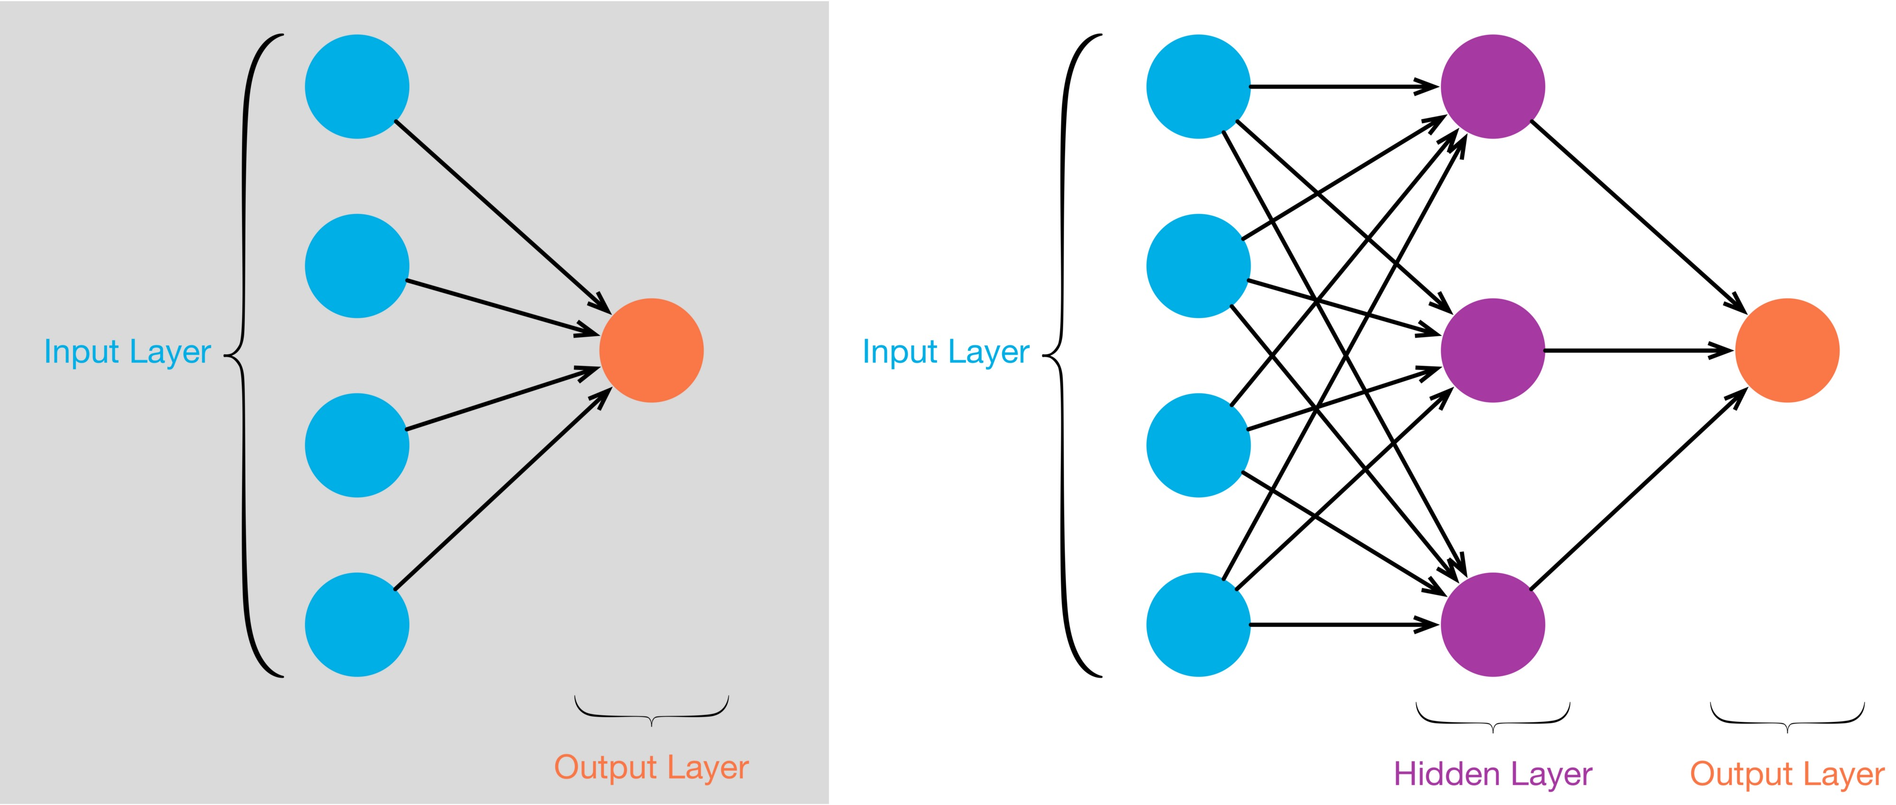
Single-layer network

Slide 8
Multi-layer network
A feedforward network contains no directed loops

Slide 9
Multi-layer networks
Use multiple hidden layers to create more complex models => can solve more complex problems.
The model will “discover” its own representation of the data in a way that best fits the learning task.
Neurons in hidden layers can therefore represent complex features without any need to engineer these a priori.
This can be very powerful if enough training data is available.

Slide 10
Fitting a neural network model
To train our model, we need to find values for the weights, w. (We can incorporate the bias b as an additional weight w₀).
The best choice of w would minimise an appropriate loss function for our predictions compared to the training data labels (e.g. mean squared error for a regression task).
For a network with m arcs and n neurons, w has (m+n) components: we will be optimising in a high-dimensional parameter space.

Slide 11
Gradient descent
This is a simple but effective optimisation method in high dimensions, which uses the gradient (i.e. slope) of the loss function and takes progressive small steps downhill until it finds a minimum.
Stochastic gradient descent includes a small random movement to helps us escape local minima.

Slide 12
Gradient descent example
With the iris dataset,
Use gradient descent to fit a binary logistic regression model that can predict iris versicolor from only petal length and petal width.

Slide 13
Backpropagation
To calculate the gradient of the loss function,we start from the output layer and work back layer by layer to build up its derivative with respect to each of the weights.
This technique is known as backpropagation

Slide 14
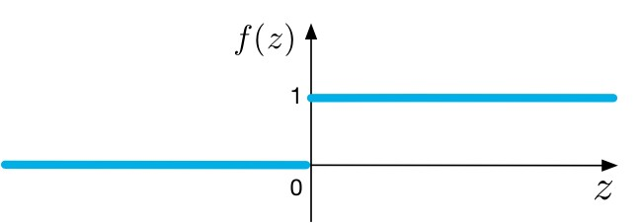
Problems with the activation function
binary output makes network less expressive
z =
zero gradient everywhere (except z=0) means backpropagation won’t work!

Slide 15
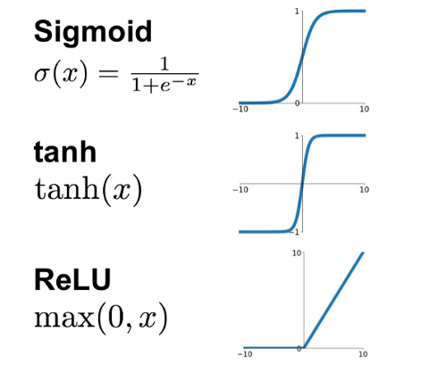
Solution: continuous activation functions
These continuous activation functions (and many others) are used in multi-layer neural networks.
Their different shapes result in different learning characteristics, suitable for different tasks.

Slide 16
Multi-layer network exercise
With the wine quality - red dataset,
Use a neural network to predict quality from the other features.
Explore how performance is affected by adding additional hidden layers to the network.

Slide 17
Deep learning

Slide 18
Deep networks
“Deep learning” concerns neural network models with many hidden layers, used in both unsupervised and supervised learning contexts.
It is difficult to train deep models effectively, so special techniques have been developed for this class of models.
Specialised software packages (e.g. TensorFlow, Keras) and computer hardware are available.

Slide 19
Unstructured data
Deep networks are especially well suited to working with unstructured input data, which doesn’t have easily definable informative features.
Images
Text
Speech
Music
…

Slide 20
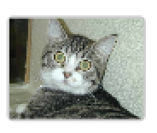
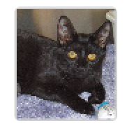
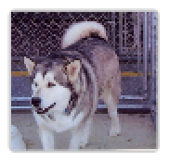
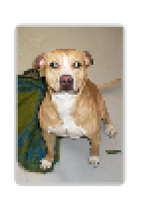
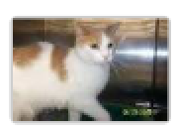
Image classification task
labelled training data
machine
?
predictions

Slide 21
From pixels to features?

Slide 22
Convolution
Convolution is a way to transform unstructured data into network inputs in a way that preserves the relevant relationships in time and/or space.
A network architecture that uses this technique is known as a Convolutional Neural Network (CNN).
In practice, convolutional layers may form part of a larger architecture.

Slide 23
Convolution
The kernel is a matrix of weights that passes over the image
next layer
input layer

Slide 24
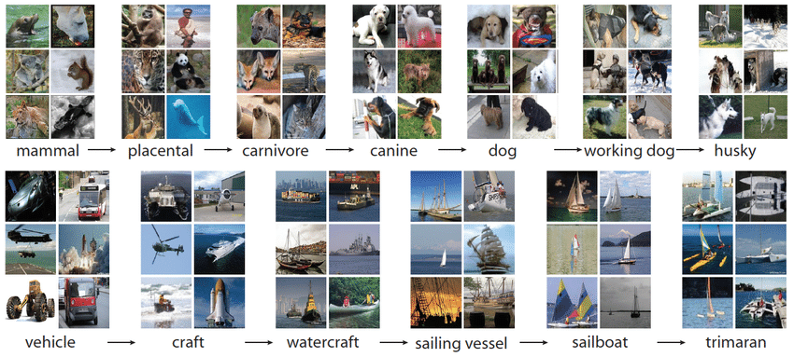
Google Inception (2015)
An image classification model, trained on the ImageNet dataset.

Slide 25
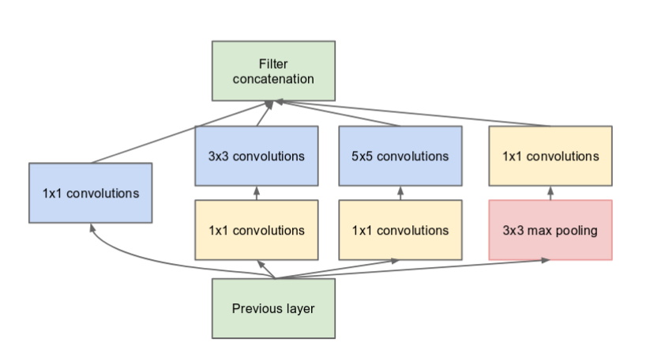
Google Inception module
Architecture is carefully designed to capture salient features and ensure efficient training.
Uses kernels of different widths to detect both local and global features

Slide 26
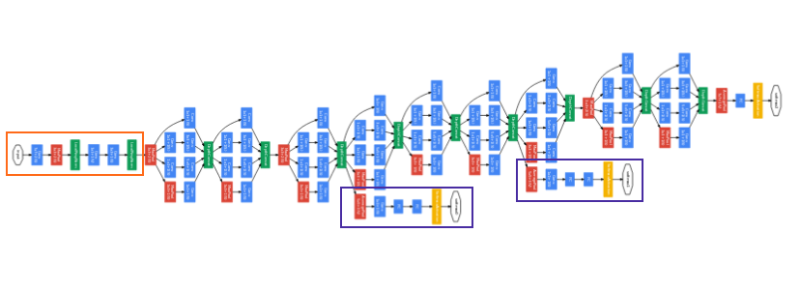
Google Inception model
modules
The overall model for image classification is built from 9 of these modules. It is 27 layers deep in total.
The authors suggest it would take about a week to train on a few high-end GPUs.

Slide 27
Embedding
Once the weights of the Inception model have been trained, we can use the model to classify any image into the ImageNet categories.
The hidden layers of the model must be capturing some highly informative features. We can make use of these features in our own models.
When an image is used as input, the activations of the penultimate layer are extracted as features. This is called embedding.

Slide 28
Image embedding example
Using image embedding, can we train a neural network to distinguish cats from dogs?

Slide 29
Some special architectures
Autoencoder
learns a compact representation of the data in an unsupervised way (e.g. for dimensionality reduction).
Recurrent Neural Network (RNN)
represents processes evolving over time.
Generative Adversarial Network (GAN)
two networks (a generator and a discriminator) compete against each other. This is often used in reinforcement learning.

Slide 30
Summary of Part 3
Artificial neural networks are a diverse family of biologically inspired learning methods.
Neurons in a network receive multiple inputs and combine these as a weighted sum. The neuron’s output is determined by its activation function.
To fit the model, weights need to be optimised e.g. by using gradient descent.
Deep learning implies any architecture with multiple hidden layers that can discover relevant features from the data itself.
Convolution layers may be used to work with unstructured inputs such as images or speech.

Slide 31
Where next…?
Müller AC & Guido S, Introduction to Machine Learning with Python
http://ebookcentral.proquest.com/lib/imperial/detail.action?docID=4698164
Burger SV, Introduction to Machine Learning With R
https://www.oreilly.com/library/view/introduction-to-machine/9781491976432/
Nielsen M, Neural Networks and Deep Learning
http://neuralnetworksanddeeplearning.com/index.html
Tutorials and examples at
https://scikit-learn.org/
https://www.kaggle.com

