Slide 1

v1
Graduate
College
School
Imperial
ReCoDE

Slide 2


Slide 3


Slide 4





v2
ReCoDE
Research Computing & Data Science Exemplars

Slide 5
v3
ReCoDE

Slide 6

v4
00101
ReCoDE

Slide 7
v5
00101
ReCoDE

Slide 8


v5
00101
ReCoDE

Slide 9
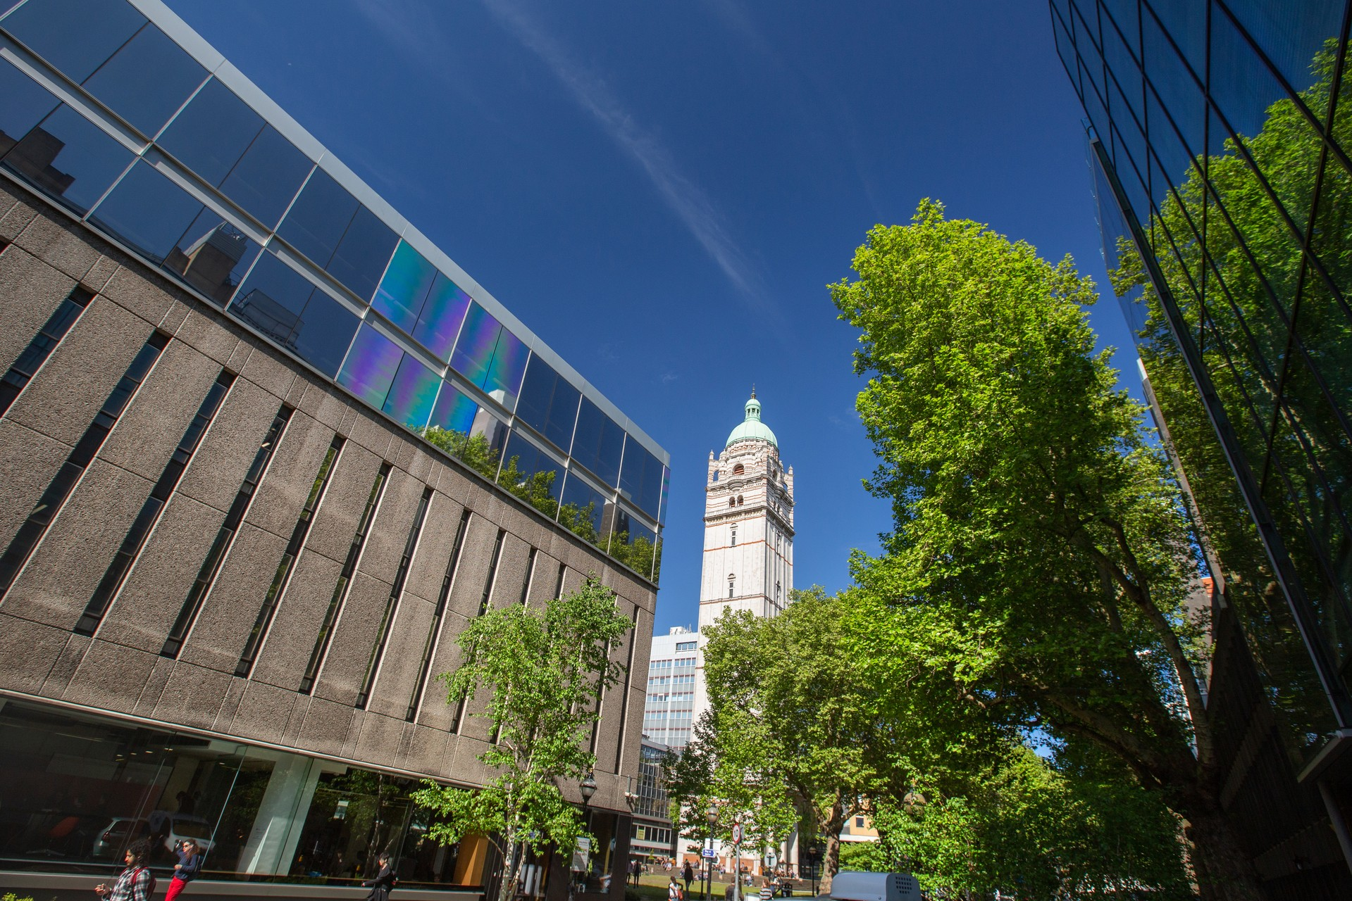
MCMC
Diffusion
COVID
IDMS
RNA

Slide 10
MCMC
Diffusion
COVID
00101
ReCoDE
IDMS
RNA

