Slide 1
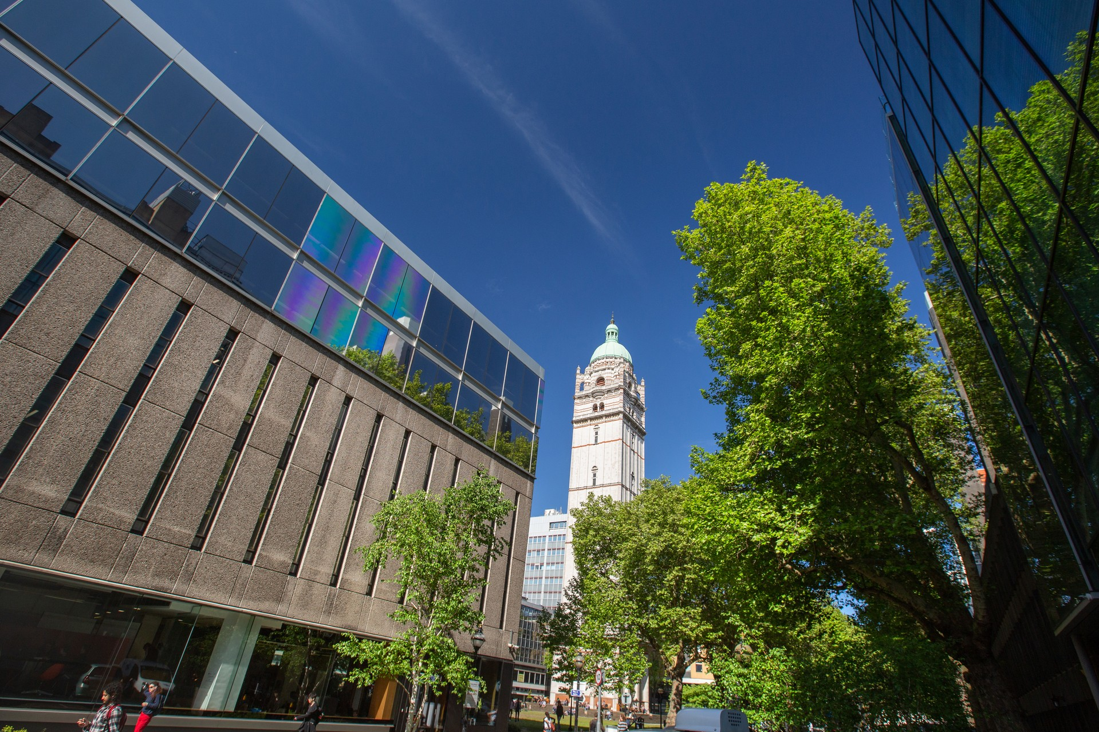


MCMC
Diffusion
COVID
00101
ReCoDE
IDMS
RNA

