Slide 1












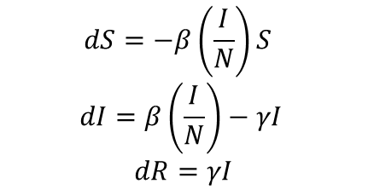


1
2
3
4
Define the research question
What is the population and time period?
What data are we fitting the model to?
What compartments do we minimally need to represent the disease transmission process?
S
I
R
5
6
7
8
What are the initial conditions? Which do we fix? Which do we estimate?
What are the rate parameters which describe movement between the compartments?
What are the equations that govern the model?
Which parameters can we fix based on the literature?
$$dS=−β\left(\frac{I}{N}\right)S$$
$$dI=β\left(\frac{I}{N}\right)−γI$$
$$dR=γI$$
$$β\left(\frac{I}{N}\right)$$
$$γ$$
$$γ$$
N
S + I + R =
S
I
R
9
10
11
12
Which parameters do we need to estimate?
Do we have any domain knowledge to inform the estimate parameter priors?
What is the model likelihood?
What assumptions have we made?
Continuous?
V
1) No underreporting
2) No incubation period
3) waning immunity
$$β$$
Multivariate?
Count data?
V
V
Uninformative?
Weekly informative?

Slide 2
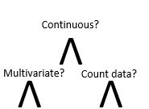
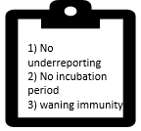


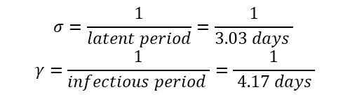






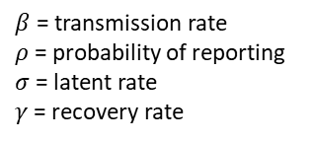
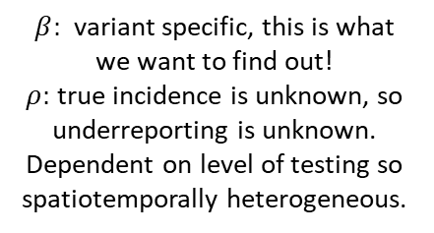
1
2
3
4
Gauteng, South Africa
N = 15,810,388
$y=$Reported incidence data for Gauteng, South Africa.
We need to reconstruct the reported incidence from the model.
I
What are the transmission dynamics of the Omicron variant of concern following its emergence?
S
E
R
Q
Sep 2021- Feb 2022 (Fourth wave, driven by omicron)
COVID-19 has an incubation period (E).
Fit to reported data, so account for detection and isolation (Q).
5
6
7
8
0
0
$$(1−ρ)σ$$
I
$$dS=−β\left(\frac{I}{\text{S}\text{t}\text{0}}\right)S$$
$$dE=β\left(\frac{I}{\text{S}\text{t}\text{0}}\right)S −σE$$
$dI=σ\left(1−ρ\right)E$ $−γI$
$$dQ=ρσE−γQ$$
$$dR=γI+ γQ$$
$$β(\frac{I}{\text{S}\text{t}\text{0}})$$
$$γ$$
S_{t0} + E_{t0} + I_{t0} + Q_{t0} + R_{t0} = N
S
E
R
$$ρσ$$
Q
$$γ$$
$$σ=\frac{1}{latent period}=\frac{1}{3.03 days }$$
$$γ=\frac{1}{infectious period }=\frac{1}{ 4.17 days }$$
Sero-prevelance study
$β$ = transmission rate
$ρ$ = probability of reporting
$σ$ = latent rate
$γ$= recovery rate
$$\text{= }\text{N}\text{−}\text{I}\text{t}\text{0}\text{−}\text{R}\text{t}\text{0}$$
Assume = 1
9
10
11
12
Uninformative?
Weekly informative?
…
…
$β:$ variant specific, this is what we want to find out!
$ρ:$ true incidence is unknown, so underreporting is unknown. Dependent on level of testing so spatiotemporally heterogeneous.
$$β \sim ND(2.2,1)$$
$$ρ \sim Beta(2,8)$$
Supports a range of plausible R₀ values.
Reported incidence data is count data and expected to be over-dispersed, so we assume a Negative Binomial likelihood. Reported incidence from the model is the rate of entry into the Q compartment.
All reported incidence is Omicron
No waning immunity
No vaccination
No pre-symptomatic transmission
…
We expect the reporting probability to be <50%.
$$y \sim NegBin(ρσE,k)$$

Slide 3
1
2
3
4
Gauteng, South Africa
N = 15,810,388
$y=$Reported incidence data for Gauteng, South Africa.
We need to reconstruct the reported incidence from the model.
I
What are the transmission dynamics of the Omicron variant of concern following its emergence?
S
E
R
Q
Sep 2021- Feb 2022 (Fourth wave, driven by omicron)
COVID-19 has an incubation period (E).
Fit to reported data, so account for detection and isolation (Q).
5
6
7
8
0
0
$$(1−ρ)σ$$
I
$$dS=−β\left(\frac{I}{\text{S}\text{t}\text{0}}\right)S$$
$$dE=β\left(\frac{I}{\text{S}\text{t}\text{0}}\right)S −σE$$
$dI=σ\left(1−ρ\right)E$ $−γI$
$$dQ=ρσE−γQ$$
$$dR=γI+ γQ$$
$$β(\frac{I}{\text{S}\text{t}\text{0}})$$
$$γ$$
S_{t0} + E_{t0} + I_{t0} + Q_{t0} + R_{t0} = N
S
E
R
$$ρσ$$
Q
$$γ$$
$$σ=\frac{1}{latent period}=\frac{1}{3.03 days }$$
$$γ=\frac{1}{infectious period }=\frac{1}{ 4.17 days }$$
Sero-prevelance study
$β$ = transmission rate
$ρ$ = probability of reporting
$σ$ = latent rate
$γ$= recovery rate
$$\text{= }\text{N}\text{−}\text{I}\text{t}\text{0}\text{−}\text{R}\text{t}\text{0}$$
Unknown so estimate
9
10
11
12
Uninformative?
Weekly informative?
…
…
$β:$ variant specific, this is what we want to find out!
$ρ:$ true incidence is unknown, so underreporting is unknown. Dependent on level of testing so spatiotemporally heterogeneous.
$$β \sim ND(2.2,1)$$
$$ρ \sim Beta(2,8)$$
Supports a range of plausible R₀ values.
Reported incidence data is count data and expected to be over-dispersed, so we assume a Negative Binomial likelihood. Reported incidence from the model is the rate of entry into the Q compartment.
All reported incidence is Omicron
No waning immunity
No vaccination
No pre-symptomatic transmission
…
We expect the reporting probability to be <50%.
$$y \sim NegBin(ρσE,k)$$

Slide 4
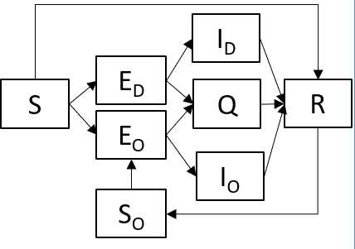










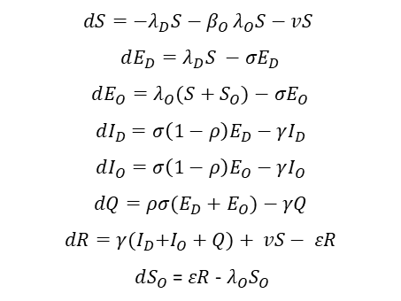




1
2
3
4
Gauteng, South Africa
N = 15,810,388
I_{D}
What are the transmission dynamics of the Omicron variant of concern following its emergence?
E_{D}
$y_{v}=$variant-specific (v = delta, omicron) reported incidence data.
S
Q
R
February 2021- Feb 2022 (3rd and 4th waves, driven by delta & omicron)
E_{O}
I_{O}
S_{O}
5
6
$$v$$
7
8
$$dS=−λ_{D}S{− β}_{O}λ_{O}S−vS$$
$$dE_{D}=λ_{D}S −σE_{D}$$
$$dE_{O}=λ_{O}(S+S_{O})−σE_{O}$$
$$dI_{D}=σ\left(1−ρ\right)E_{D}−γI_{D}$$
$$dI_{O}=σ\left(1−ρ\right)E_{O}−γI_{O}$$
$$dQ=ρσ(E_{D}+E_{O})−γQ$$
$$dR=γ{(I}_{D}+I_{O}+Q)+ vS− εR$$
$dS_{O}$ = $εR$ - $λ_{O}S_{O}$
0
0
0
$$(1−ρ)σ$$
$$λ_{D}$$
$$ρσ$$
$$γ$$
$$σ=\frac{1}{latent period}=\frac{1}{3.03 days }$$
$$γ=\frac{1}{infectious period }=\frac{1}{ 4.17 days }$$
$υ=\frac{daily second doses administed}{N}=0.001$
S_{t0} + E_{Vt0}+ I_{Vt0}+ Q_{t0}+ S_{Ot0}+ R_{t0} = N
$$γ$$
$$λ_{O}$$
$$ρσ$$
$$γ$$
$$(1−ρ)σ$$
$$λ_{O}$$
$$\text{= }\text{N}\text{−}\text{I}\text{0}\text{V}\text{−}\text{R}\text{0}$$
= 1
Sero-prevelance study
$$ε$$
9
10
11
12
$$β \sim ND(2.2,1)$$
$$ρ \sim Beta\left(1,1\right)$$
$ω\sim Beta(1,1)$
…
…
Supports a range of plausible R₀ values.
Reported incidence data is count data and expected to be over-dispersed, so we assume a Negative Binomial likelihood. Reported incidence from the model is the rate of entry into the Q compartment.
$β_{v}:$ variant specific.
$ρ:$ true incidence is unknown, so underreporting is unknown. Dependent on level of testing so spatiotemporally heterogeneous.
$ω:$ unknown.
$ε:$
Uniform 0-1, the bounds of probability.
No waning immunity
No pre-symptomatic transmission
Variant-specific prevalence in GISAID is proportional to its reported incidence.
Uniform 0-1, the bounds of possible reduction.
$$y_{v} \sim NegBin (ρσE_{v})$$

Slide 5













6
$$v$$
$$(1−ρ_{D})σ_{D}$$
I_{D}
E_{D}
$$γ_{D}$$
$$λ_{D}$$
Q
$$γ_{D}$$
S
$$ρ_{D}σ_{D}$$
R
$$λ_{O}$$
E_{O}
$$ρ_{O}σ_{O}$$
Q
$$γ_{O}$$
$$γ_{O}$$
I_{O}
$$λ_{O}$$
$$(1−ρ_{O})σ_{O}$$
S_{O}
$$ε$$

