Slide 1
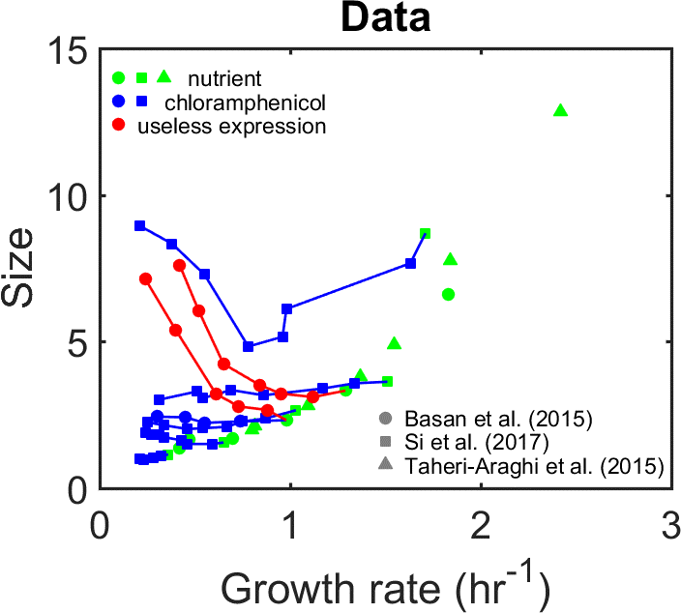
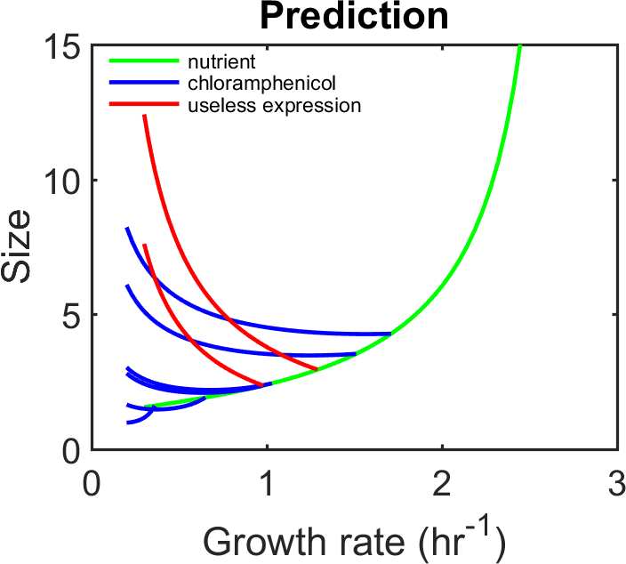
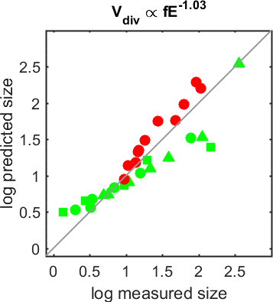
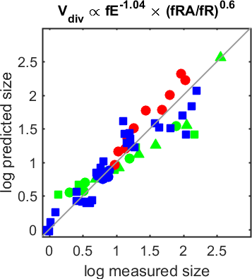



A
B
C
Regulation of X expression
by coarse-grained proteome sectors ?
$$V_{div}=\frac{X_{div}}{x}=\frac{X_{div}}{f_{X}(1−a)}\sim \frac{X_{div}}{f_{X}}$$
invariant
1 sector
2 sectors
$$f_{X}=f\left(e\right) ?$$
$$f_{X}=f\left(r\right) ?$$
…
$$f_{X}=f\left(e,r\right) ?$$
$$f_{X}=f\left(e,r_{a}\right) ?$$
…
D
E
F

Slide 2



A
B
C
Regulation of X expression
by coarse-grained proteome sectors ?
$$V_{div}=\frac{X_{div}}{x}=\frac{X_{div}}{f_{X}(1−a)}$$
1 sector
2 sectors
$$f_{X}=f\left(e\right) ?$$
$$f_{X}=f\left(r\right) ?$$
…
$$f_{X}=f\left(e,r\right) ?$$
$$f_{X}=f\left(e,r_{a}\right) ?$$
…
D
E

Slide 3
Regulation of X expression
by coarse-grained proteome sectors ?
$$V_{div}=\frac{X_{div}}{x}=\frac{X_{div}}{f_{X}(1−a)}$$
1 sector
2 sectors
$$f_{X}=f\left(e\right) ?$$
$$f_{X}=f\left(r\right) ?$$
…
$$f_{X}=f\left(e,r\right) ?$$
$$f_{X}=f\left(e,r_{a}\right) ?$$
…

