Slide 1








$$k$$
Transport and metabolism
Modeling nutrient quality
E
Q
Housekeeping
$$fE$$
$$f_{Q}$$
$$fU$$
U
Modeling expression of useless protein
nutrients
A
Useless proteins
$$f_{R}$$
$$f_{X}$$
$${σ, a}_{sat}$$
X
Cell division
Modeling ribosome inactivation by chloramphenicol
R_{active}
R_{total}
R_{inactive}
Protein synthesis
$$V=M=A+E+Q+X+R+U$$
$$a=A/V, e=E/V…$$
$$fE+f_{R}+f_{Q}+f_{X}+fU=1$$

Slide 2
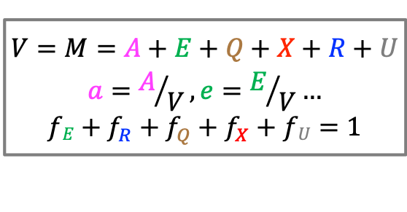
k
Transport and metabolism
E
Modeling nutrient quality
f_{E}
Q
Housekeeping
f_{Q}
f_{U}
Modeling expression of useless protein
nutrients
A
U
Useless proteins
σ, a_{sat}
f_{X}
X
Cell division
f_{R}
Modeling ribosome inactivation by chloramphenicol
R_{active}
R_{total}
R_{inactive}
Protein synthesis
$$V=M=A+E+Q+X+R+U$$
$$a=A/V, e=E/V…$$
$$fE+f_{R}+f_{Q}+f_{X}+fU=1$$

