Slide 1
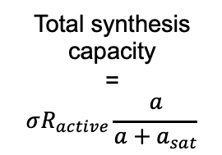
f_{Q}
Regulated such that
concentration q is constant
Total synthesis capacity
=
$$σR_{active}\frac{a}{a+a_{sat}}$$
1-f_{Q}-f_{X} ~ 1-f_{Q}
f_{R}
Optimally allocated to
maximize growth rate
f_{E}
f_{X} << 1
Small allocation fraction

