Slide 1



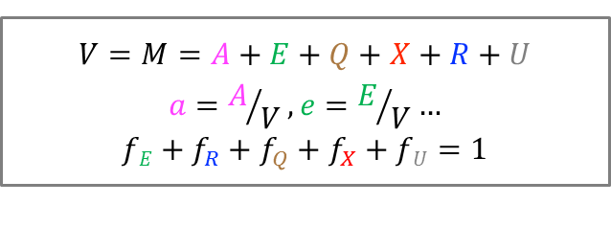




Model structure
$$k$$
Transport and metabolism
Modeling nutrient quality
E
Q
Housekeeping
$$fE$$
$$f_{Q}$$
$$fU$$
U
Modeling expression of useless protein
nutrients
A
Useless proteins
$$f_{R}$$
$$f_{X}$$
$${σ, a}_{sat}$$
X
Cell division
Modeling ribosome inactivation by chloramphenicol
R_{active}
R_{total}
R_{inactive}
Protein synthesis
$$V=M=A+E+Q+X+R+U$$
$$a=A/V, e=E/V…$$
$$fE+f_{R}+f_{Q}+f_{X}+fU=1$$

Slide 2
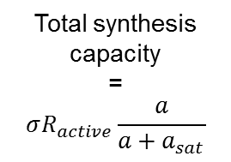
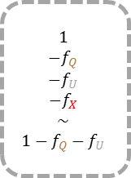

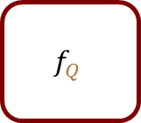

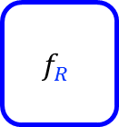



How are $fE$, $f_{R}$, $f_{Q}$, $f_{X}$, $fU$ dynamically set ?
$$f_{Q}$$
Constant allocation fraction to Q proteins
Total synthesis capacity
=
$$σR_{active}\frac{a}{a+a_{sat}}$$
Imposed allocation to useless proteins
$$f_{U}$$
$$1$$
$$−f_{Q}$$
$$−f_{U}$$
$$−f_{X}$$
$$\sim$$
$$1−f_{Q}−f_{U}$$
$$f_{R}$$
Allocation to R proteins set by A concentration: $f_{R}=δ∗a$
Remainder allocated
to E proteins
$$fE$$
$$f_{X}≪1$$
Small allocation fraction to X proteins

Slide 3
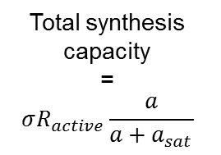
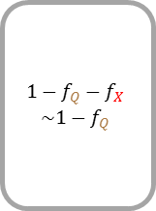




How are $fE$, $f_{R}$, $f_{Q}$, $f_{X}$, $fU$ dynamically set ?
$$f_{Q}$$
Constant allocation fraction to Q proteins
Total synthesis capacity
=
$$σR_{active}\frac{a}{a+a_{sat}}$$
$$1−f_{Q}−f_{X}$$
$$\sim 1−f_{Q}$$
$$f_{R}$$
Allocation to R proteins set by A concentration: $f_{R}=δ∗a$
Remainder allocated
to E proteins
$$fE$$
$$f_{X}≪1$$
Small allocation fraction to X proteins

