Slide 1


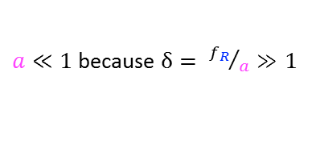
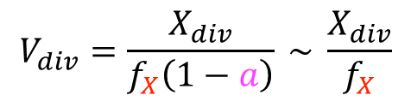
$$e=f_{E} \left(1−a\right) \sim { f}_{E}$$
$$r=f_{R} \left(1−a\right) \sim { f}_{R}$$
$$q=f_{Q} \left(1−a\right) \sim { f}_{Q}$$
$$x=f_{X} \left(1−a\right) \sim { f}_{X}$$
Protein sector concentration
=
sector allocation fraction
X
total protein concentration
$a≪1$ because $δ= {f_{R}}/a≫1$
Growth rate $α=ke=σr_{a}\frac{a}{a+a_{sat}}$
Balance between
precursor synthesis and protein synthesis
Size at division
=
X division threshold
/
X concentration
$$V_{div}=\frac{X_{div}}{f_{X}\left(1−a\right)} \sim \frac{X_{div}}{f_{X}}$$

