Slide 1
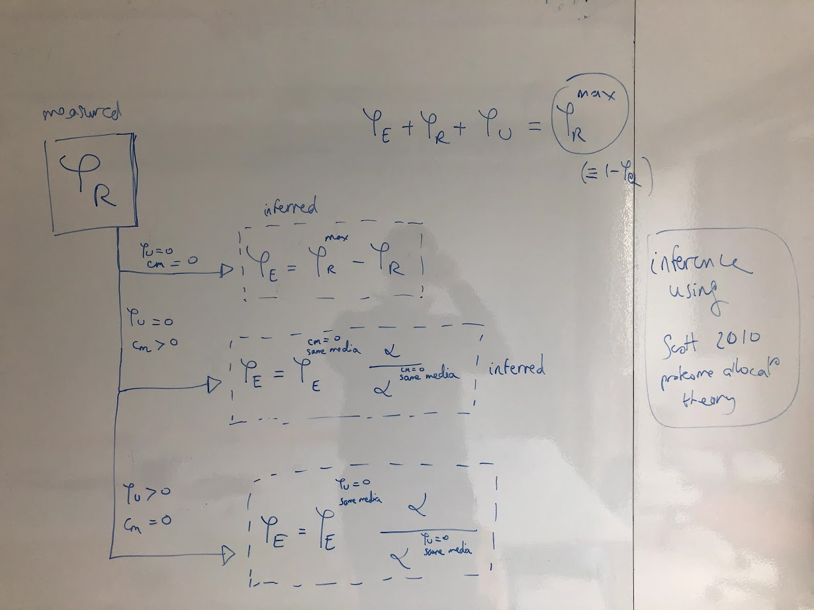

Slide 2
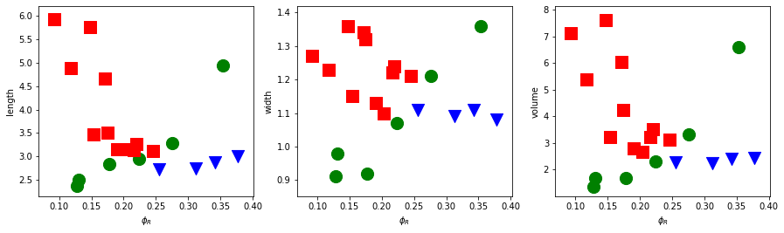
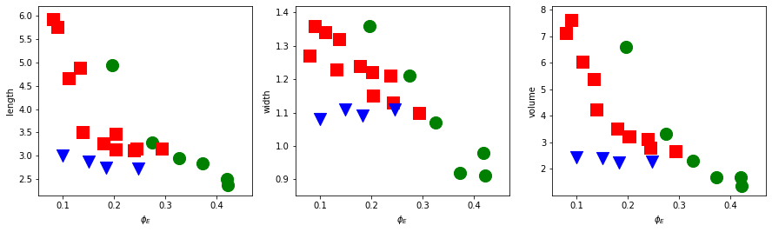
Basan data – phi_R_max = 0.55 (preferred value of scott)

Slide 3
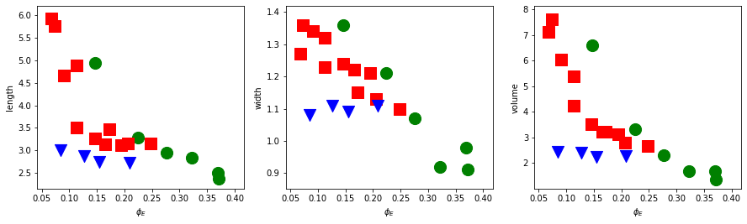
Basan data – phi_R_max = 0.5
Clearly, phi_R cannot predict geometry across the 3 modulations !
Phi_E can somewhat predict geometry for useless and nutrient, not much for cm.
Simple linearish relationship for width !

Slide 4
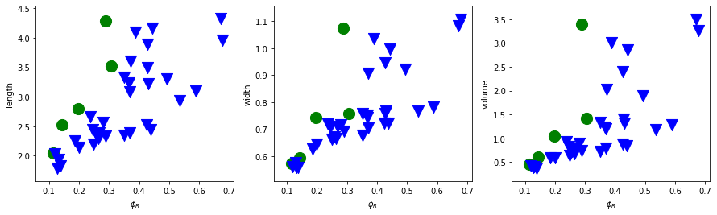
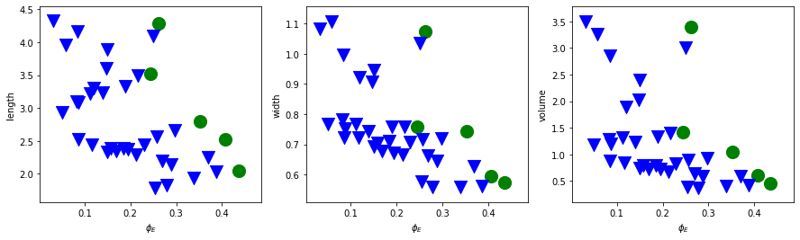
Si data – phi_R_max = 0.55 (preferred value of scott)

Slide 5
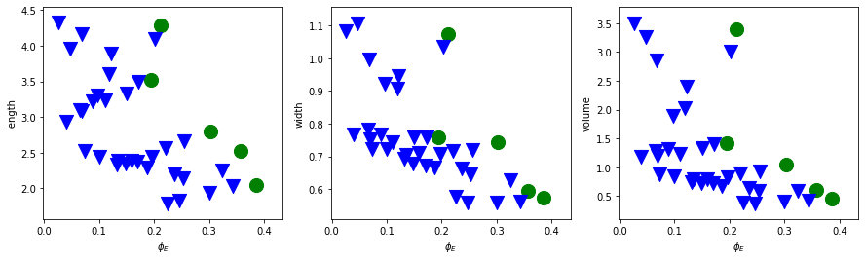
Si data – phi_R_max = 0.5

