Slide 1

Probability
RCDS Statistics Foundations
Aida Sanchez Ricol
25/03/2026

Slide 2
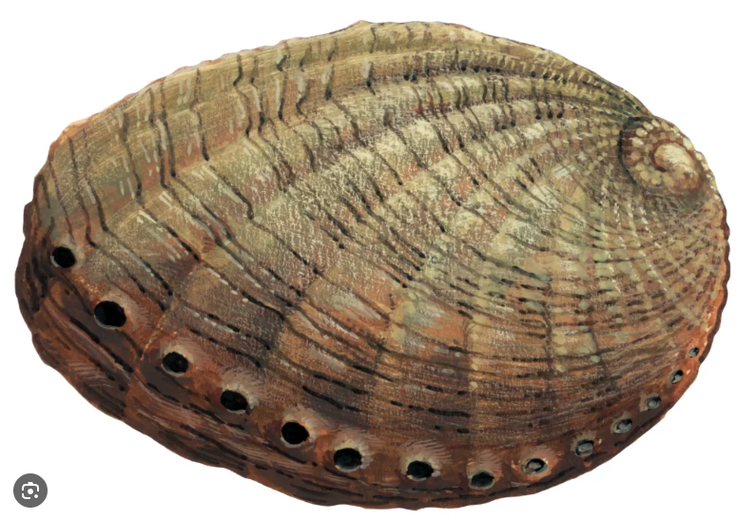
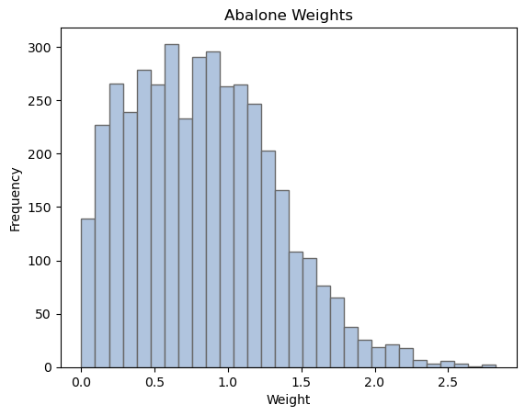
Introduction
Experimental samples can be described by different metrics:
Location parameters: mean, median, mode
Scaling parameters: standard deviation
Shape parameters: skewness, kurtosis
random variable

Slide 3
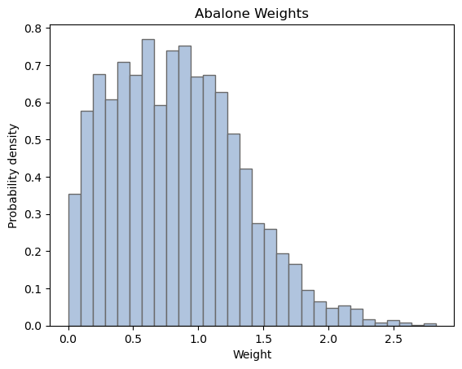
How likely are we to measure a specific value?
Goal of most science experiments:
sample
population
Probability theory can help gain information from a reduced subset of the population

Slide 4

Probability values
Probability values measure how likely we are to measure a certain value
$$p\left(x\right)$$
0
1
Certain I will never get this
Certain I will always get this
Frequentist interpretation
relative frequency of a given outcome
Bayesian interpretation
state of knowledge, priors

Slide 5
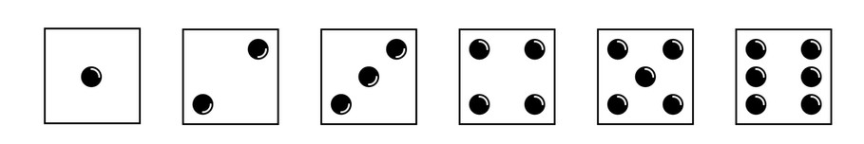
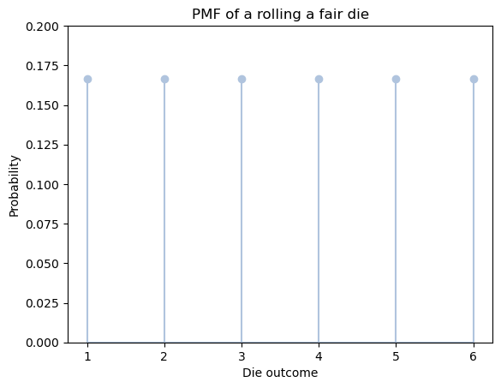

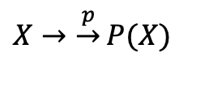
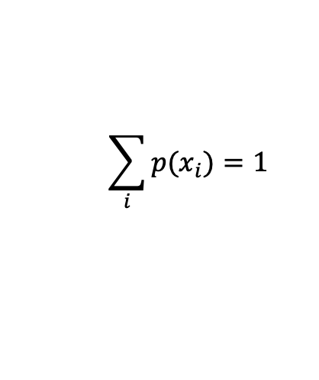






Normalising probability values
Discrete variables
Ex: rolling a fair die
$$X=\{1, 2, 3, 4, 5, 6\}$$
$$p(1)=1/6$$
$$p(4)=1/6$$
$$p(2)=1/6$$
$$p(5)=1/6$$
$$p(3)=1/6$$
$$p(6)=1/6$$
$$\sum_{i}{p(x_{i})}=1$$
$X→\underset{→}{p}P(X)$
Probability Mass Function (PMF)

Slide 6

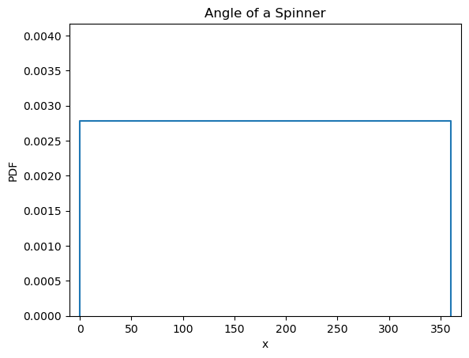

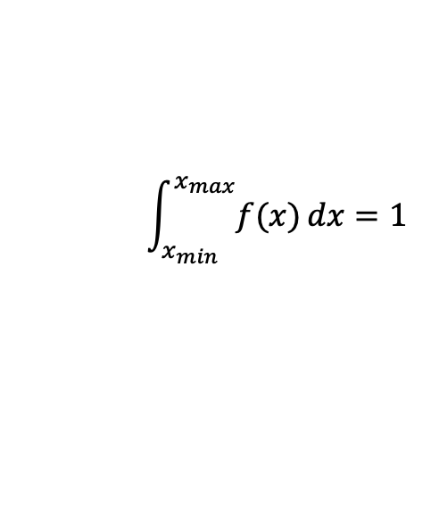
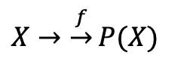
Normalising probability values
Continuous variables
Ex: angle of spinner
$$X=[0, 360º]$$
$X→\underset{→}{f}P(X)$
Probability Density Function (PDF)
$$\int_{x_{min}}^{x_{max}}{f(x)}dx=1$$

Slide 7
Common probability distributions
Discrete PMF
Continuous PDF
Binomial
Poisson
Uniform
Gaussian

Slide 8
Binomial distribution
Built up from binary events (success/failure) – known as Bernouilli trials
Examples:
Particle detection: is anything detected at specific detector?
Disease infection: is individual infected?
Gene inheritance: is a trait present in an individual?

Slide 9
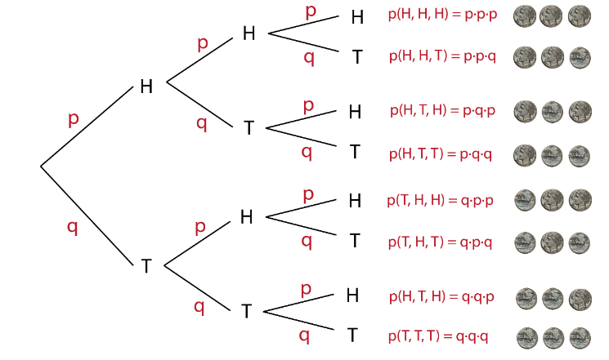
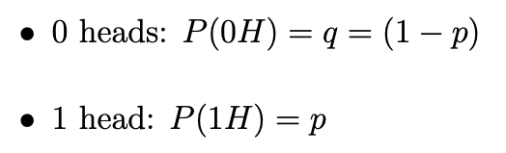
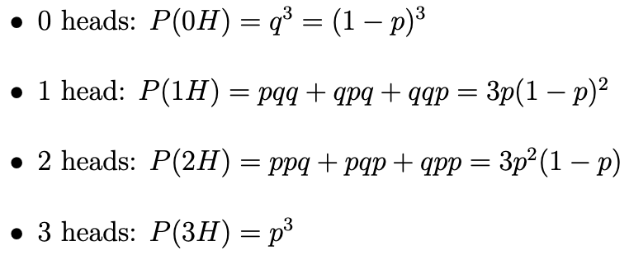
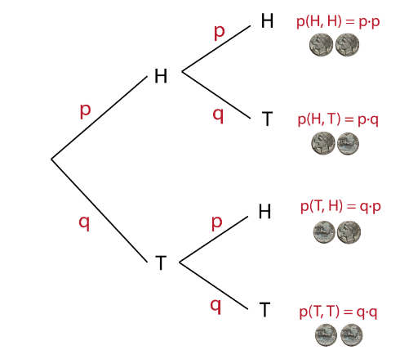
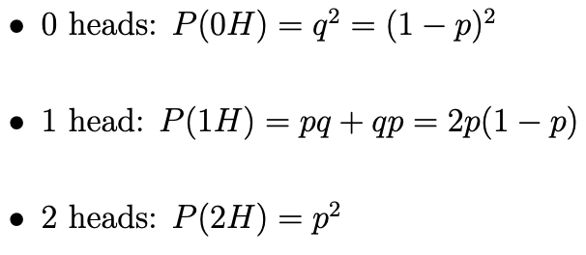
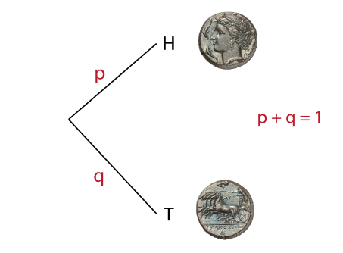
Binomial distribution
Ex: tossing a coin (heads or tails)
What is the probability of obtaining k heads when we toss a coin n times?

Slide 10
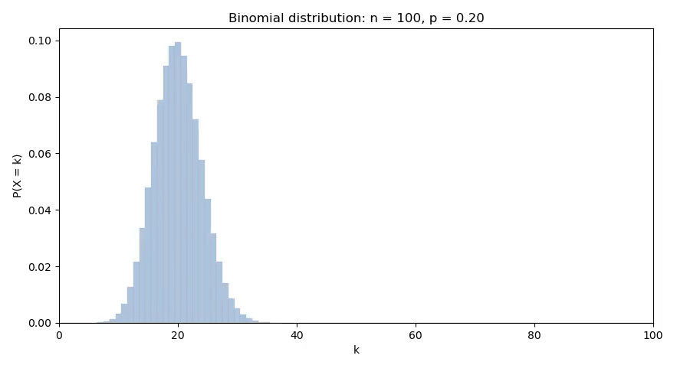
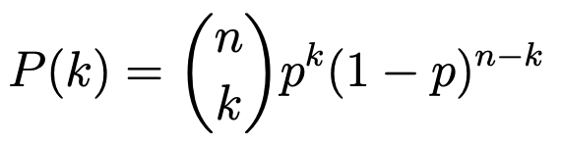
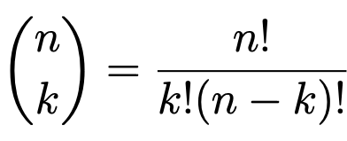

Binomial distribution
Ex: tossing a coin (heads or tails)
What is the probability of obtaining k heads when we toss a coin n times?
General case
# of ways of ordering results
prob of k consecutive heads
prob of n-k consecutive tails

Slide 11
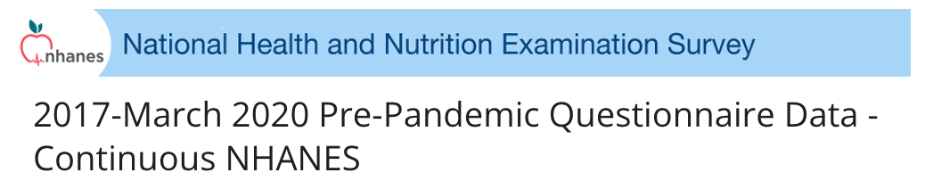
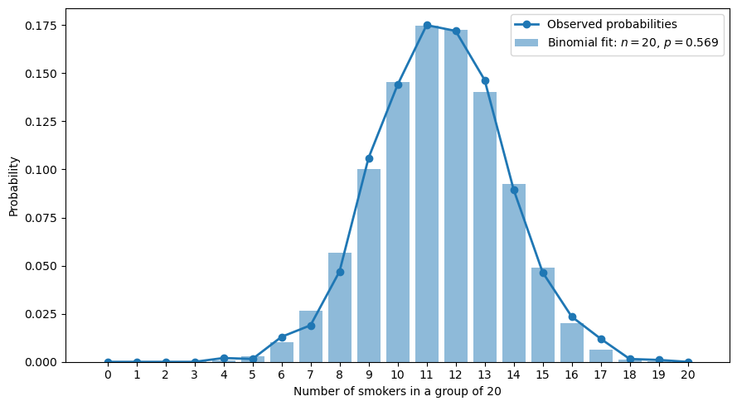
Binomial distribution
Case study
Randomise participants into groups of 20
Probability of k smokers in group of n = 20?
Age
Smoker? YES/NO
Overall prob of being a smoker in age band 30-44
p = 0.569

Slide 12


Binomial distribution
Case study
np.random
math.comb
matplotlib.pyplot
pandas
Randomise participants into groups of 20
1. Find overall p
Probability of k smokers in group of n = 20?
2. Seed the code
3. Generated 2000 samples
4. Construct pmf from overall p

Slide 13
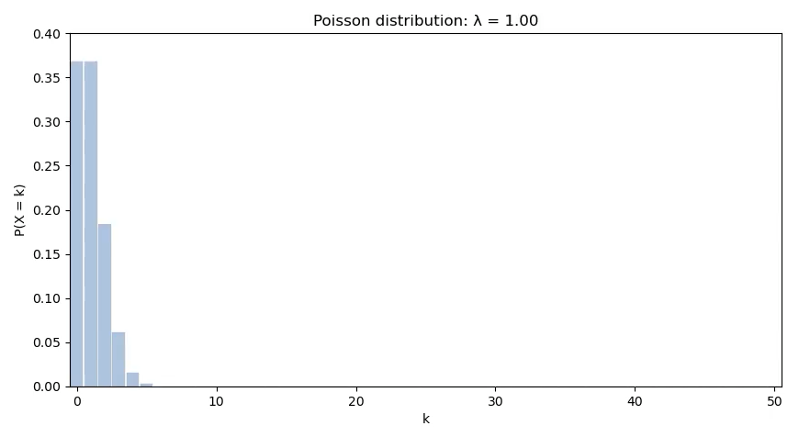

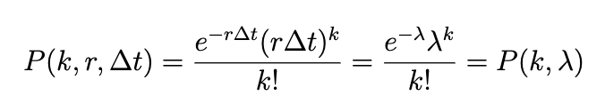
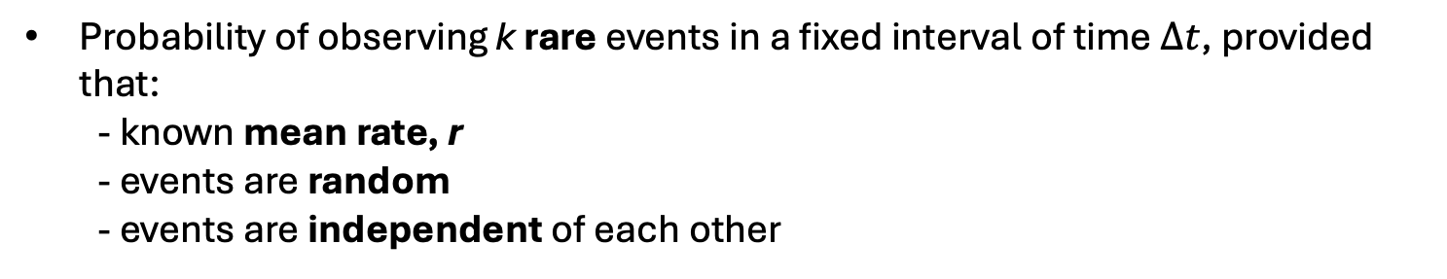
Poisson distribution
Probability of observing k rare events in a fixed interval of time $∆t$, provided that:
  - known mean rate, r
  - events are random
  - events are independent of each other
mean # of events in fixed time interval
Examples:
Spontaneous mutation in DNA sequence in a given time
Radioactive decay

Slide 14
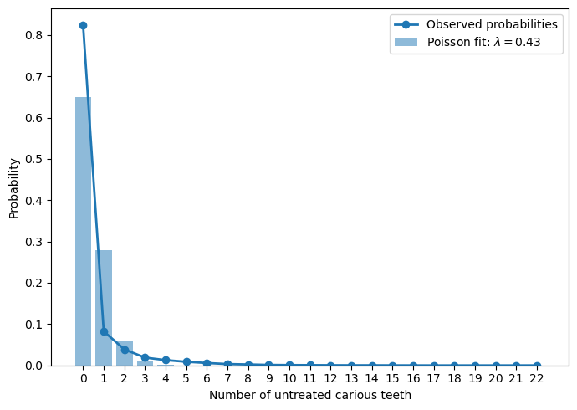
Poisson distribution
Case study
# active/untreated caries
Oral health – dentition?
Average number of carious teeth
λ = 0.43
Not really a Poisson – limited # of teeth, different people have different λ_{i} (not really measuring an external event)

Slide 15
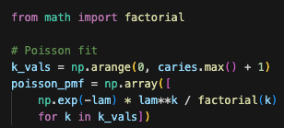
Poisson distribution
Case study
math.factorial
matplotlib.pyplot
# active/untreated caries
Construct pmf from λ

Slide 16
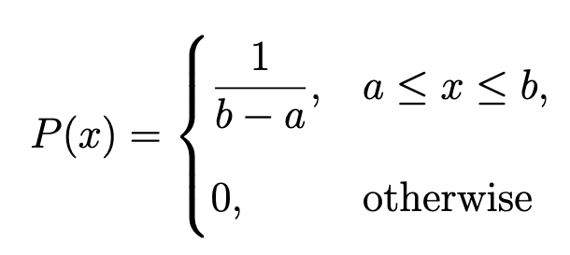
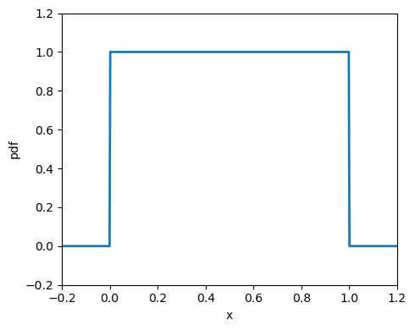


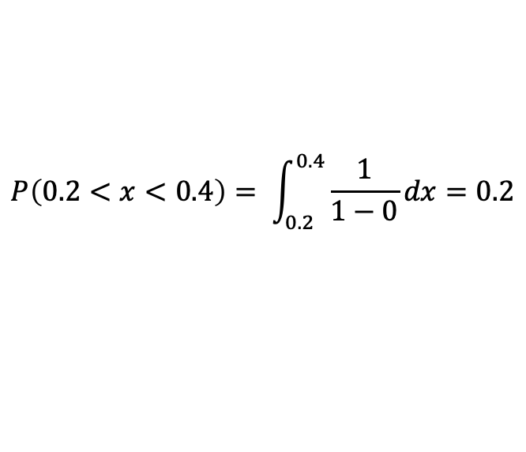
Uniform distribution
Constant probability density in a given range
x position of particle in a box
$$a=0$$
$$b=1$$
$$P\left(0.2<x<0.4\right)= \int_{0.2}^{0.4}{\frac{1}{1−0}dx}=0.2$$
Examples:
Phase of a wave
Particle position in a box

Slide 17
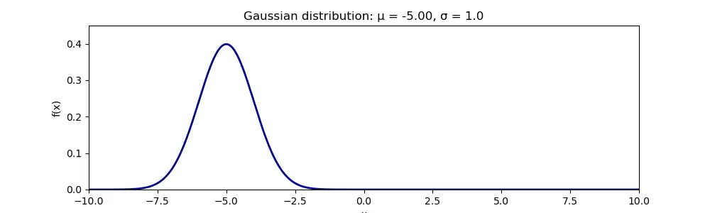
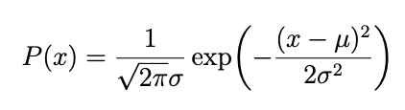
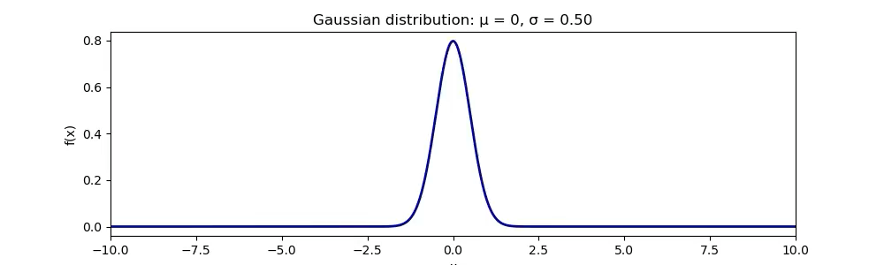
Gaussian distribution
Continuous variables that result from many small independent random influences
Examples:
Thermal velocity of particles
Height, weight, feet length
Measurement errors
μ = population mean
σ = population variance

Slide 18
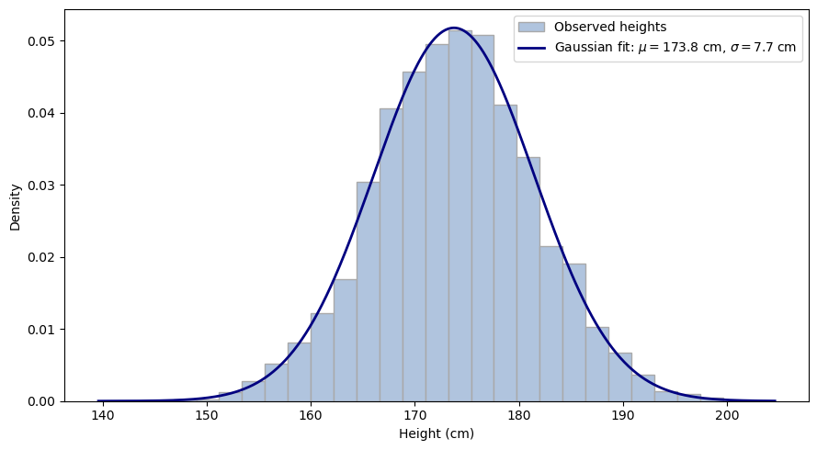
Gaussian distribution
Case study
Adult men height
Body measures

Slide 19


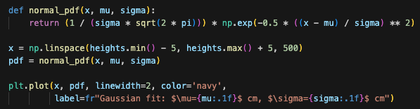
Gaussian distribution
Case study
math
matplotlib.pyplot
pandas
Adult men height
1. Find μ and σ
2. Plot binned data
3. Plot corresponding Gaussian

Slide 20


Time for exercises!
Solve by using:
Functions from standard libraries
Your own functions
scipy
numpy.random
stats.models
numpy
matplotlib.pyplot

