Slide 1
Python Framework for processing SPEAR

Slide 2
Aim
A set of Python codes as the framework for basic usage of SPEAR (and EasyCom) datasets
To be publicly released with SPEAR Challenge
Useful for participants and us (organisers)
It includes
utility functions to read-in and visualise data and metadata
Baseline enhancement method (Iso-MVDR/Superdirective beamformer)
Evaluation using intrusive metrics
Visualisation of metrics result
Why Python?
It’s free so anyone has access
Widely used in academia, industry and private sectors
More suitable for open-source public release on GitHub

Slide 3
Type | Name | Format | Lines
Class | SPEAR | .py | 280+
Class | Processor | .py | 390+
Script | batch_processing | .py | 50+
Script | batch_evaluation | .py | 120+
Script | batch_visualisation | .py | 100+
Total | --- | --- | 950+
Overview
Consisting 5x original python files
2x classes (dataset class & processor class)
3x scripts (batch processing, batch evaluation, batch visualisation)
SPEAR class
Data & Metadata
I/O & Utilities
Array, Session, File, Targets
Chunks CSV
Processing script
Array setup
Targets summary/setup
Beamformer setup
Data STFT
Beamforming
Data iSTFT
Play/Save Output
Evaluation script
Input audio paths
Input chunks csv
Metrics setup
Metrics calculation
Save results in csv
Plotting script
Input csv path
Results plotting
(Optional) save plot
Processor class
Array I/O subset
Steering vector
STFT beamforming
MVDR weights
Diffuse Cov. Matrix
Enhanced Audio
Metrics CSV
Plots

Slide 4
Classes

Slide 5
SPEAR Class to handle dataset
Parameters: (holding)
Fixes settings
Paths and subfolders
Prefix of file names
Total durations/frames
Frame rate (OptiTrack)
Sample rate (Audio)
Wearer Participant ID
Dataset, Session, File of interest
Present Participant IDs
VADs
Interpolant functions for:
Head-tracking
Sources DOA/position wrt. to wearer
Utility Functions:
Default Initialization
Set
Dataset/Session/File
Get
All possible Targets ID
Head-tracking of a target
DOA of a target
Array audio
Array AIRs
VADs
List of files for requested Dataset(s) & Session(s)
Plot
VADs
3D Geometry utilities
Spherical to Cartesian
Cartesian to Spherical
Rotation of coordinate system

Slide 6
Processor Class to handle enhancement operation (compatible with any dataset)
Parameters: (holding)
Default Array
Total channels
Directions
AIR (Impulse Responses)
ATF (Transfer Functions)
Sample Rate (Original)
Frequencies
Array settings
Output sample rate
I/O channels subset
STFT settings
Target position interpolant
Beamformer settings
Diffuse Covariance matrix
Diagonal loading settings
Pre-calculated weights
Visualisation settings
Beampattern Resolution
…
Utility Functions:
Default Initialization
Set/Change
Default Array
I/O channels
Output sample rate
Target position interpolant
Diagonal loading settings
STFT settings
Plot
Beam pattern
Single frame
Animated over time
3D Geometry utilities
Spherical to Cartesian
Cartesian to Spherical
Nearest-neighbour direction
…
Utility Functions …
Get
I/O audio (multi-level access)
Wav file
Time-domain signal
STFT-domain signal
Beamformer weights
STFT-domain
Beampattern
Operations
STFT / iSTFT / FFT / iFFT
Beamforming
MVDR weight calculation
Covariance matrix calculation
Diagonal loading
Quadrature weighting
..

Slide 7
Scripts

Slide 8
batch_processing
(1)
root_path = '/Volumes/HD FRL/data/SPEAR/Main/Train/’
save_path = '/Volumes/HD FRL/data/SPEAR Enhanced/Baseline/'
﻿fs = int(48e3) # output freq
mics = [] # array subset (all channels)
out_chan = [5,6] # output channels subset (binaural)
sp = SPEAR_Data(root_path)
proc = SPEAR_Processor(sp.get_all_AIRs(),fs=fs,mics=mics,out_chan=out_chan)
cases=sp.get_cases(['D2',1]) # e.g. Dataset 2, Session 1, All files
nCase = len(cases)
for n in range(nCase): # loop through files
this_case = cases.loc[n]
dataset = this_case['dataset']
session = this_case['session']
file = 'D%d_S%d_%s' % (dataset,session,this_case['file’])
﻿ print('\n--+ %d/%d (%%%2.2f) %s +--' % (n+1,nCase,100*n/nCase,file))
sp.set_file(dataset,session,file) # update dataset object to file of interest
targets = sp.get_targets() # all possible targets
nTarget = len(targets)
for ti in range(nTarget): # loop through targets
﻿print('Target: %d/%d'%(ti+1,nTarget))
target = targets[ti]
proc.set_target_pos(sp.get_pos_interp(target)) # set processor target
saveName = '%s%s_%d/Session_%d/' % (save_path,'Dataset',dataset,session)
if not os.path.exists(saveName): # set up save path
os.makedirs(saveName)
saveName = '%s%s_ID_%d.wav' % (saveName,file,target)
_, _ = proc.process_file(sp.array_file,out_file=saveName) # process & save
Set up I/O root paths
Set up I/O audio settings
Set up dataset & processor objects
Set up files of interest
Loop through files
6. Loop through targets
7. Process & Save the entire file
(2)
(3)
(4)
(5)
(6)
(7)

Slide 9
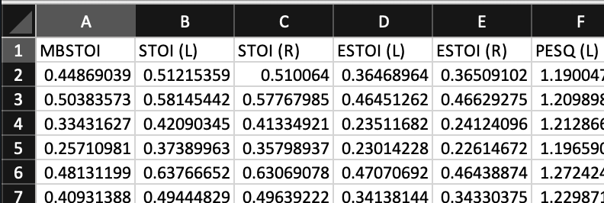
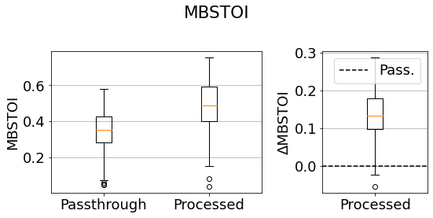
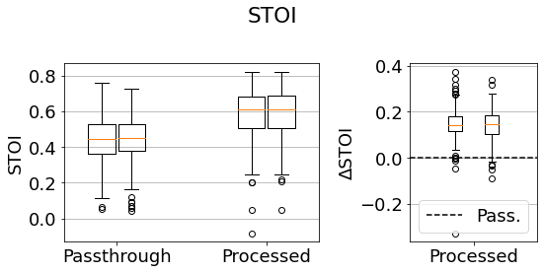
batch_evaluation
Set up I/O root paths
Set up method name & dataset
Load chunks csv
Prepare metrics
Loop through chunks
6. Loop through metrics
7. Evaluate audio & save metric
Single binaural and pairs (L/R) of monaural metrics
. . .
. . .
Single box for binaural metrics
batch_visualisation
Set up I/O root paths
Set up method name & dataset
Load metrics csv
Loop through metrics
5. Plot absolute & relative (∆ wrt. passthrough) values
.
.
.
Two boxes for L/R monaural metrics

Slide 10
Standard Module/Packages required
Modules/ Packages | Used for | SPEAR (Class) | Processor (Class) | ._Processing (Script) | ._Evaluation (Script) | ._Visualisation (Script) | URL / Documentation
NumPy | Matrix processing Algebra | ✓ | ✓ | -- | ✓ | ✓ | https://numpy.org
SciPy | Interpolation STFT/FFT 3D Rotation | ✓ | ✓ | -- | -- | -- | https://scipy.org
Panda | Read/Write CSV | ✓ | -- | ✓ | ✓ | ✓ | https://pandas.pydata.org
SoundFile | Write Multi-channel audio | -- | ✓ | -- | ✓ | -- | https://pysoundfile.readthedocs.io/
Librosa | Read Audio Resampling | ✓ | ✓ | -- | -- | -- | https://librosa.org
MatPlotLib | Plots | ✓ | ✓ | -- | -- | ✓ | https://matplotlib.org
H5py | Read H5 | ✓ | -- | -- | -- | -- | https://www.h5py.org
glob | File search | ✓ | -- | -- | -- | -- | https://docs.python.org/3/library/glob.html
os | Folder creation | -- | -- | ✓ | ✓ | ✓ | https://docs.python.org/3/library/os.html

Slide 11
Third Party Metrics Module/Packages required
Modules/ Packages | Used for | SPEAR (Class) | Processor (Class) | ._Processing (Script) | ._Evaluation (Script) | ._Visualisation (Script) | URL / Documentation
PySTOI | STOI ESTOI | -- | -- | -- | ✓ | -- | https://github.com/mpariente/pystoi
CLARITY | MBSTOI HASPI | -- | -- | -- | ✓ | -- | https://claritychallenge.github.io
PySEPM | SegSNR fwSegSNR | -- | -- | -- | ✓ | -- | https://github.com/schmiph2/pysepm
Speech Metrics | PESQ PESQ_NB SI-SDR SDR ISR SAR | -- | -- | -- | ✓ | -- | https://github.com/aliutkus/speechmetrics

