Slide 1

Leanne’s ABC SMC
Results 01/05/2020

Slide 2
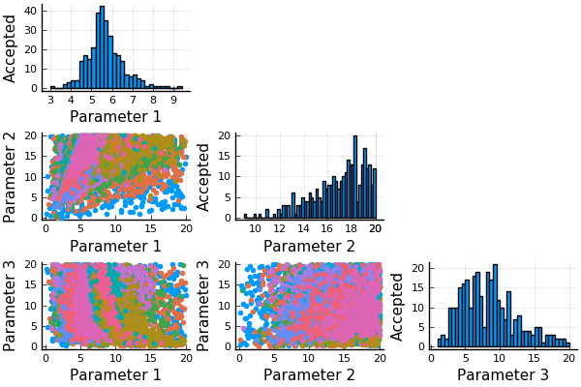
Vanilla ABC SMC (not stopping and starting)
Real parameters:
  5.92, 19.28, 9.09
Mean of final population:
  5.66, 16.95, 8.42
Conclusion: 3 parameters can be estimated fairly well after 15 rounds of SMC

Slide 3
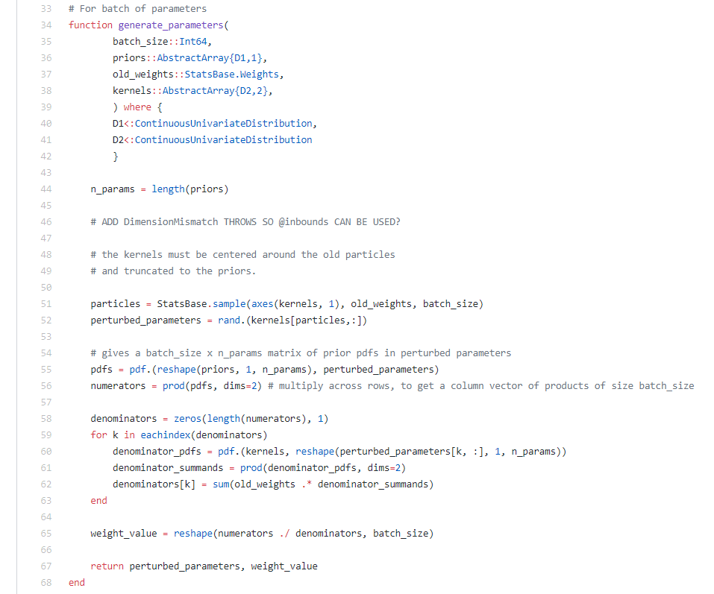
Perturbation kernel from GpABC source code
https://github.com/tanhevg/GpABC.jl/blob/master/src/abc/smc.jl
Appears to be a truncated normal perturbation kernel?

Slide 4
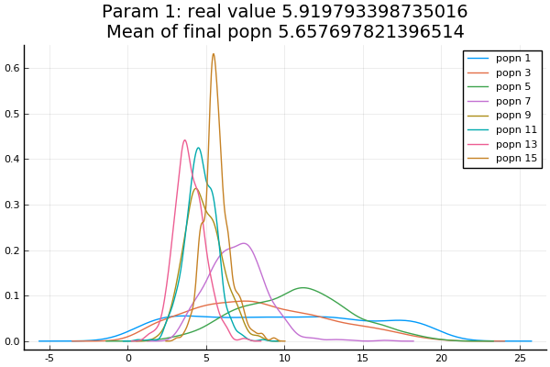
Weights of Parameter 1, k_cat_AA

Slide 5
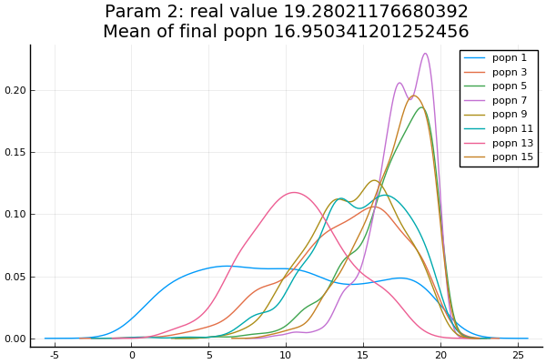
Weights of Parameter 2, k_a_NH4

Slide 6
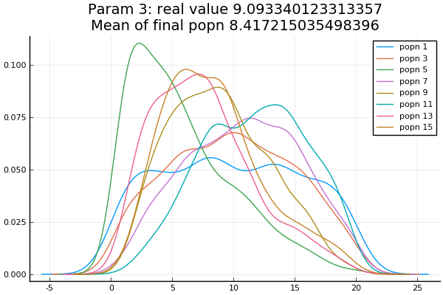
Weights of Parameter 3, k_NH4

Slide 7
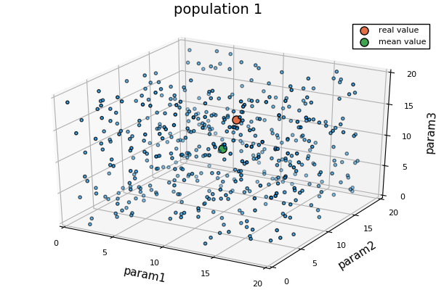

Slide 8
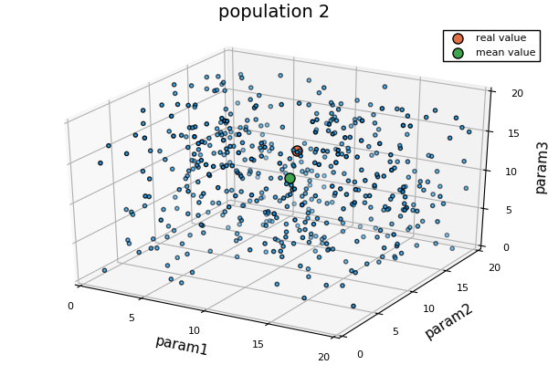

Slide 9
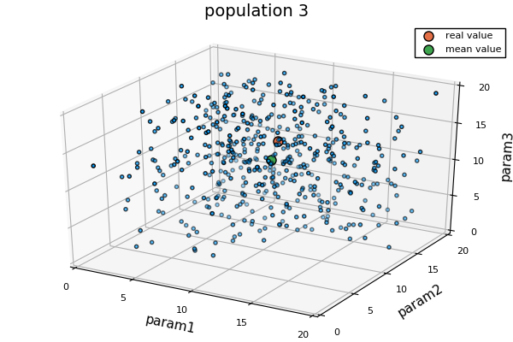

Slide 10
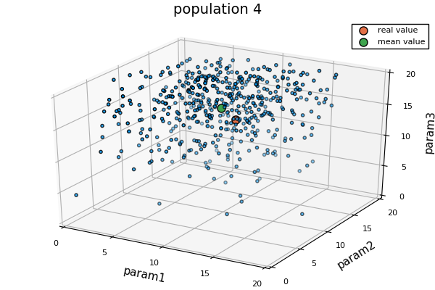

Slide 11
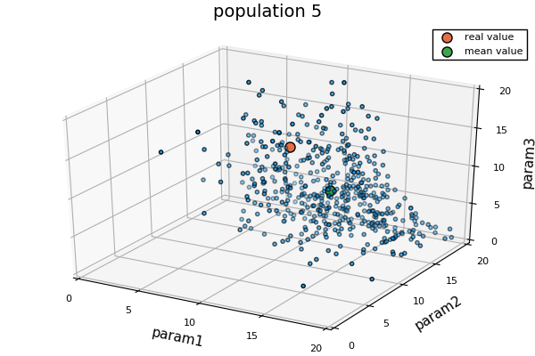

Slide 12
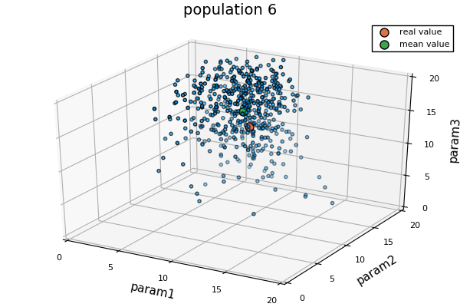

Slide 13
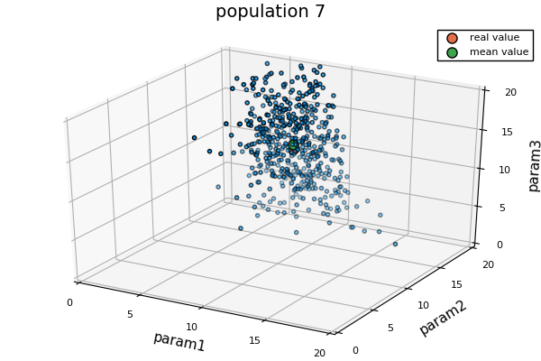

Slide 14
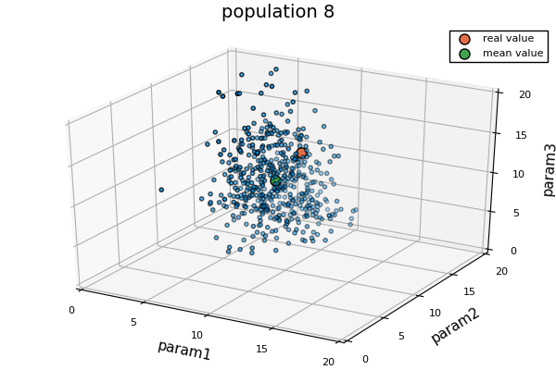

Slide 15
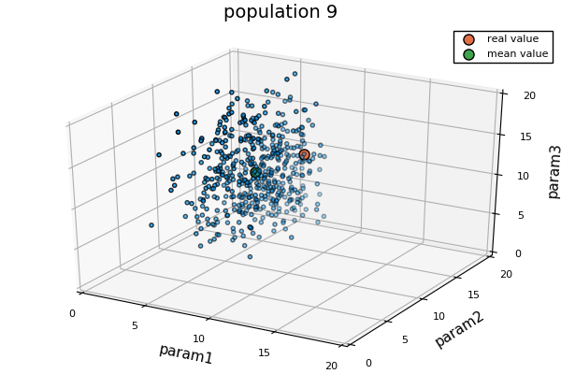

Slide 16
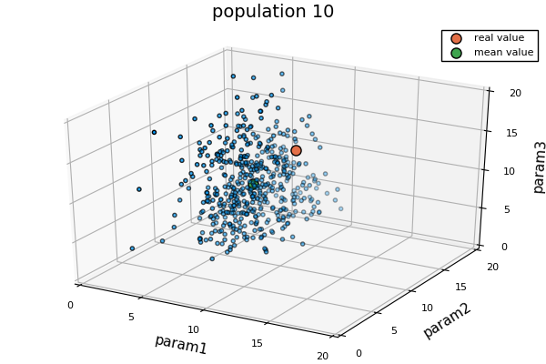

Slide 17
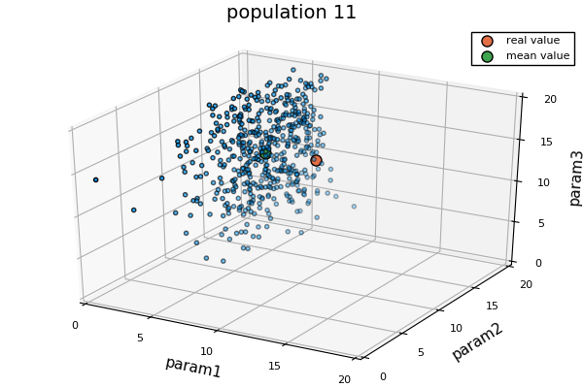

Slide 18
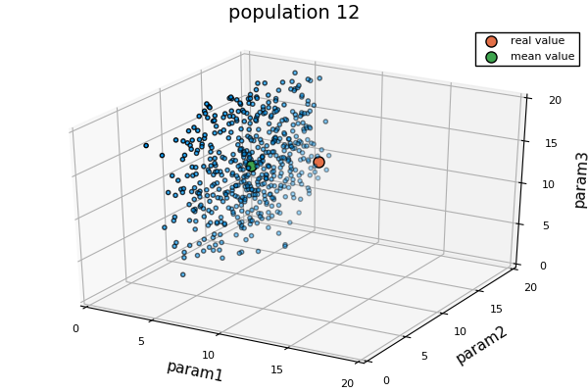

Slide 19
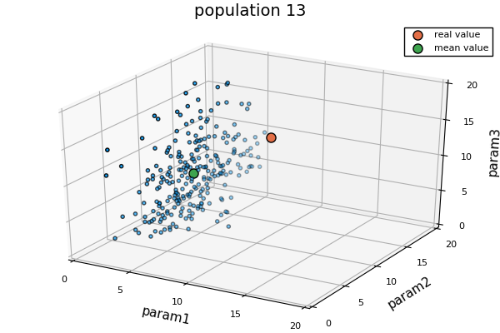

Slide 20
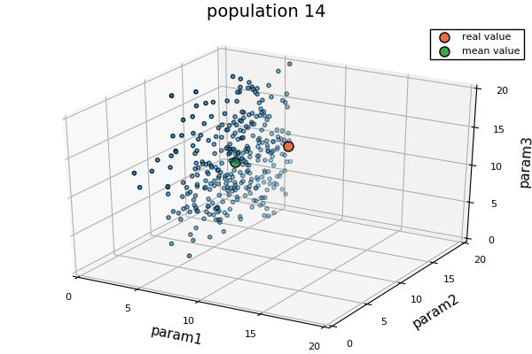

Slide 21
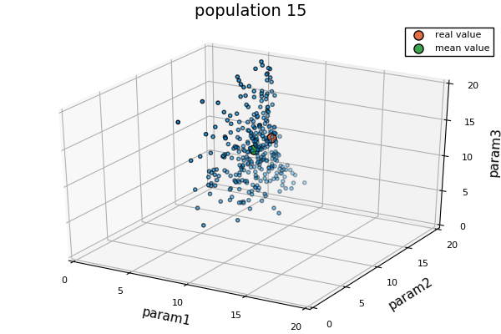

Slide 22
Old Slides

Slide 23
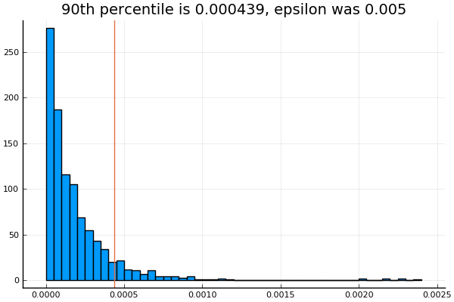
Distribution of distances of 1000 particles from posterior. All 1000 particles were accepted since epsilon was large

Slide 24

Showing SMC rounds 1, 4, 7, and 10

Slide 25
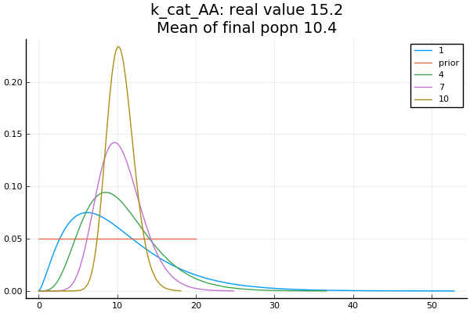
Prior was Uniform(0, 20)
Final posterior was Gamma(36.5, 0.29)

Slide 26
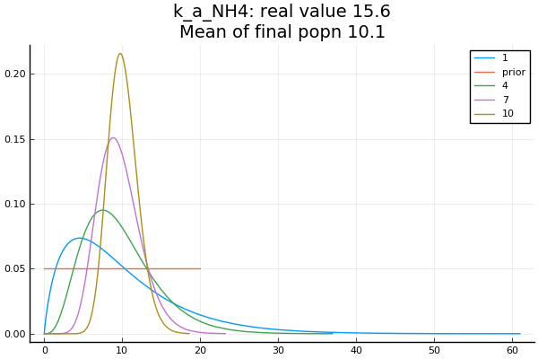

Slide 27
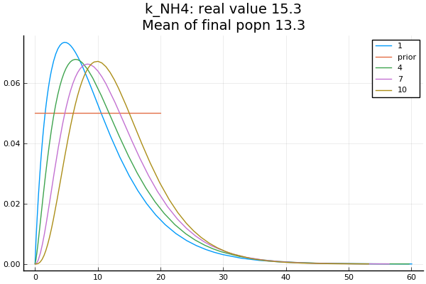

Slide 28
True and Estimated Parameter Values
True Params are
K_cat_AA: 15.2
K_a_NH4: 15.6
K_NH4: 15.3
Estimated Params are
K_cat_AA: 10.4
K_a_NH4: 10.1
K_NH4: 13.3

Slide 29
Threshold Schedule
0.0005000
0.0002997
0.0002116
0.0001699
0.0001364
0.0001090
0.0000819
0.0000691
0.0000549
0.0000473
Threshold values are calculated as the best 90th percentile of distances

Slide 30
Conclusions and next steps
3 parameter inference produces good results after 10 rounds of SMC
  Will use adaptive method to stop SMC if threshold is not decreasing i.e. if posterior distribution appears to be stable
Parameters 1 and 2 (k_cat_AA and k_a_NH4) appear in a fraction, thus the ratio of these parameters is what is important. The true and estimated ratio inferred match very well
Parameter 3 (k_NH4) is less well inferred than 1 and 2. This appears only once in the bottom of the equation, maybe result is less sensitive to this parameter?
Gamma distribution appears to be better than Normal distribution
NaNs are produced if parameter 2 (k_a_NH4) is zero due to divide by zero error, fixed by setting prior to Uniform(0.1 to 20)
Now trying to infer 3 different parameters

