Slide 1

Leanne’s ABC SMC
Results 05/05/2020

Slide 2
Results of vanilla 6 parameter inference version 1.0
Not inferred well
Are inferred well
k_cat_AA (param 1)
  Real: 9.0
  Inferred: 0.91
k_a_NH4 (param 2)
  Real: 10.3
  Inferred: 3.7
k_a_AA (param 4)
  Real: 0.33
  Inferred: 7.8
k_cat_AA (param 3)
  Real: 16.6
  Inferred: 14.1
k_a_NH4 (param 5)
  Real: 14.8
  Inferred: 14.03
k_a_AA (param 6)
  Real 12.8
  Inferred: 17.06

Slide 3
Results of vanilla 6 parameter inference version 2.0
Not inferred well
Are inferred well
k_cat_AA (param 1)
  Real: 12.32
  Inferred: 13.77
k_a_NH4 (param 2)
  Real: 10.3
  Inferred: 3.7
k_a_AA (param 4)
  Real: 0.33
  Inferred: 7.8
k_cat_AA (param 3)
  Real: 16.6
  Inferred: 14.1
k_a_NH4 (param 5)
  Real: 14.8
  Inferred: 14.03
k_a_AA (param 6)
  Real 12.8
  Inferred: 17.06

Slide 4
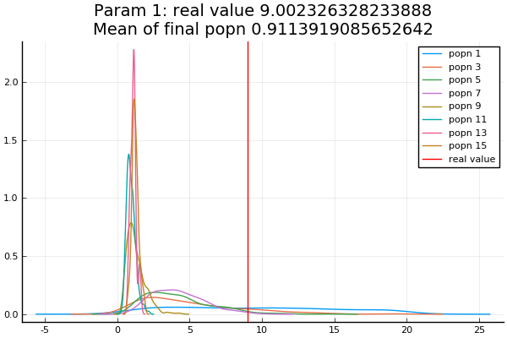
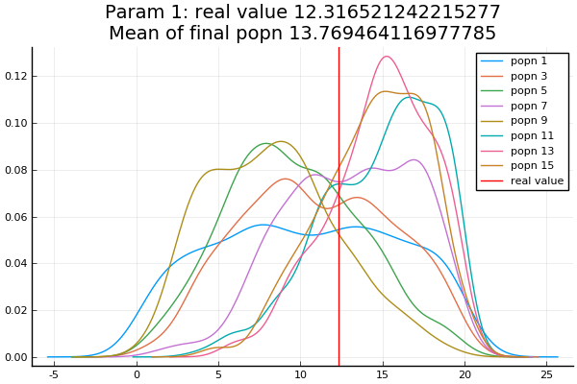
Parameter 1: k_cat_AA

Slide 5
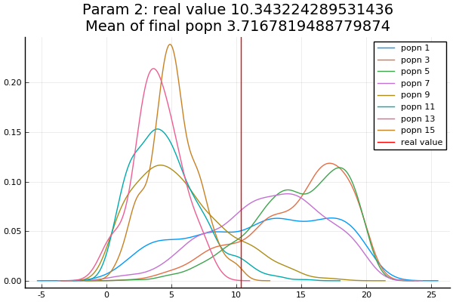
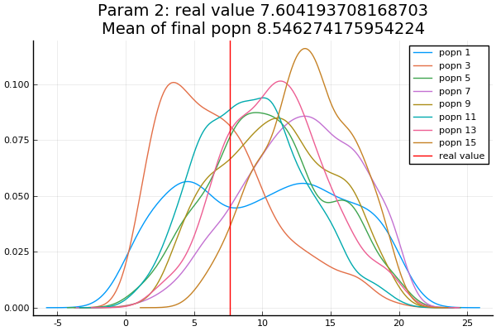
Parameter 2: k_a_NH4

Slide 6
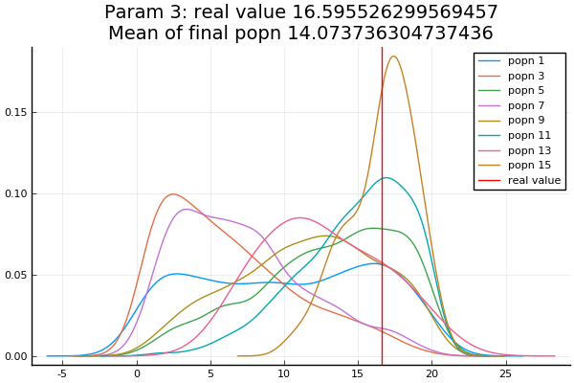
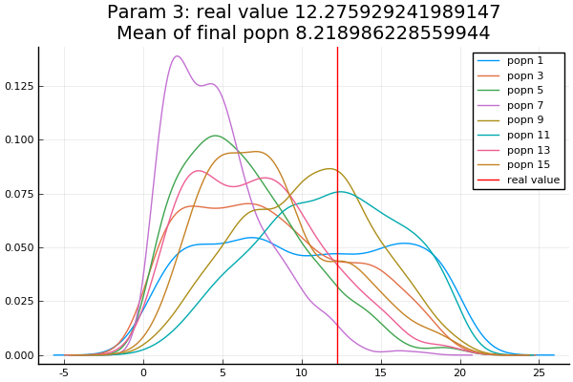
Parameter 3: k_NH4

Slide 7
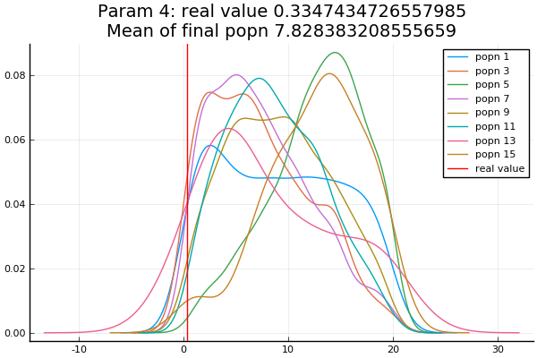
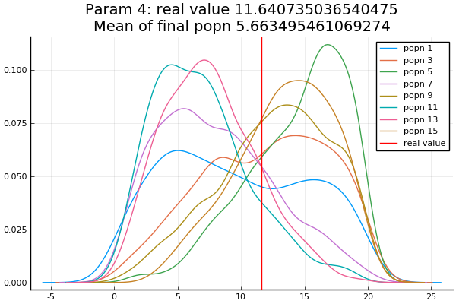
Parameter 4: k_a_AA

Slide 8
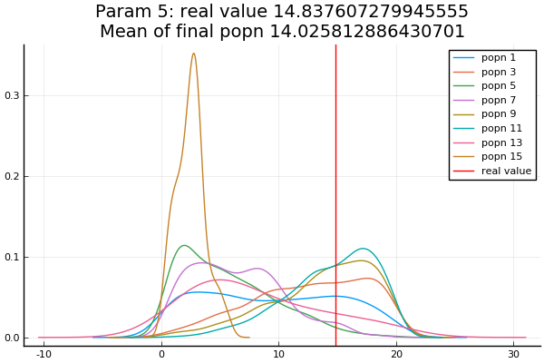
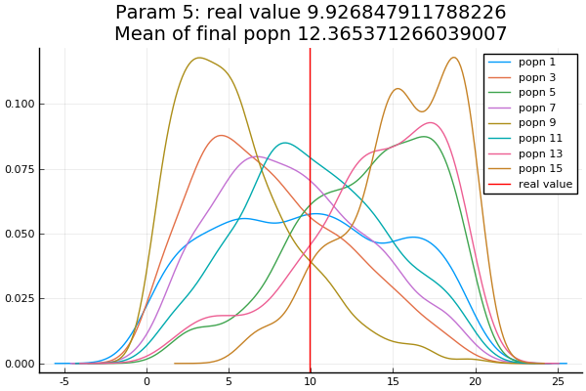
Parameter 5: k_NH4_AA

Slide 9
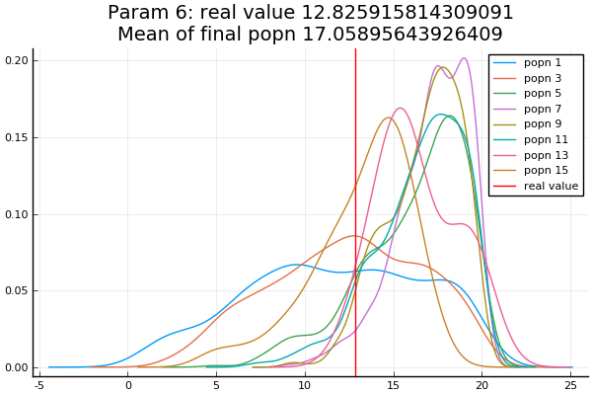
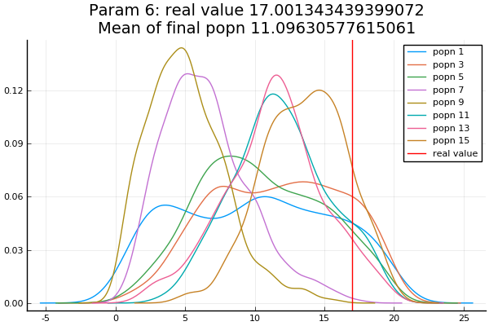
Parameter 6: k_a

Slide 10
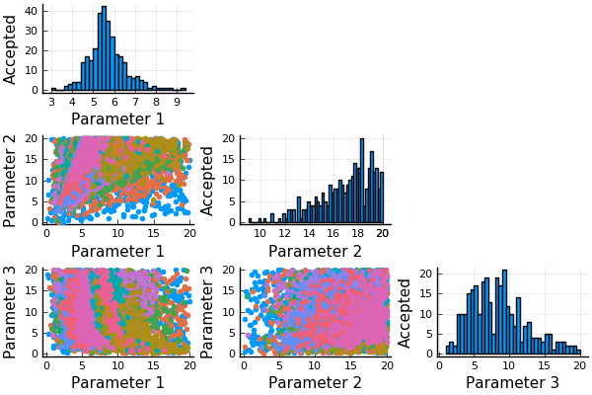
Vanilla ABC SMC (not stopping and starting)
Real parameters:
  5.92, 19.28, 9.09
Mean of final population:
  5.66, 16.95, 8.42
Conclusion: 3 parameters can be estimated fairly well after 15 rounds of SMC

Slide 11
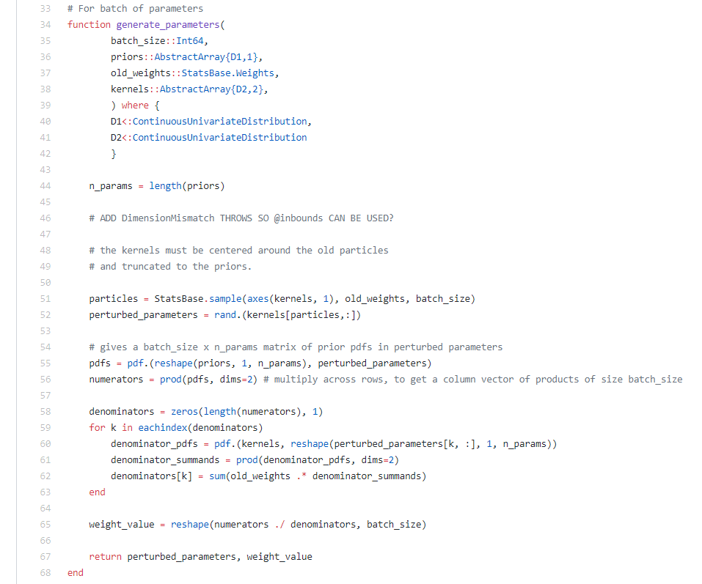
Perturbation kernel from GpABC source code
https://github.com/tanhevg/GpABC.jl/blob/master/src/abc/smc.jl
Appears to be a truncated normal perturbation kernel?

Slide 12
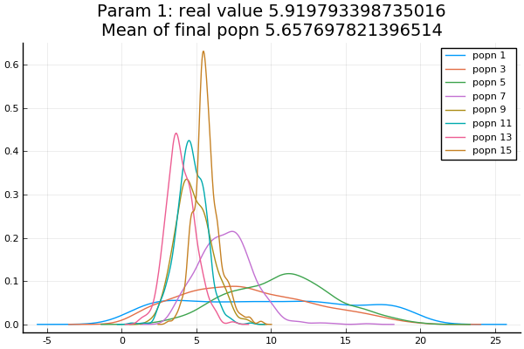
Weights of Parameter 1, k_cat_AA

Slide 13
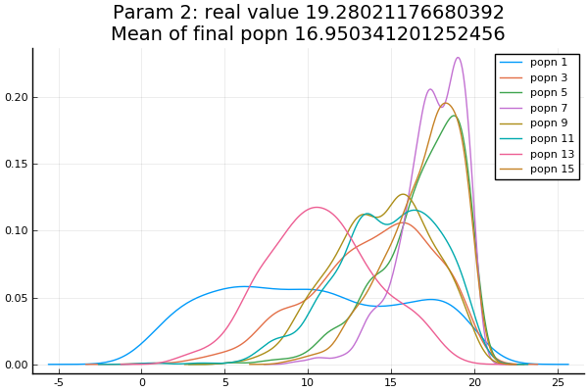
Weights of Parameter 2, k_a_NH4

Slide 14
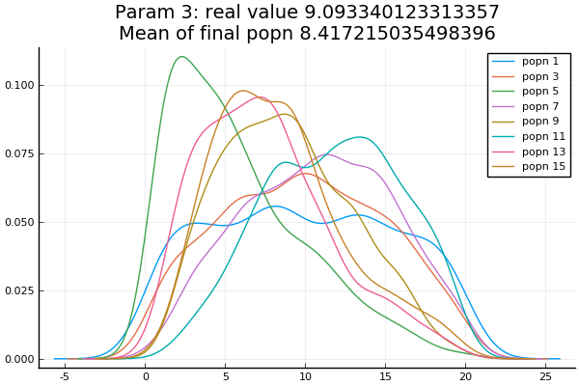
Weights of Parameter 3, k_NH4

Slide 15
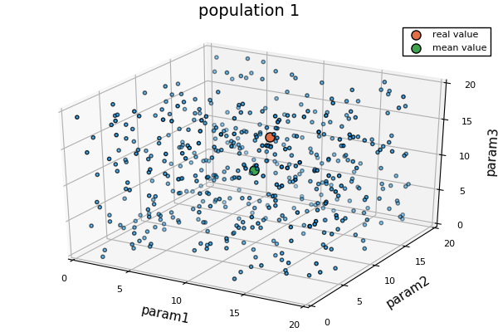

Slide 16
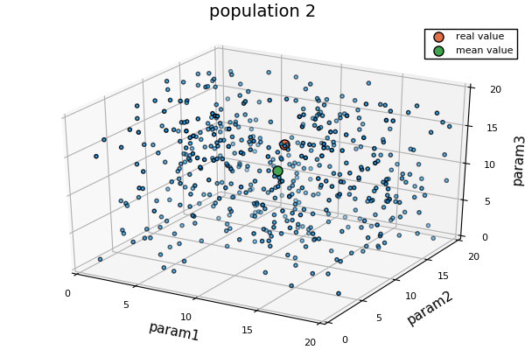

Slide 17
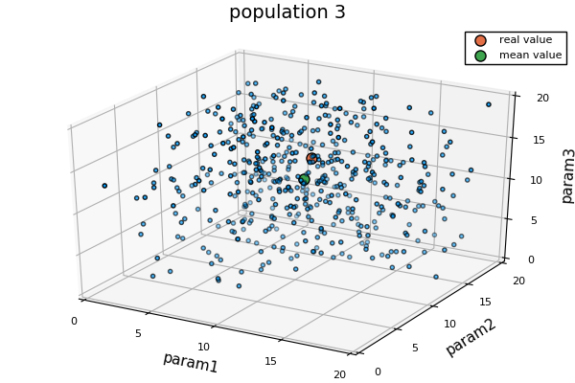

Slide 18
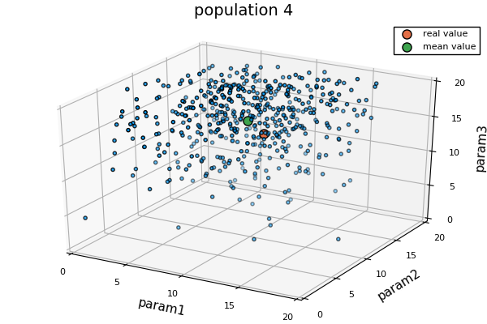

Slide 19
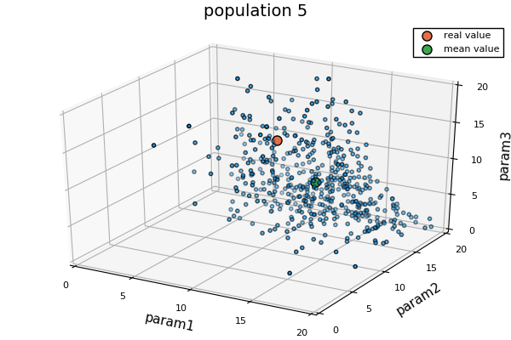

Slide 20
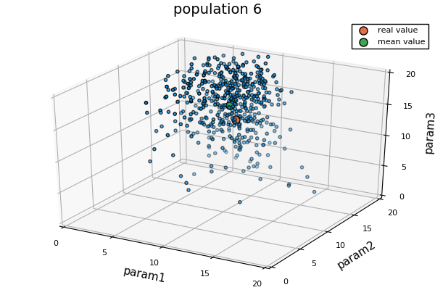

Slide 21
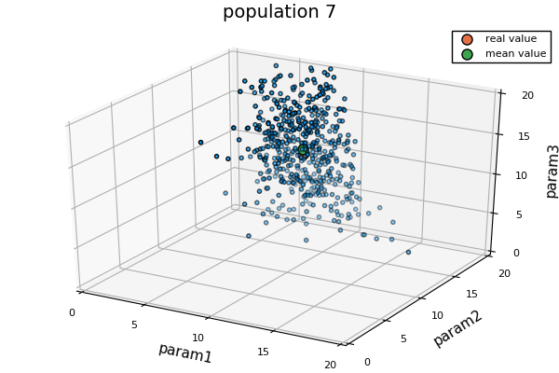

Slide 22
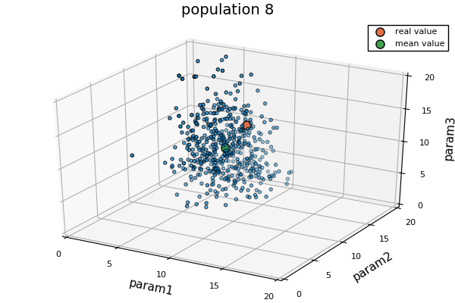

Slide 23
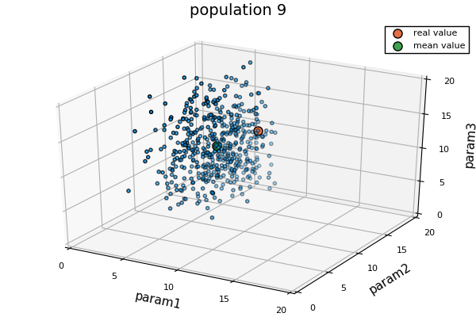

Slide 24
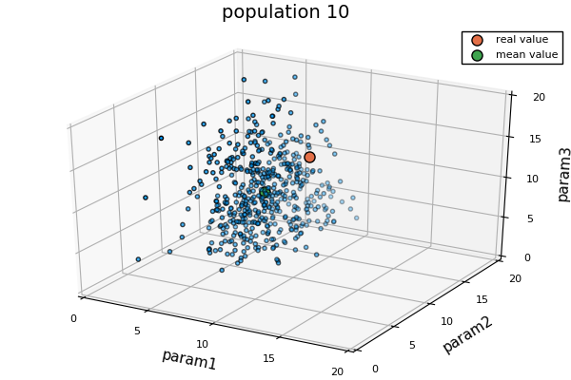

Slide 25
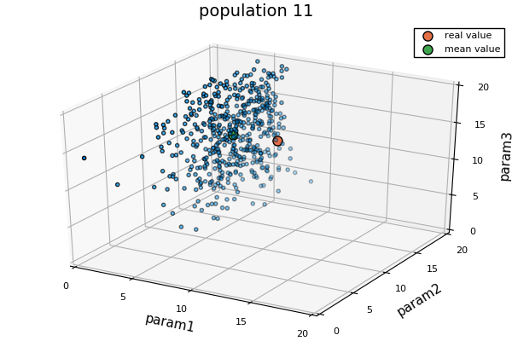

Slide 26
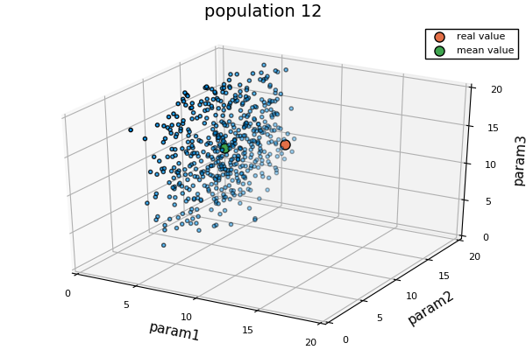

Slide 27
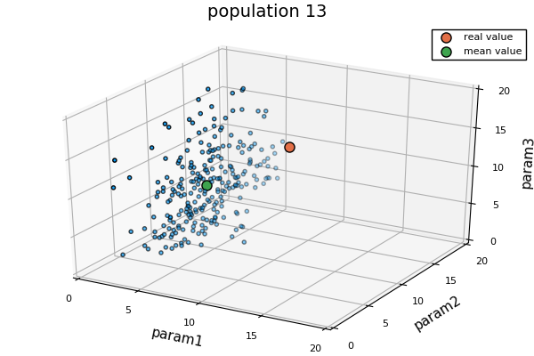

Slide 28
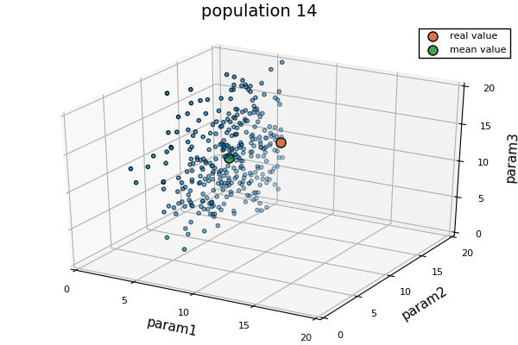

Slide 29
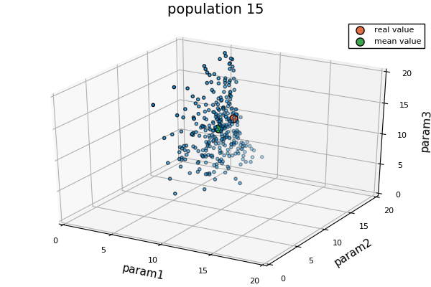

Slide 30
Old Slides

Slide 31
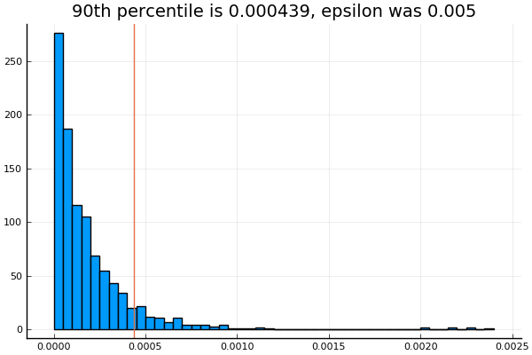
Distribution of distances of 1000 particles from posterior. All 1000 particles were accepted since epsilon was large

Slide 32

Showing SMC rounds 1, 4, 7, and 10

Slide 33
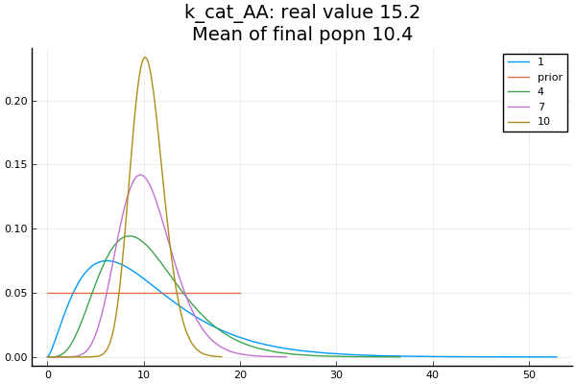
Prior was Uniform(0, 20)
Final posterior was Gamma(36.5, 0.29)

Slide 34
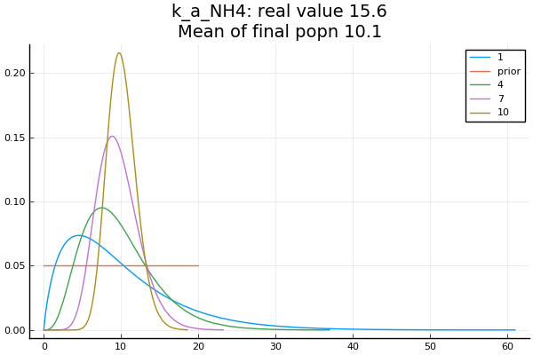

Slide 35
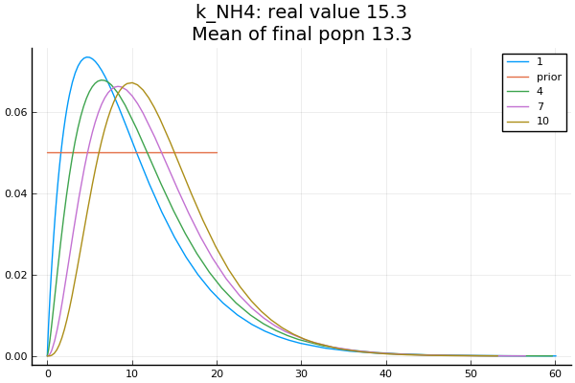

Slide 36
True and Estimated Parameter Values
True Params are
K_cat_AA: 15.2
K_a_NH4: 15.6
K_NH4: 15.3
Estimated Params are
K_cat_AA: 10.4
K_a_NH4: 10.1
K_NH4: 13.3

Slide 37
Threshold Schedule
0.0005000
0.0002997
0.0002116
0.0001699
0.0001364
0.0001090
0.0000819
0.0000691
0.0000549
0.0000473
Threshold values are calculated as the best 90th percentile of distances

Slide 38
Conclusions and next steps
3 parameter inference produces good results after 10 rounds of SMC
  Will use adaptive method to stop SMC if threshold is not decreasing i.e. if posterior distribution appears to be stable
Parameters 1 and 2 (k_cat_AA and k_a_NH4) appear in a fraction, thus the ratio of these parameters is what is important. The true and estimated ratio inferred match very well
Parameter 3 (k_NH4) is less well inferred than 1 and 2. This appears only once in the bottom of the equation, maybe result is less sensitive to this parameter?
Gamma distribution appears to be better than Normal distribution
NaNs are produced if parameter 2 (k_a_NH4) is zero due to divide by zero error, fixed by setting prior to Uniform(0.1 to 20)
Now trying to infer 3 different parameters

