Slide 1

Leanne’s ABC SMC
Results 27/04/2020

Slide 2

Showing SMC rounds 1, 4, 7, and 10

Slide 3
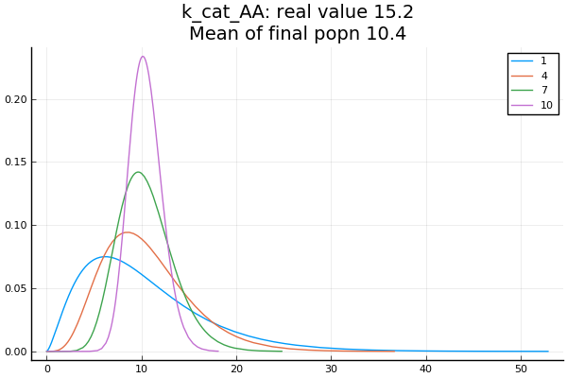

Slide 4
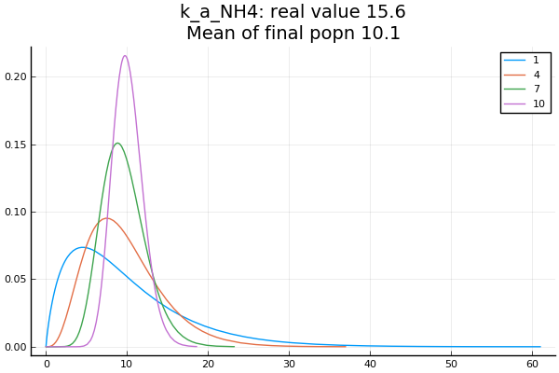

Slide 5
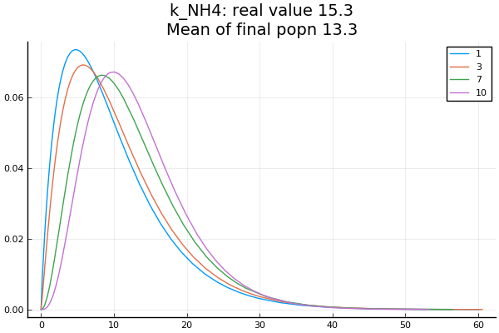

Slide 6
True and Estimated Parameter Values
True Params are
K_cat_AA: 15.2
K_a_NH4: 15.6
K_NH4: 15.3
Estimated Params are
K_cat_AA: 10.4
K_a_NH4: 10.1
K_NH4: 13.3

Slide 7
Threshold Schedule
0.0005000
0.0002997
0.0002116
0.0001699
0.0001364
0.0001090
0.0000819
0.0000691
0.0000549
0.0000473
Threshold values are calculated as the best 90th percentile of distances

Slide 8
Conclusions and next steps
3 parameter inference produces good results after 10 rounds of SMC
  Will use adaptive method to stop SMC if threshold is not decreasing i.e. if posterior distribution appears to be stable
Parameters 1 and 2 (k_cat_AA and k_a_NH4) appear in a fraction, thus the ratio of these parameters is what is important. The true and estimated ratio inferred match very well
Parameter 3 (k_NH4) is less well inferred than 1 and 2. This appears only once in the bottom of the equation, maybe result is less sensitive to this parameter?
Gamma distribution appears to be better than Normal distribution
NaNs are produced if parameter 2 (k_a_NH4) is zero due to divide by zero error, fixed by setting prior to Uniform(0.1 to 20)
Now trying to infer 3 different parameters

