Slide 1
Impetus Technologies Inc.
Coverture Tool 2.0
“Enhancements”

Slide 2
Agenda
Enhancements in 2.0 Version
Screen Prints of some Implementations
Coverture Tool Clients

Slide 3
Enhancements in Version 2.0
Support For Multi Module Projects
Downloadable not covered lines of code for userstories.
Support for latest SonarQube Version

Slide 4
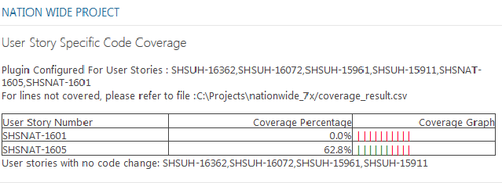
Coverture Plugin – Connecture
Coverture Plugin now support integration and deployment on latest SonarQube version 5.4 used by Connecture.

Slide 5
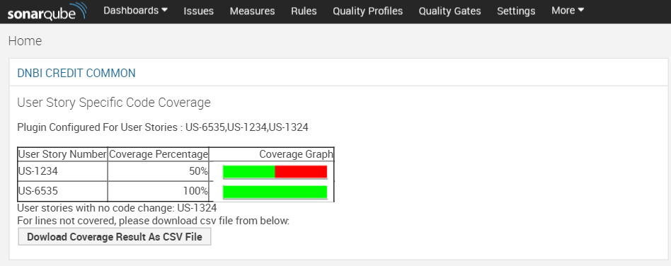
Coverture Plugin – DNB

Slide 6
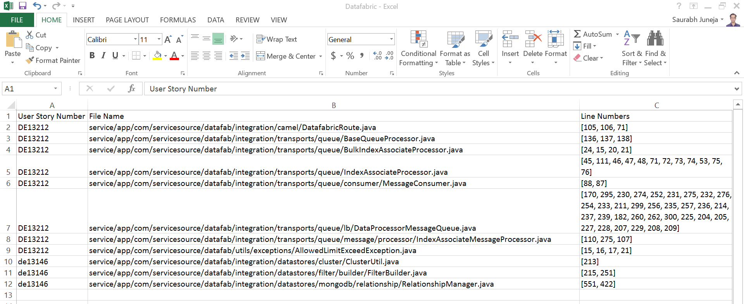
Not Covered lines
Not covered lines of code for configured user story is exportable from SonarQube Coverture Tool widget as CSV

Slide 7
Clients
S.No. | Client Name | USSCC Tool Implementation Level
1 | SSI | Sonar Plugin is Integrated with there Sonar Setup on ISE
2 | Connecture | Sonar Plugin is Integrated with there local Sonar Setup
3 | DNB | Sonar Plugin is Integrated with local Sonar Setup
4 | Patent Keeper | Standalone Program is shared with Patent Keeper Team
5 | CI Reference Implementation | Integrated with CI Reference Implementation
6 | Kronos | Sonar Plugin is Delivered to Client with Modifications

Slide 8
Thank You!

