Slide 1
Impetus Technologies Inc.
User Story Specific
Code Coverage Tool 2.0
“Enhancements”

Slide 2
Agenda
Enhancements in 2.0 Version
Screen Prints of some Implementations
USSCC Tool Clients

Slide 3
Enhancements in Version 2.0
Support For Multi Module Projects
Downloadable not covered lines of code for userstories.
Support for latest SonarQube Version

Slide 4
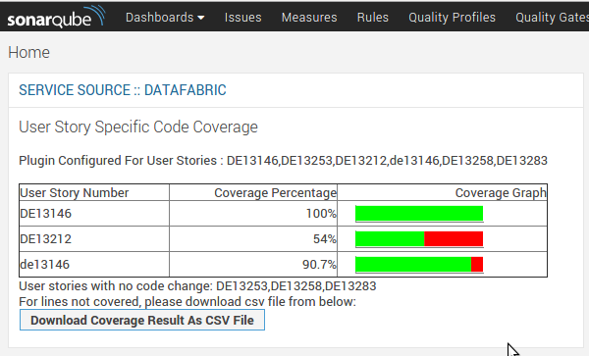
USSCC Plugin – Service Source

Slide 5
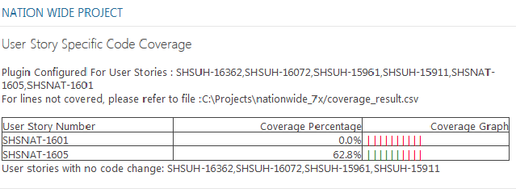
USSCC Plugin – Connecture
USSCC Plugin now support integration and deployment on latest SonarQube version 5.4 used by Connecture.

Slide 6
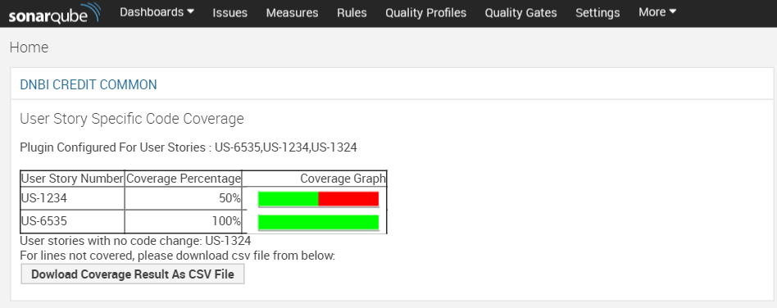
USSCC Plugin – DNB

Slide 7
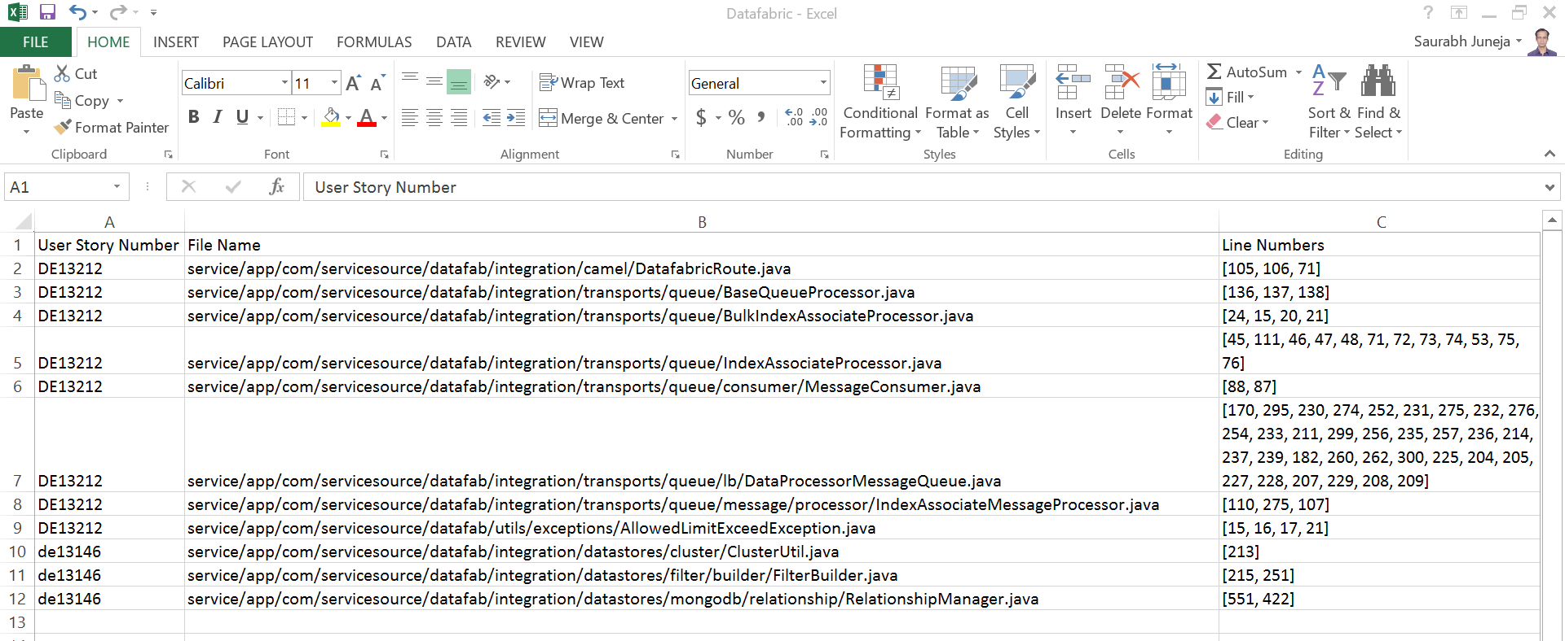
Not Covered lines
Not covered lines of code for configured user story is exportable from SonarQube USSCC Tool widget as CSV

Slide 8
Clients
S.No. | Client Name | USSCC Tool Implementation Level
1 | SSI | Sonar Plugin is Integrated with there Sonar Setup on ISE
2 | Connecture | Sonar Plugin is Integrated with there local Sonar Setup
3 | DNB | Sonar Plugin is Integrated with local Sonar Setup
4 | Patent Keeper | Standalone Program is shared with Patent Keeper Team
5 | CI Reference Implementation | Integrated with CI Reference Implementation
6 | Kronos | Sonar Plugin is Delivered to Client with Modifications

Slide 9
Thank You!

