Slide 1
Virtual Pantry
Emmanuel Velazquez & Oscar Benitez

Slide 2
Synopsis
The goal of our project is to design and implement a Database for a virtual pantry. The system will allow customers to browse the pantry and order food online through a website. This is closely related to a curbside pickup or delivery model where employees receive and fulfill these orders by collecting items within the pantry and then updating the inventory after every order.

Slide 3
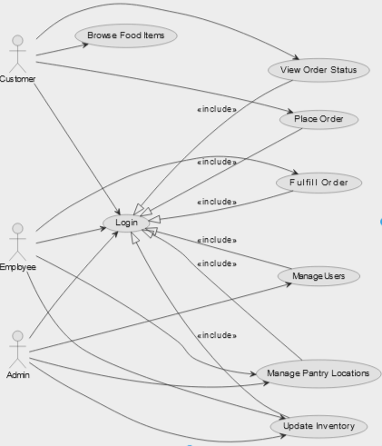
Use Case Diagram

Slide 4
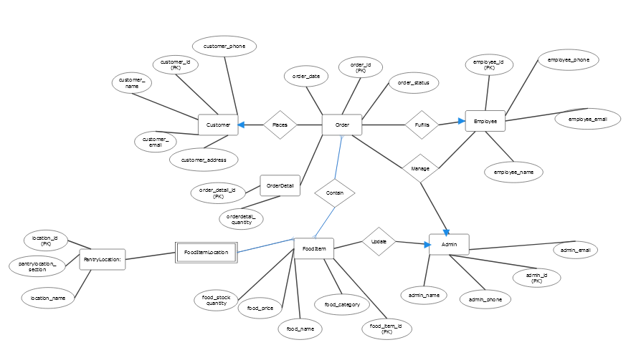
E/R Diagram

Slide 5
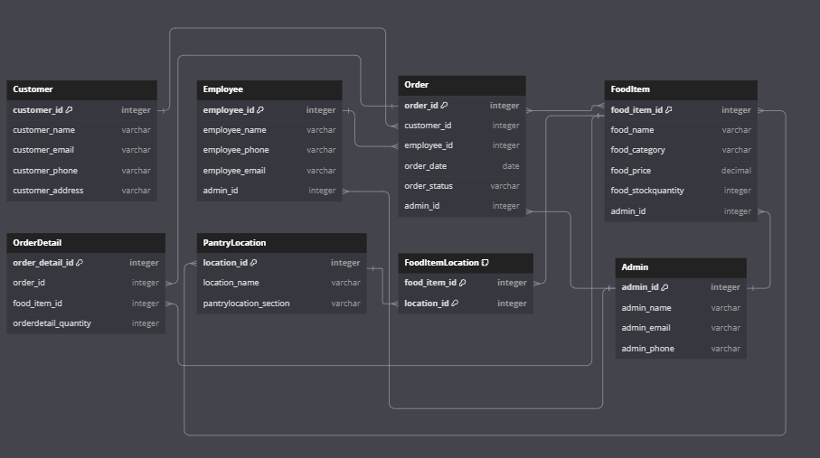
Relational Schema

Slide 6
GitHub Repo

