Slide 1

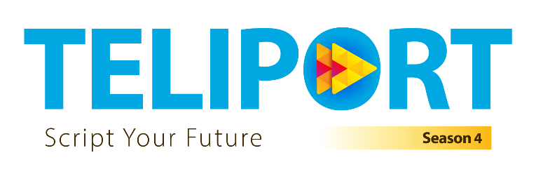
Team <Team Name>
Case Study No. 4
<College>
<Member 1> · <Member 2> · <Member 3>
LabelTwin: Label-as-Code for medical device labeling

Slide 2


LabelTwin: Label-as-Code for self-validating, traceable medical device labels
Case Study 4 · HLS · End-to-End Labeling Automation Management | Team <Team Name> · <College>
The real problem
• 1 product change → 30+ labels × 20+ languages × packaging levels, re-verified by eye
• Values are copied across PLM, ERP, RIM & artwork, so errors are born at every hand-off
• Rules keep moving: ISO 20417:2026, ISO 15223-1 Amd 1:2025, FDA QMSR (Feb 2026), EUDAMED mandatory (2026)
Our reframe
“Labeling is a data-consistency problem disguised as a document problem.”
Every label becomes a computed, self-proving view of product data × market rules × language × packaging level. We make most errors structurally impossible, then let AI catch the rest.
Design principles
• Deterministic core; GenAI & vision only at the unstructured edges
• AI may add findings, never clear them
• Every element carries provenance + regulatory citation
• Humans decide at 3 e-signed gates (Part 11-style audit)
• Plugs into existing PLM / ERP / LMS: no rip-and-replace
Architecture: agents propose, gates & humans dispose
Sources
PLM · ERP/SAP · RIM · Risk file & IFU · legacy artwork · FDA / EUR-Lex / MDCG / ISO feeds
Knowledge layer
Product golden record · Regulatory knowledge graph · Rule packs (Compliance-as-Code) · ISO 15223-1 symbol ontology
Label Digital Twins
Every element bound to source field + rule + hazard (ISO 14971)
7 AI engines
① Reg Watcher ② Change Impact (graph)
③ GenAI Composer (RAG, cited)
④ Compliance Checker (rules + LLM)
⑤ Vision Verifier (OCR · symbols · GS1)
⑥ Translation QA ⑦ Risk Predictor
Governance
Workflow state machine · e-signature · hash-chained audit · traceability matrix
Outputs
PRISYM / Loftware / Kallik · GUDID & EUDAMED · change order · line scan-to-verify
What makes it different
1 Label Digital Twin: each element knows its data source, the clause requiring it (e.g. EU MDR Annex I §23.2(h) UDI) and the hazard it controls, so one click answers “Why is this here?”
2 Compliance-as-Code: versioned, unit-tested rule packs (MDR §23, 21 CFR 801.18 / 801.20 / 801.109, GS1 UDI, ISO 15223-1 symbols) with effective dates
3 Graph change-impact: a PLM or regulation change instantly yields impacted labels, markets, actions and a draft change order
4 Vision + GS1 verification: auto-redline of artwork & print; DataMatrix AI(17)/(10) ↔ printed expiry/lot cross-check; translation invariants (37 °C never becomes 73 °C)
How we will prove it: LabelBench
• 60 label twins · 5 markets (US, EU-DE, EU-FR, UK, CH) · 3 packaging levels; fictitious devices with GUDID-realistic attributes
• 20+ defect types mined from FDA labeling-recall root causes, seeded with ground truth
• Ablation: rules-only vs LLM-only vs hybrid · timed user study vs manual checklist
• Trust built in: e-sign with meaning, hash-chained audit, risk-based tool validation (CSA)
Targets: ≥95% recall on critical defects · change-impact days → minutes · ≥70% of repetitive checks automated · 100% element traceability
Prototype stack: FastAPI · Neo4j · YAML rule engine · PyMuPDF + PaddleOCR + OpenCV · zxing-cpp + GS1 parser · local LLM (Ollama) + bge-m3 RAG · React
Fit for Tata Elxsi: a tool-agnostic accelerator layered on the LMS/PLM stacks TE already implements for medtech clients, in line with the HLS “AI-first, regulatory-aware” direction. Data stays on-prem with a local LLM.

