Slide 1

SEASONAL AGRICULTURE PERFORMANCE ANALYSIS
Student Name- Imran Ansari
College Name- Dr. Ambedkar Institute of Technology for Divyangjan, Kanpur, U.P
AICTE STU ID : (STU6a3e0db78c6641782451639)

Slide 2

PROBLEM STATEMENT
How farm performance varies with the seasons is not well explained by raw agricultural data.
Agricultural activities are influenced by seasonal variations in environmental conditions, farming practices, resource availability and market conditions. As a result, agricultural performance may differ from one season to another.
However, raw agricultural data does not clearly explain how agricultural performance changes across seasons or what patterns can be observed in different seasonal conditions.
The problem is to analyses the given agricultural dataset and investigate seasonal differences in agricultural performance by identifying meaningful patterns, trends, relationships and variations within the available data.

Slide 3
PROJECT DESCRIPTION
This project analyzes 4,000 farm records across 3 seasons, 8 crops, 8 states and 4 irrigation methods to uncover seasonal patterns, relationships and differences in agricultural performance.
Objectives
ANALYTICAL WORKFLOW
Clean and prepare the raw dataset.
Compare performance across seasons, crops, states and irrigation methods.
Study environmental/resource relationships with yield and profit.
Convert findings into evidence-based recommendations.
1. Load and inspect
2. Clean and validate
3. EDA
4. Correlation
5. Seasonal + custom analyses
6. Insights & recommendations

Slide 4
WHO ARE THE END USERS?
Potential end users, derived from the project’s analysis and recommendations
Farmers and farm managers
Use seasonal, crop and irrigation findings to support planning.
Agricultural advisors
Guide crop selection, irrigation choices and resource efficiency.
Policy makers and support agencies
Target insurance, subsidies, price stabilization and seasonal support.
Agricultural analysts / Researchers
Explore patterns, correlations and regional profitability for further study.

Slide 5
TECHNOLOGY USED
The notebook is designed to run end-to-end in Kaggle with commonly available Python analytics libraries.
Python
Core analysis language
Pandas
Data loading, cleaning, grouping, and summaries
NumPy
Numerical operations
Matplotlib
Charts and visualization
Seaborn
Statistical plots and heatmaps
Kaggle
Notebook execution and output environment

Slide 6

RESULTS - DATASET AND DATA CLEANING
RECORDS
4000
COLUMNS
28
CROPS
8
IRRIGATION
4
CLEANING STEPS
FEATURE GROUPS
Missing values found in Rainfall_mm, Soil_Moisture_pct and Yield_Tonnes_Ha (~1% each).
Missing values were imputed using the median within each Season.
A global median was used only as a safety net.
Duplicate records were checked; the notebook reports the dataset as clean on this front.
Farming practices
Environmental conditions
Resource usage
Production
Economics

Slide 7
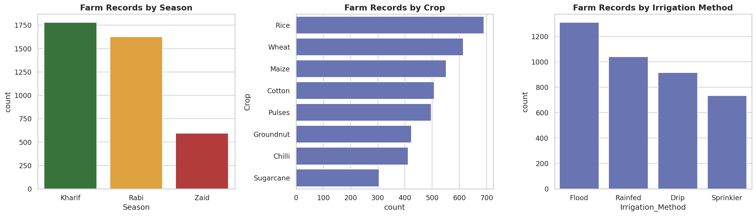
RESULTS – UNIVARIATE ANALYSIS
Kharif has the highest number of farm records (1,779), followed by Rabi (1,627), while Zaid has the fewest (594).
Rice is the most represented crop, and Flood irrigation is the most commonly used method in the dataset.

Slide 8
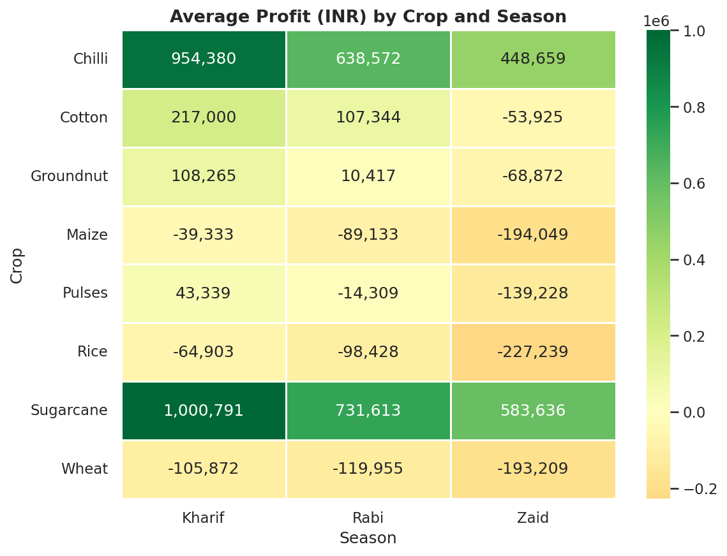
RESULTS – MULTIVARIATE ANALYSIS

Slide 9
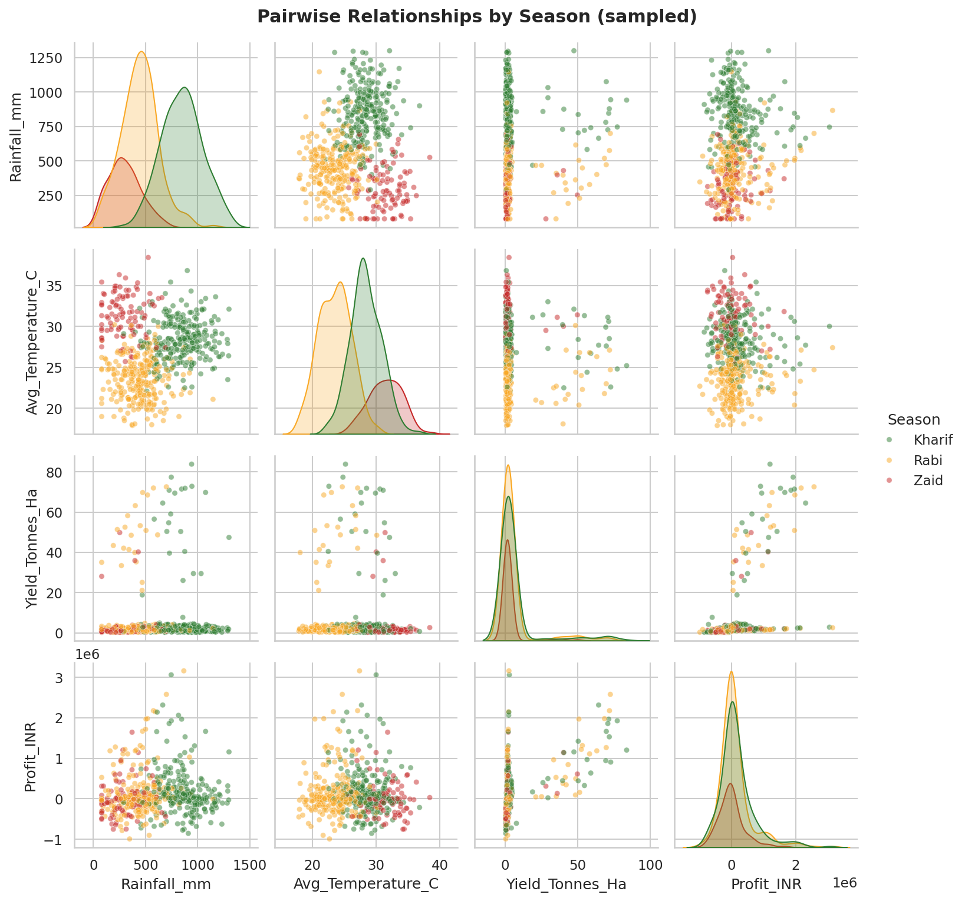
RESULTS - MULTIVARIATE ANALYSIS WITH PAIRPLOT

Slide 10
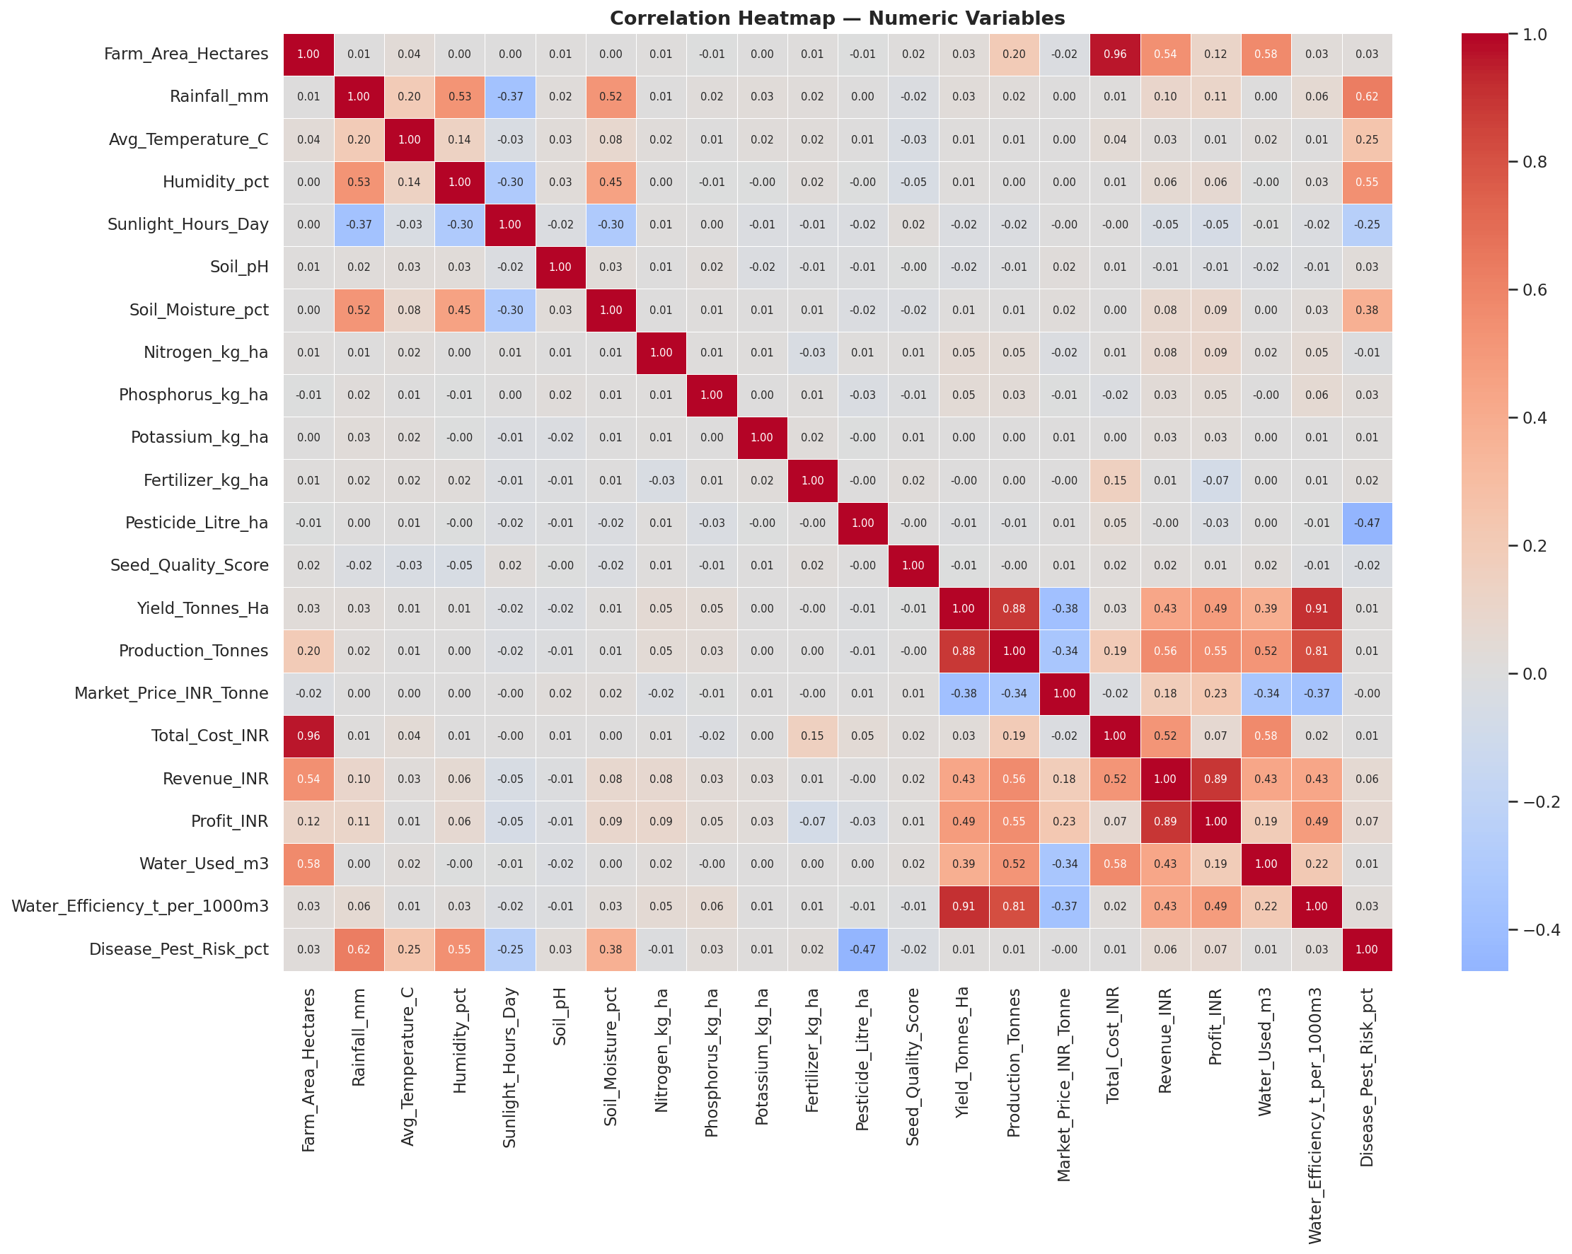
RESULTS – CORRELATION ANALYSIS

Slide 11
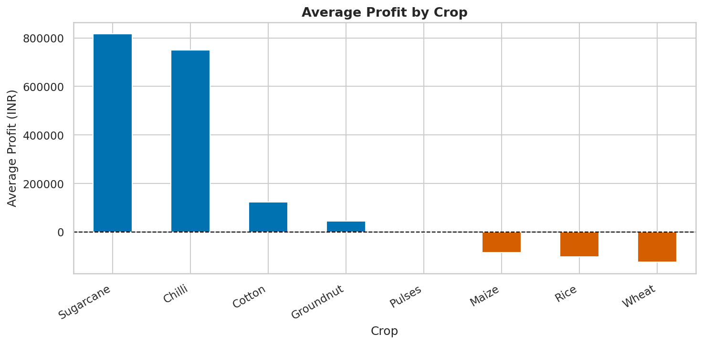
RESULTS – CROP PROFIT AND LOSS
Sugarcane and Chilli are most profitable, while Wheat, Rice and Maize show negative average profits.

Slide 12
RESULTS — SELF DESIGNED ANALYSES
IRRIGATION EFFICIENCY
Does irrigation method affect water efficiency and profitability?
Finding:
Rainfed and Drip show the highest water efficiency.
Flood is the least efficient and among the least profitable.
Drip has the highest average profit among irrigation methods
STATE CONSISTENCY
Which states are most consistent in profitability?
Finding:
Punjab and Maharashtra lead on average profit.
Andhra Pradesh has the lowest average profit and highest coefficient of variation.
This indicates greater profitability volatility in Andhra Pradesh.
CROP PROFITABILITY
Which crops drive profits versus losses?
Finding:
Sugarcane and Chilli are strongly profitable.
Six other crops average at or below break-even.
About 49% of farms operate at a loss overall.

Slide 13
FUTURE SCOPE AND LIMITATIONS
FUTURE SCOPE
LIMITATIONS
Add multi-year farm records to study trends and season-to-season changes over time.
Validate economic variables with external market and price data.
Expand beyond 8 states, 8 crops and 4 irrigation methods.
Build predictive models for yield/profit and scenario analysis.
Develop an interactive dashboard for farmers and decision makers.
Cross-sectional dataset; no year-over-year farm tracking.
Correlation does not establish causation.
Small geographic/crop/irrigation scope limits generalization.
Economic fields were used as provided; no external validation.
Small (~1%) imputation introduces minor uncertainty.

Slide 14
GitHub LINK
Project Repository
GitHub URL: https://github.com/Imran-Ansari5290/Seasonal-Agriculture-Performance-Analysis.git

Slide 15

VOIS COURSE COMPLETION CERTIFICATE
COURSE NAME - DATA VISUALIZATION

Slide 16
THANK YOU
Seasonal Agriculture Performance Analysis
Imran Ansari

