Slide 1


ExRaDe (Exposing Racism Using Deep Learning)

Slide 2
Group members: Sabeeh Ali Akbar i160017 Imran Haider i160247
Asad Mansoor Dar i160261
Supervisor: Mr. Jawad Hassan
Co Supervisor: Mr. Qasim Mehmood

Slide 3
Contents
Project overview
Data flow diagrams
Timeline
Implementation
models implemented
Next iteration

Slide 4
Project overview
Detection of Racism in Social Media using machine learning
Roman Urdu
Web interface

Slide 5
Data Flow diagrams

Slide 6
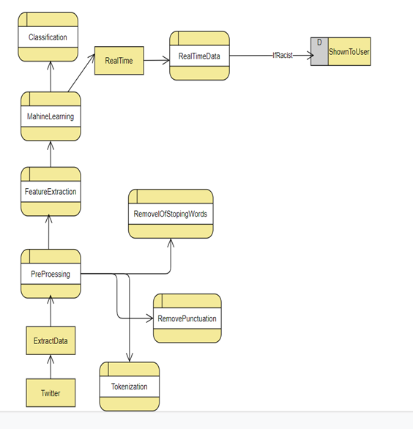

Slide 7
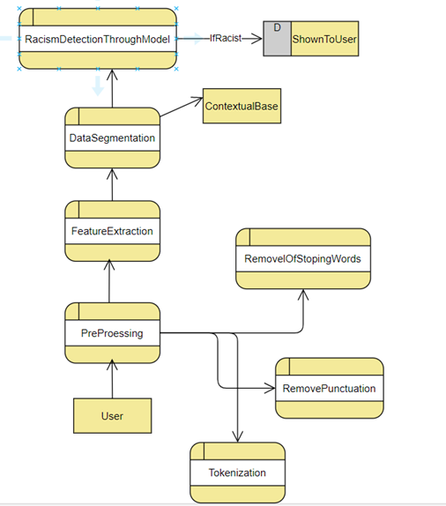

Slide 8
Timeline
ITERATION 1
State of the art
Dataset collection/generation
Annotation
Data pre-processing
ITERATION 2
Initial Training and detection of racism words
Design of GUI and Testing
ITERATION 3
Detection of racism sentences
Contextual based classification
ITERATION 4
Design and final GUI design
Testing and deployment in website

Slide 9
Implementation
collection of dataset
Annotation
Pre-Processing
Case Folding
Punctuation removal
Stop words removal
Tokenization
Training and Testing of different models
Design of GUI and Testing

Slide 10
Models Implemented
Naive bayes
Accuracy: 70%
Random forest
Accuracy: 91%
Neural networks
Accuracy: 96%

Slide 11

Web Application

Slide 12
Next iteration
Contextual Base classification
Adding features to our website

Slide 13
Thank you
Any Questions?

